Slide 1

Tatoo
2014

Slide 2
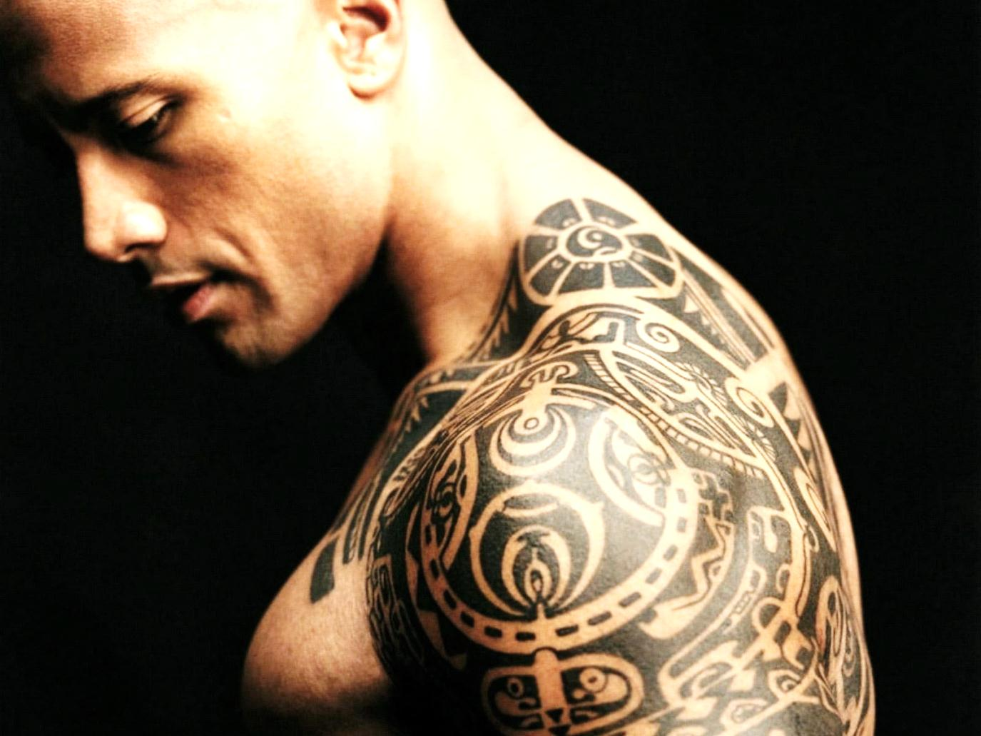
Are you interested in tattooing and want to know a few facts, tips and advice about tattooing and the art of the tattoo?

Slide 3

The art of tattooing has come a long way from its ancient origins. It is predominantly a Eurasian practice which was not only an expression of artistic genius but also a display of social standing.

Slide 4

These days, tattooing is a very popular hobby and it has also become one of the highly recognized art form in popular culture.

Slide 5

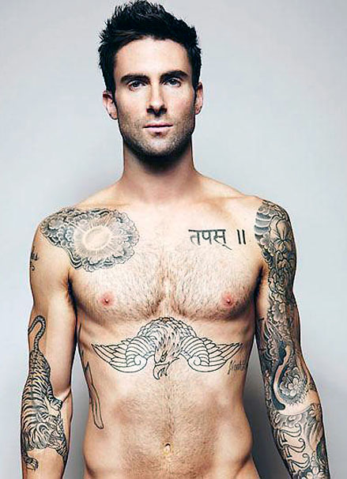
Interesting facts
In the U.S., more women than men are tattooed (23% vs. 19%), according to a 2012 survey.

Slide 6

Interesting facts
A 2006 survey revealed that 36% of those ages 18-25 and 40% of those ages 26-40 have at least one tattoo.

Slide 7
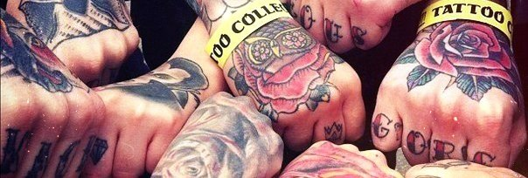
Interesting facts
The National Geographic states that in April 2000, 15% of Americans (40 million people) were tattooed.

Slide 8

Interesting facts
There are over 20,000 tattoo parlors in the United States alone. A new establishment is being added in the country every day!

Slide 9

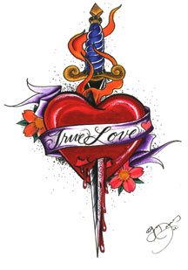
Interesting facts
An Oxygen Media survey in 2012 revealed that 59% of people with tattoos are women, with the most popular images being hearts and angels.

Slide 10

Interesting facts
A tattoo machine:

Slide 11
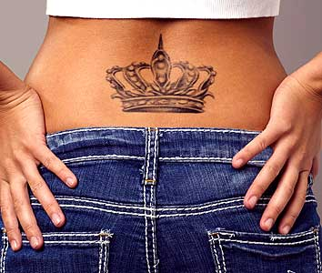
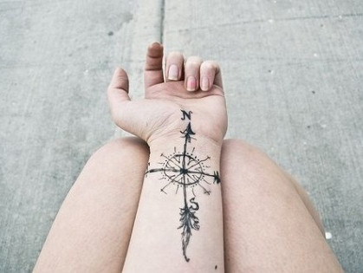
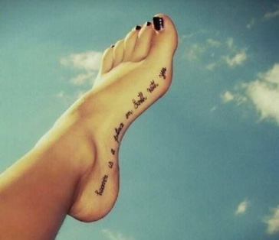
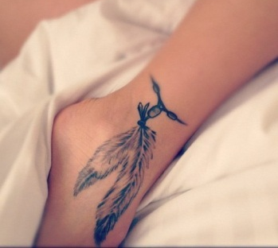
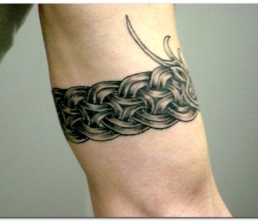
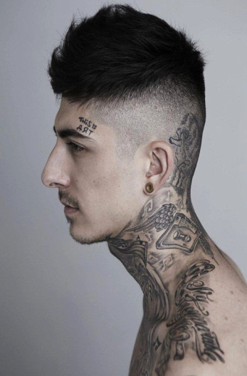
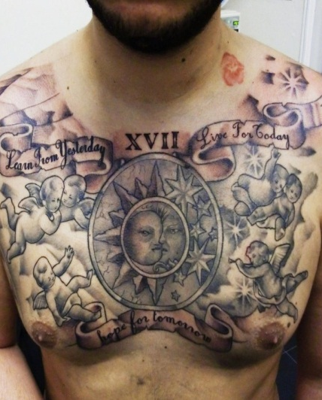

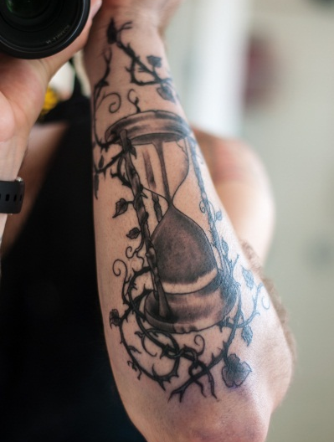
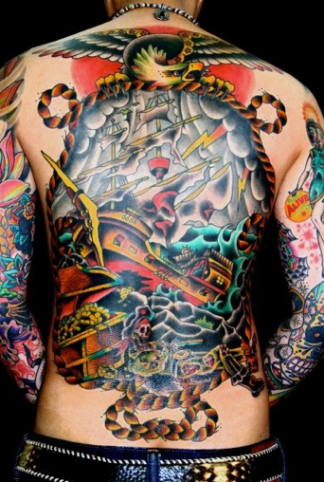
Interesting facts
The top 10 most popular spots for tattoos:

Slide 12
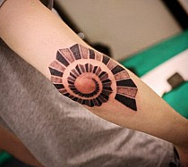
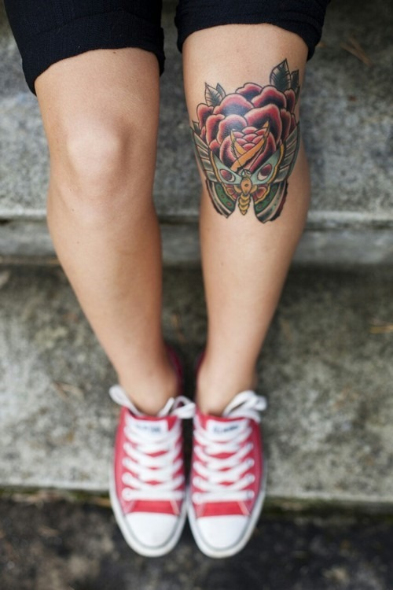
Interesting facts
Not all skin on the body is the same and, therefore, will not take tattoo pigment the same. For example, tattoos on elbows, knuckles, knees, and feet are infamous for fading.

Slide 13
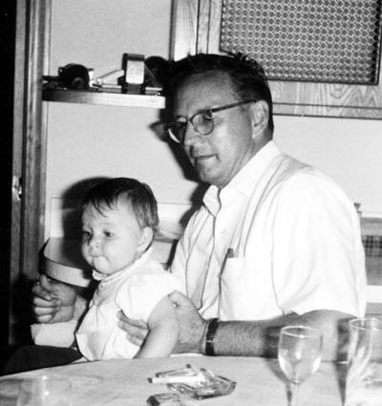
Interesting facts
The first professional tattoo artist in the U.S. was a German immigrant, Martin Hildebrandt, who arrived in Boston in 1846.

Slide 14
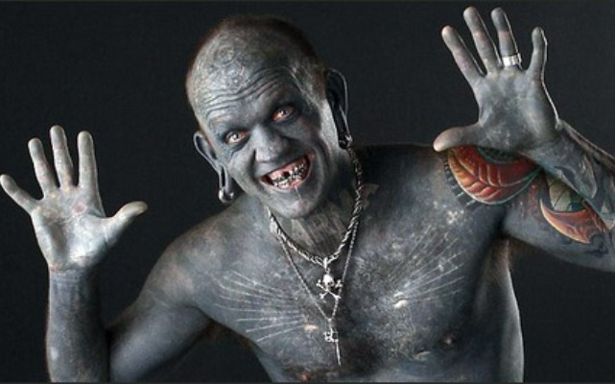
Interesting facts
The most tattooed man in the world is Gregory Paul McLaren (1971), also known as Lucky Diamond Rich. He is 100% tattooed, including the inside of his foreskin, mouth, and ears.

Slide 15

Interesting facts
Johnny Depp once said “My body is my journal and my tattoos are my story.

Slide 16




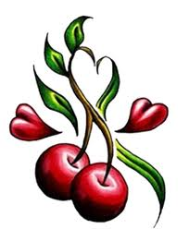
Meaning of tattoo
Butterfly
Popular with women, its short life and beauty have become symbolic of youth and femininity.
Angels
Symbols of protection
Cat
Symbol of independence and free thinking.
Cherry
Fertility, chastity, and purity.
Dove
Also a symbol of peace.

Slide 17
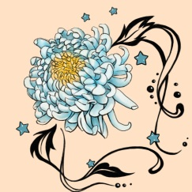

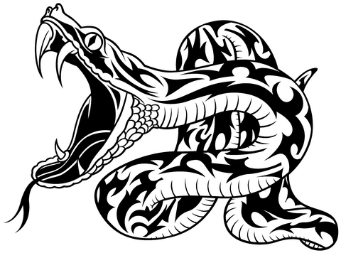
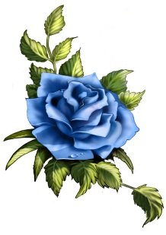
Meaning of tattoo
Chrysanthemum
From the Greek for “gold flower,” it is the ultimate flower. In China, it is a symbol of perfection and simplicity. In Japan, it is the Japanese Royal Flower. In Europe, however, it is the flower of death.
Wolf
Represents seriousness and craziness, as well as loyalty and courage.
Snake
symbolized wisdom, charm, immortality, and free thought.
Rose
Most popular of all flower tattoo designs, the rose is associated with true love.

Slide 18
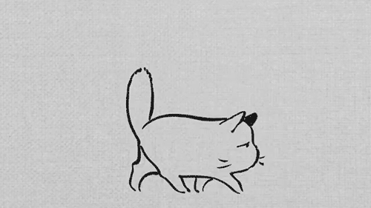
Thank you for your attention!

