Slide 1
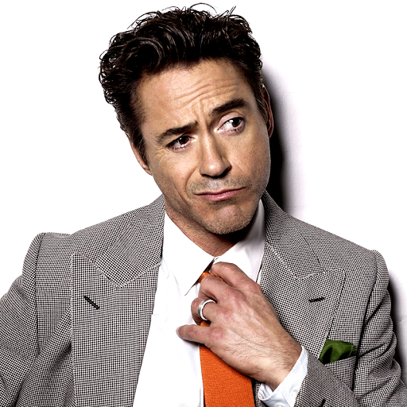
My favorite actor
Robert Downey, Jr.

Slide 2
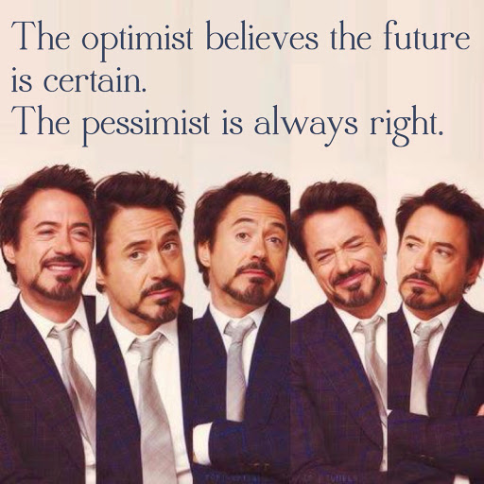
Credo of his life

Slide 3
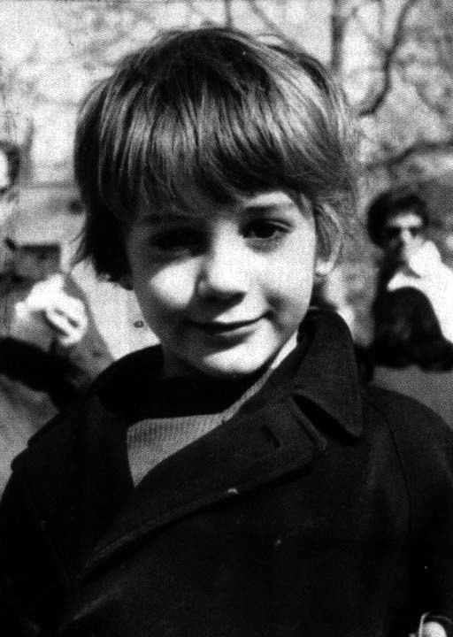
Early life and family
Downey was born in Manhattan, New York City, the younger of two children. His father, Robert Downey, Sr., is an actor, writer, producer, cinematographer, and director of underground films, and his mother, Elsie is also an actress and appeared in Downey, Sr.'s films. As a child, Downey was "surrounded by drugs". His father, a drug addict, allowed Downey to use marijuana at age six, an incident which his father has said that he now regrets. Downey stated that drug use became an emotional bond between him and his father: "When my dad and I would do drugs together, it was like him trying to express his love for me in the only way he knew how. "Eventually, Downey began spending every night abusing alcohol and "making a thousand phone calls in pursuit of drugs".
During his childhood Downey had minor roles in his father's films. He made his acting debut at the age of five, playing a sick puppy in the absurdist comedy Pound (1970), and then at age seven appeared in the surrealist Greaser's Palace (1972).At the age of ten, he was living in England and studied classical ballet as part of a larger curriculum.He attended the Stagedoor Manor Performing Arts Training Center in upstate New York as a teenager. When his parents divorced in 1978, Downey moved to California with his father, but in 1982 he dropped out of Santa Monica High School and moved back to New York to pursue an acting career full-time.

Slide 4
Personal life
Downey started dating actress Sarah Jessica Parker after meeting her on the set of Firstborn. They separated in 1991 because of his drug addiction, according to Downey. He married actress/singer Deborah Falconer on May 29, 1992, after a 42-day courtship, and had a son with her, Indio Falconer Downey. The strain on their marriage from Downey's repeated trips to rehab and jail finally reached a breaking point; in 2001, in the midst of Downey's last arrest and sentencing to an extended stay in rehab, Falconer left Downey and took Indio with her. Downey and Falconer finalized their divorce on April 26, 2004. Downey now sees his son frequently after settling custody arrangements with Falconer.
In 2003, on the set of Gothika, Downey met producer Susan Levin, an Executive Vice President of Production at Joel Silver's film company, Silver Pictures. Downey and Susan quietly struck up a romance during production, though Susan turned down his romantic advances twice. Despite Susan's worries that the romance would not last after the completion of shooting because "he's an actor; I have a real job", the couple's relationship continued after production wrapped on Gothika, and Downey proposed to Susan on the night before her thirtieth birthday. A couple were married on August 27, 2005. They have a son together named Exton Elias Downey, born on February 7, 2012 in Los Angeles, California. Downey has credited his wife with helping him kick his drug and alcohol habits. "There's no understanding for me of the bigger picture in real time in a hands-on way without her. Because it was the perfect, perfect, perfect matching of personalities and gifts." A tattoo on one of his biceps reads "Suzie Q" in tribute to her.

Slide 5
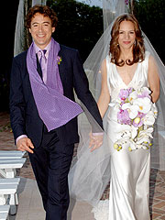
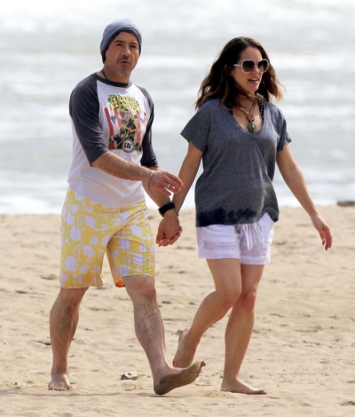
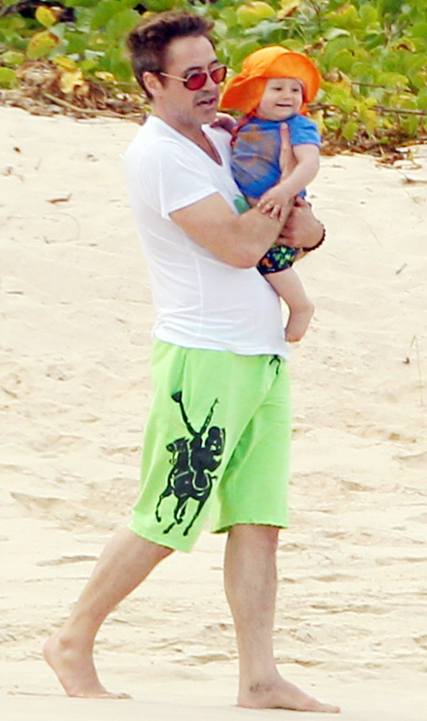
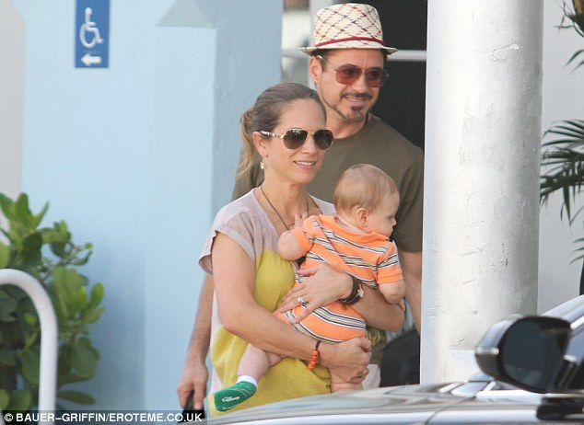


Slide 6
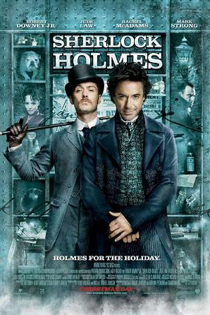
Sherlock Holmes
Sherlock Holmes is a 2009 British–American action mystery film based on the character of the same name created by Sir Arthur Conan Doyle. The film was directed by Guy Ritchie Robert Downey, Jr. and Jude Law portray Sherlock Holmes and Dr. John Watson respectively. In the film, Holmes and his companion Watson, with aid from former adversary Irene Adler, investigate a series of murders connected to occult rituals. The film went on general release in the United States on 25 December 2009, and on 26 December 2009 in the UK, Ireland, and the Pacific.
Sherlock Holmes received mostly positive critical reaction., praising the story, and Robert Downey Jr's performance as the main character, winning on the nomination on the Golden Globe Award for Best Actor on a Comedy. The film was also nominated for two Academy Awards, Best Original Score and Best Art Direction, which it lost to Up and Avatar, respectively.

Slide 7
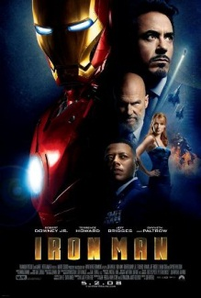
Iron Man
In 2007, Downey was cast as the title character in the film Iron Man,with director Jon Favreau explaining the choice by stating: "Downey wasn't the most obvious choice, but he understood what makes the character tick. He found a lot of his own life experience in 'Tony Stark'."the role Downey had to gain more than 20 pounds of muscle in five months to look like he "had the power to forge iron."
Iron Man was globally released between April 30 and May 3, 2008, grossing over $585 million worldwide and receiving rave reviews which cite Downey's performance as a highlight of the film. As a result, both Downey and Favreau stated their interest in making an Iron Man trilogy. By October 2008, Downey had agreed to appear as Iron Man in two Iron Man sequels and The Avengers, the superhero team that Stark joins based on Marvel's comic book series The Avengers.

Slide 8
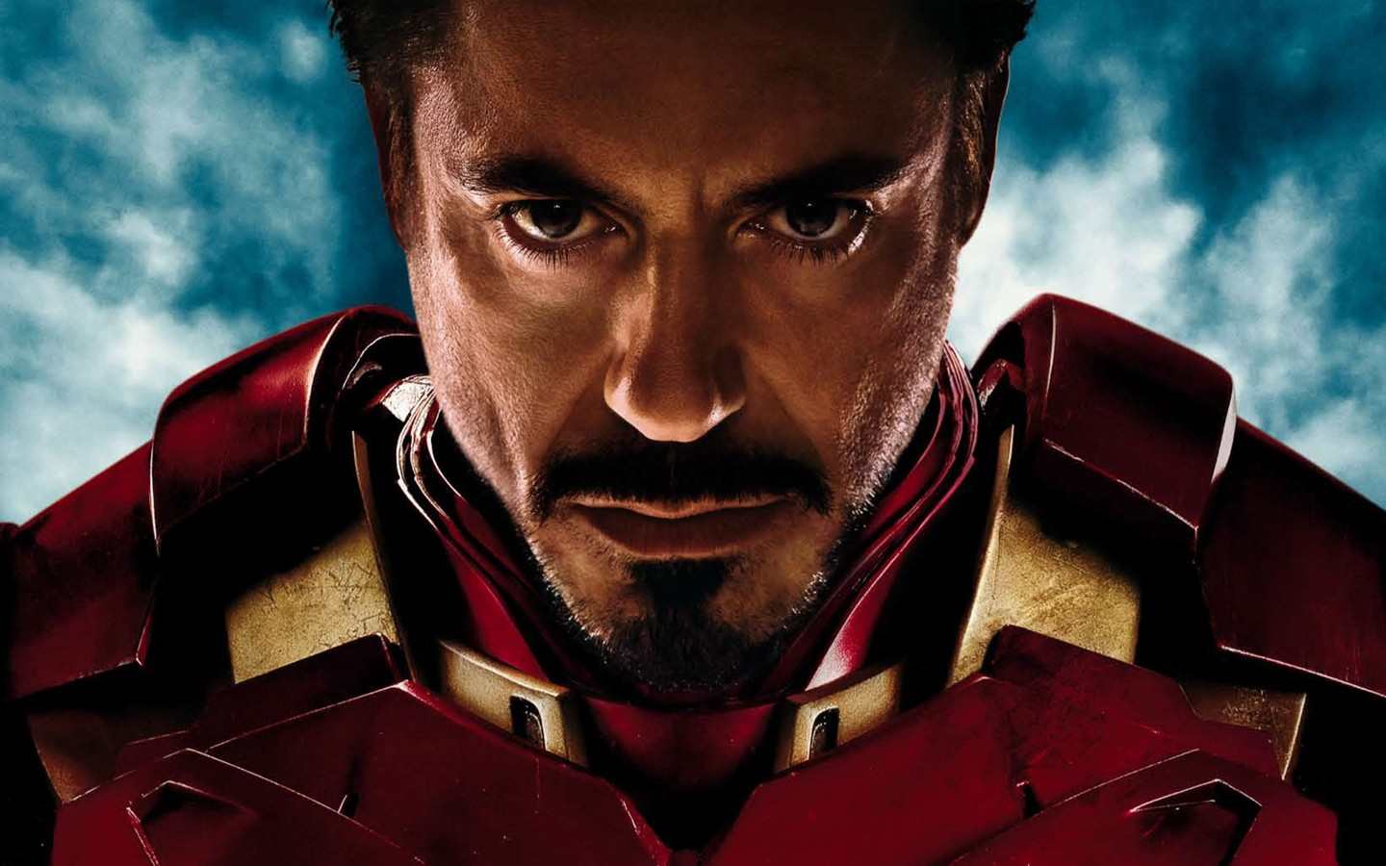
Iron man brought the worldwide popular

Slide 9
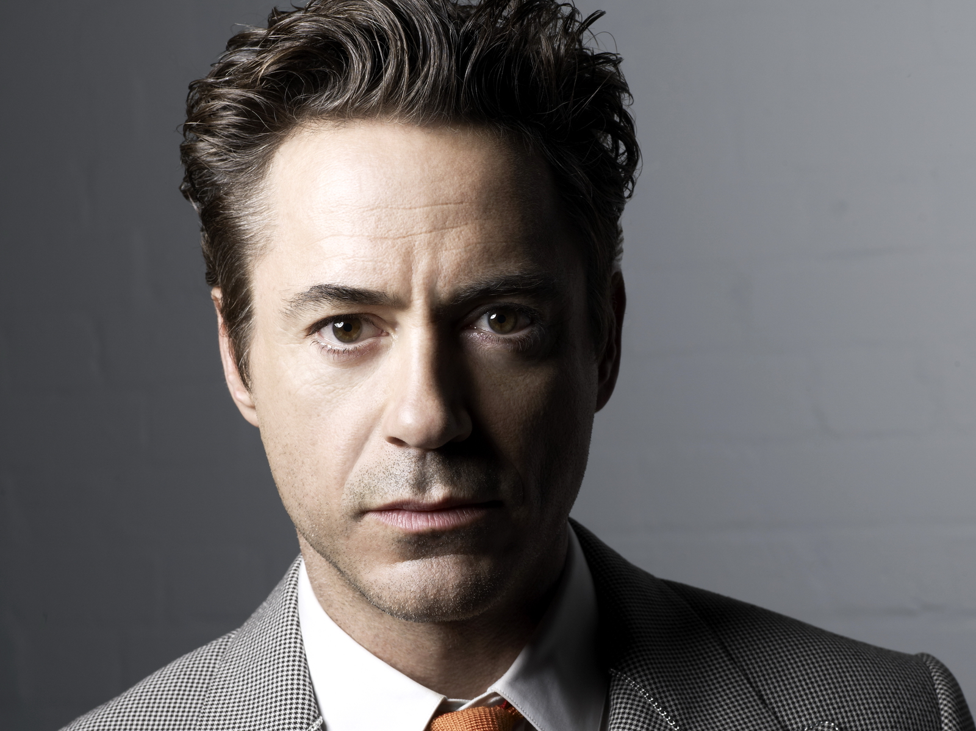
Now he is one of the most popular actor in the world

Slide 10
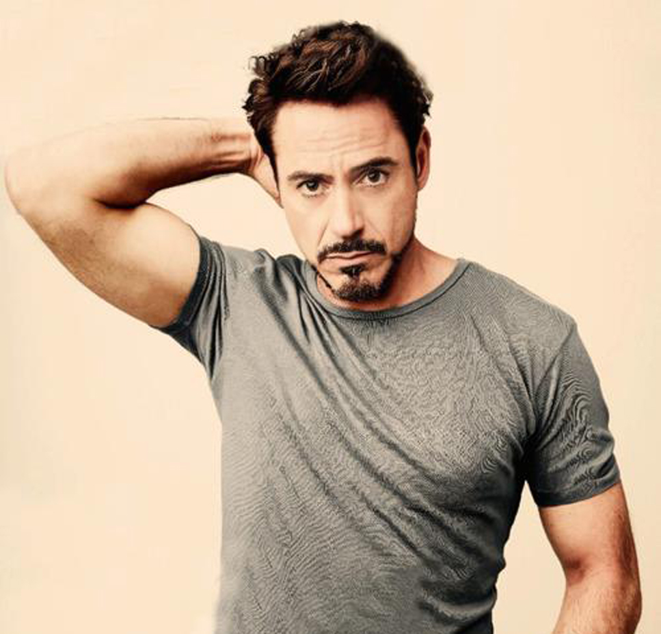
I adore him because of his perfect talent and actor skills

Slide 11
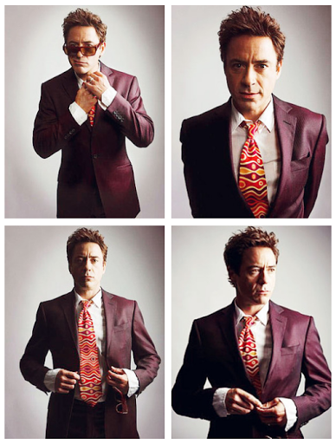
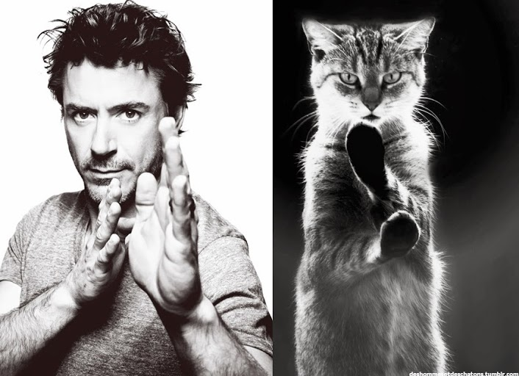
Just perfect actor

