Slide 1
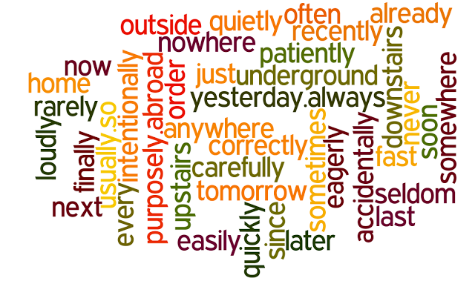
Adverbs

Slide 2
Block 1: Degrees of Comparison

Slide 3
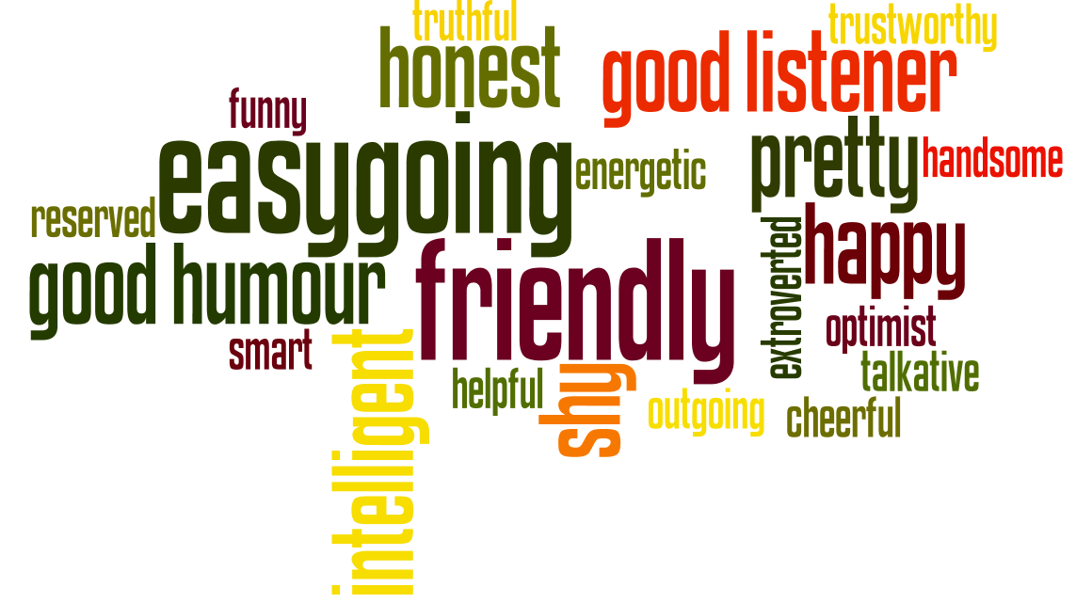
Make three forms of comparison

Slide 4
Basic (positive)
Comparative
Superlative
Quietly
more Quietly
The most Quietly
Politely
more politely
The most politely
Loudly
More loudly
The most loudly

Slide 5
Basic (positive)
Comparative
Superlative
Hard
Harder
The hardest
early
Earlier
The earliest
Fast
Faster
The Fastest

Slide 6
Basic (positive)
Comparative
Superlative
Well
Better
The best
far
Farther/ further
The farthest/ the furthest
Little
Less
The least

Slide 7
Basic (positive)
Comparative
Superlative
Badly
Worse
The worst
much/ many
More
The most
Little
Less
The least

Slide 8
Choose a right variant:

Slide 9
Quiet
He left a room …
Quietly
Jane works …
Hard
Hardly

Slide 10
Free
Her nephew behaves …
Freely
They took this ticket …
Free
Freely

Slide 11
Hard
She speaks quickly so he … understands her
Hardly
Her niece is a workaholic and she works …
Hard
Hardly

Slide 12
Early
Earlier
More early
The most early
The earliest

Slide 13
Far
Farer
Farther
The farthest
The farest

Slide 14
Look this cute boy is running …
Quickly
Quick

Slide 15

Your new idea seems …
Interesting
Interestingly

Slide 16
Actually this new train can move …
fast
Fastly

Slide 17
Его одноколассник такой же высокий как и он.
His classmate is as tall as he is.

Slide 18
Этот автомобиль не такой быстрый как тот.
This car is not so fast as that one.

Slide 19

Block 4: Correct the mistakes

Slide 20

Ann talks loudly than Liza.
More loudly
She gets up more early than her friend.
Earlier
She is a wonderful singer. She sings beautiful.
Beautifully

Slide 21
They left the party lately.
Late
This man is walking slow.
Slow
He speaks interesting.
Interestingly

Slide 22
Her aunt is a good cook. She cooks good.
Well
He is a good reader. He reds all texts careful.
Carefully
This apple pie tastes well.
Good

