Slide 1

SKRILLEX

Slide 2
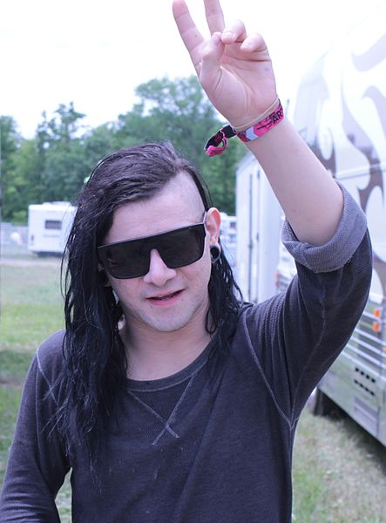
Sonny John Moore
Sonny John Moore born January, 15 1988 better known by his stage name Skrillex, is an American electronic dance music producer, DJ, and singer-songwriter.

Slide 3

Skrillex was nominated for five awards "Grammy" in 2011, including «Best New Artist»
He was awarded in three categories: Scary Monsters and Nice Sprites - best dance / electronic album; «Scary Monsters and Nice Sprites» - Best Dance Recording; «Benny Benassi - Cinema (Skrillex Remix)» - Best Remix. On the 55th ceremony of "Grammy"

Slide 4

From First to Last
In 2004, Moore agreed with Matt Hood of From First to Last on how to play the guitar for their debut album. Sonny was heard by three producers, Derrick Thomas, Eric Dane and McHale Butler, and became a soloist of the group, and Goode played guitar.

Slide 5

In 2008, Moore began performing under the alias Skrillex at clubs in Los Angeles. Previously, he was known on the Internet as Twipz. June 7, 2010 Sonny released debut album Free Skrillex My Name is Skrillex EP.
Moore provided the vocals a UK metalcore band Bring Me the Horizon for their third studio album, There Is a Hell, Believe Me I've Seen It.There Is a Heaven, Let's Keep It a Secret. [15] Later, Sonny began touring the country with Deadmau5 after signing a contract with mau5trap Records and released it on his second EP Scary Monsters and Nice Spirits.

Slide 6







