Slide 1
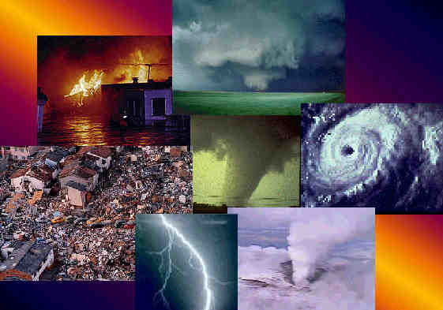
Natural disasters

Slide 2
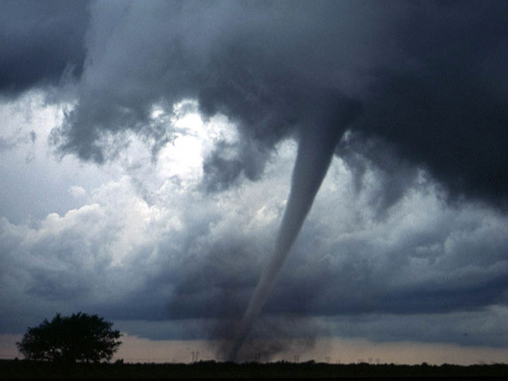
Tornado

Slide 3
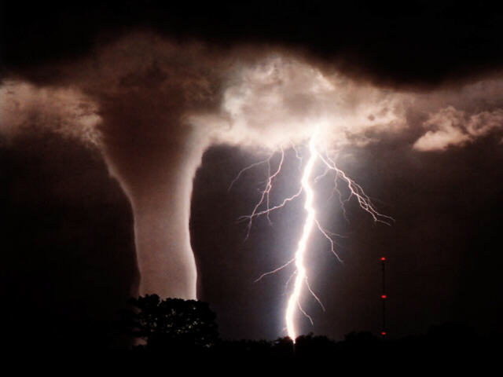
Tornado - monstrously narrow rotating column of air that extends from a thunderstorm cloud to the ground. As the wind is invisible, you can not always see a tornado. Visible sign - funnel consisting of water droplets, sometimes items throughout its existence tornadoes are not always in contact with the ground. Dust and debris in a rotating funnel also make a tornado visible and indicate the position of the tornado.

Slide 4
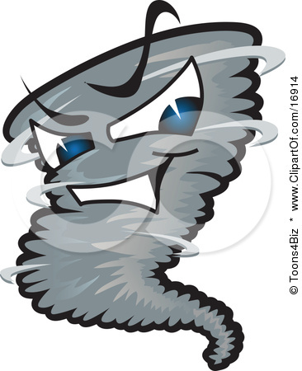
Known fact: Tornado - the most violent disaster.

Slide 5
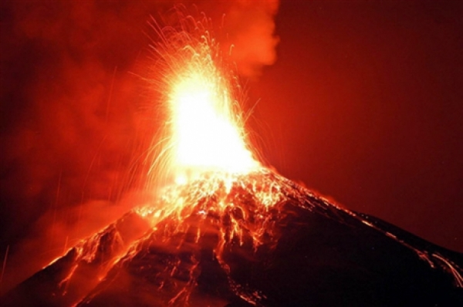
Volcanic eruption

Slide 6
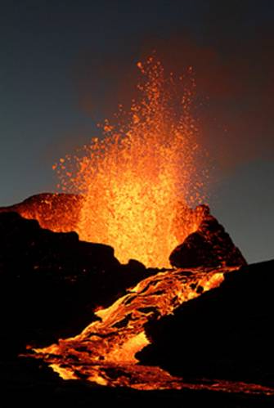
Eruption - process emissions volcano on the Earth's surface hot debris, ash outpouring of magma, which izlivshis on the surface, it becomes lava. Eruption may have a time period ranging from several hours to many years.

Slide 7
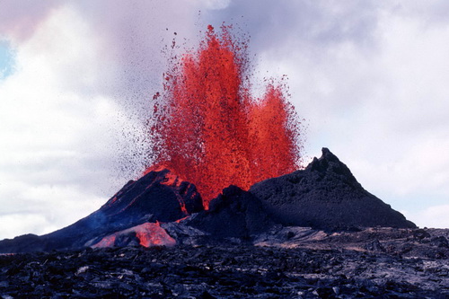
Interesting fact: On Earth, about 1500 active volcanoes, not counting submarines. Of these, only 20-30 erupt each year.

Slide 8
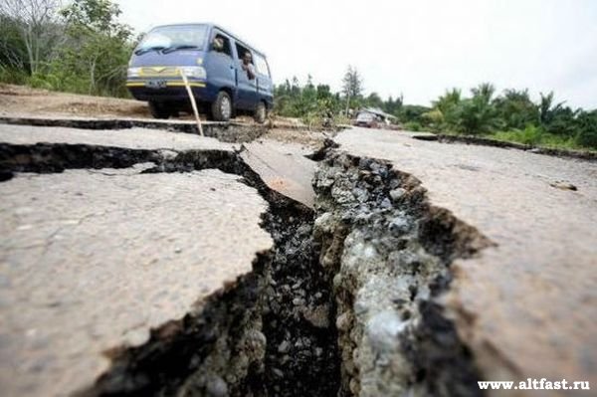
Earthquake

Slide 9
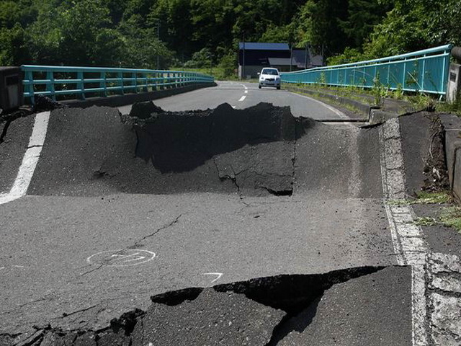
Earthquake - is any wobble in the Earth surface due to natural causes, among which the main role belongs to tectonic processes (mass transfer inside the Earth). It is a common phenomenon observed in many areas of continents and on the ocean floor.

Slide 10
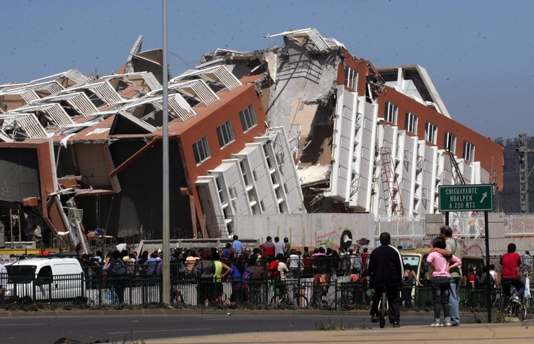
Interesting fact: In the main earthquakes happen because of geological problems, but sometimes they can be caused by landslides, explosions in mines, nuclear tests and volcanic activity.

Slide 11
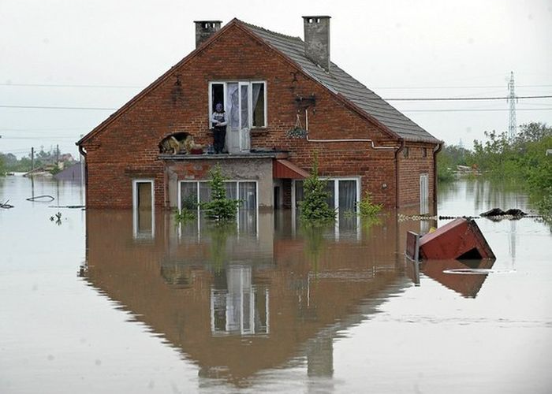
Flood

Slide 12
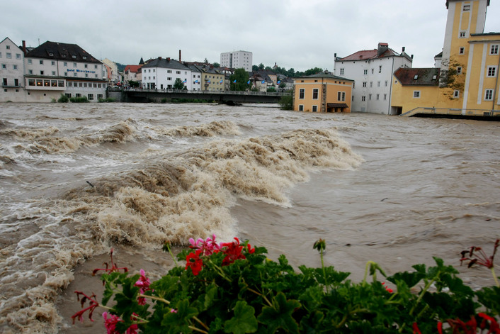
Flood - is significant flooding areas from rising water levels in the river, lake or sea during snowmelt, rainfall, wind surges, with traffic jams, ice jams, etc.

Slide 13
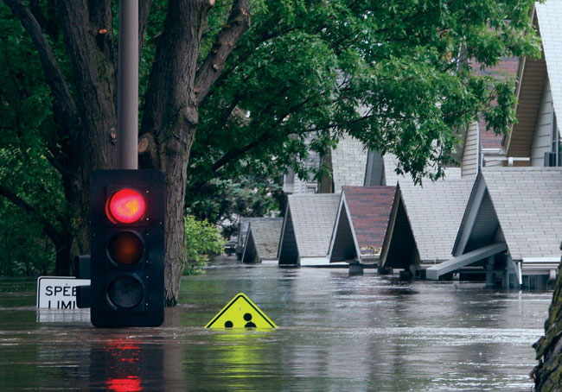
Interesting fact: The annual damage to the world economy floods and other water-related disasters, ranging from 50 to 60 billion U.S. dollars.

Slide 14
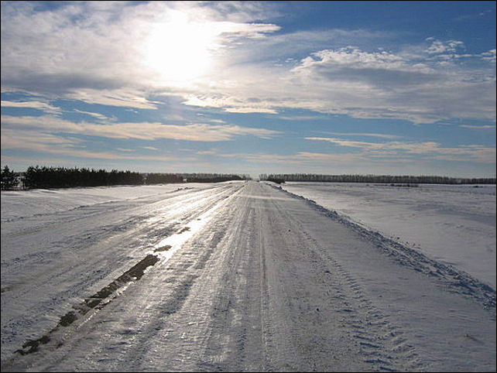
Ice

Slide 15
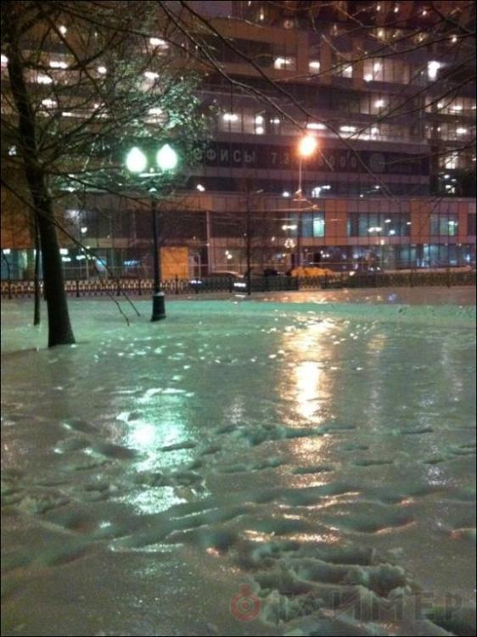
Ice - this dense layer of ice formed on the surface of the earth, sidewalks, roadway and on objects (trees, wires, etc.) when freezing of supercooled rain and drizzle (fog)

Slide 16
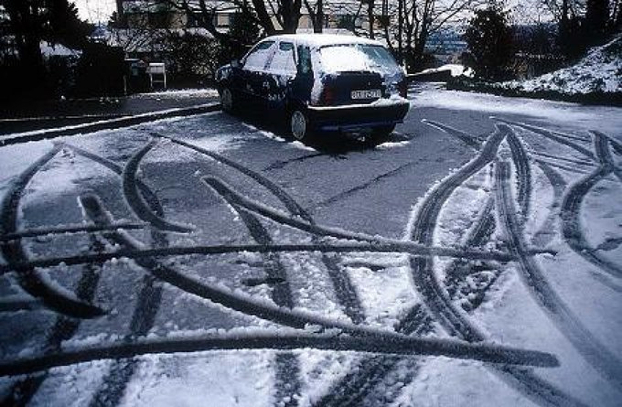
Interesting facts: In terms of handling and stability of the car on the road is much more dangerous ice icy.

