Slide 1
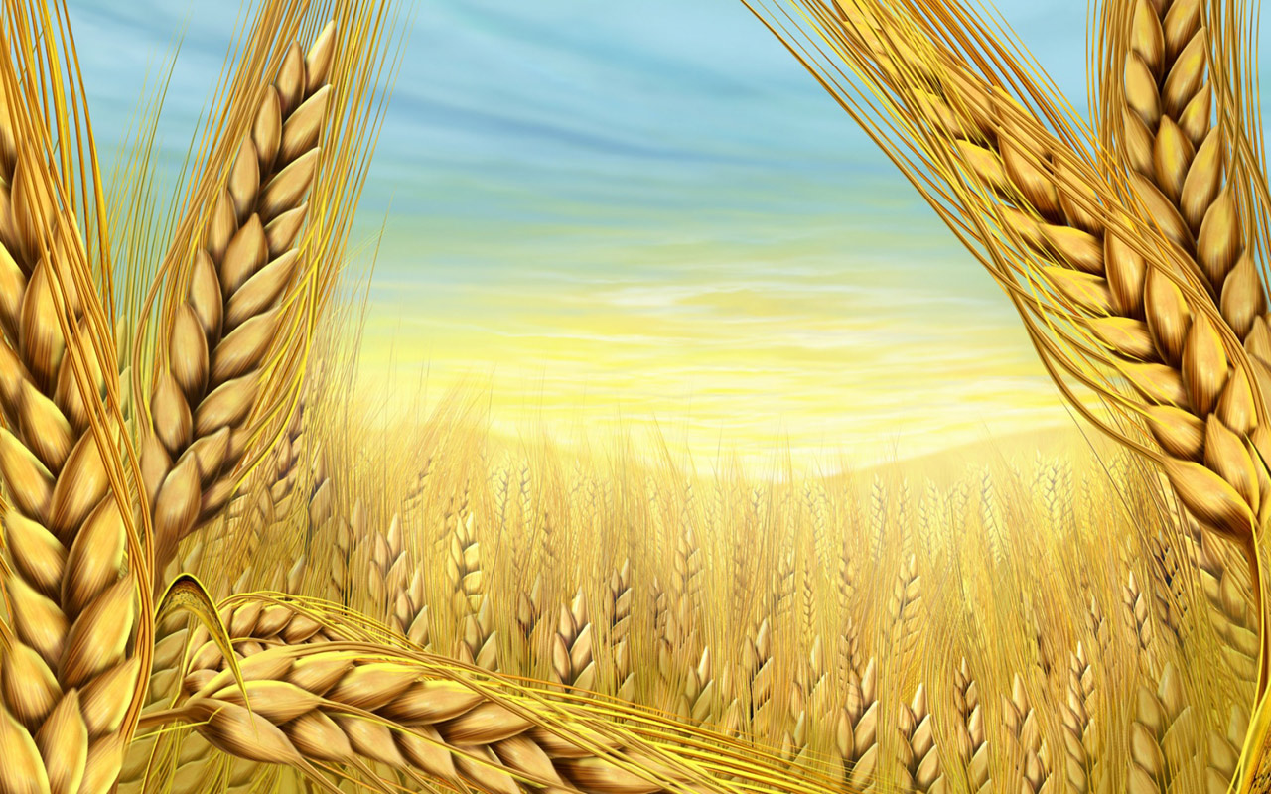
Ukrainian Cuisine

Slide 2
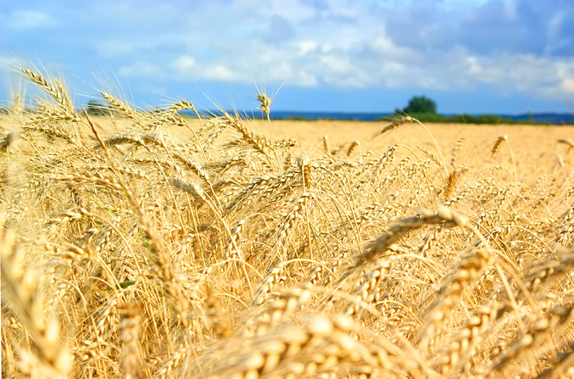
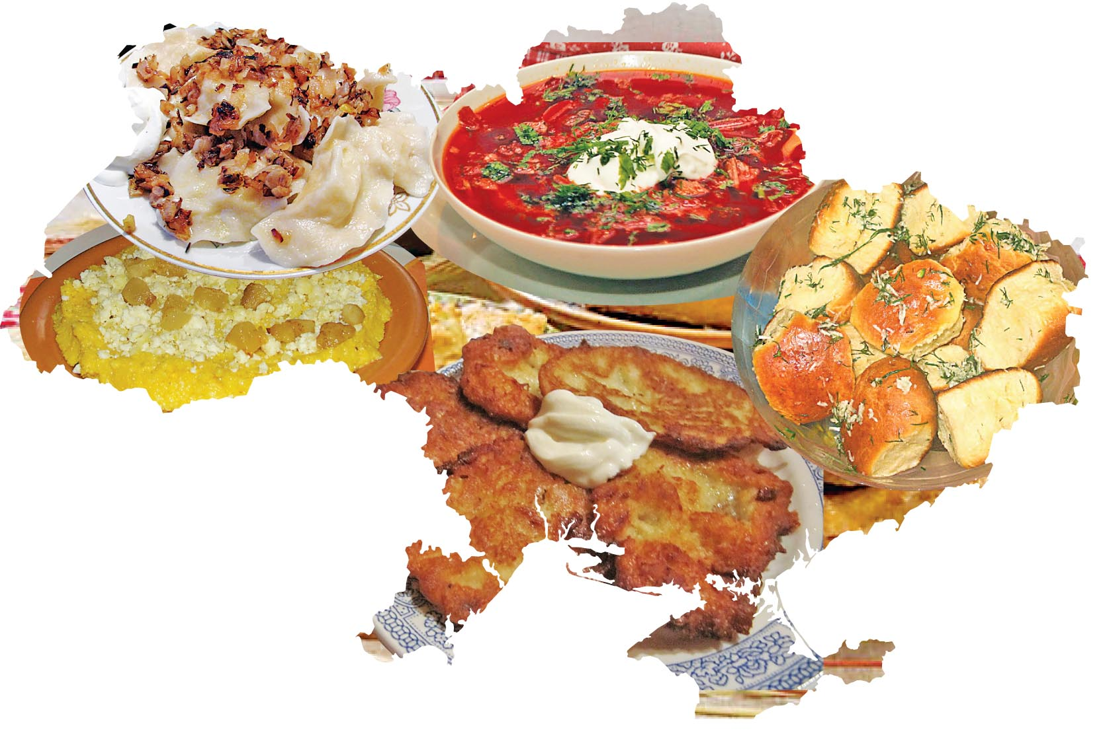
Ukrainian cuisine is very diverse and has a rich history.

Slide 3
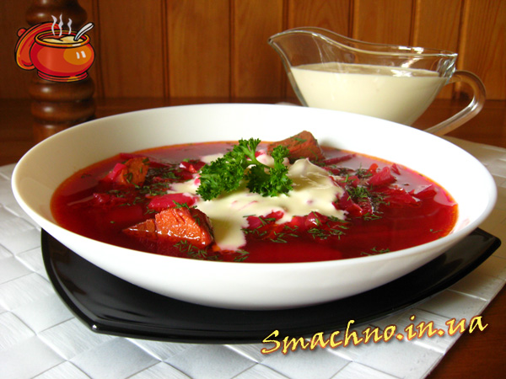
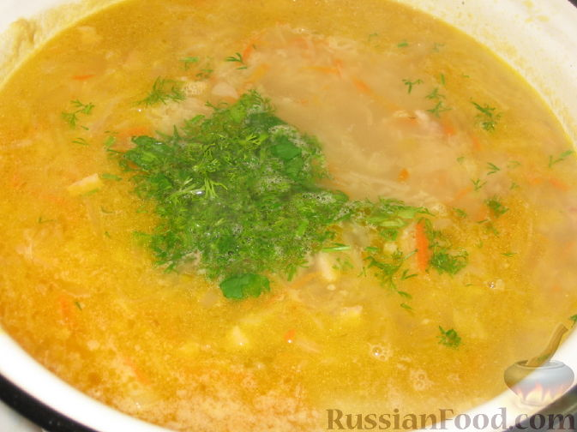
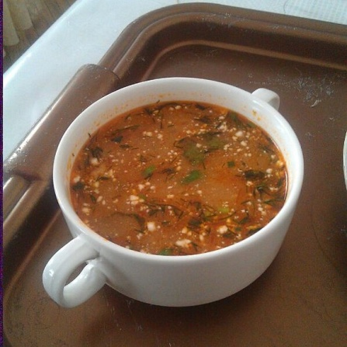
Soups
Borshch is a vegetable soup made out of beets, cabbage, potatoes, tomatoes, carrots, onions, garlic, dill. There are about 30 varieties of Ukrainian borscht. It may include meat or fish.
Kapusniak: soup made with pork, salo, sauerkraut, and served with smetana (sour cream).
Rosolnyk: soup with pickled cucumbers.

Slide 4
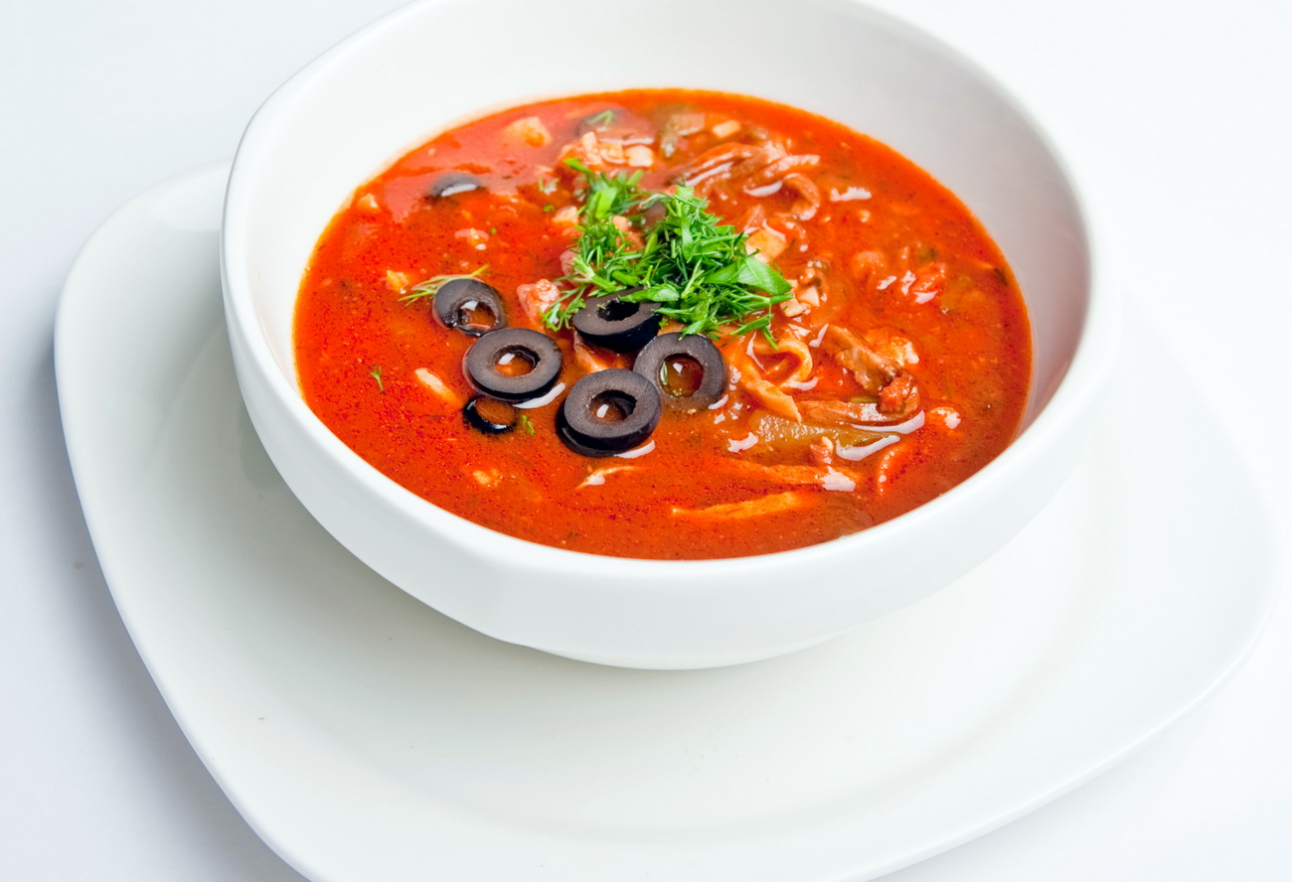
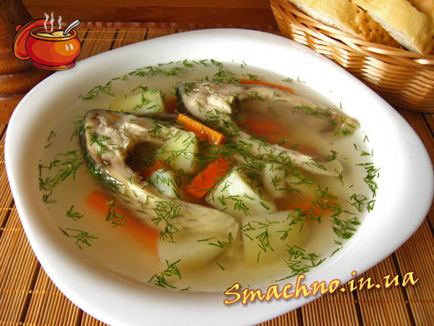
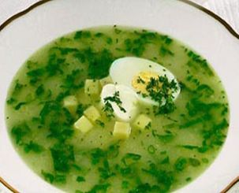
Solyanka: thick, spicy and sour soup made with meat, fish or mushrooms and various vegetables and pickles.
Yushka: clear soup, made from various types of fish such as carp, bream, wels catfish, or even ruffe.
Zelenyj borshch (green borscht) or shchavlevyj sup (sorrel soup): water or broth based soup with sorrel and various vegetables, served with chopped hard boiled egg and sour cream

Slide 5
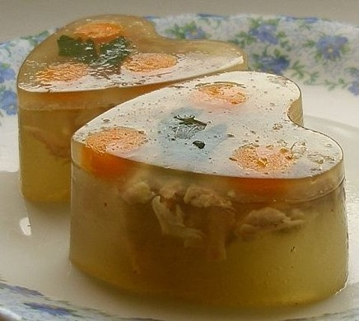
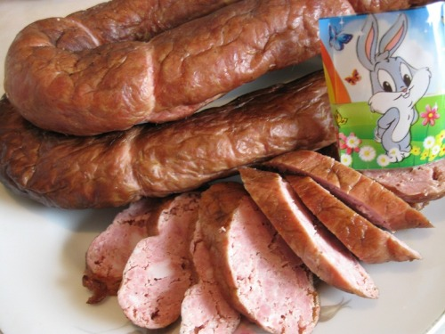
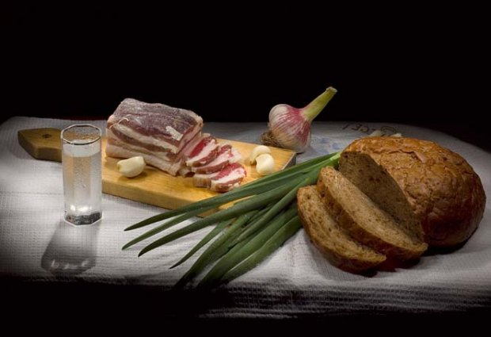
Appetisers
Salo ("Pork fat") is one of the most popular dishes in Ukrainian cuisine. All Slavic people love salo. Salo is rich in vitamins A, D, E, F, carotene. Smoked, salted pork fat (salo) with garlic and bread is usually served with borsch.
Kovbasa: various kinds of smoked or boiled pork, beef or chicken sausage.
Studenetz: aspic made with fish or meat (kholodets).

Slide 6
Breads
Babka: Easter bread, usually a sweet dough with raisins and other dried fruit.
Bublik: ring-shaped bread roll made from dough that has been boiled before baking. It is similar to bagel, but usually somewhat bigger and with a wider hole.
Kоlach: ring-shaped bread typically served at Christmas and funerals. The dough is braided, often with three strands representing the Holy Trinity. The braid is then shaped into a circle (circle = kolo in Ukrainian) representing the circle of life and family.
Korovai: a round, braided bread, similar to the kоlach. It is most often baked for weddings and its top decorated with birds and periwinkle.
Pampushki: soft, fluffy bread portions topped with garlic butter.
Paska: traditional rich Easter bread. It is shaped in a short round form. The top of the paska is decorated with typical Easter symbols, such as roses or crosses.

Slide 7
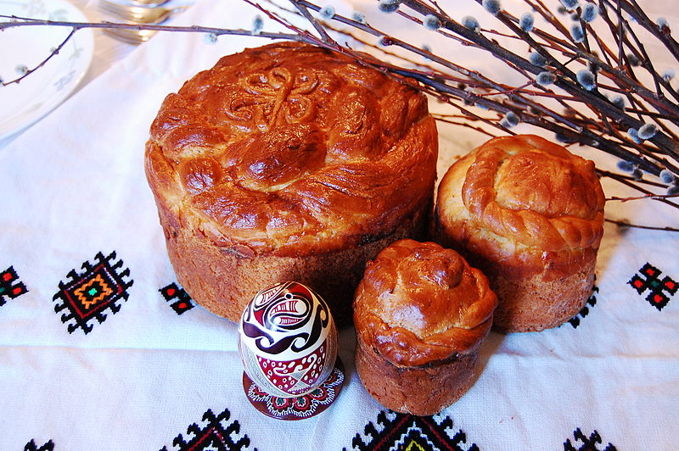

Slide 8
Main courses
Varenyky (also called pyrohy in some regions of Western Ukraine): dumplings made with fillings, such as mashed potatoes and fried onions, fried cabbage with fried onions, quark, cherries, and strawberries. Served with sour cream and butter or sugar, when filled with fruits.
Holubtsi: cabbage leaves rolled with rice filling and may contain meat (minced beef or bacon), baked in oil and carmelized onions and may contain as a baking sauce tomato soup, cream or sour cream.
Mlyntsi or nalisnyky: thin pancakes filled usually with quark, meat, cabbage, fruits, served with sour cream.
Deruny: potato pancakes, usually served with rich servings of sour cream

Slide 9
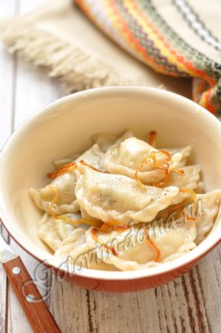
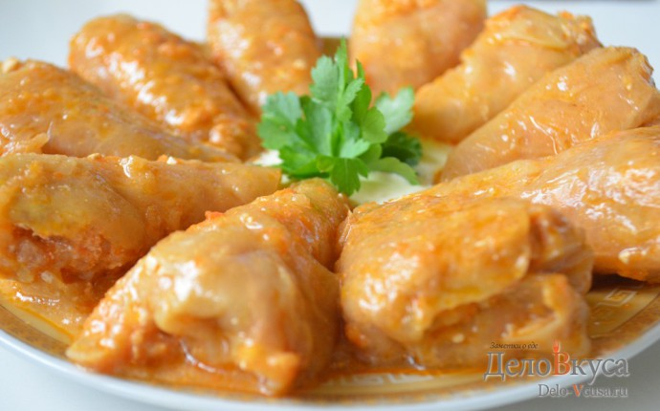
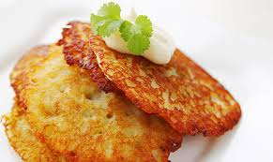
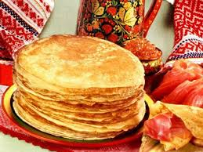

Slide 10
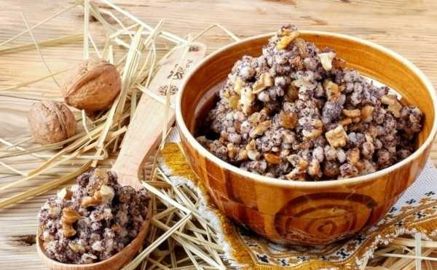
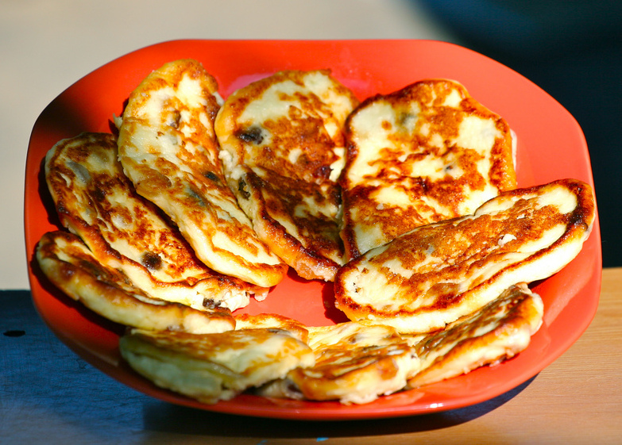
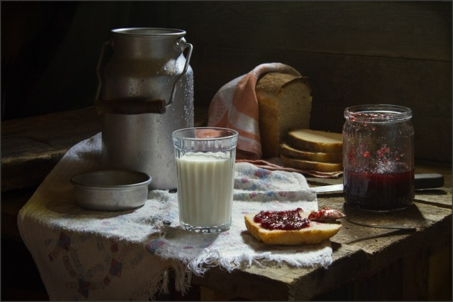
Desserts
Kutia: traditional Christmas dish, made of poppy seeds, wheat, nuts, honey, and delicacies.
Syrnyky: fried quark fritters, sometimes with raisins, served with sour cream, jam (varennya), honey or apple sauce.
Varennya: a whole fruit preserve made by cooking berries and other fruits in sugar syrup.

Slide 11
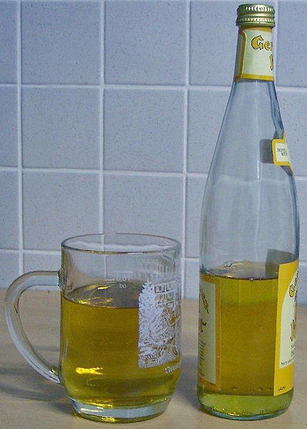
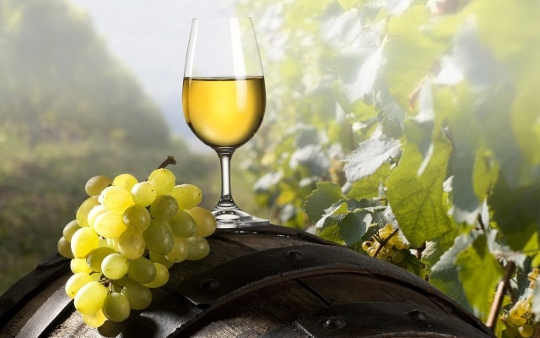
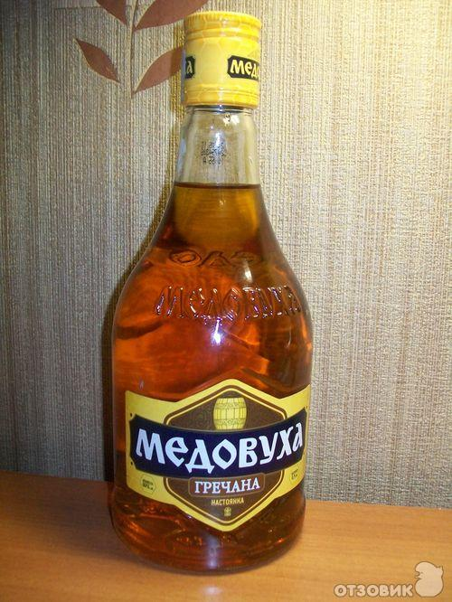
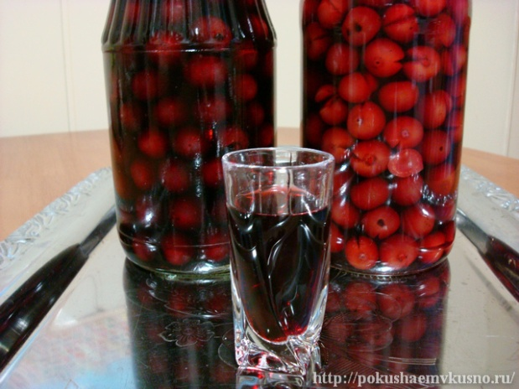
Beverages
Alcoholic
Strong spirits (gorilka): Samohon (moonshine) is also popular, including with infusions of fruit, spices, herbs or hot peppers.
Beer (pyvo): the largest producers of beer are Obolon, Lvivske, Chernihivske, Slavutych, Sarmat, and Rogan, which partly export their products.
Wine (vyno): from Europe and Ukraine (particularly from Crimea).
Mead (medovukha): a fermented alcoholic beverage made from honey, water, and yeast.
Nalyvka : a homemade wine made from cherries, raspberries, gooseberries, bilberries, blackberries, plums and other berries.

Slide 12
Non-alcoholic
Kompot: a sweet beverage made of dried or fresh fruits and/or berries boiled in water.
Uzvar: a specific type of kompot made of dried fruit, mainly apples, pears, and prunes.
Kvas: a sweet-and-sour sparkling beverage brewed from yeast, sugar, and dried rye bread.
Kefir: milk fermented by both yeast and lactobacillus bacteria, and having a similar taste to yogurt. Homemade kefir may contain a slight amount of alcohol.
Mineral water: well-known brands are Truskavetska, Morshynska, and Myrhorodska.
Pryazhene moloko: baked milk, a milk product having a creamy color and a light caramel flavour. It is made by simmering milk on low heat for at least eight hours.
Ryazhanka: fermented baked milk.

Slide 13
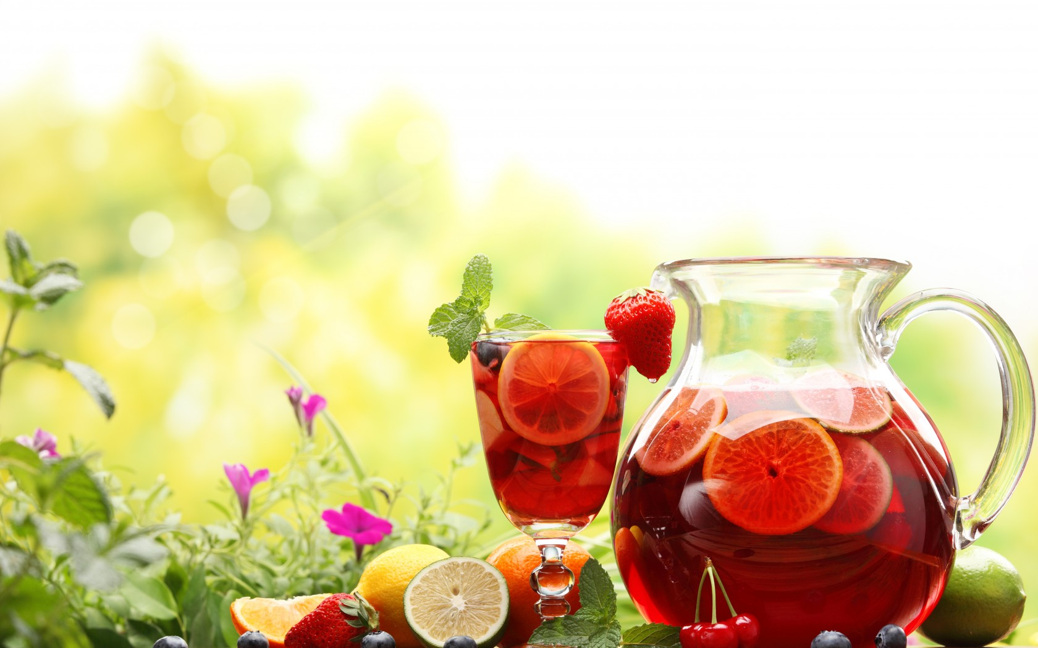
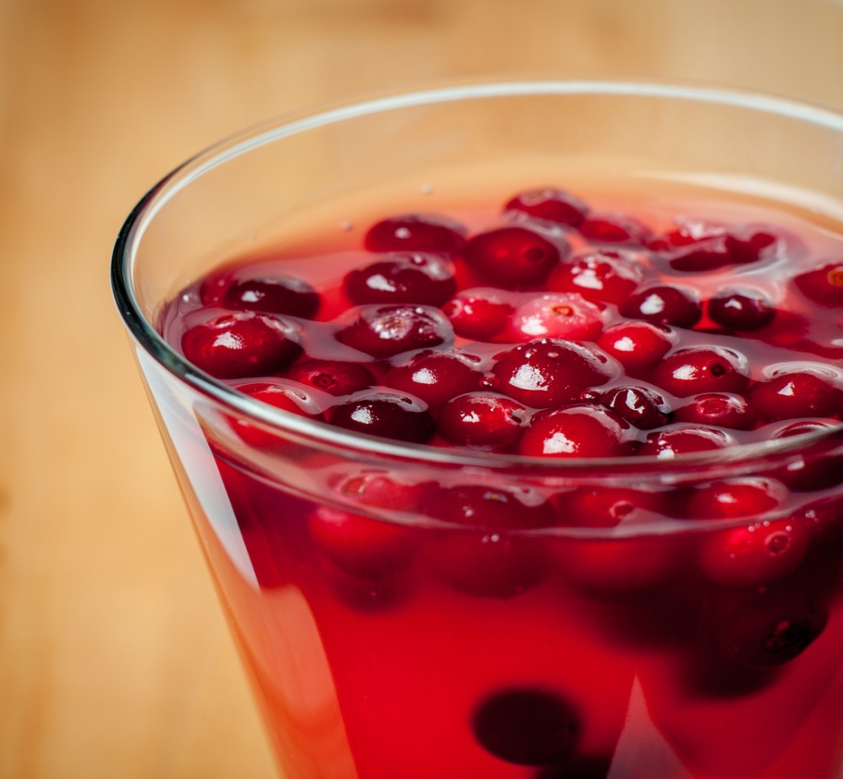
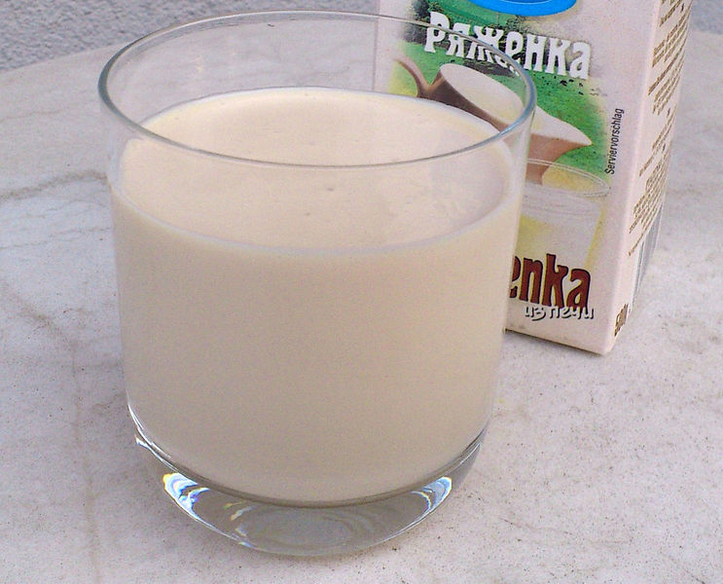
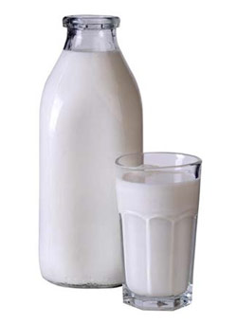

Slide 14
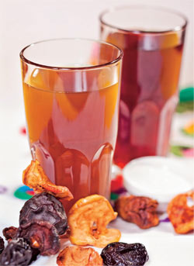
Uzvar is a compote prepared from several kinds of dried fruits: mainly apples, pears and prunes and sometimes berries, however, various recipes include raisins, dried sour cherries and even dried apricots sweetened with honey or sugar. Uzvar is a traditional Christmas Eve supper drink in Ukraine and some other countries of Eastern Europe. Uzvar is very refreshing, tasty and easy to do.

Slide 15
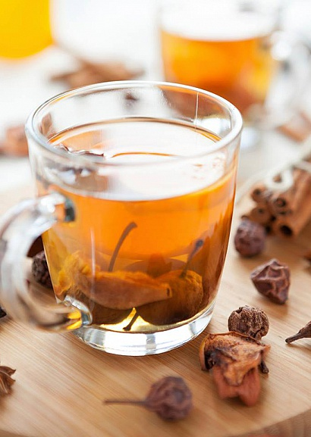
How to cook Uzvar: Ingredients: 100 g dried apples 100 g dried pears 100 g dried rose hips 3 tablespoons of sugar Directions: Dried fruits need to be reconstituted before boiling, so wash all dried fruits with cold water thoroughly. Put all dried fruits (apples, pears and prunes) to a big cooking pot , fill it with cold water, cover with a lid and let it stay on room temperature over night. Next day (or at least in several hours) put the saucepan over medium heat and wait for boiling. Simmer for 10-15 mins, then taste and add sugar (or honey) if needed and mix Then cool it without opening a lid. Enjoy it!

Slide 16


