Slide 1
Francis Scott Key Fitzgerald
(September 24, 1896 – December 21, 1940)

Slide 2
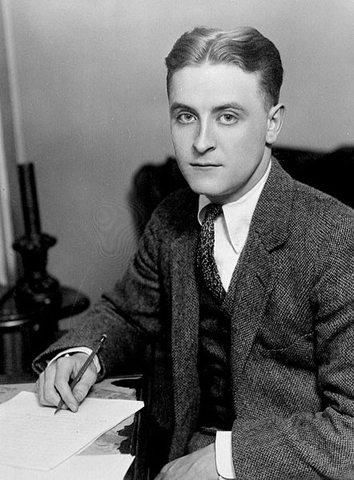

Slide 3
Francis was born on September 24th, 1896 in Saint Paul, Minnesota to an upper middle class family.
Fitzgerald dropped out of Princeton University to join the U.S. Army.
The success of his first novel, “This Side of Paradise” (1920), made him an instant celebrity.
His third novel, “The Great Gatsby” (1925), was highly regarded, but “Tender is the Night” (1934) was considered a disappointment.
Struggling with alcoholism and his wife’s mental illness, Fitzgerald attempted to reinvent himself as a screenwriter. He died before completing his final novel, “The Last Tycoon” (1941), but earned posthumous acclaim as one of America’s most celebrated writers.

Slide 4
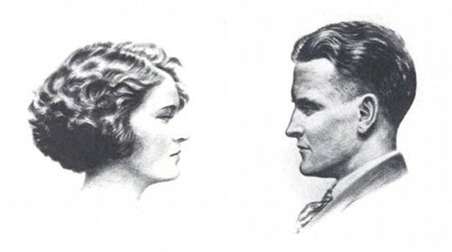
Interesting facts
F. Scott Fitzgerald was named after a distant cousin, who was also famous.
His wife wouldn’t marry him until after he had a book deal.
He was friends with Ernest Hemingway.
Alcoholism was his downfall.
HOLLYWOOD

Slide 5
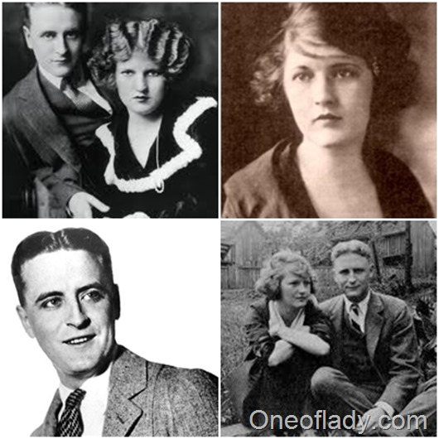
Francis Scott Fitzgerald with his wife Zelda Fitzgerald

Slide 6
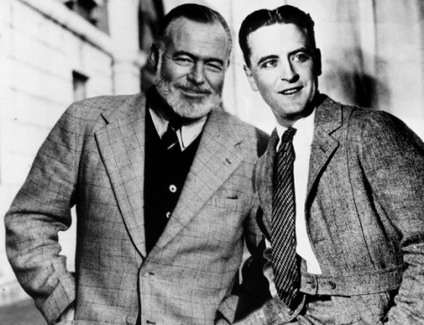
F.S. Fitzgerald and Ernest Hemingway

Slide 7
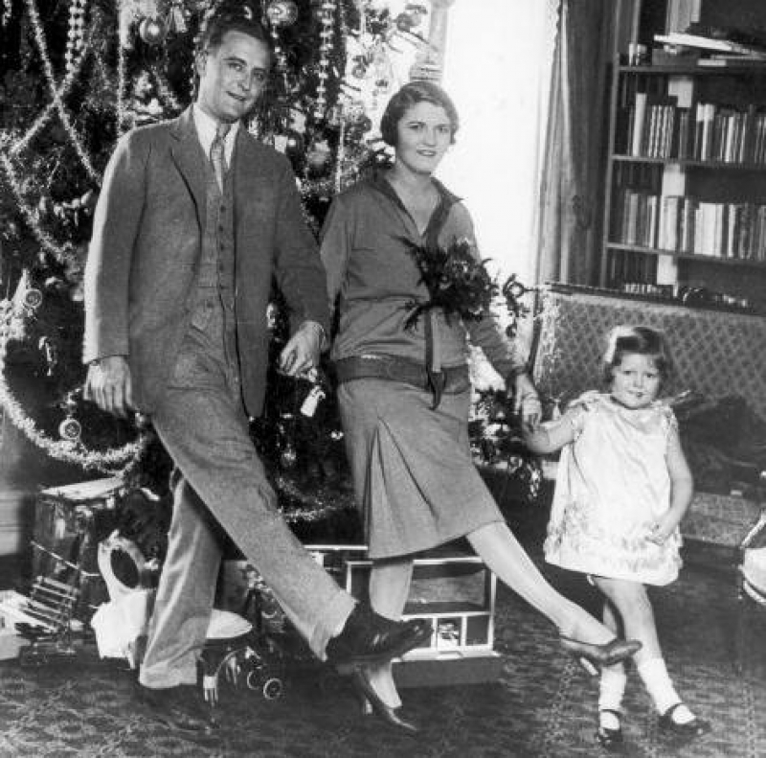
Family(daughter Frances Fitzgerald)

Slide 8

The Jelly-Bean

