Slide 1
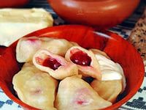
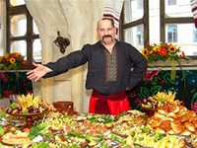
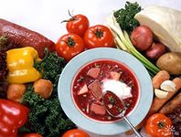
Ukrainian cuisine
Виконав
Учень 6. г класу
Бендас Юрій

Slide 2
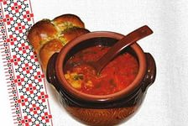
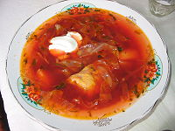
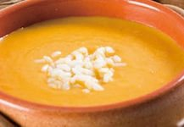
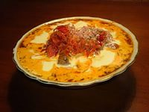
Soups
Borsch (borshch) is a vegetable soup made out of beets, cabbage, potatoes, tomatoes, carrots, onions, garlic, dill, sometimes green pepper, served with sour cream. There are about 30 varieties of Ukrainian Borsch soup, and the dish often includes meat.
Kapusniak soup made with pork, salo (pork fat),sauerkraut and served with sour cream
Rosolnyk: soup with pickles.
Yushka: fish soup, made of fresh-water fish, usually carp. Similar to the Russian cuisine, Ukha, which is also a fish-soup.
Zelenyj Borscht ("Kvaskova Zupa" or "Shchaveleva Zupa"): water or broth based soup with sorrel and various vegetables, served with chopped hard boiled egg and sour cream.

Slide 3
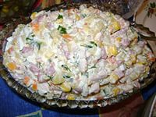
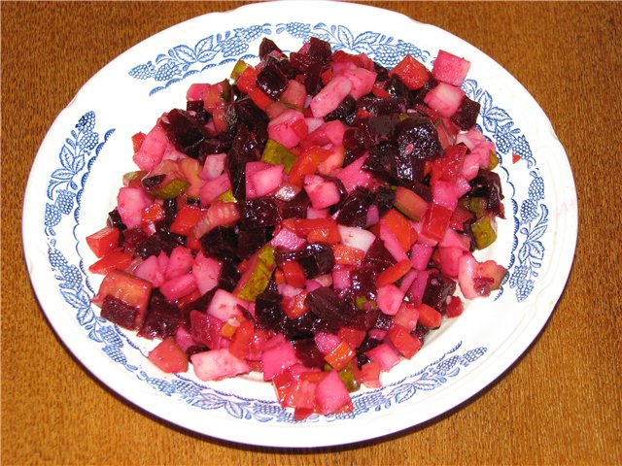
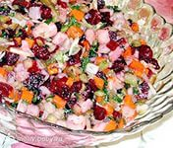
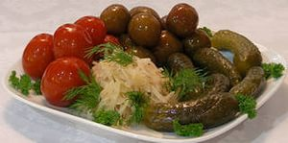
Salads
Olivye (Salade Olivier): salad made out of cooked and chopped potatoes, dill pickles, broiled chopped eggs, cooked and chopped ham, chopped onions, canned peas, mixed with mayonnaise.
Vinigret (from French Vinaigrette): salad with cooked and shredded beets, sauerkraut, cooked and chopped potatoes, onions and carrots,sometimes pickles mixed with some sunflower oil and salt.
Pickles: Pickled cucumbers (kvasheni ohirky) or tomatoes (kvasheni pomidory) are usually made with garlic and dill. Also,sauerkraut (kvashena kapusta).

Slide 4
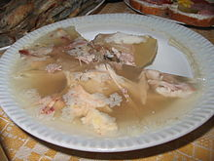
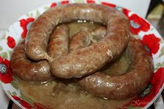
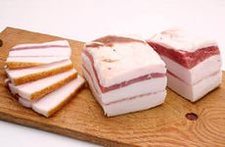
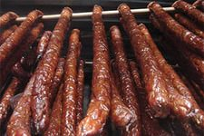
Appetisers
Kovbasa: various kinds of smoked or boiled pork, beef or chicken sausage. Sosysky: (hot dogs without buns) typically eaten for breakfast.
Salo: cured fatback.
Studenetz: aspic made with fish (zalyvne) or meat (kholodets).

Slide 5
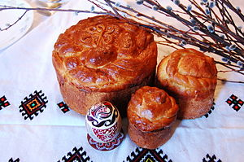
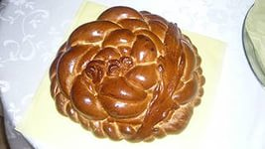
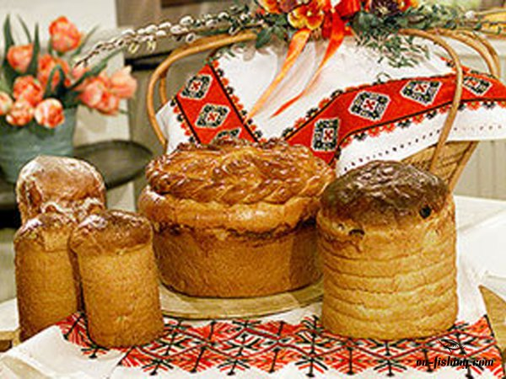
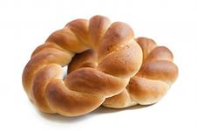
Breads
Paska: traditional rich Easter bread. It is shaped in a short round form. The top of the paska is decorated with typical Easter symbols, such as roses or crosses.
Babka: another Easter bread, usually a sweet dough with raisins and other dried fruit. It is usually baked in a tall, cylindrical form.
Kalach: ring-shaped bread typically served at Christmas and funerals. The dough is braided, often with three strands representing the Holy Trinity. The braid is then shaped into a circle (circle = kolo in Ukrainian) representing the circle of life and family.

Slide 6
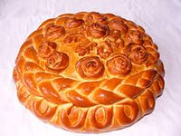
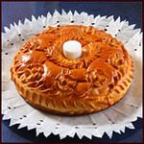
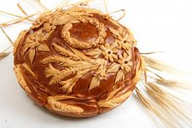
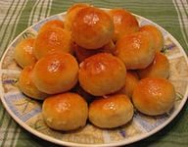
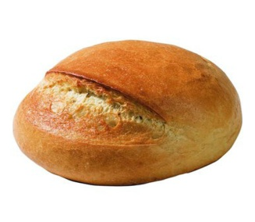
Korovai: a round, braided bread, similar to the kolach. It is most often baked for weddings and its top decorated with birds andperiwinkle.
Palyanytsya;
Pampushki: type of dinner roll. Once baked it is tossed with minced garlic, fresh herbs and oil. Served with soups such as borsch.

Slide 7
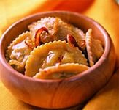
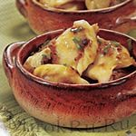
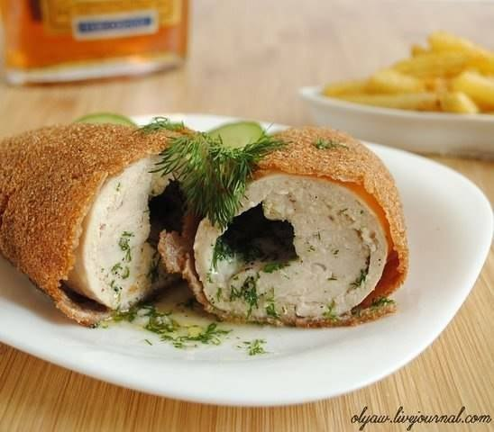
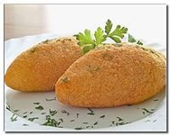
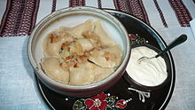
Main courses
Varenyky (also called pyrohy in some regions of Western Ukraine): dumplings made with fillings, such as mashed potatoes and fried onions, boiled ground meat and fried onions, liver and fried onions, fried cabbage with fried onions, quark, cherries, and strawberries. Served with sour cream and butter or sugar, when filled with fruits.
Kotleta po-kyivsky: chicken Kiev.

Slide 8
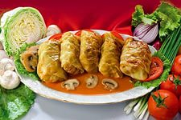
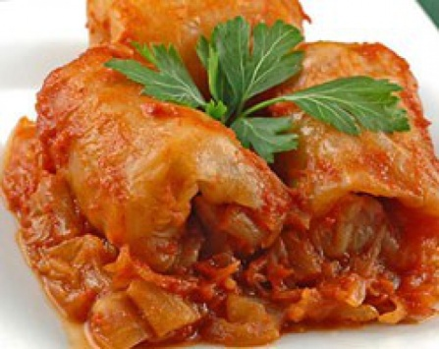
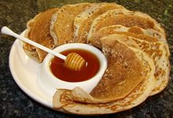
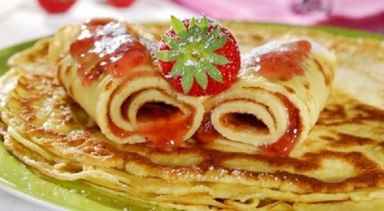
Holubtsi: cabbage leaves (fresh or sour) rolled with rice filling and may contain meat (minced beef or bacon), baked in oil and carmelized onions and may contain as a baking sauce tomato soup, cream or sour cream, bacon drippings or roasted with bacon strips on top.
Mlyntsi or nalisnyky: thin pancakes filled usually with quark, meat, cabbage, fruits, served with sour cream.

Slide 9
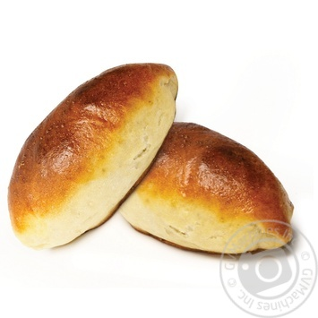
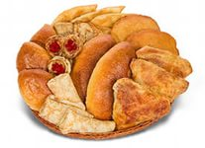
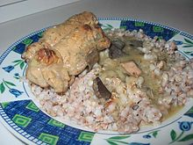
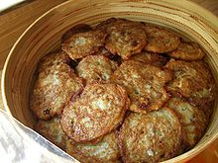
Pyrizhky: baked buns stuffed with different fillings, such as ground meat, liver, eggs, rice, onions, fried cabbage or sauerkraut, quark, cherries etc.
Kasha hrechana zi shkvarkamy: buckwheat cereal with pork rinds and onion.
Deruny: potato pancakes, usually served with rich servings of sour cream.

Slide 10
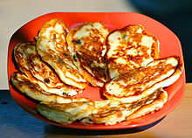
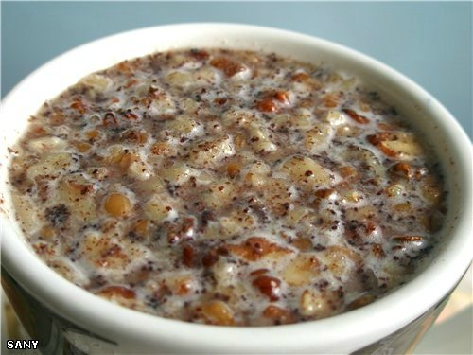
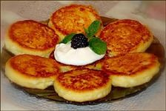
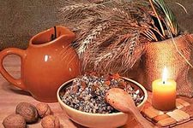
Desserts
Kutia: traditional Christmas dish, made of poppy seeds, wheat, nuts, honey, and delicacies.
Pampushky: sweet dough similar to doughnut holes. Frequently tossed with sugar. Traditionally filled with rose preserve, but can also be filled with poppy seed or other sweet fillings.
Syrnyky: fried quark fritters, sometimes with raisins, served with sour cream, jam (varennya), honey or apple source.

Slide 11
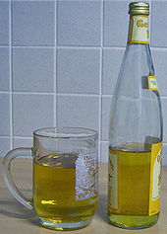
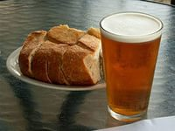
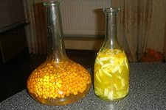
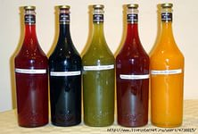
Beverages
Alcoholic:
Mead: a fermented alcoholic beverage made from honey, water, and yeast. Its flavour depends on the plants frequented by the honeybees, the length of time and method of aging, and the specific strain of yeast used. Its alcohol content will vary from maker to maker depending on the method of production.
Nalyvka (наливка): a homemade wine made from cherries, raspberries, gooseberries, bilberries, blackberries, plums, blackthorns and other berries. Berries were put into a sulija (a big glass bottle), some sugar was added. After the berries fermented, the liquid was separated from the berries, and put into corked bottles. The berries were used to make pyrozhky (baked or fried pastry). The wine has about 15% of alcohol.

Slide 12
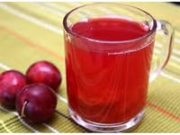
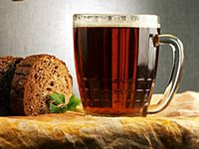
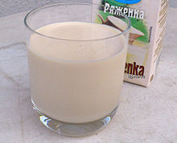
Non-alcoholic:
Kompot: a sweet beverage made of dried or fresh fruits and/or berries boiled in water.
Uzvar: a specific type of kompot made of dried fruit, mainly apples, pears, and prunes.
Kvas: a sweet-and-sour sparkling beverage brewed from yeast, sugar, and dried rye bread.
Kefir: milk fermented by both yeast and lactobacillus bacteria, and having a similar taste to yogurt. Homemade kefir may contain a slight amount of alcohol.
Mineral water: well-known brands are Truskavetska, Morshynska, and Myrhorodska. They usually come strongly carbonated.
Pryazhene moloko: baked milk, a milk product having a creamy color and a light caramel flavour. It is made by simmering milk on low heat for at least eight hours.
Ryazhanka : fermented baked milk.

Slide 13
Thank for attention!

