Slide 1
Gothic subculture
Created by Viktoria Dolia and Yaroslav Antonenko

Slide 2
Goths - representatives of the Gothic subculture that originated in the late 70s of the 20th century on a wave of post-punk.

Slide 3
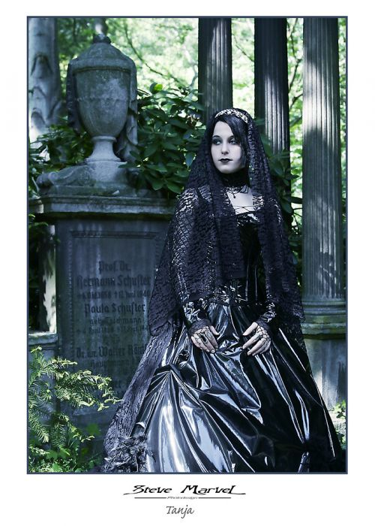
Origin and development(1979–1985)

Slide 4
Reason to be Goths

Slide 5
Gothic rock
Fields of the Nephilim
Peter Murphy, leader of the legendary band Bauhaus, is considered the godfather of gothic subculture, and his team considered the first gothic rock band

Slide 6
Gothic metal
Nick Holmes, lead singer of Paradise Lost - the first band whose style has been described as gothic metal

Slide 7
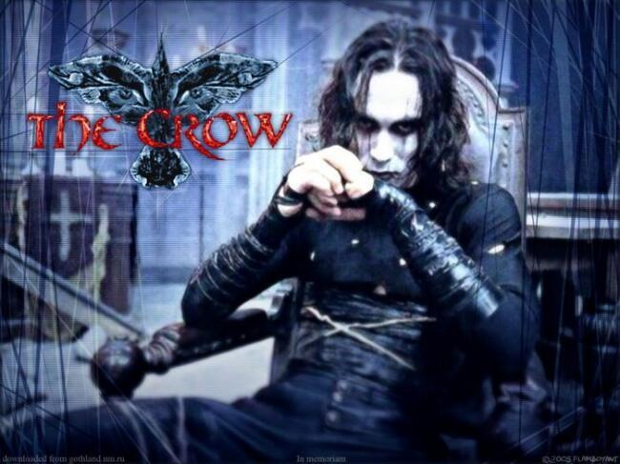
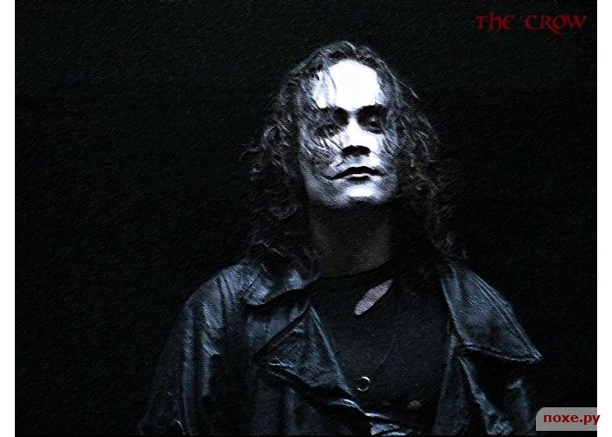
Films that portray the essence of the Goths

Slide 8
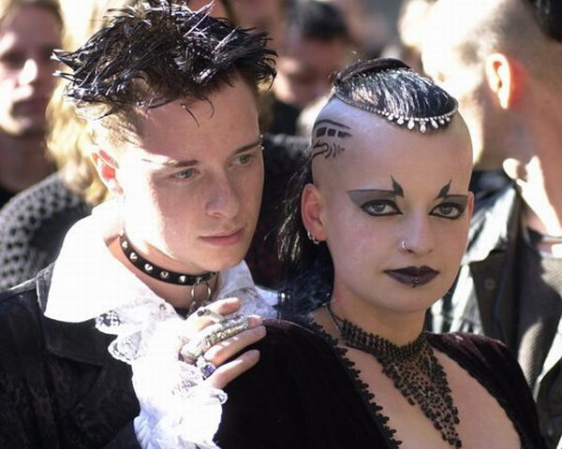
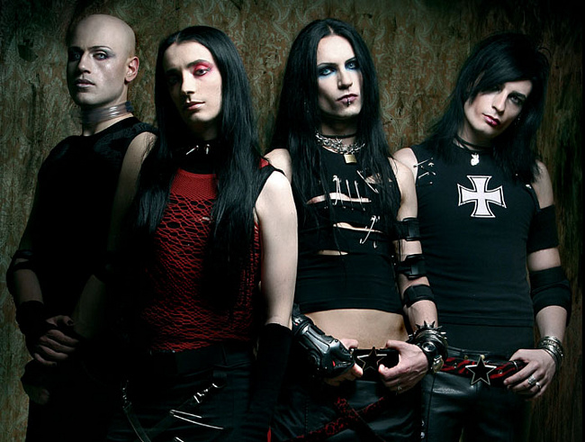
Goths

