Slide 1
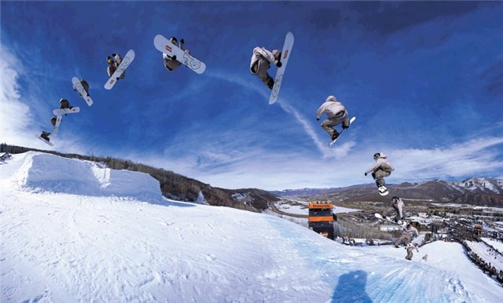
Extreme sport
Глушенко Ирина Викторовна учитель английского языка
МБОУ СОШ №2 ст.Ленинградской

Slide 2

water rafting

Slide 3
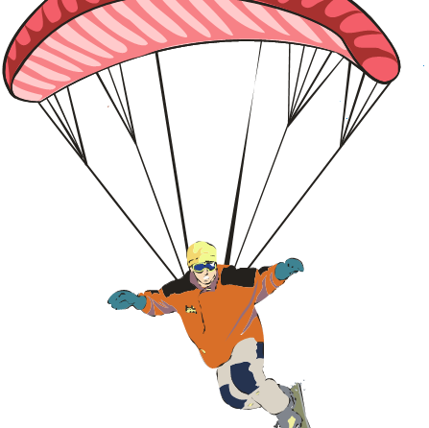
sky surfing
parachuting

Slide 4

surfing

Slide 5
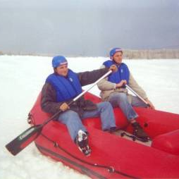
snow rafting

Slide 6
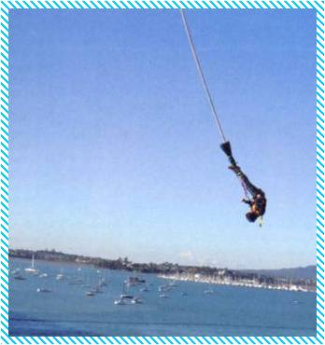
bungee jumping

Slide 7
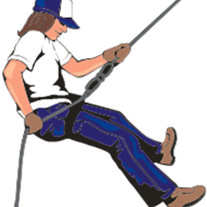
Rock - climbing
mountaineering

Slide 8
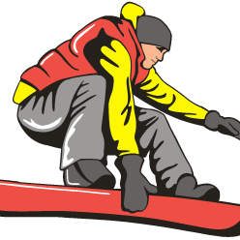
snowboarding

Slide 9
Прочитайте текст и составьте к нему вопросы.
The game of darts is a traditional English game. It is supposed to develop from archery(стрельба из лука).You can play darts in all English pubs. Each pub has a dart-board. The dart-board has a number of sections. The score depends on the section on the dart-board. Each player throws(бросать) three darts in turn. It is difficult to win after several glasses of beer and fish and chips at an English pub.

Slide 10
Раскройте скобки, поставив глаголы в Present Perfect Passive
Rugby(to play) all over Britain since 1845.
The Highland Games (to hold) since the 19th century.
Boat races between the universities of Oxford and Cambridge (to take place) since 1820.
Shooting competitions (to organize) since ancient times.
Table tennis (to play) with rules since the beginning of the 20th century.

