Slide 1
Global ecological problems of the Earth

Slide 2
The main problems are:
Water pollution
Air pollution
Land pollution
Destroying of ozone layer
Global warming

Slide 3
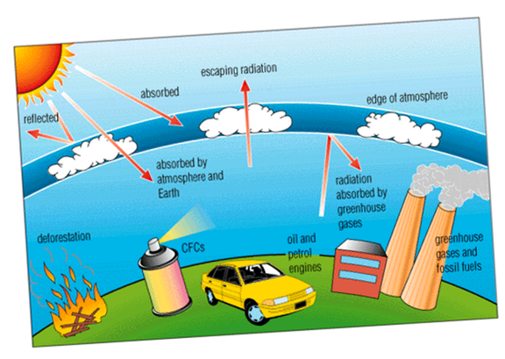
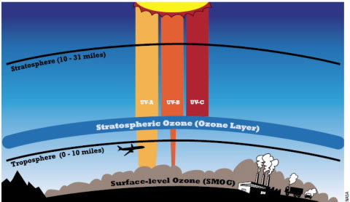
Ozone layer is a protecting layer of our planet. It protects us from UV and other high radiation. But Ozone layer has holes.

Slide 4
The planet without ozone layer.

Slide 5
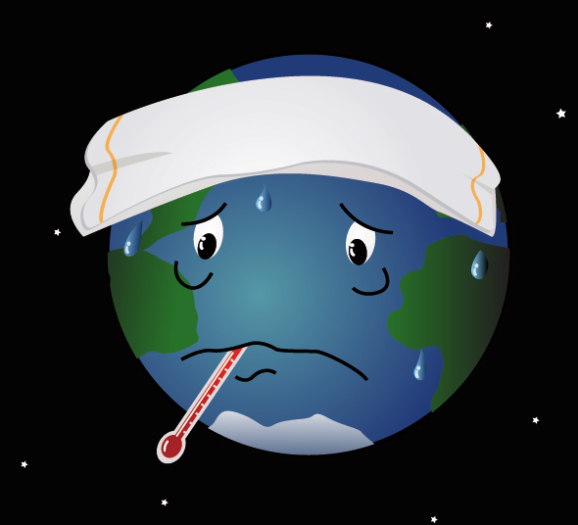
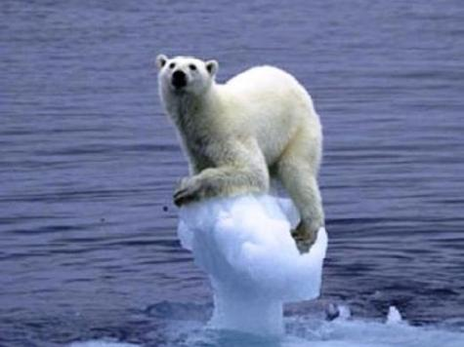
Global warming is sometimes referred as the greenhouse effect. It means that atmosphere becomes warmer.

Slide 6
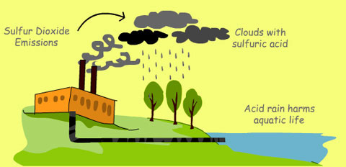
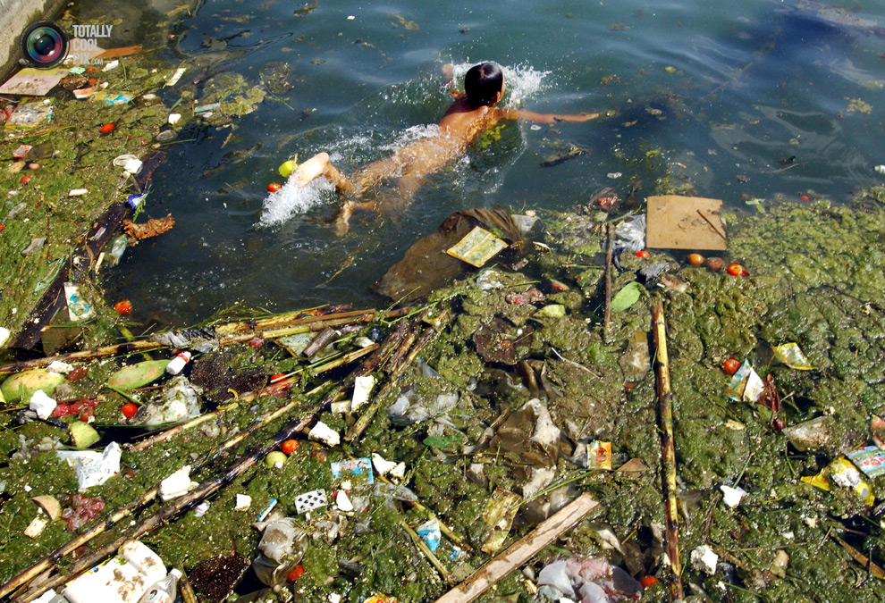
Water is necessary for our life. all organisms contain it, some drink it and some live in it.

Slide 7
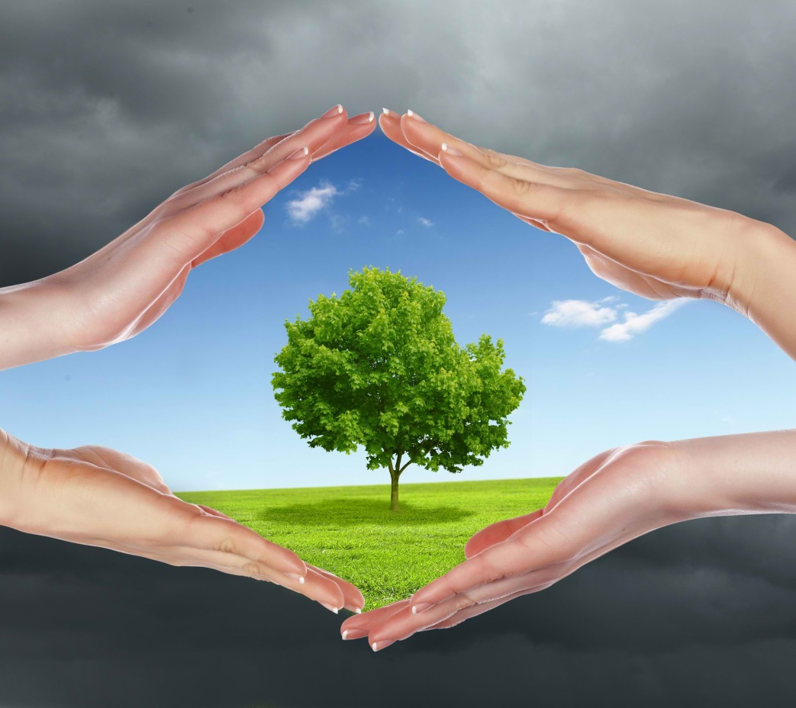
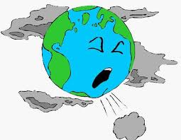
Air is the most essential element for all living. but people play a big role on it`s polluting. Asthma, cancer, acid rains are only a few causes of air pollution.

Slide 8
Land is our home. but our home is in a big trouble and needs “first aid”. The land is very dirty. it is full of litter.

Slide 9
There are many different groups which try to find solutions to the problems of pollution at the national and international level.

Slide 10
Protect and save the nature!!!
Remember the three R`s: reduce, reuse, recycle!!!!
Put your litter in the bin!!!
Never cut down baby trees!!!
Don`t hurt animals!!!
Protect wildlife, plants and trees!!!
Feed birds in winter!!!
Plant trees and flowers!!!

Slide 11
Be a friend to the nature!!!

