Slide 1
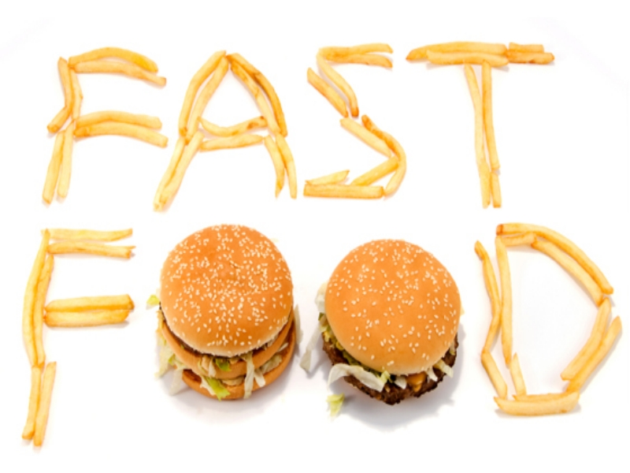
Fast food

Slide 2
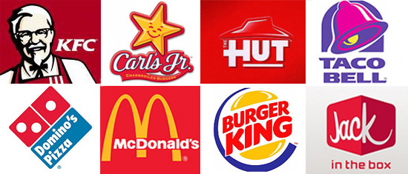
Fast food is the term given to food that is prepared and served very quickly, first popularized in the 1950s in the United States.

Slide 3

Аdvantages

Slide 4
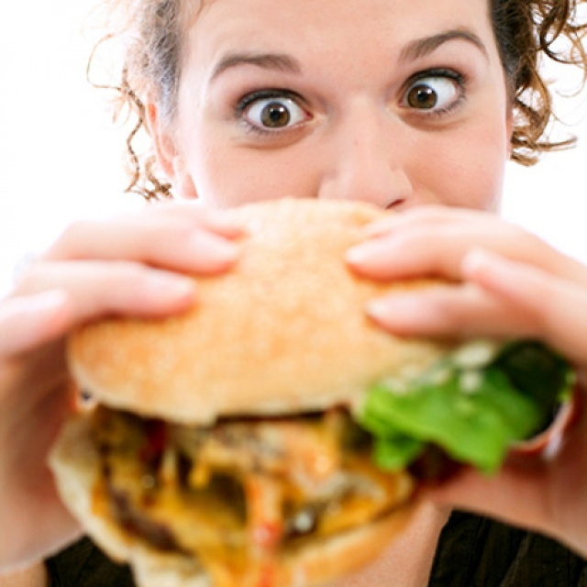
Fast food is popular among teenagers. It is very convenient because you don't have to wait for a long time until your food is prepared.

Slide 5
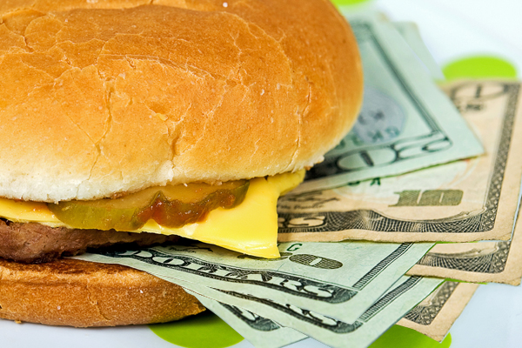
In addition, it is rather cheap, which is very important for teens who usually do not have much pocket money.

Slide 6
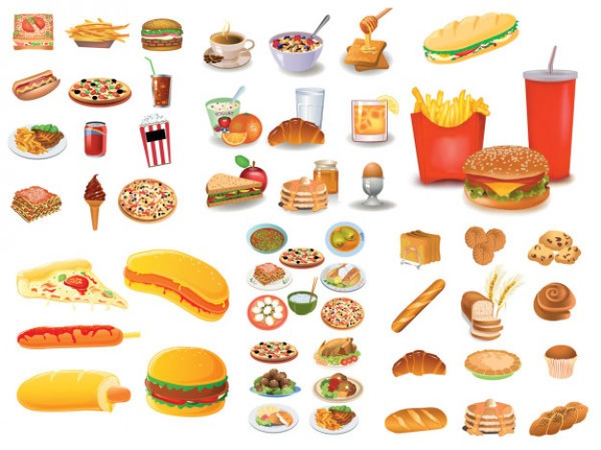
Junk food such as pizzas, burgers, chocolate bars are tasty and lots of teens like it.

Slide 7
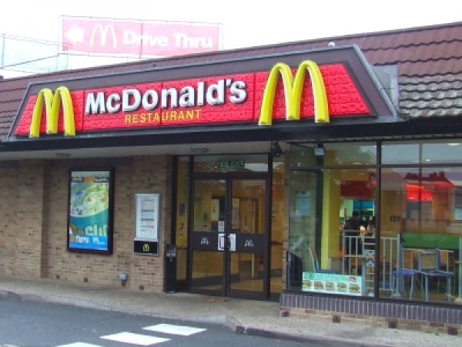
It's almost impossible not to find a fast food restaurant in your way to work or to school

Slide 8

Nearly from its inception, fast food has been designed to be eaten "on the go," often does not require traditional cutlery, and is eaten as a finger food

Slide 9
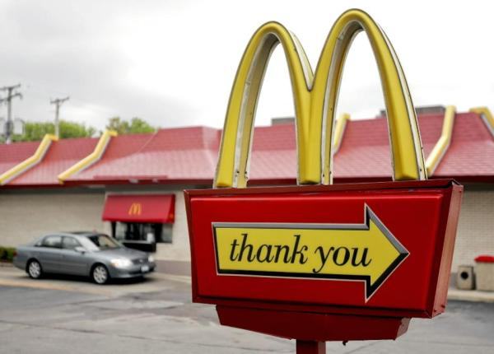
Fast food restaurants usually have a walk up counter or drive-thru window where you order and pick up your food.

Slide 10
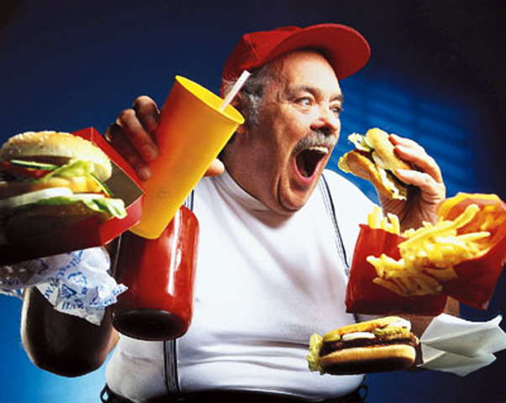
Perfect for when you are really hungry

Slide 11

Disadvantages

Slide 12
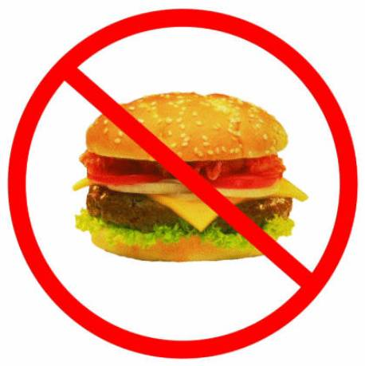
Fast food is high in saturated fat, trans fat, and cholesterol, eating too much over a long period of time can lead to health problems such as high blood pressure, heart disease, and obesity.

Slide 13
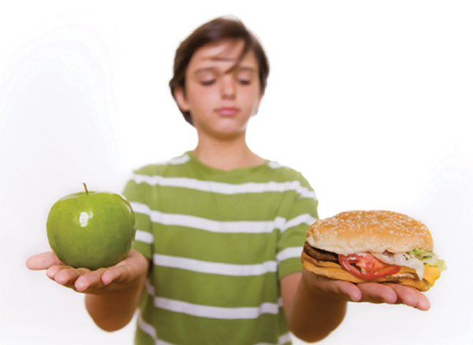
Fast food also lacks many of the nutrients, vitamins, and minerals our bodies need

Slide 14
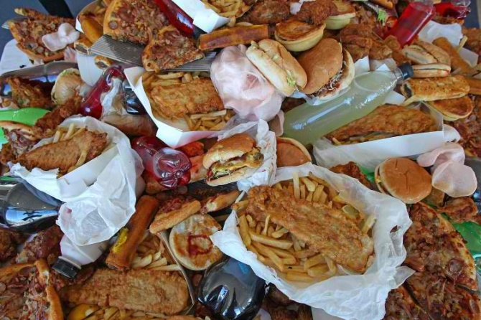
Fast food is usually cheap because it's often made with cheaper ingredients such as high fat meat, refined grains, and added sugar and fats, instead of nutritious foods such as lean meats, fresh fruits, and vegetables

Slide 15
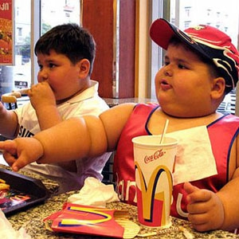
If you eat too much fast food you are likely to gain weight. Besides, weight gained in adolescence is extremely hard to lose

Slide 16
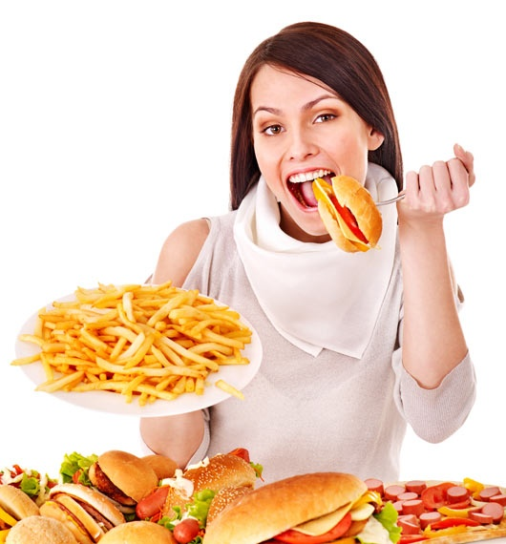
The sizes keep increasing, making us more and more dependent on this type of food; in addition, because it is tasty, you'll try to eat the entire "super-size" meal, even if your body doesn't need that much

Slide 17
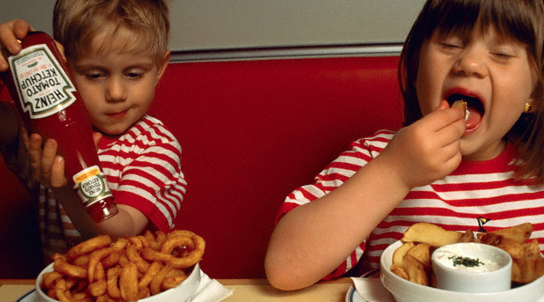
The biggest problem of fast food is that it's very easy to find and very accessible for kids; during childhood, they need healthy food, water or natural juice, not soda and fats

Slide 18
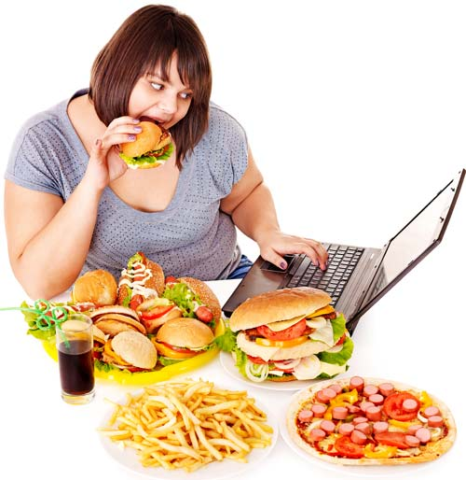
Fast food means empty calories in the body, stored as body fat. A regular meal at McDonald's (a Big Mac, large fries, and a large Coca-Cola) has 1430 calories. We need 2000 calories for an entire day

Slide 19
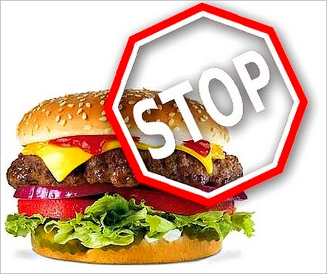
The bad side of fast food is that it has almost "zero" nutritious value.

Slide 20

Conclusion
It's clear that the fast food has more disadvantages than advantages. And if you want to have a slim figure and a glowing skin, you should limit the amount of junk food and eat only healthy food includes fruits and vegetables.

Slide 21
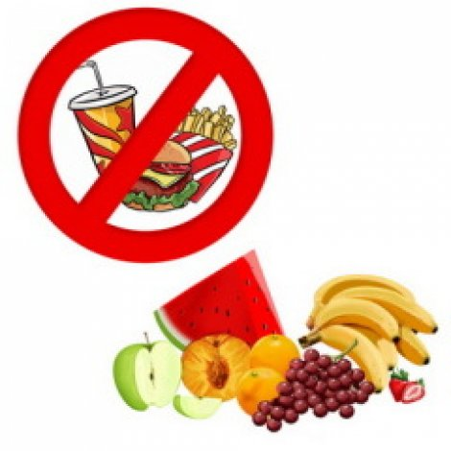
That's why we say "NO" to fast food.

Slide 22
Thank you for attention

