Slide 1
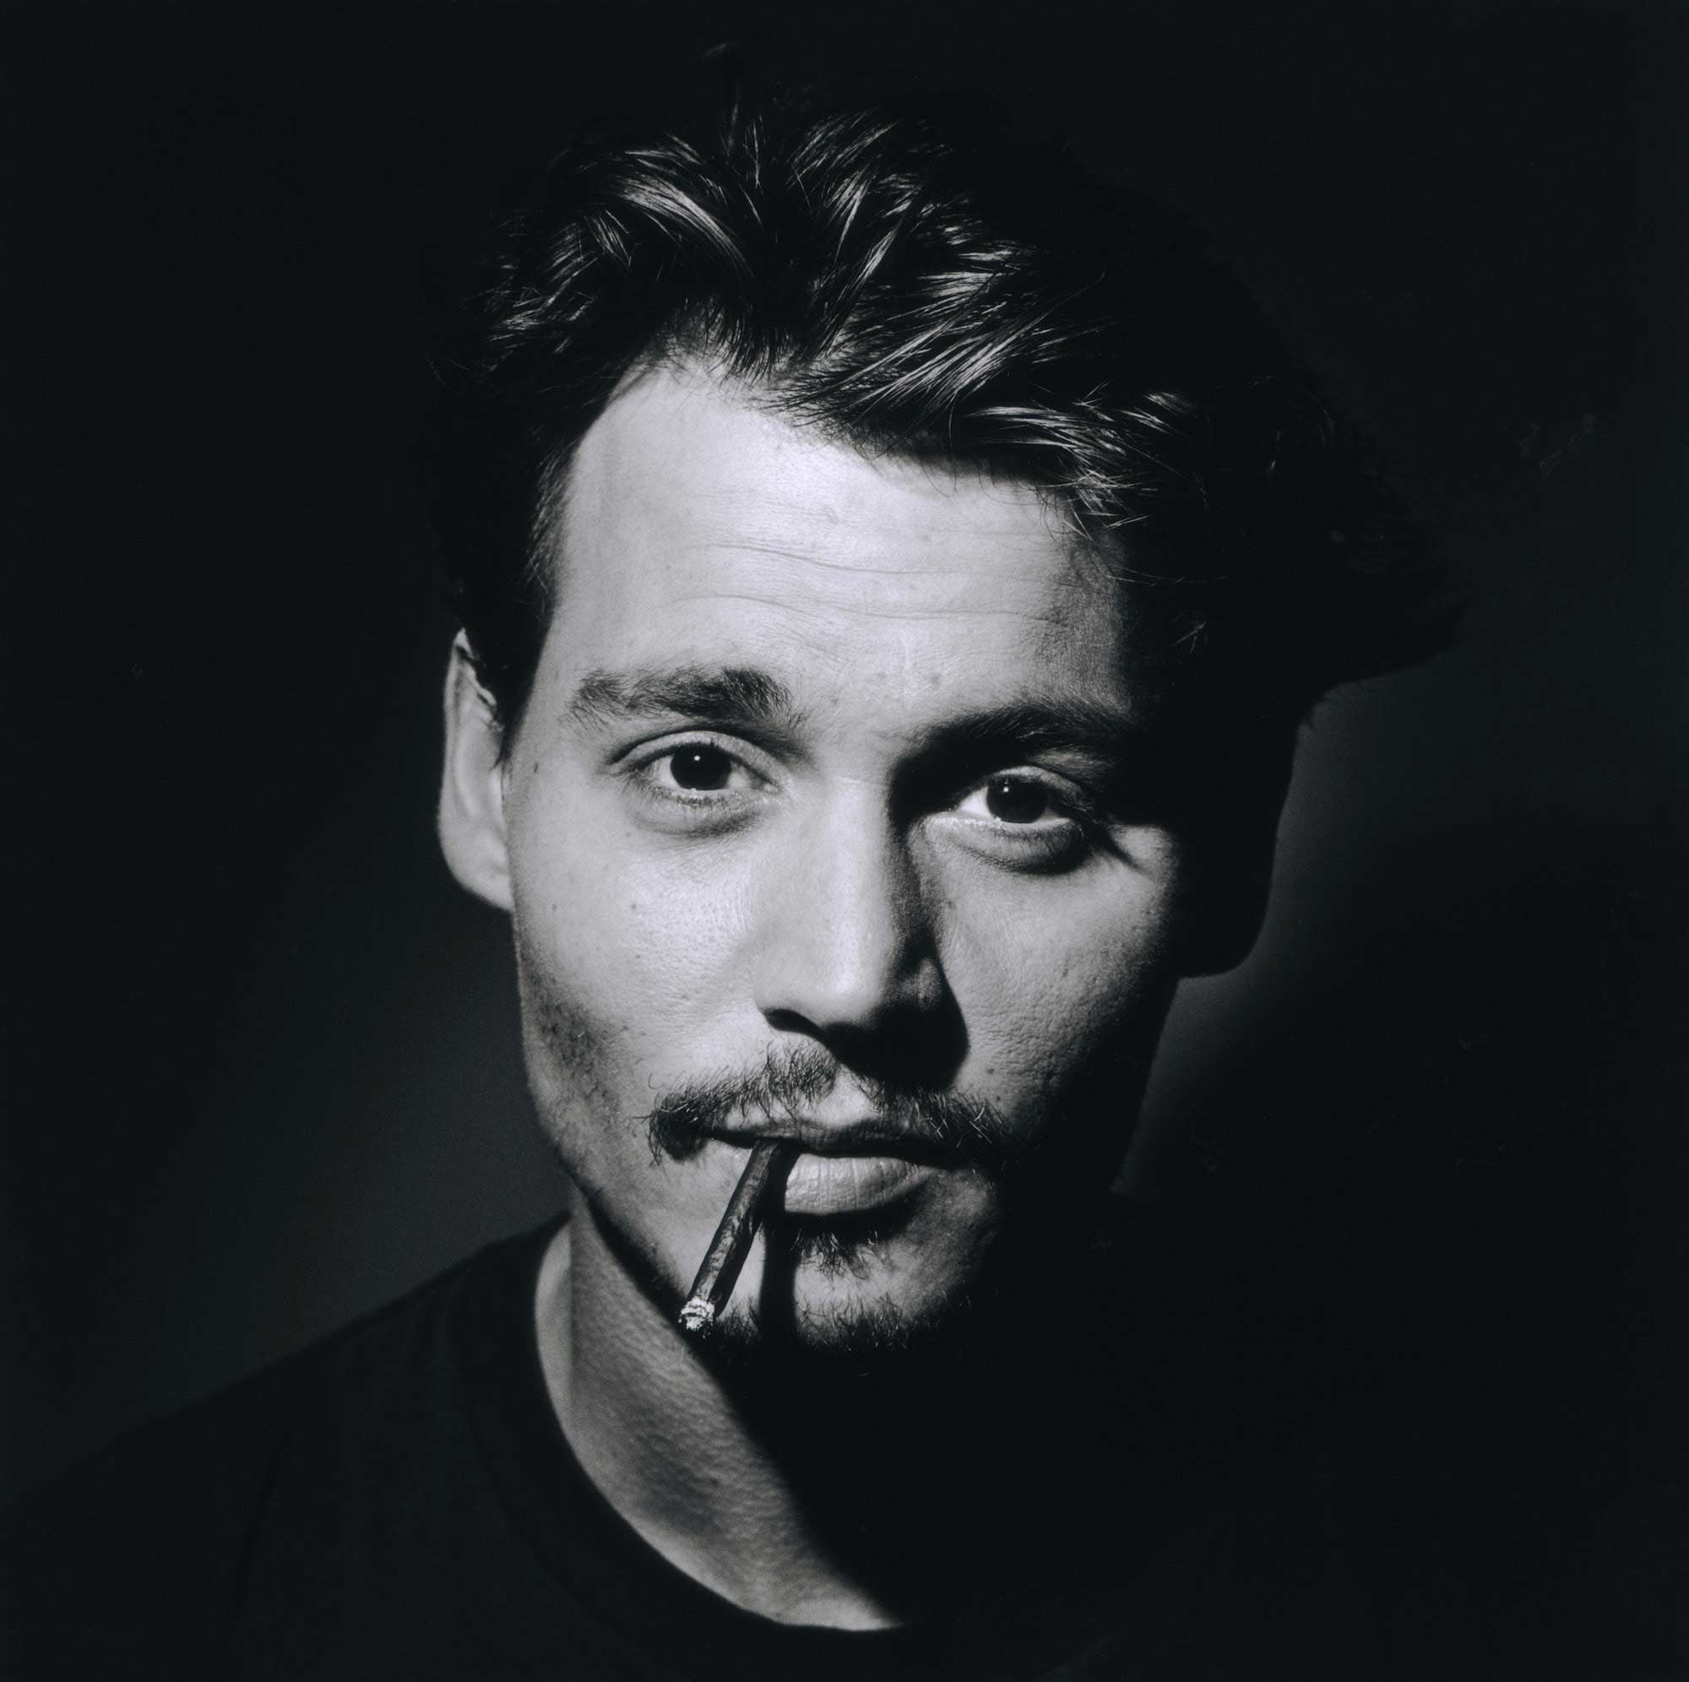
Johnny Depp

Slide 2
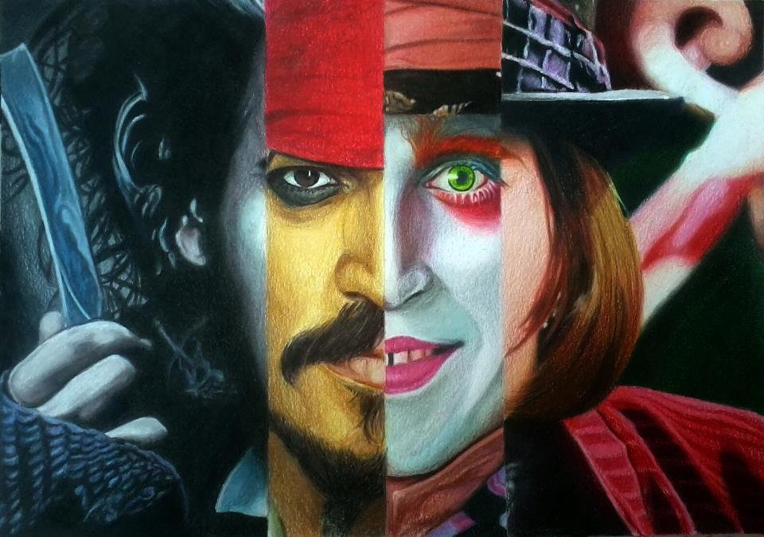
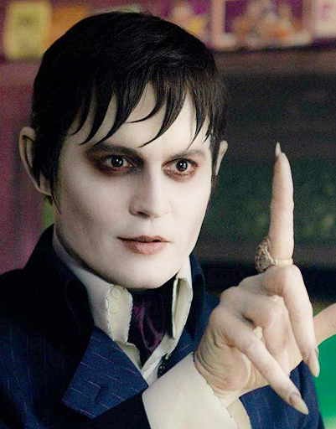
John Christopher "Johnny" Depp is an American actor, film producer, and musician.

Slide 3
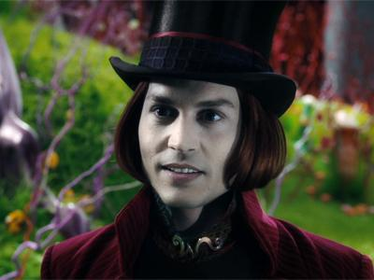
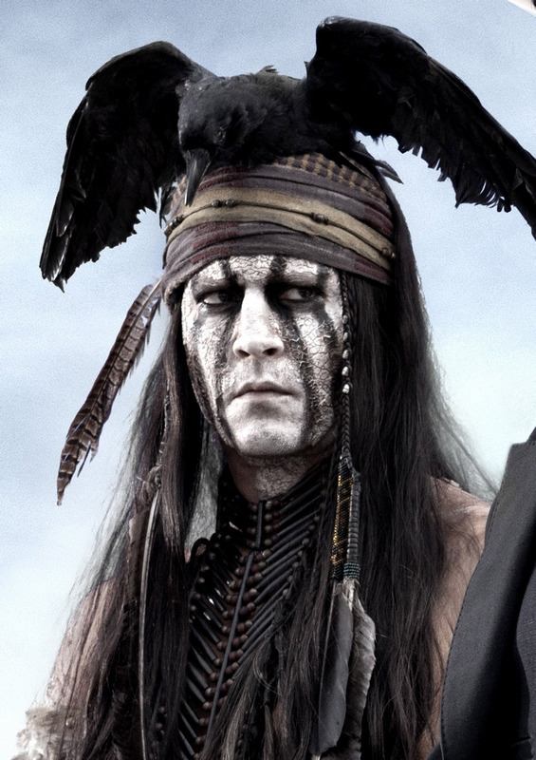
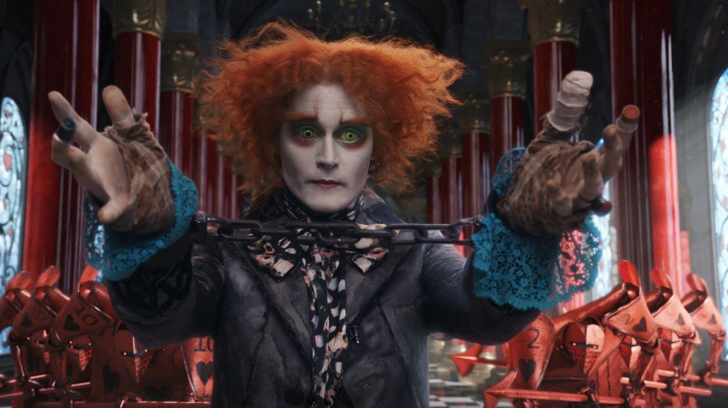
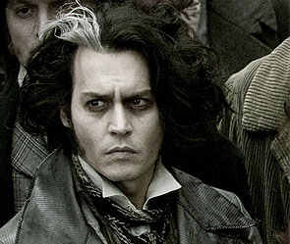

Slide 4
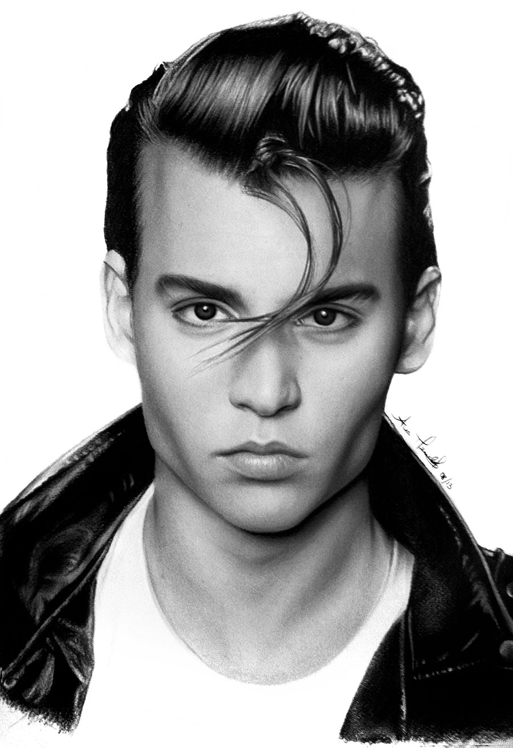
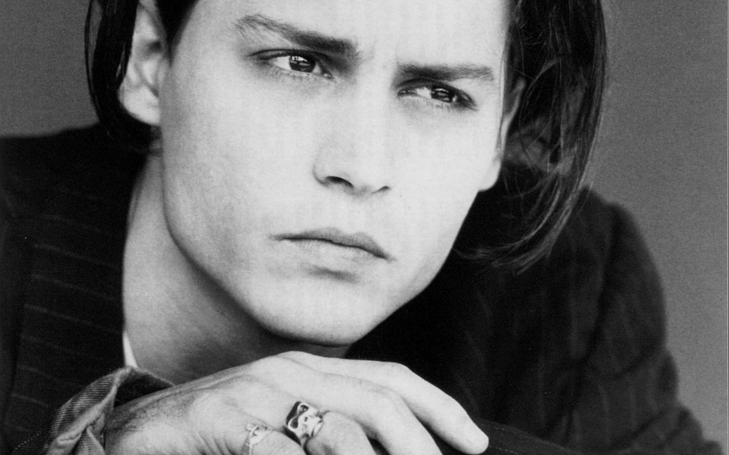
Depp was born in Owensboro, Kentucky in 1963, as the youngest of four children of Betty Sue Palmer, a waitress, and John Christopher Depp, a civil engineer.

Slide 5
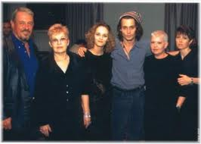
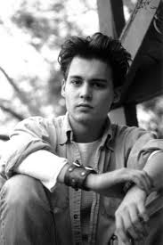
Depp moved frequently during his childhood, and he and his siblings lived in more than 20 different locations, settling in Miramar, Florida, in 1970. In 1978, when he was 15, Depp's parents divorced.

Slide 6
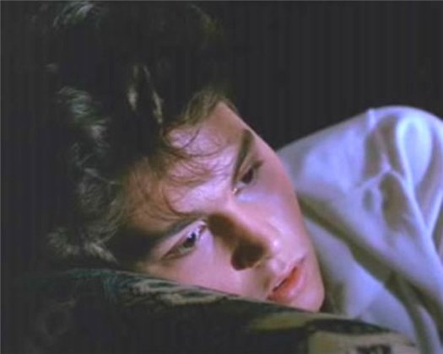
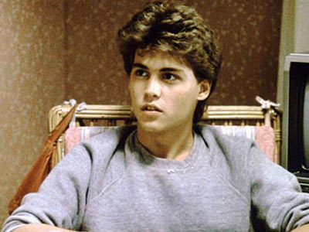
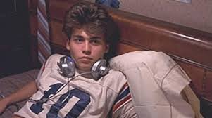
Depp's first major role was in the 1984 classic horror film "A Nightmare on Elm Street", playing the boyfriend of the heroine, Nancy Thompson (played by Heather Langenkamp) and one of Freddy Krueger's victims.

Slide 7
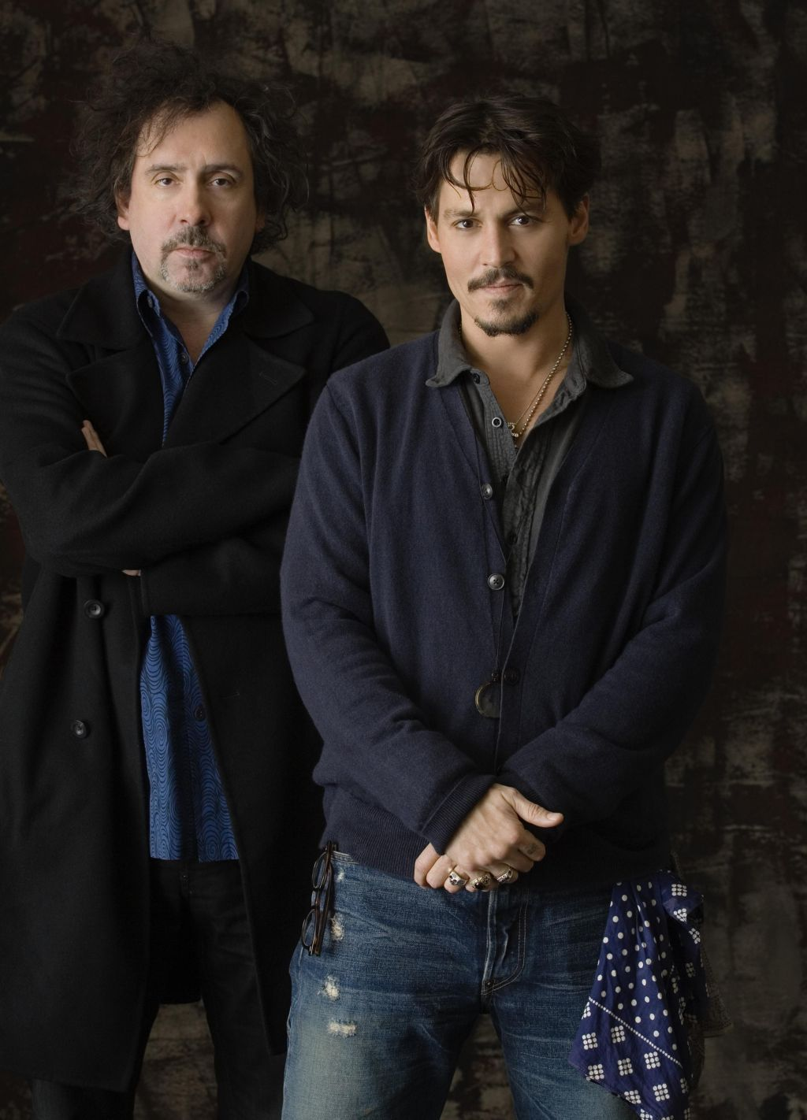
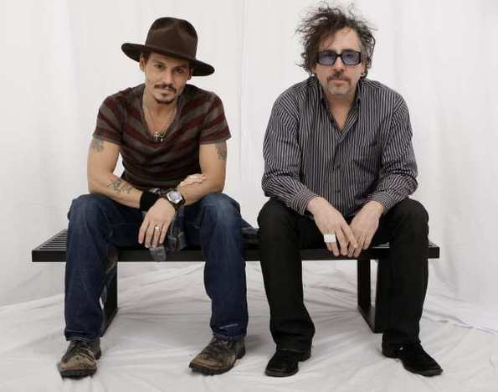
Depp has collaborated with director and close friend Tim Burton in film.

Slide 8
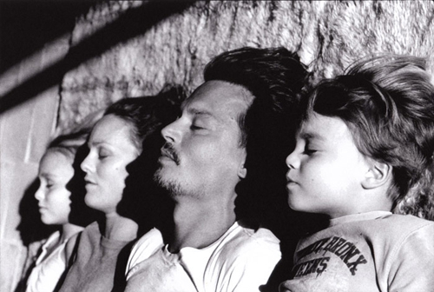
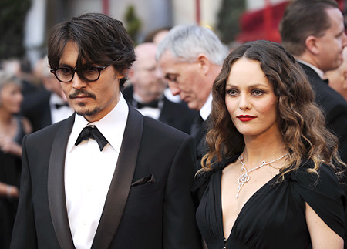
Іn 1998, Depp met the French singer and actress Vanessa Paradis and moved to France. The couple have two children - daughter Lily-Rose Melody (27 May 1999) and son Jack John Christopher III (April 9, 2002).
June 19, 2012 Depp publicist made ​​a statement that Depp and Paradis split

Slide 9
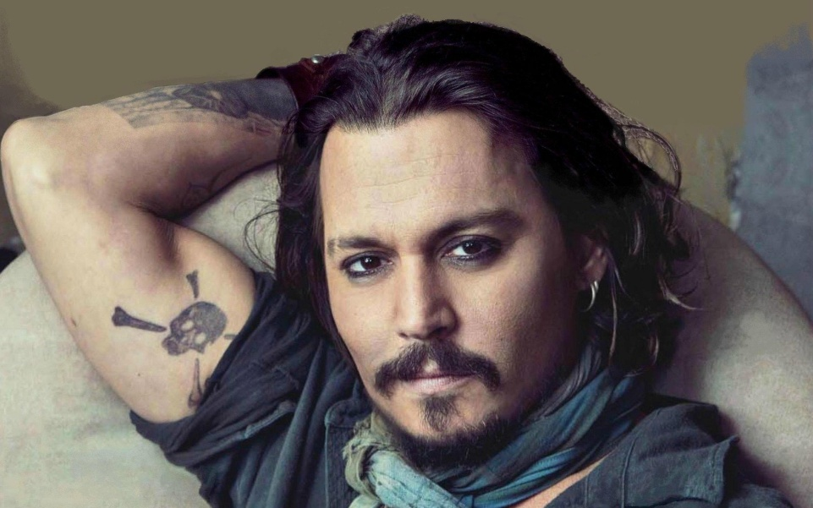
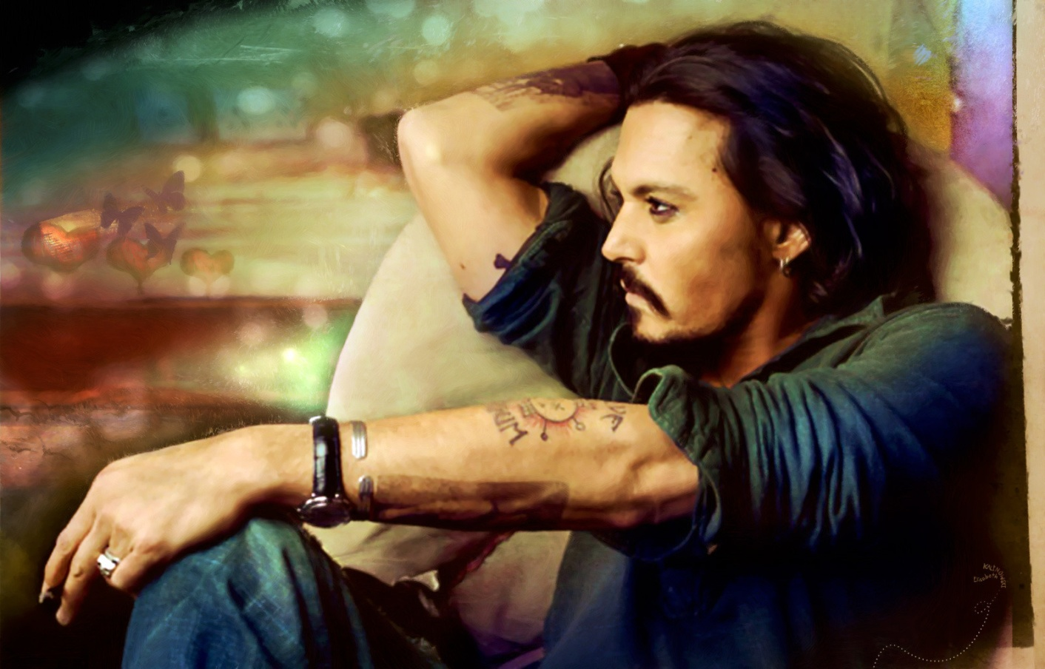
Depp has around 13 tattoos, many of them signifying important persons or events in his life.

Slide 10
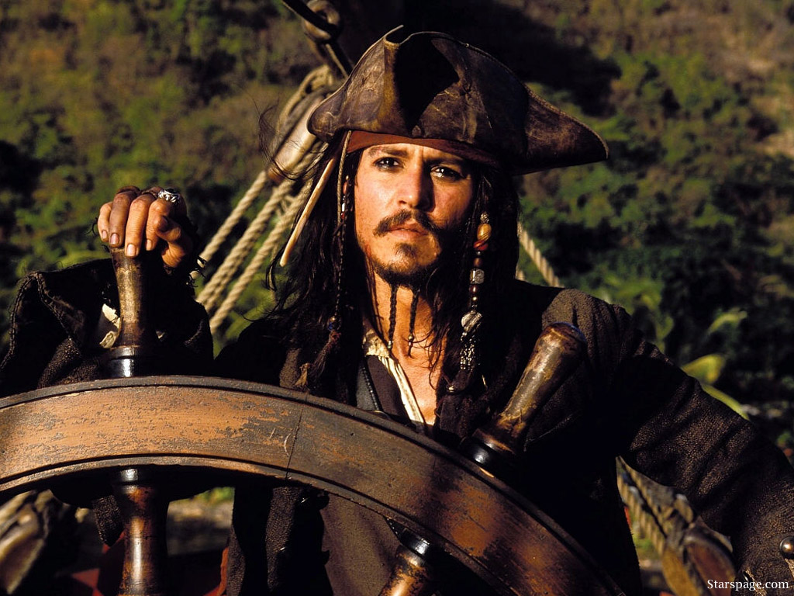
For the role of Jack Sparrow in the fourth part of "Pirates of the Caribbean" Johnny Depp received 55.6 million dollars - a record fee in the history of Hollywood.

Slide 11
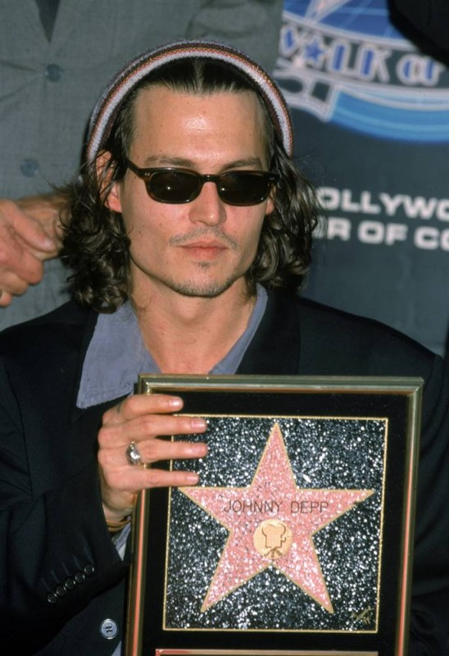
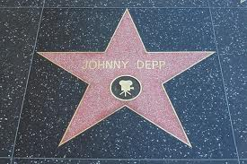
Johnny Depp has a number of star names on the 7018 Walk of Fame in Hollywood, opened November 16, 1999.

Slide 12
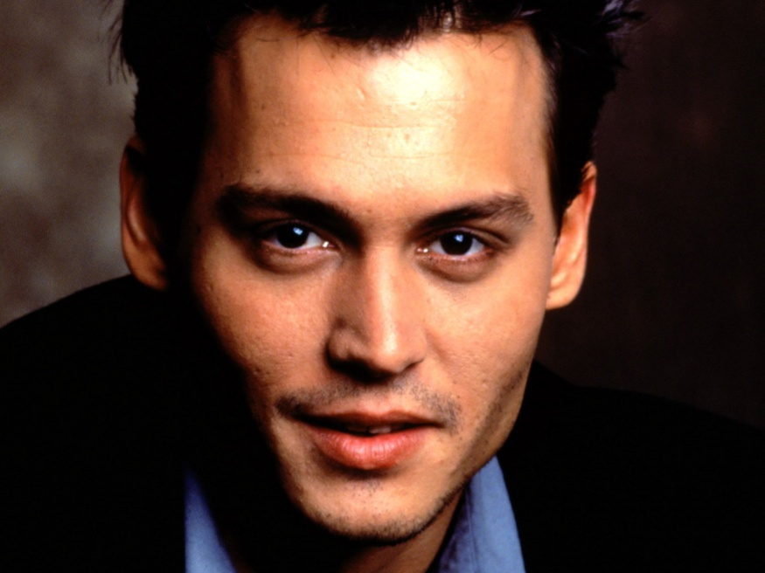
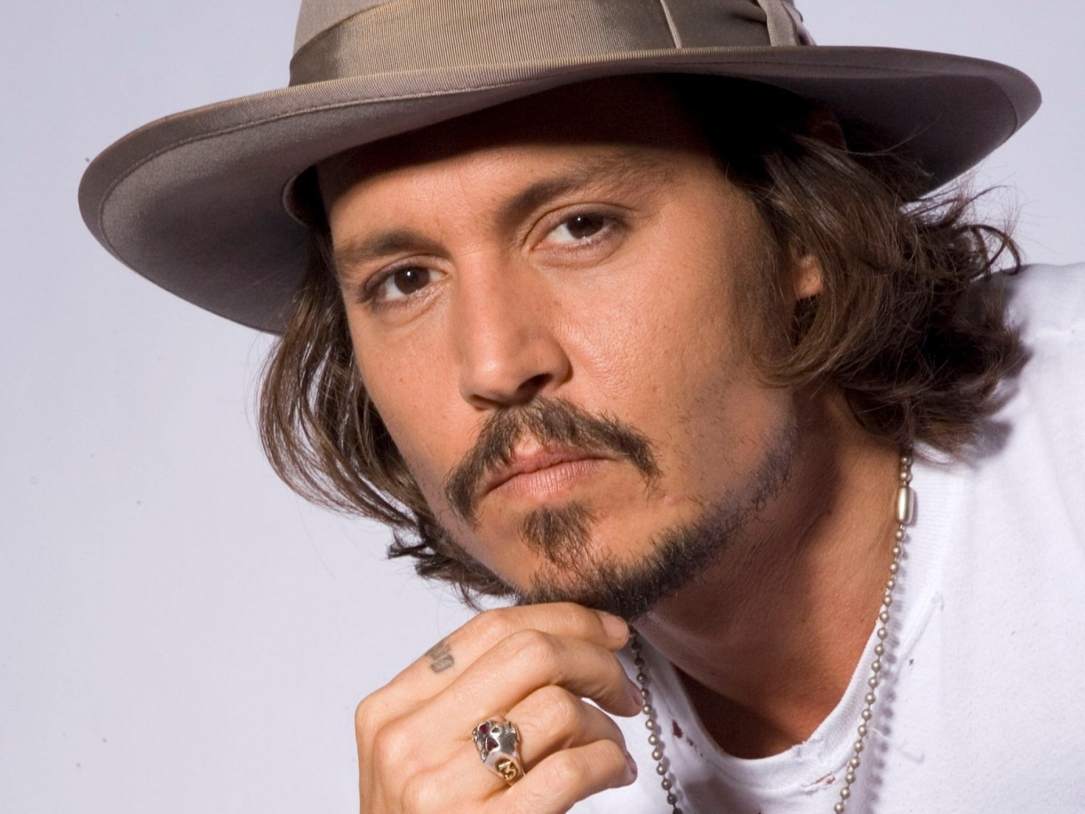
Johnny Depp - is an intelligent and creative personality. He is a wonderful actor and a good friend, musician, tried to write ...... he has a lot of talent. Over the years, Depp becomes more interesting and full of inspiration for new work.

Slide 13
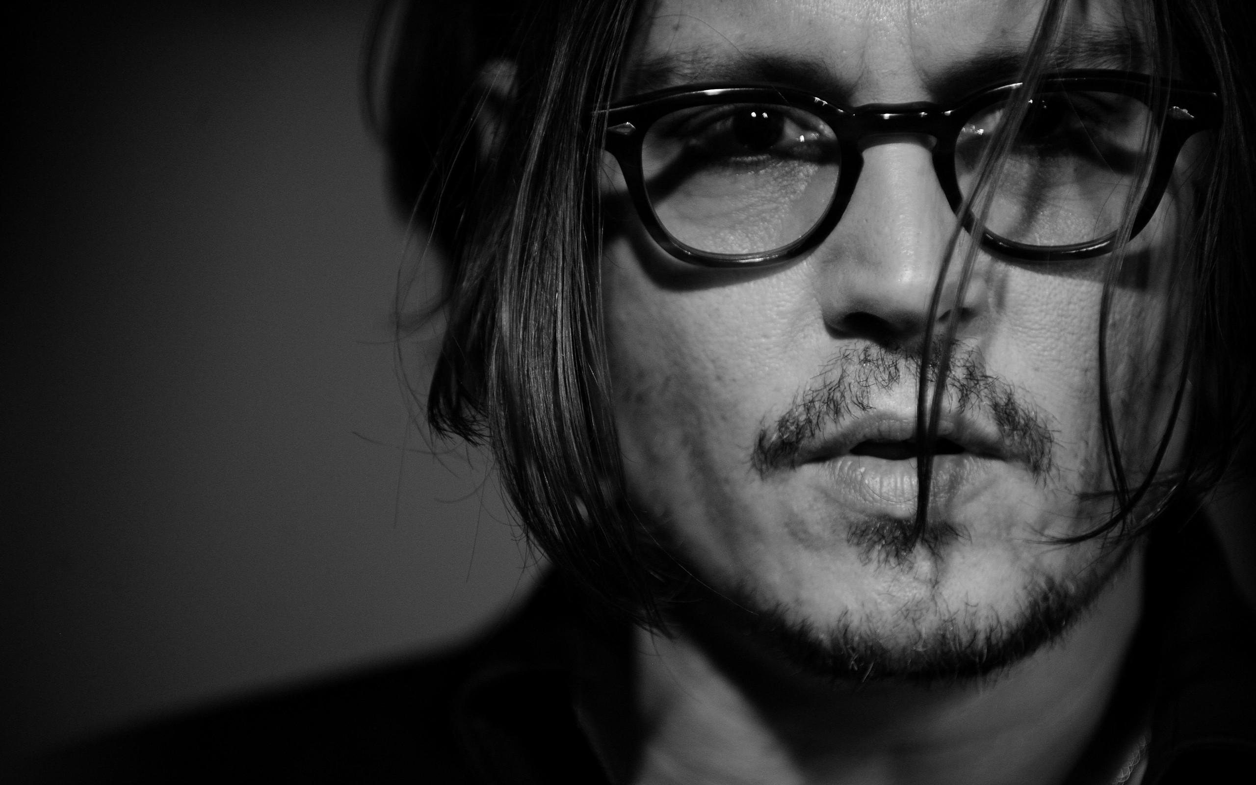
Thank you for your attention!

