Slide 1
Famous persons in the uk
Presentation prepeare
Pupil of 11 group
Vlad Muzychenko

Slide 2
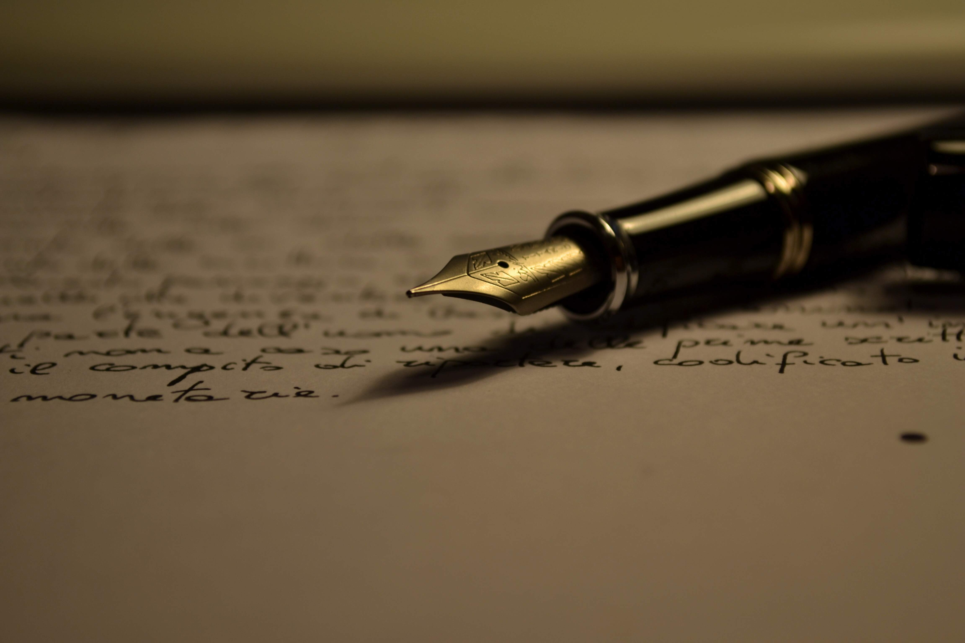
Enter
Great Britain made a great contribution to the science, literature, music and arts of the world.
It gave mankind a lot jf outstanding scientists, writers and poets, muzicians and painters.

Slide 3
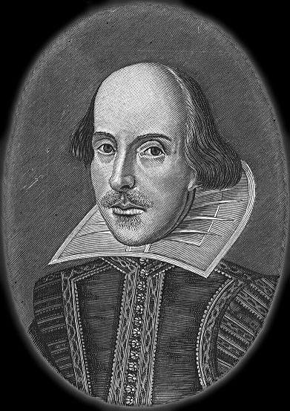
POETS
I shure, you know about William Shakespeare. He is one of the most famous writrs in the world.
His plays were translated almost every language and staged in every theatre.
TOP 5 the best plays:
“ Romeo and Juliet “
“ Hamlet, the Prince of Denmark “
“ Tina Andronica ”
“ King Lear “
“ Mcbeth “

Slide 4
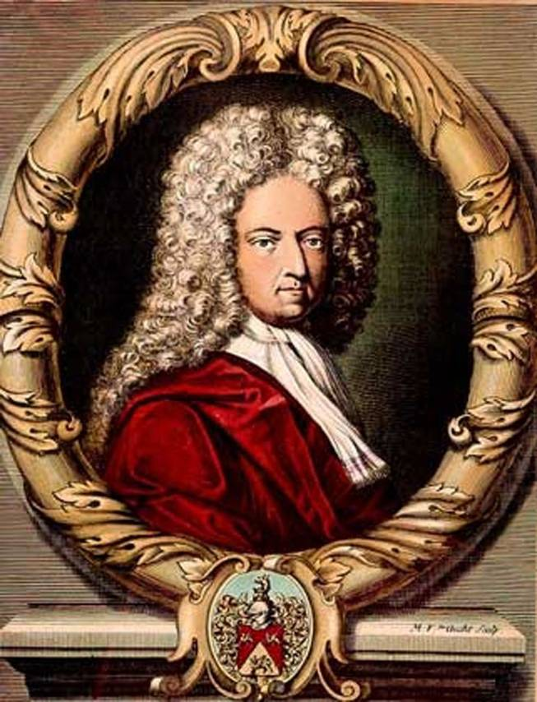
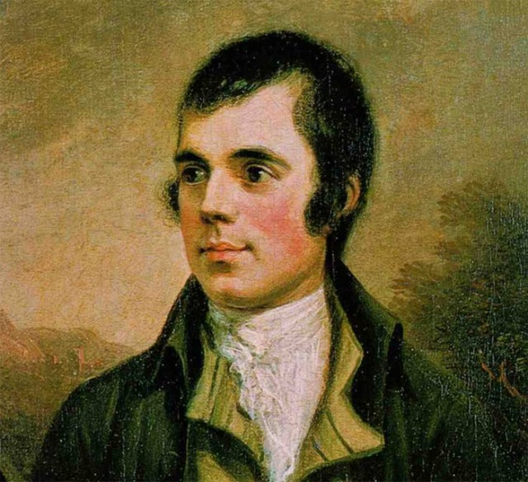
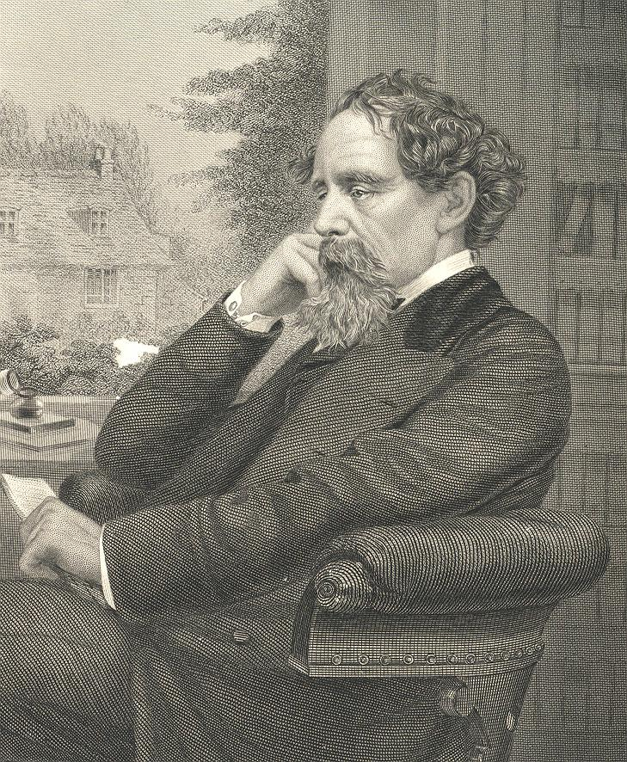
Other poets
Daniel Defoe, Robert Burns, Charles Dickens are only few names well-known all over the world.

Slide 5
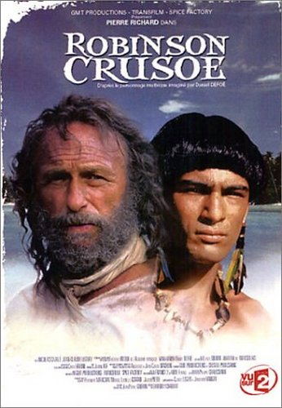
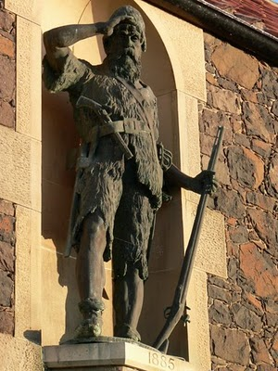
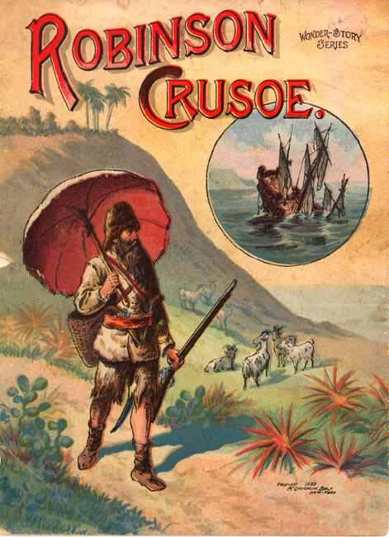
Daniel defoe
Daniel Defoe was born in 1660. He wrote the adventure story “ Robinson Crusoe “ in 1719 , which is about a sailor who lived on the uninhabited island for a long time.

Slide 6
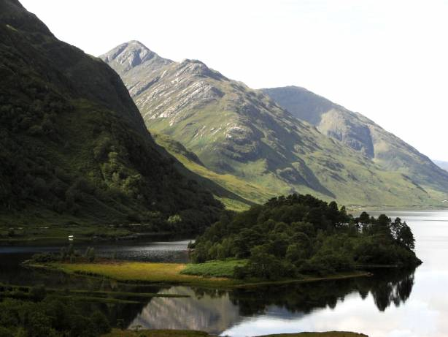
Robert burns
Robert Burns is the world famous Scotish poet. He wrote a poem “ My heart in the Highlands “ , in which he expressed his love to his native Scotland.
Now you can to read this poem:
My heart's in the Highlands, my heart is not here,
My heart's in the Highlands a-chasing the deer -
A-chasing the wild deer, and following the roe;
My heart's in the Highlands, wherever I go.
Farewell to the Highlands, farewell to the North
The birth place of Valour, the country of Worth;
Wherever I wander, wherever I rove,
The hills of the Highlands for ever I love.
Farewell to the mountains high cover'd with snow;
Farewell to the straths and green valleys below;
Farewell to the forrests and wild-hanging woods;
Farwell to the torrents and loud-pouring floods.
My heart's in the Highlands, my heart is not here,
My heart's in the Highlands a-chasing the deer
Chasing the wild deer, and following the roe;
My heart's in the Highlands, whereever I go.

Slide 7
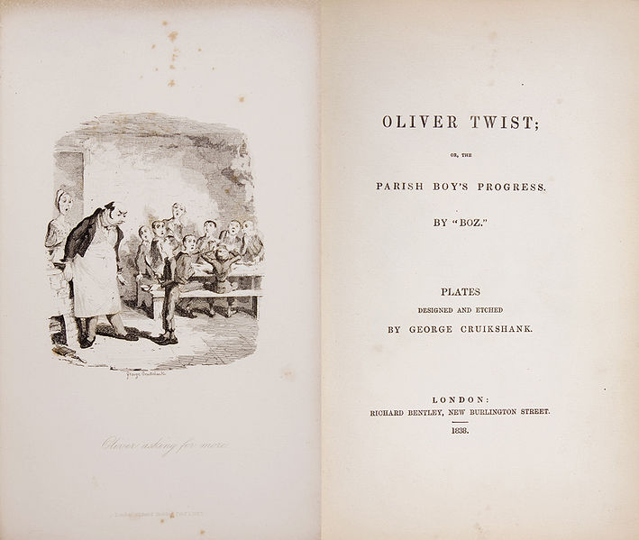
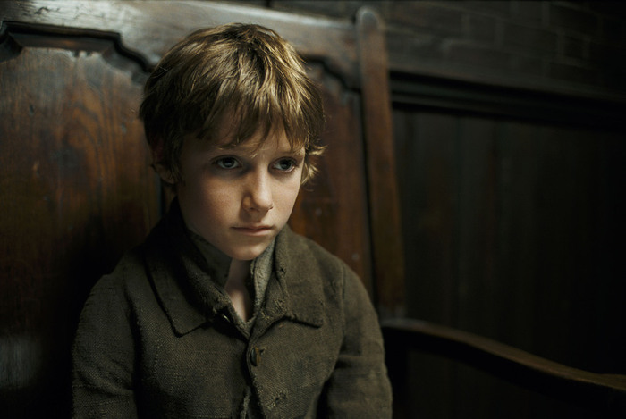
Charles Dickens
Charles Dickens was born in 7 February 1812 in Landport. He wrote the “ Adventures of Oliver Twist “ in 1837.

Slide 8
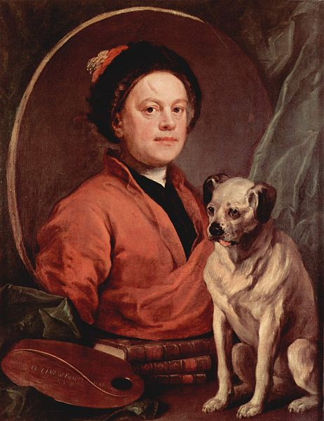
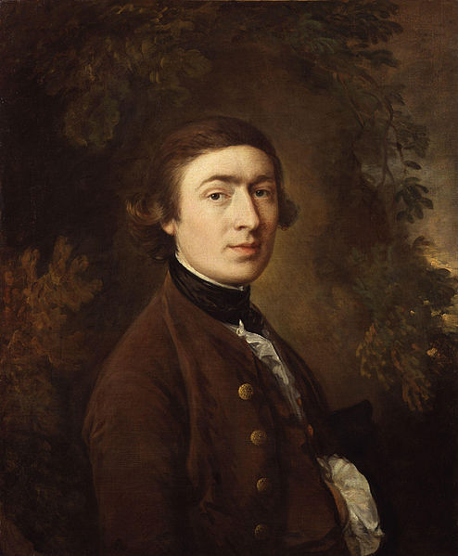
Painters
William Hogarth, Thomas Gainsborough contributed to the world’s pinting treasures.

Slide 9
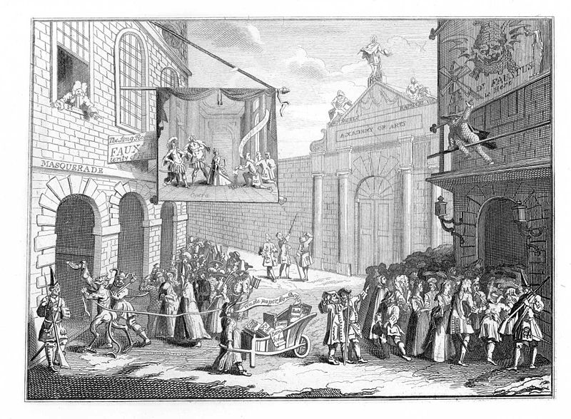
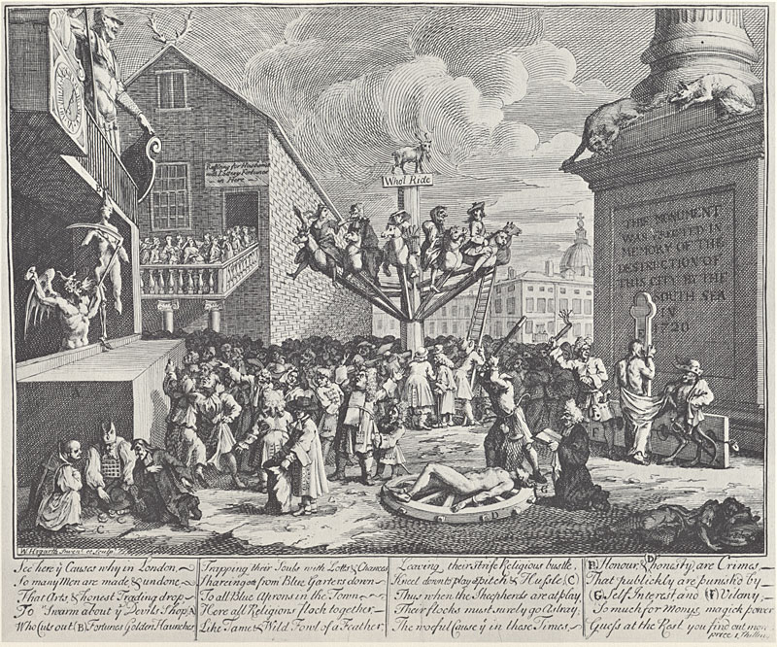
William Hogarth
William Hogarth painted many works such as:
Masquerades and Operas
The South Sea Scheme

Slide 10
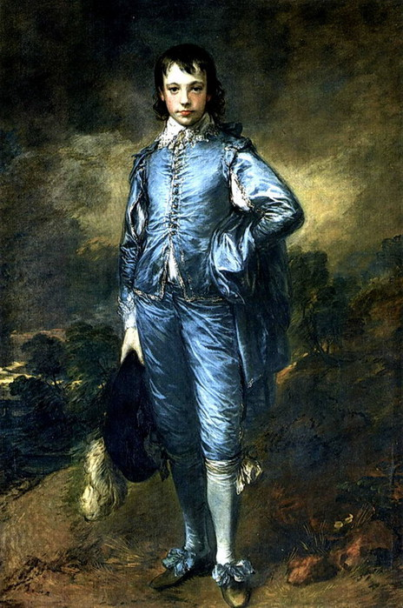
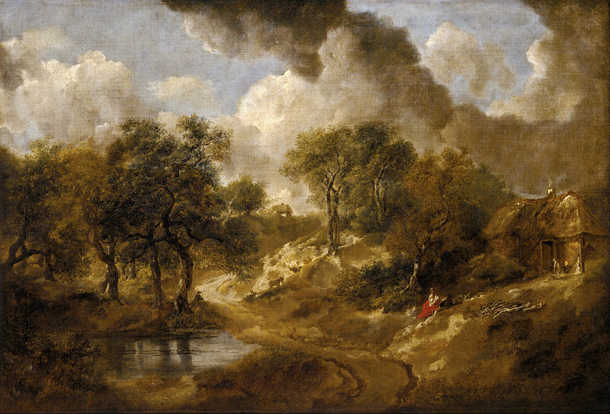
Thomas gainsborough
Thomas Gainsborough painted many works such as:
“ Blue boy “ “ Landscape in Suffolk ”

Slide 11
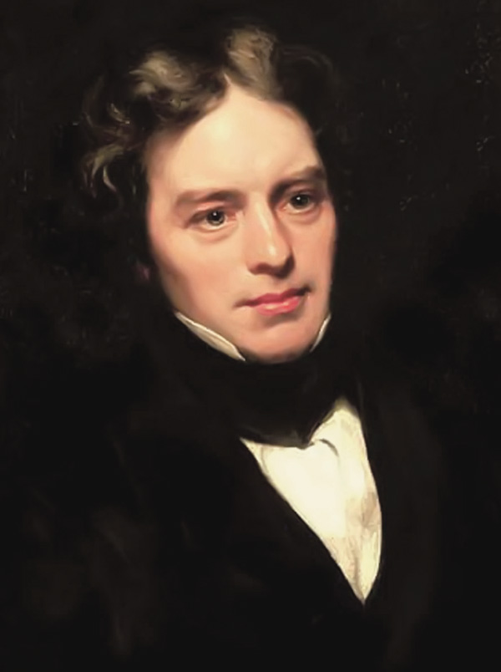
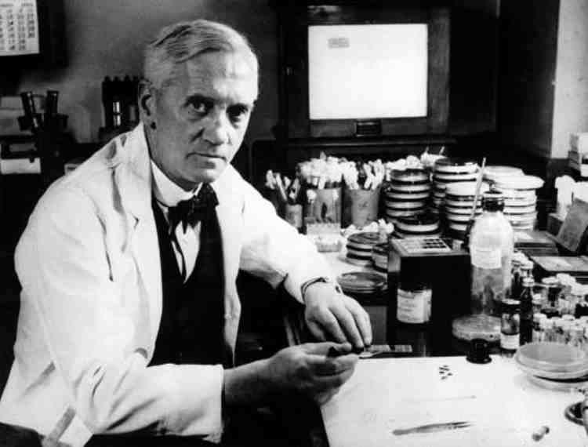
British scientists
The most famous British scientists, which made a great contribution in science are Alexander Fleming and Michael Faraday.

Slide 12
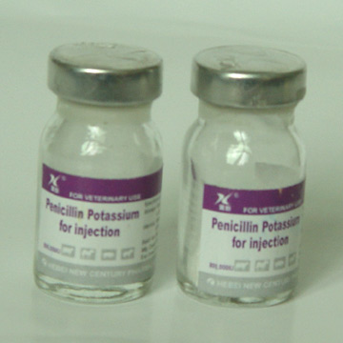
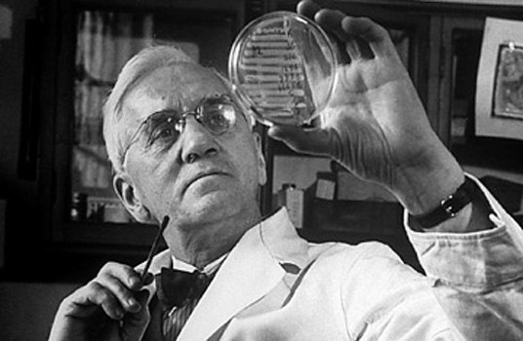
Alexandr Fleming
Alexandr Fleming – british bacteriologist.He discovered penicillin. Penicillin-first antibiotic.

Slide 13
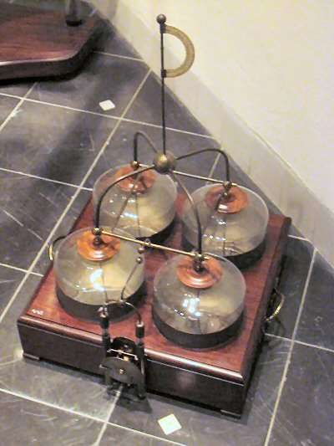
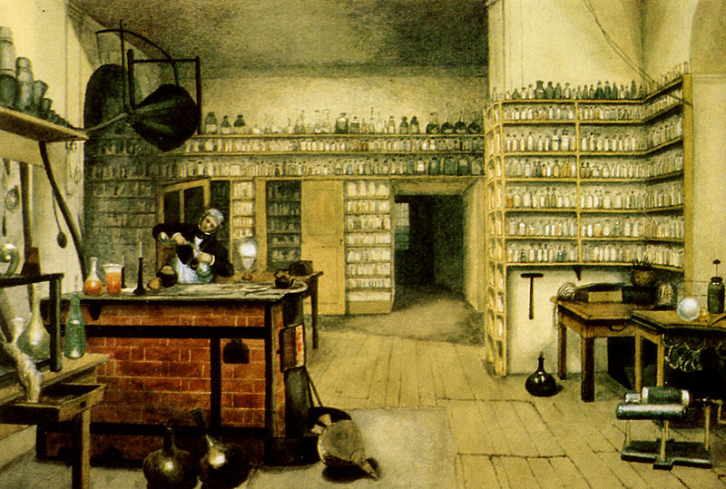
Michael Faraday
M. Faradey was born in 1791. He discovered electromagnetic induction, his major discovery in the field of electricity.
Leidse flessen

Slide 14

conclusion
Many outstanding people of Great Britain made a great contribution in the development of culture, science and arts.

