Slide 1

My favourite film
V for Vendetta

Slide 2
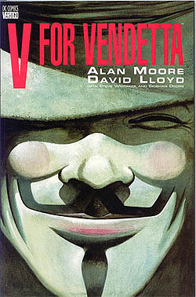
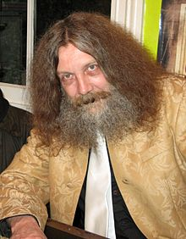
V for Vendetta is a graphic novel written by Alan Moore. The story depicts a future history of the United Kingdom in the 1990s preceded by a nuclear war in the 1980s, which has left much of the world destroyed, though most of the damage to the country is indirect, via floods and crop failures.

Slide 3
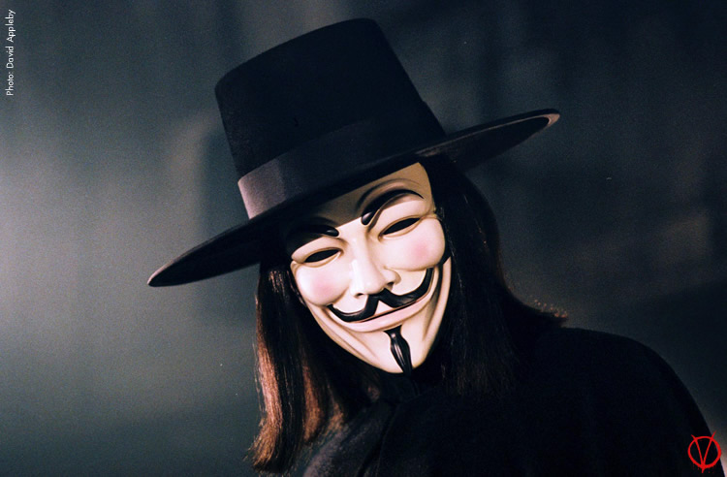
One night in London there is a freedom fighter known as V, which starts a guerrilla war with the regime in an attempt to return to people taken away his freedom. In this war, he draws on his side a young woman which he snatched from the clutches of the secret police.

Slide 4
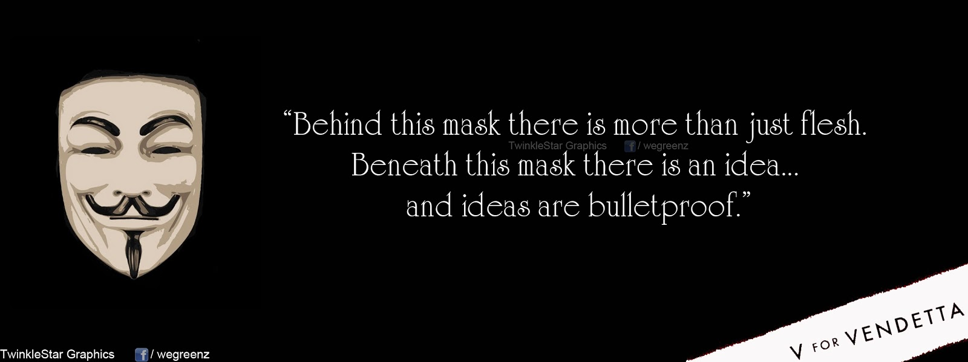
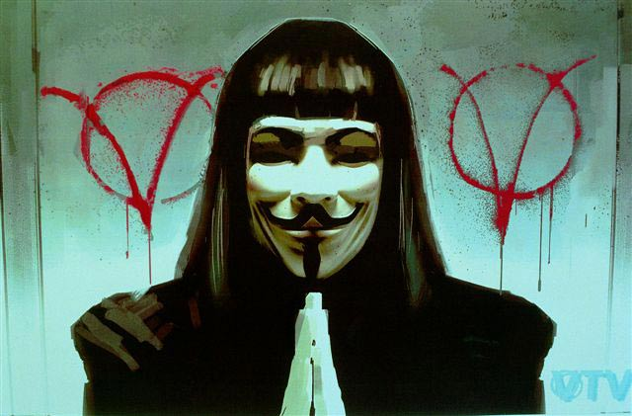

Slide 5


V - anarchist terrorist wearing a Guy Fawkes mask . Later it turns out that he is a former prisoner of the concentration camp , the only one of the group exposed to medications, which has survived by acquiring new structure thinking and sufficient time for reflection. Organized a revolt against the totalitarian regime.

Slide 6
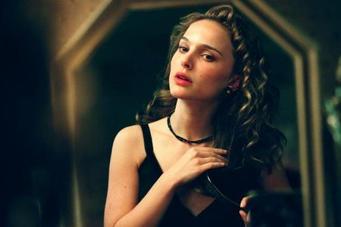
Evey

Slide 7
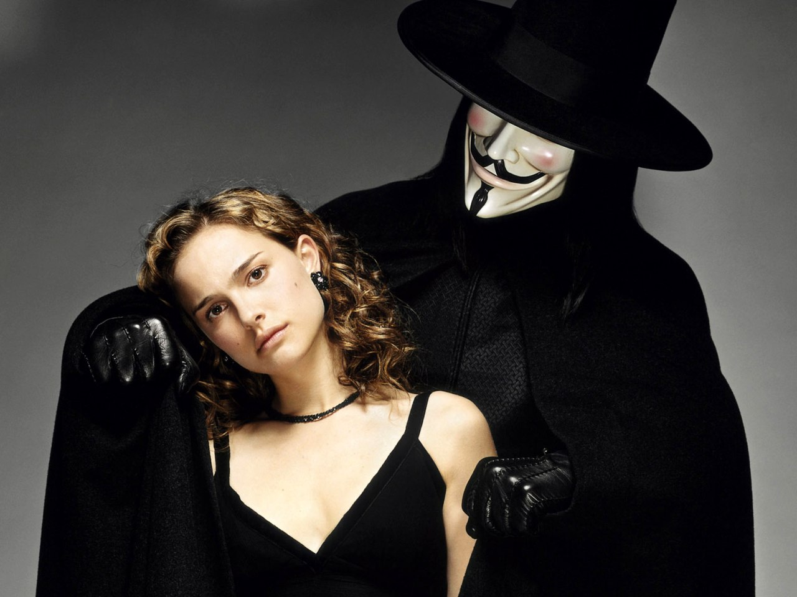

Slide 8
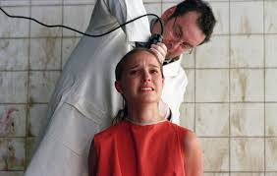

Slide 9
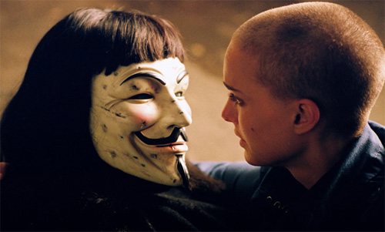
When Creedy executes Sutler, V refuses to surrender and is shot by Creedy's bodyguards. V survives and kills Creedy and his men, effectively decapitating the government. Mortally wounded, V returns to Evey to thank her and admits he loves her before dying in her arms.

Slide 10


V leaves Evey…

Slide 11
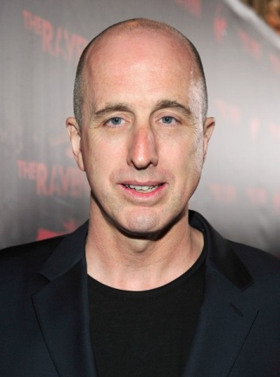
James McTeigue
(an Australian film director)

Slide 12
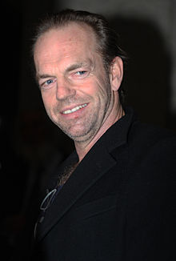
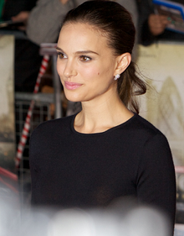
Hugo Weaving as V
Natalie Portman as Evey Hammond

Slide 13


Slide 14

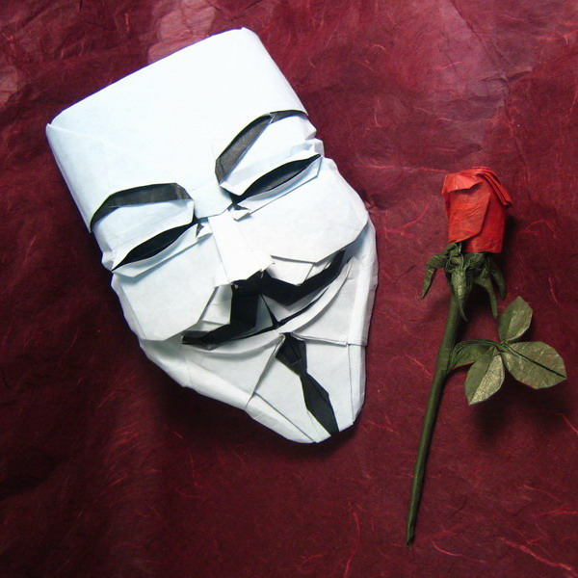

Slide 15
Julia Kolchag
Form 11-B

