Slide 1
Flora and fauna of Australia

Slide 2
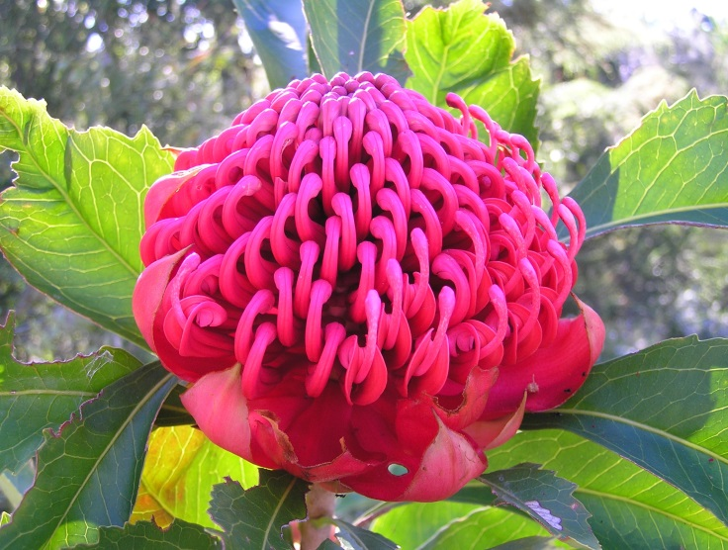
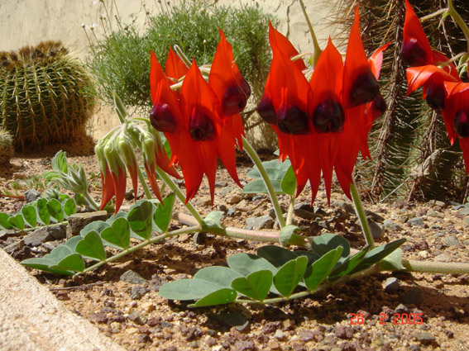
Plants include living fossils such as the cycad palm and the grass tree, and brilliant wildflowers such as the waratah, Sturt’s desert pea, banksia and kangaroo paws.
Waratah
Sturt’s desert pea

Slide 3
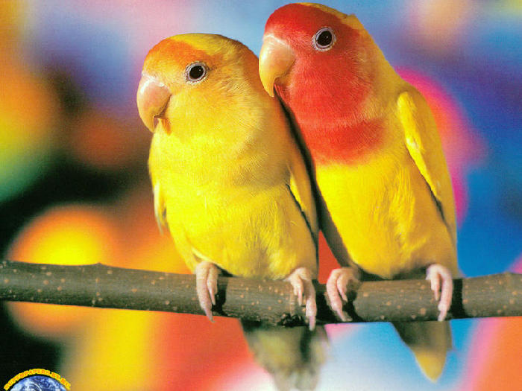
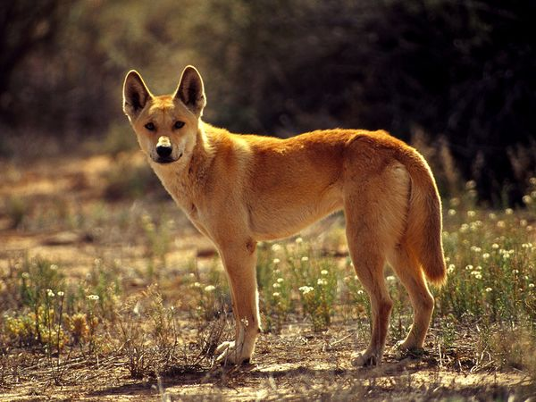
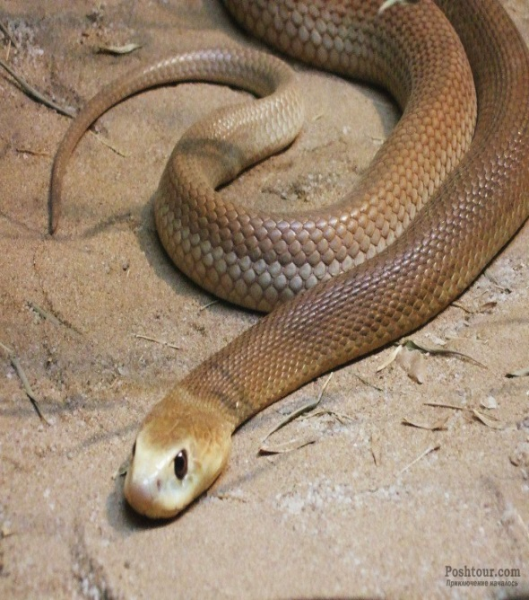
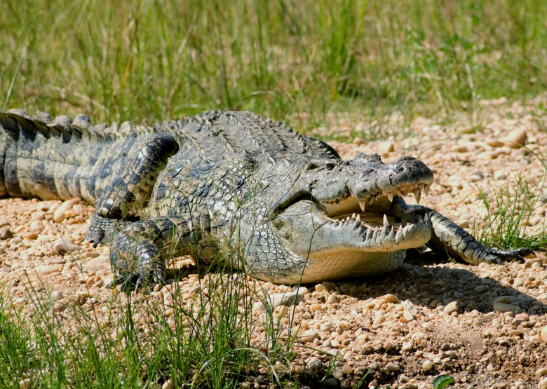
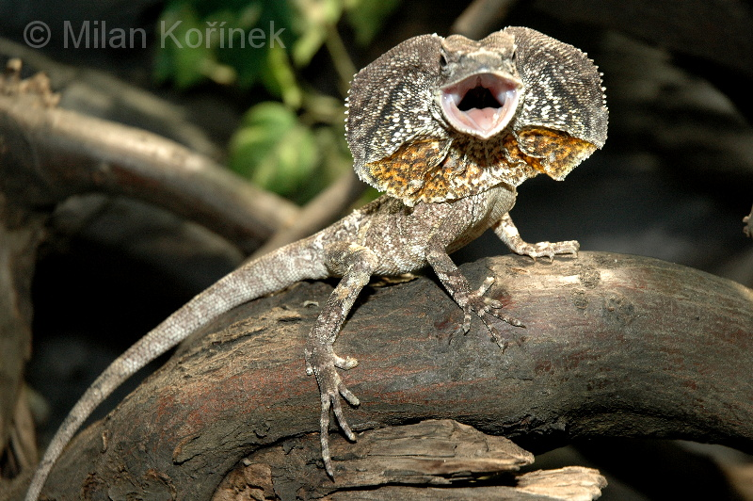
In Australia there are more than 378 species of mammals, 828 species of birds, 300 species of lizards, 140 species of snakes and two species of crocodiles.

Slide 4
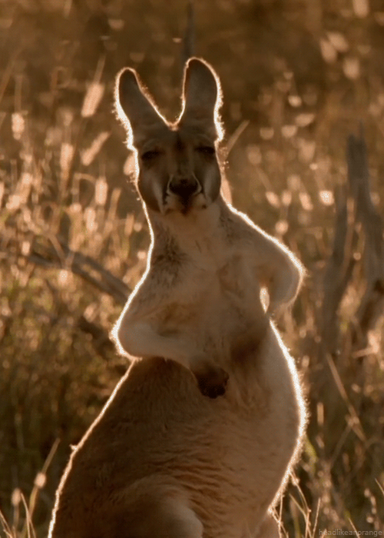
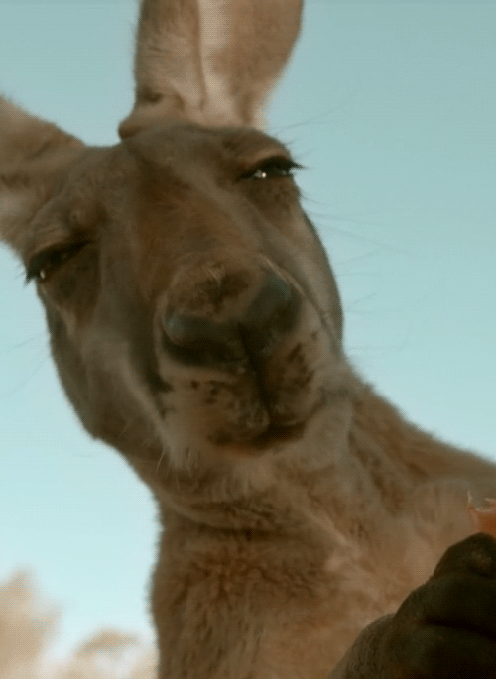
Kangaroo is an unofficial symbol of Australia

Slide 5
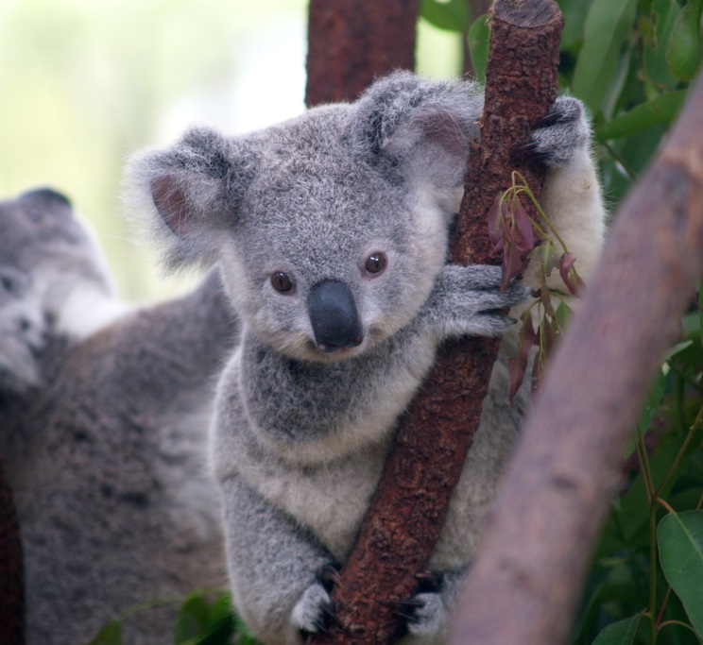
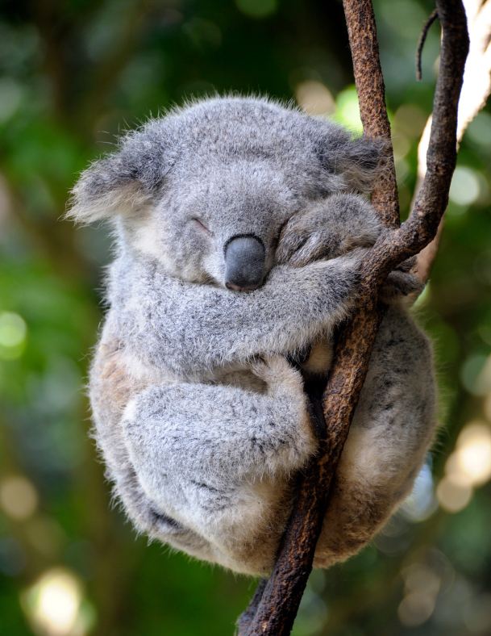
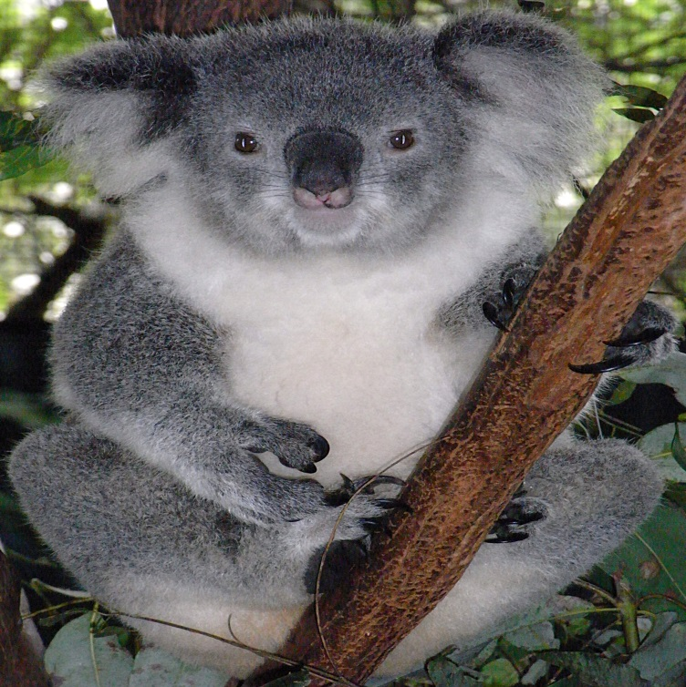
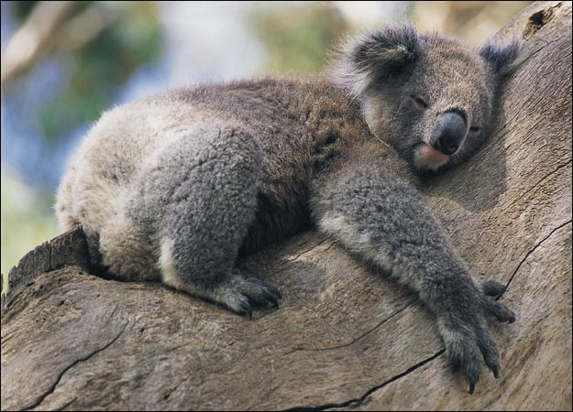
Koala is is a marsupial bear inhabit the forests of eastern Australia.

Slide 6
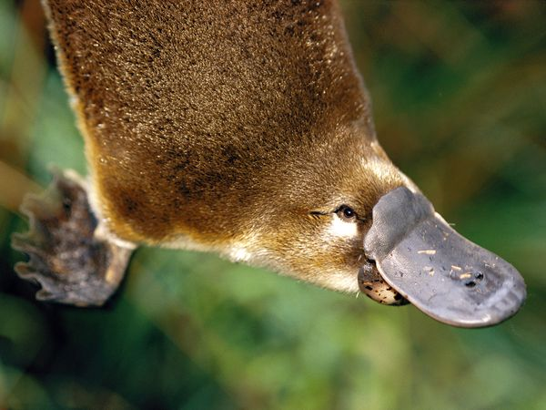
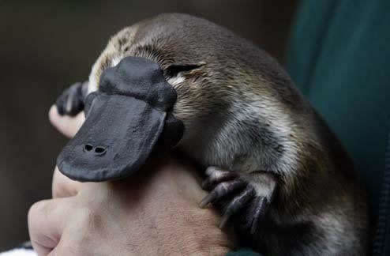
Platypus is called a God’s joke

Slide 7
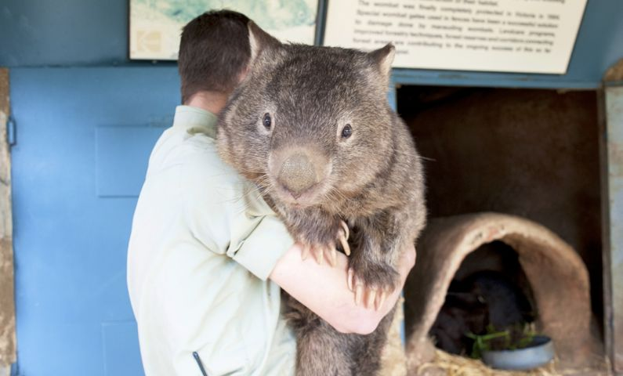
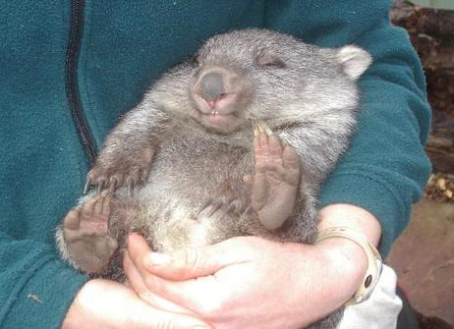
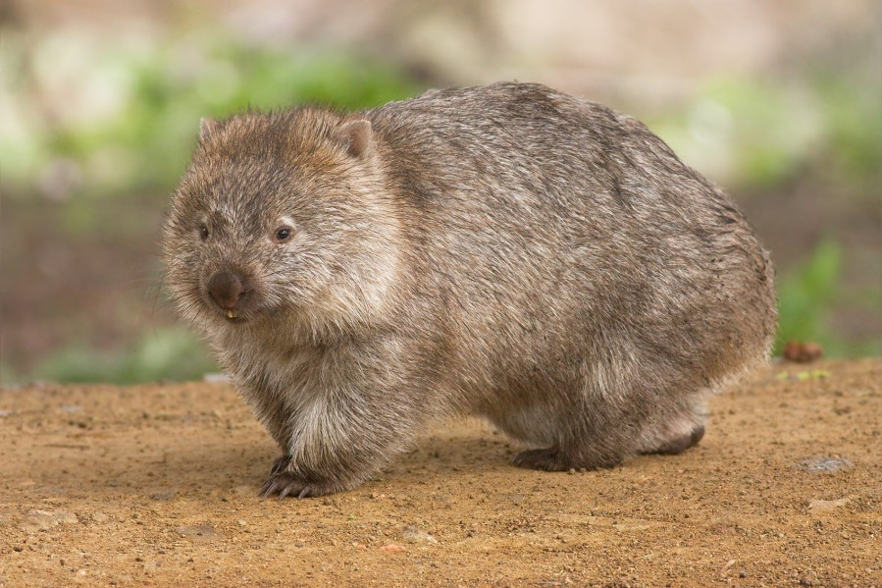
Wombat

Slide 8
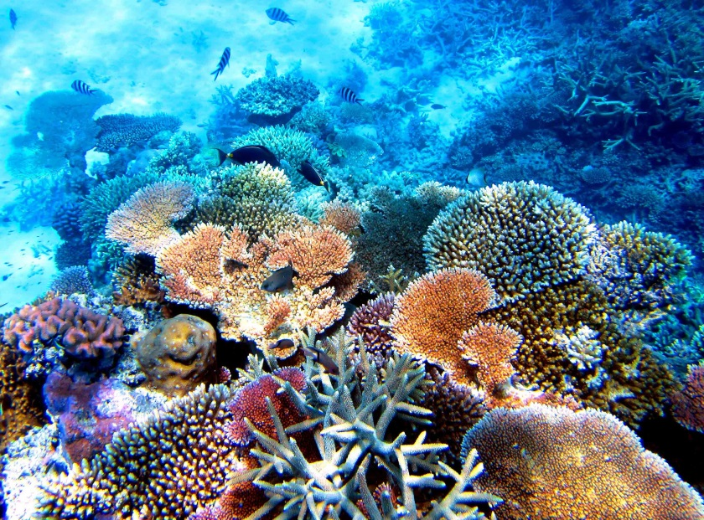
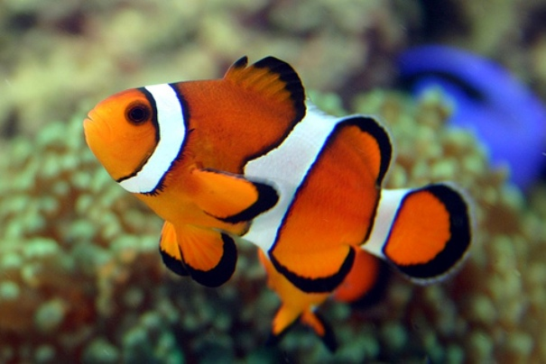
Australia’s diverse oceans support around 4000 of the world’s 22 000 types of fish. Australia is also home to the world’s largest coral reef system.
Clownfish

Slide 9
Thanks for your attention

