Slide 1
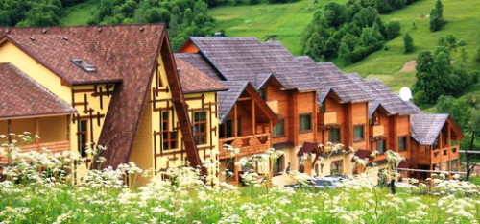
Готельно ресторанний комплекс
‘В Кума’

Slide 2
Список залів:
1. Перший зал
2. Другий зал
3. Третій зал
4. Четвертий зал
5. Зал народної символіки
6. Готель

Slide 3
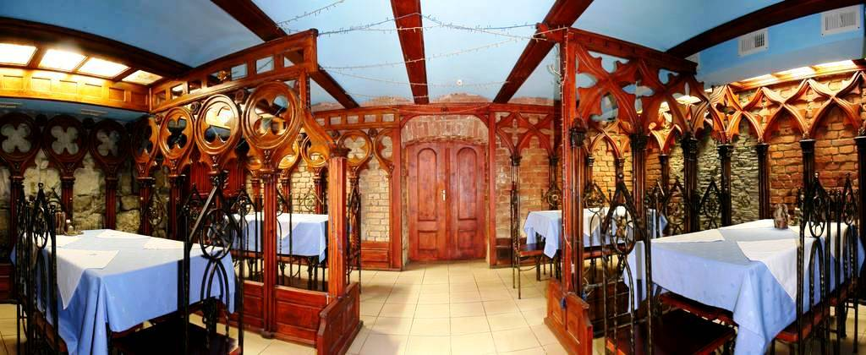
First hall
First-with strict columns, caps and arches made from a natural tree in baroque. It is a hall for smoking. He discounted on 24 landings places. Here after delicious dinner.You will be able to revise the favorite musical and sporting programs.

Slide 4
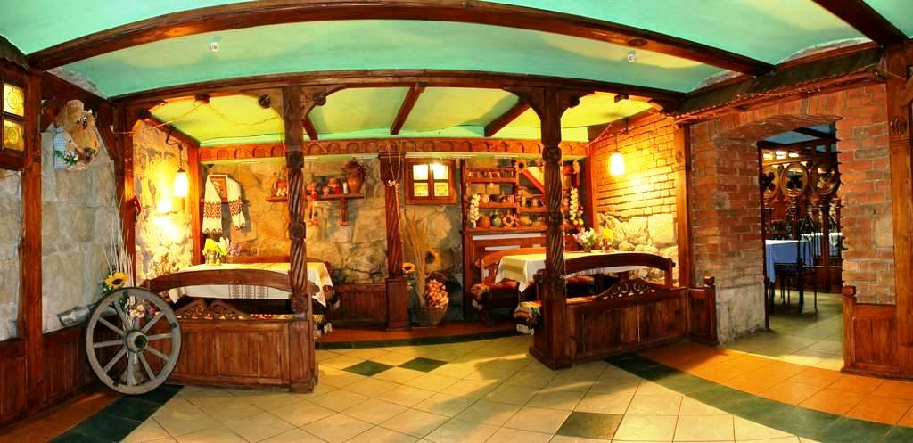
Second hall
The second hall is a folk interior, by the embroidered towels and clay tableware. Part of this room under a ball-room, where under Ukrainian folk music, and music of modern folk performers you can dance in the circle of friends and acquaintances.

Slide 5
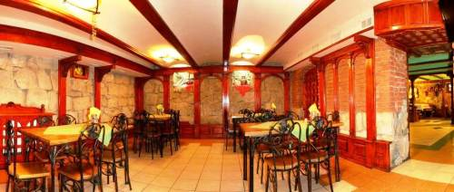
Third hall
Third hall executed in a gothic that on reflections and tender romantic conversation. This hall is the favorite of falling in love of pairs and old friends it always will that about what talk.

Slide 6
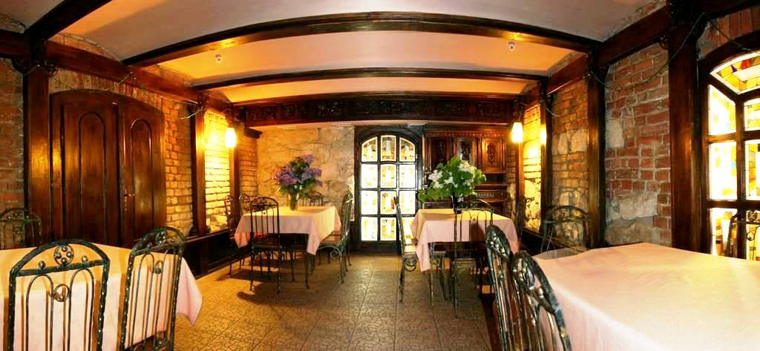
fourth hall
Opening ancient doors with a subzero arch, inclining chairman, you get in a fourth hall with designer creations from a tree, by large windows with stained-glass window sand metallic decoration.

Slide 7
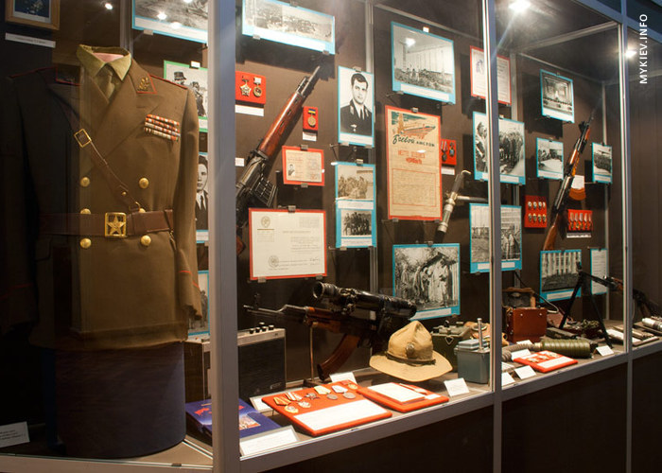
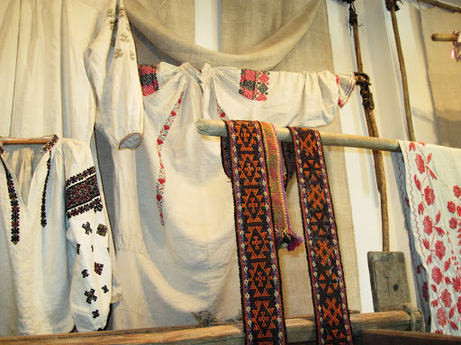
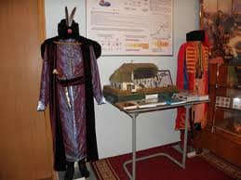
Hall of folk symbolic

Slide 8
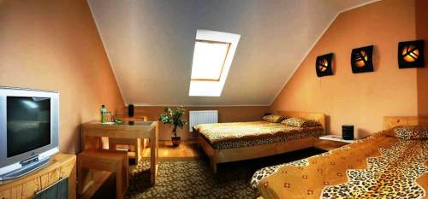
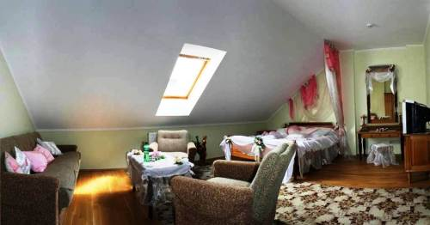
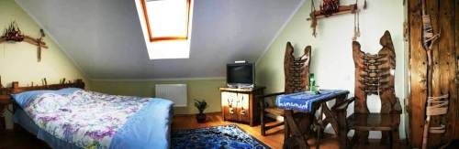
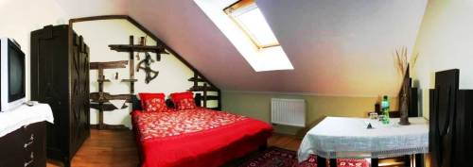
Hotel
4 numbers of doubles, one-room
3 numbers of four bed, one-room;
1 numbers double, one room
1 number four bed , two room
In every number : a doubles bed, table, two arm-chairs, closet, is for a clothing, satellite TV, refrigerator, bathroom from: rest room, shower, washstand; hair dryer, 4 towels; nicely, shampoo, shower gel.

