Slide 1

MAFIA
– my favourite restaurant

Slide 2
Situation
MAFIA is situated in the centre of Kyiv (in the downtown). It’s an expensive restaurant, so I went there with my friends.

Slide 3
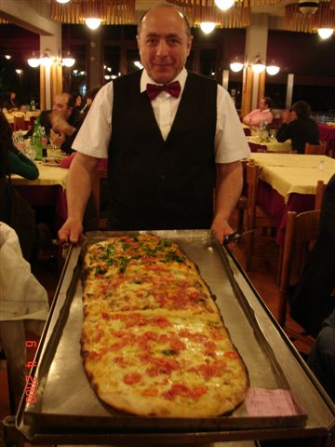
My favourite dish
My favourite dish in
MAFIA is the “Meter
Pizza” – a long and
very delicious Italian
pizza. We ordered it
for 150 hrn.

Slide 4
The design
The inside design of MAFIA is in Italian style. There are a lot of baroque decorations (columns etc.)

Slide 5

Music
In MAFIA you can listen to good Italian music. An example of such music you can listen to in my presentation.

Slide 6

Staff
The staff in restaurant
is friendly and glad to
see any visitor. Their
smile and tolerance
will impress you for a
long time.

Slide 7
Invitation
I want to invite you to MAFIA – my favourite restaurant.

