Slide 1

Highland games

Slide 2
Brief information

Slide 3
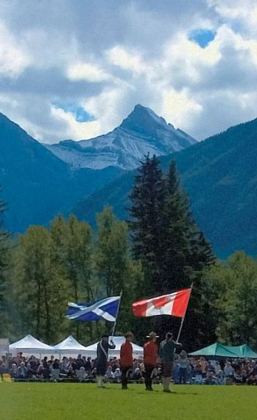
Highland games are events held throughout the year in Scotland and other countries.
Certain aspects of the games are so well known as to have become emblematic of Scotland.
The games also include entertainment and exhibits related to other aspects of Scottish and Gaelic culture.
Opening ceremonies of 2004 Canmore Highland games

Slide 4
History
It is reported in numerous books and Highland games programs
Some have seen this apocryphal event to be the origin of today's modern Highland games.
The modern Highland games are largely a Victorian invention, developed after the Highland Clearances.

Slide 5
Events

Slide 6
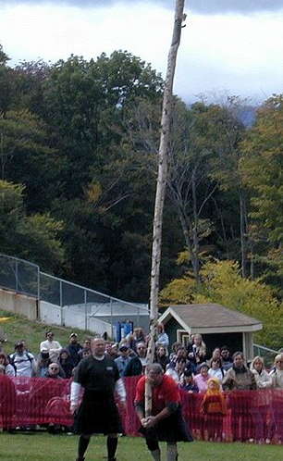
Highland games revolved around athletic and sports competitions.
Though other activities were always a part of the festivities
The athletic competitions are at least an integral part of the events and one — the caber toss — has come to almost symbolize the Highland games.
A caber being thrown at the 2000 New Hampshire Highland Games

Slide 7
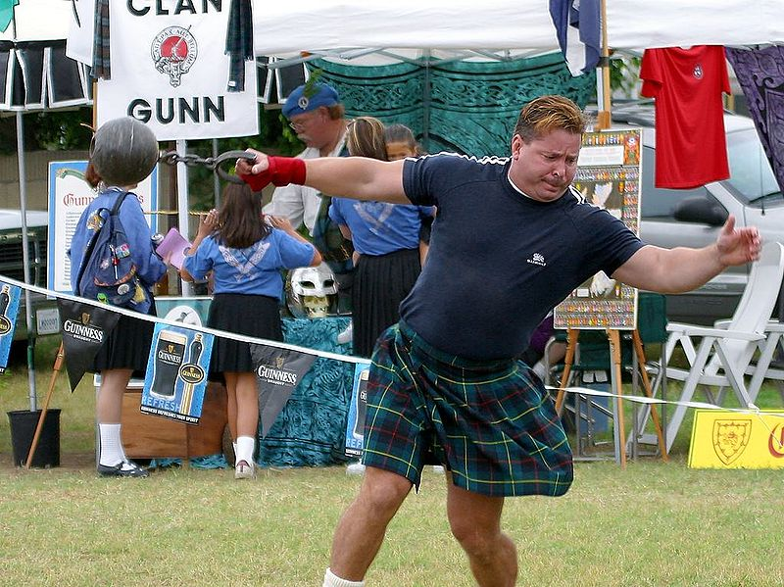
Weight throw
Weight throw, also known as the weight for distance event.
The weights are made of metal and have a handle attached either directly or by means of a chain.
The implement is thrown using one hand only, but otherwise using any technique.
The longest throw wins.

Slide 8
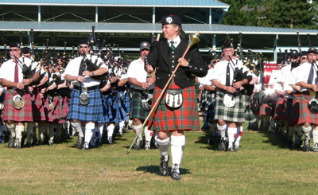
Music
The most memorable of all the events at the games is the massing of the pipe bands.
Normally held in conjunction with the opening and closing ceremonies of the games.
Massed bands at the 2005 Pacific Northwest Highland Games

Slide 9
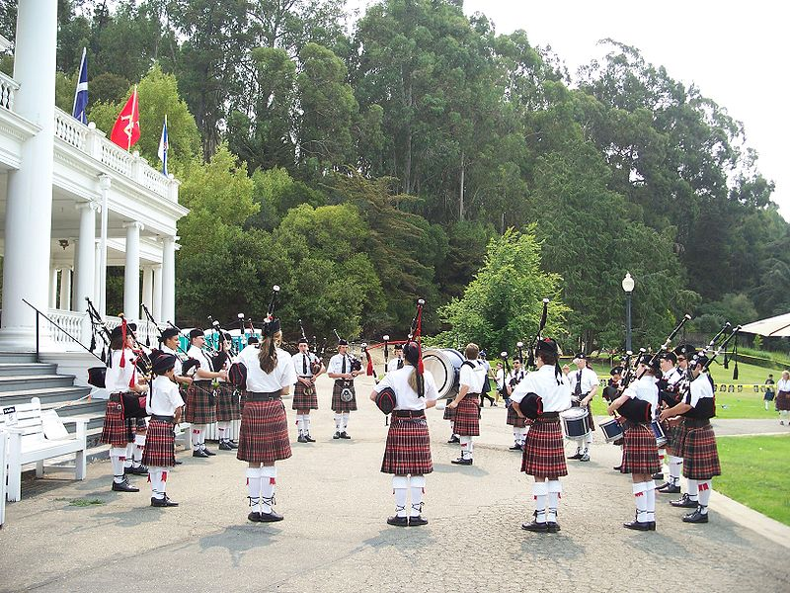
Highland Pipeband Competition Circle [Prince Charles Pipe Band 2008]

Slide 10
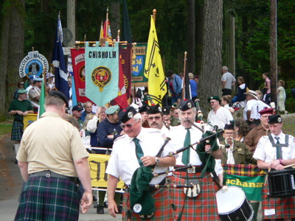
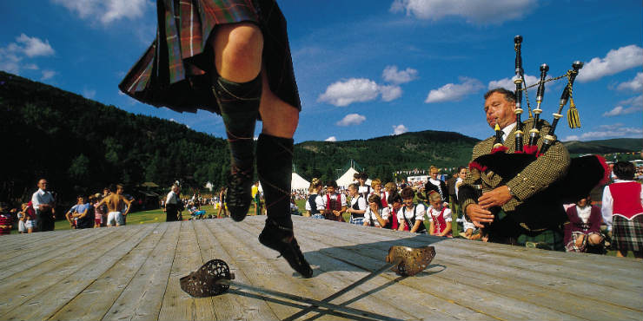
Dance
The Cowal Highland Gathering hosts the annual World Highland Dancing Championship. This event gathers the best competitive dancers from around the world who compete for the SOBHD sanctioned World Championship title.
Assembling for the parade of clans at the 2005 Tacoma Highland Games

