Slide 1
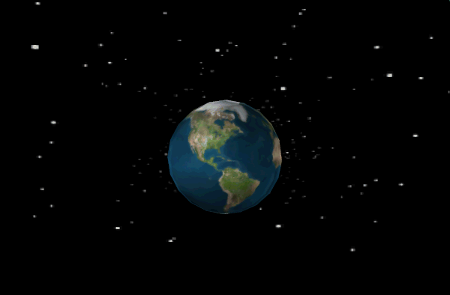
Interesting facts about Earth

Slide 2


The hottest temperature ever recorded on Earth’s surface was 57.8 degrees in El Azizia, Libya recorded in 1922.

Slide 3

Only 3% water of the earth is fresh, rest 97% salted. Of that 3%, over 2% is frozen in ice sheets and glaciers. Means less than 1% fresh water is found in lakes, rivers and underground.

Slide 4

One of Interesting Facts About Earth is it doesn’t take 24 hours to rotate on its axis. It’s actually 23 hours, 56 minutes and 4 seconds.

Slide 5

Each winter there are about 1 septillion snow crystals that drop from the sky.

Slide 6

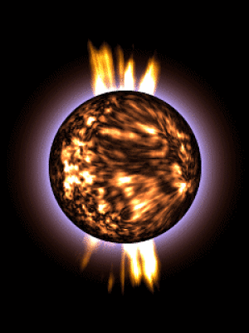
The earth is smoother than a bowling ball.
100 tons of small meteorites enter the atmosphere every day.

Slide 7


There are 8.6 million
lightning strikes per day.
Antarctica has as much ice
as the Atlantic Ocean
has water.

Slide 8


Only 8-12 humans are killed per year by sharks, but 100 million sharks are killed per year by humans to harvest their fins.
90% of all volcanic activity occurs in the ocean.

Slide 9
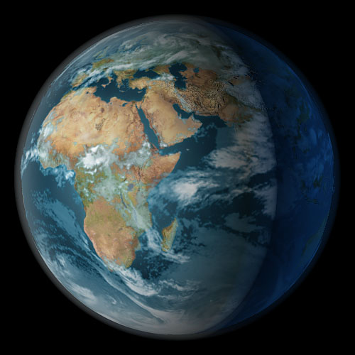

The continents move about 2 cm every year.
200,000 people are born every day.
2 people die every second.

Slide 10


The international space station was the most expensive object ever constructed. ($150 billion!)
99% of the earth’s gold lies in the core.

