Slide 1
Education in Great Britain

Slide 2
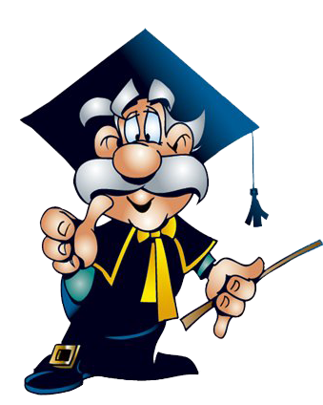
Compulsory education in Great Britain are
Primary school
Secondary school
Further education
(university)

Slide 3
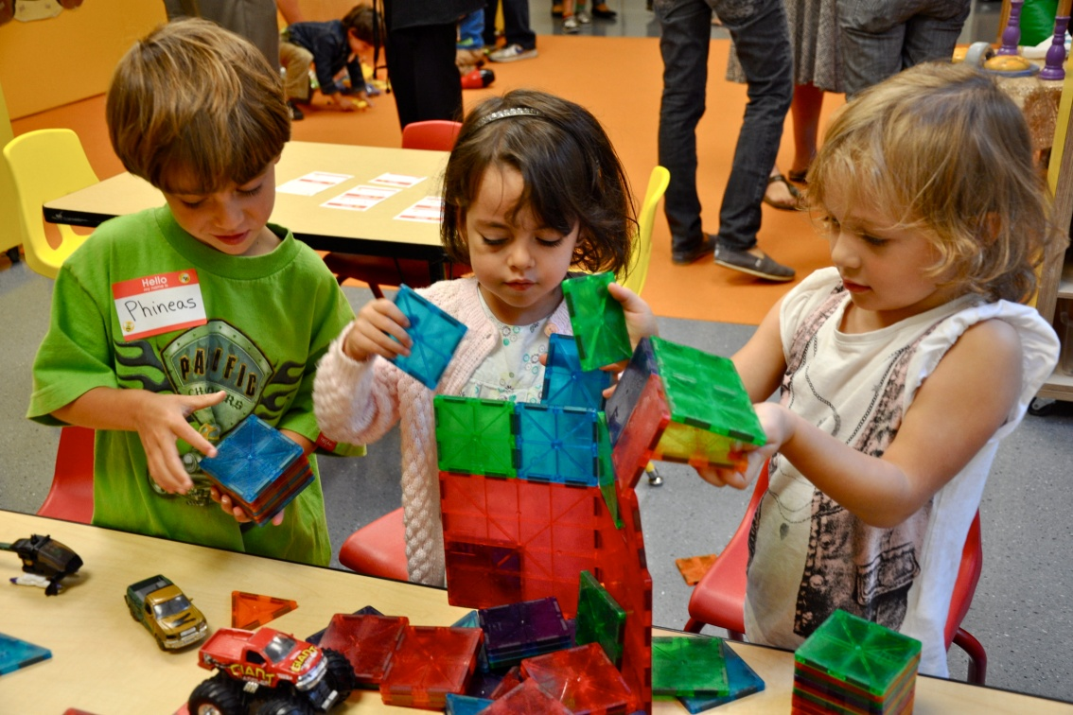
Nursery school
There are many children who attend a nursery school from the age of 3, but it is not compulsory.
Children are taught to sing,draw,they play different creative games.
Compulsory education
begins at the age of 5,
when children go to
primary school.

Slide 4
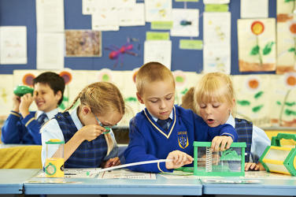
Primary school
All children start primary school by the age of 5.
Primary education lasts for 6 years.
They attend the infact school from 5 to 7 and then junior school until they are 11.

Slide 5
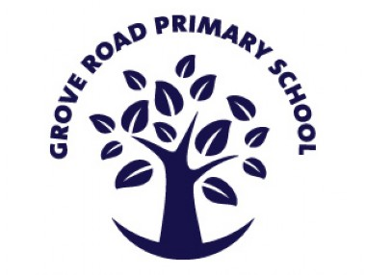
Some parents pay for their children to attend a private school but all children have the right to go to a state school which is free.
Private school are called public schools.

Slide 6
Secondary education
Children study compulsory subjects:
English Literature
Mathematics
IT(informational technology)
Religious education
And optical courses:
One foreign language
One science subject
One art subject

Slide 7
History
Geography
PE(physical education)
Design and Technology
Compulsory education ends at 16.
Some people leave secondary school and go to college for further education.
Some choose to stay at secondary school for 2 years more prepare for a university.

Slide 8
Higher education
There are 126 university in Great Britain.
They are divided into 5 types:
The Old ones, which were founded before the 19th century, such as Oxford and Cambridge;
The Red Brick, which were founded in the 19th or 20th century;
The Plate Glass, which were founded in 1960s;

Slide 9
The Open University It is the only university offering extramural education. Students learn subjects at home and then post ready exercises off to their tutors for marking;
The New ones. They are former polytechnic academies and colleges.
Many students then continue their studies for a Master's Degree and then a Doctor's Degree

Slide 10
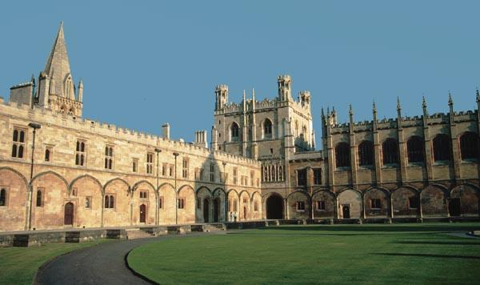
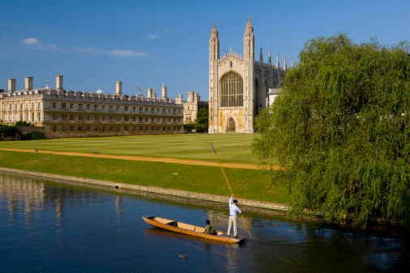
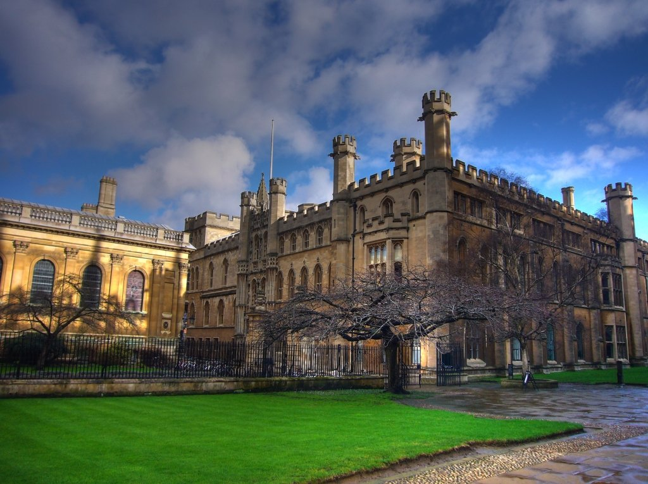
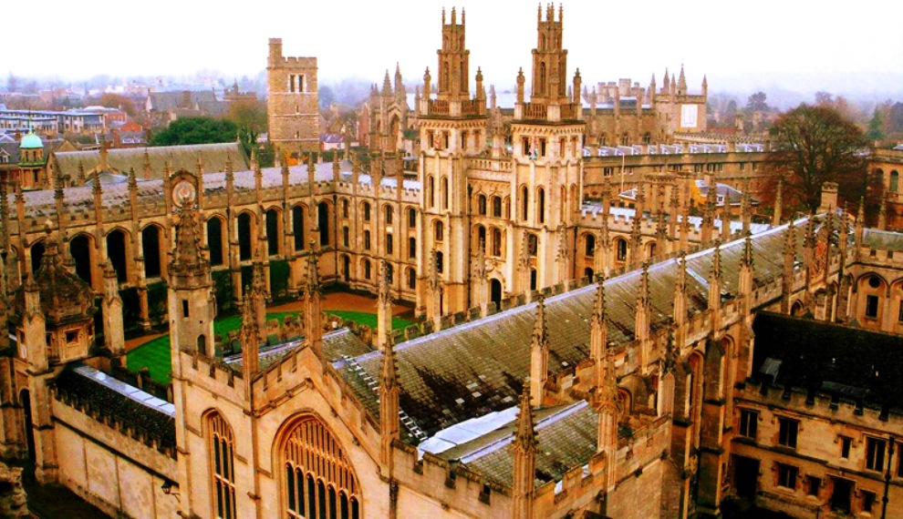

Slide 11
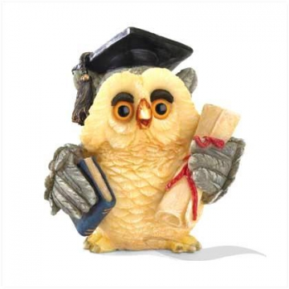
Thanks you for your attention

