Slide 1
Pollution of the atmosphere of Earth

Slide 2
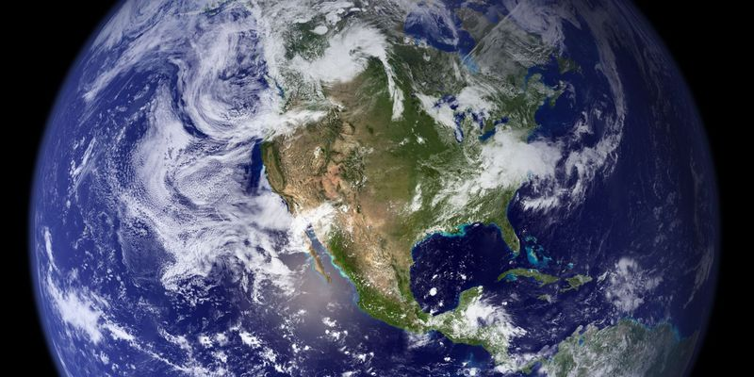
Pollution of the atmosphere of Earth — bringing in atmospheric air new uncharacteristic for it physical, chemical and biological substances or change of their natural concentration

Slide 3
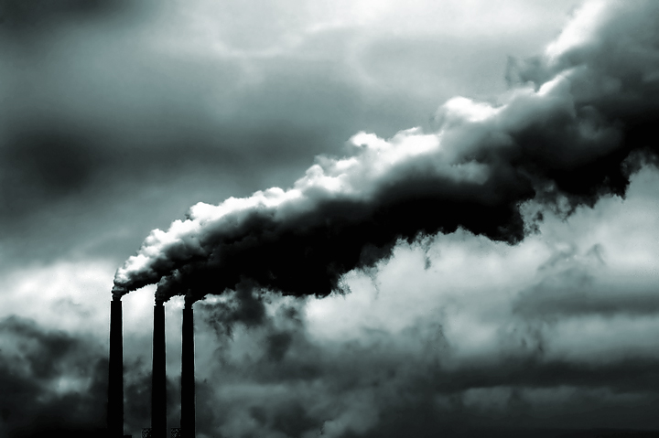
According to the International agency on studying of a cancer of the World Health Organization (WHO), air pollution is the main reason of emergence of oncological diseases

Slide 4
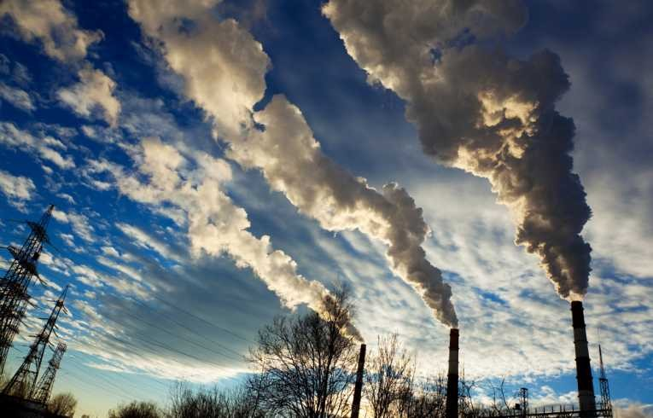
Types of pollution

Slide 5
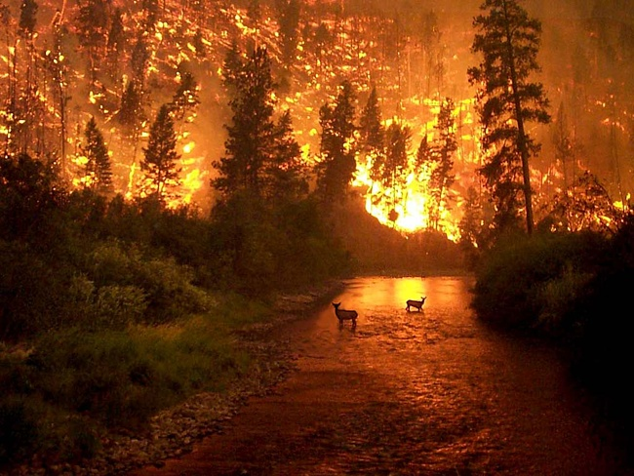
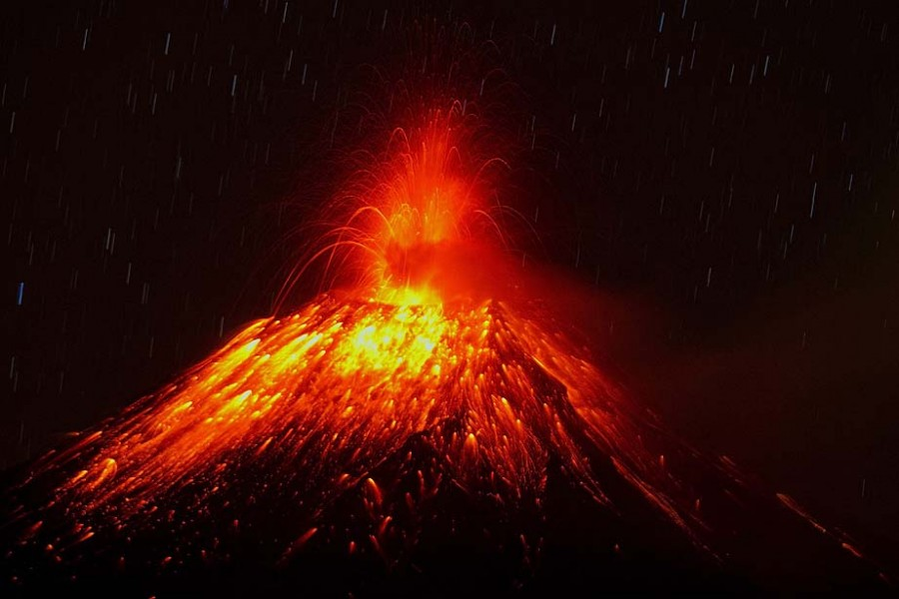
On pollution sources:
The natural
The anthropogenous

Slide 6
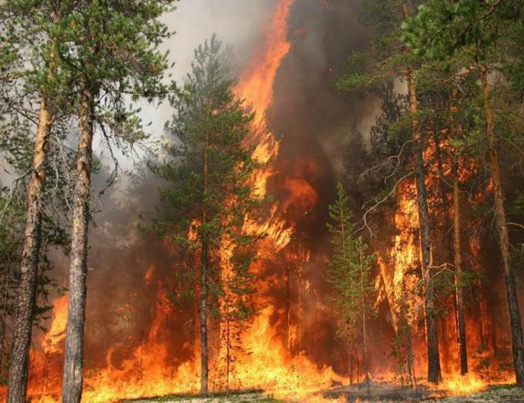
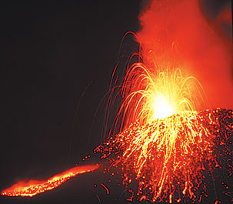
On character of a pollutant atmosphere pollution:
the physical
the chemical
the biological

Slide 7
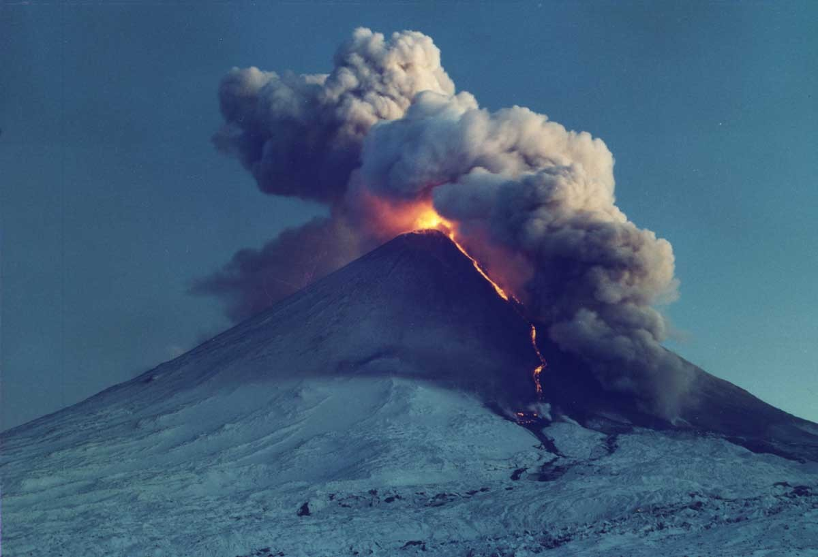
Pollution sources
Natural (eruptions of volcanoes, forest and steppe fires, dust, pollen of plants)
The artificial:
— Transport
— Production
— Household

Slide 8
Main pollutants
Carbon oxide
Nitrogen oxides
Sulfur dioxide
Hydrocarbons
Aldehydes
Heavy metals (Pb, Cu, Zn, Cd, Cr)
Ammonia
Dust
Radioactive isotopes

Slide 9
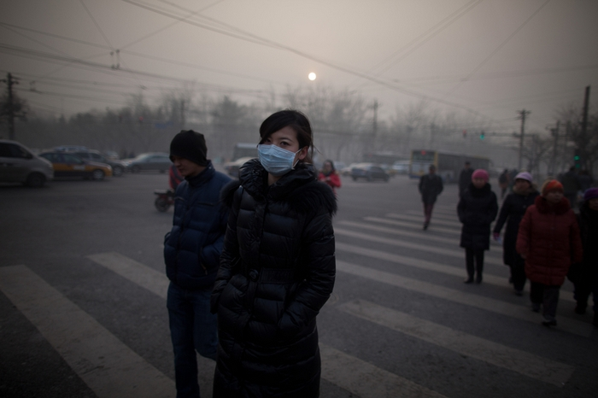
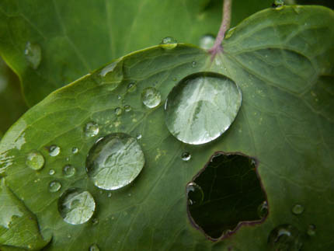
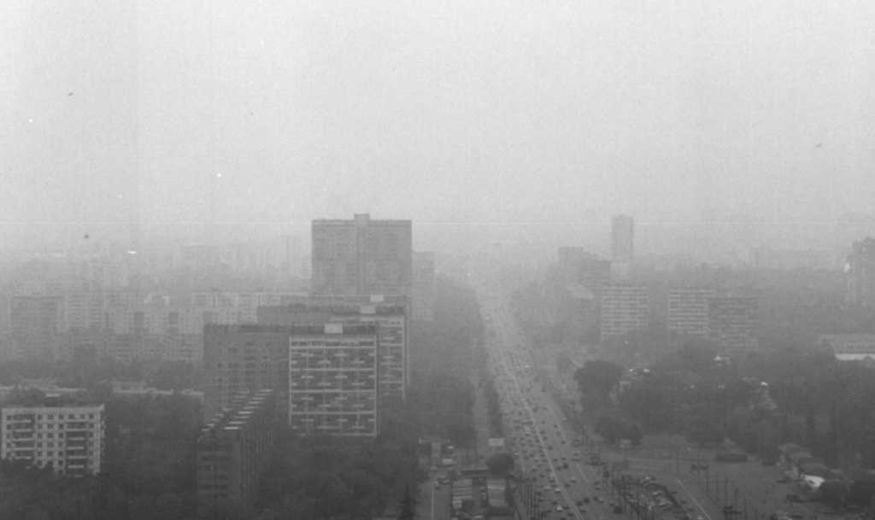
Consequences
It is possible to carry greenhouse effect, acid rains, a smog and an ozone gap

