Slide 1
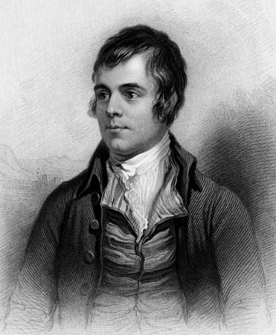
Robert Burns (25 January 1759 – 21 July 1796)

Slide 2
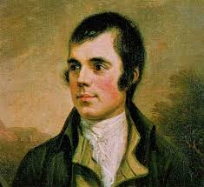
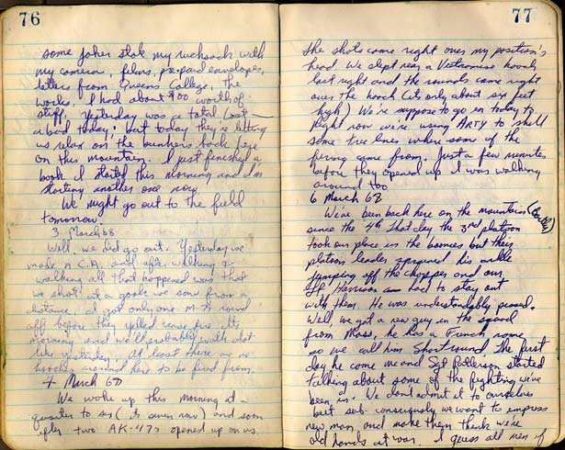
Robert Burns - a Scottish poet and lyricist
He is the best known of the poets who have written in the Scots language

Slide 3
Robert Burns
He is regarded as a pioneer of the Romantic movement.
Celebration of his life and work became almost a national charismatic cult during the 19th and 20th centuries.

Slide 4
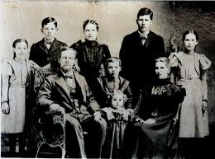
Family and biography
Burns was born in Alloway, South Ayrshire, Scotland, the eldest of the seven children of William Burnes.

Slide 5
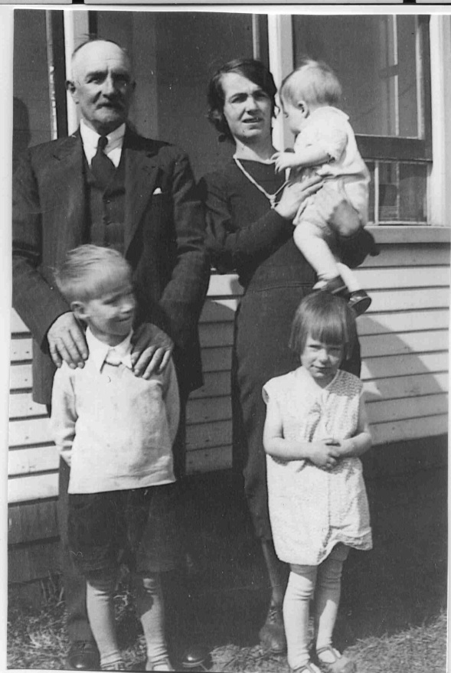
Family
His father died in 1784, and with his brother Gilbert the poet rented the farm of Mossgiel; but this venture was as unsuccessful as the others.

Slide 6
Education
He had little regular schooling and got much of his education from his father, who taught his children reading, writing, arithmetic, geography, and history and also wrote for them A Manual Of Christian Belief.

Slide 7
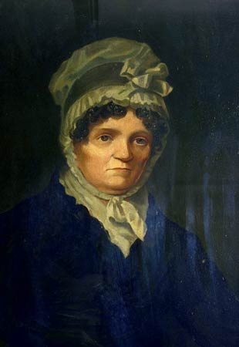
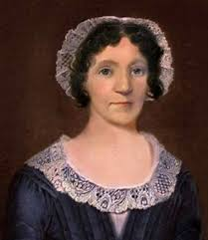
Love affairs
His first child, Elizabeth Paton Burns, was born to his mother's servant, Elizabeth Paton while he was embarking on a relationship with Jean Armour

Slide 8
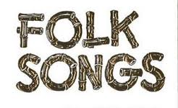
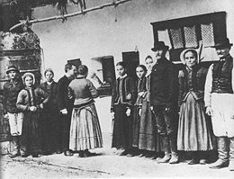
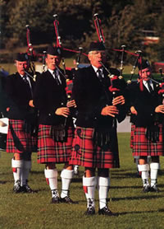
Creation
As well as making original compositions, Burns also collected folk songs from across Scotland, often revising or adapting them.

Slide 9
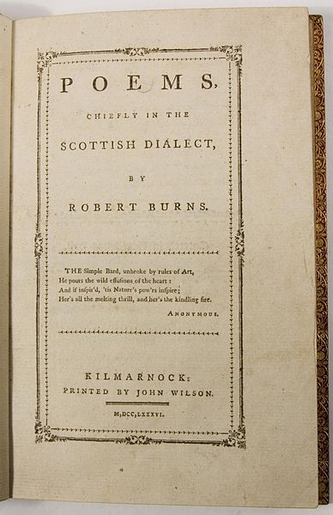
The best poems
Poems and songs of Burns that remain well known across the world today include "A Red, Red Rose"; "A Man's A Man for A' That"; "To a Louse"; "To a Mouse"; "The Battle of Sherramuir"; "Tam o' Shanter"; and "Ae Fond Kiss".

Slide 10
Robert Burns’ death
As his health began to give way, he began to age prematurely and fell into fits of despondency. On the morning of 21 July 1796 Burns died in Dumfries, at the age of 37.

