Slide 1
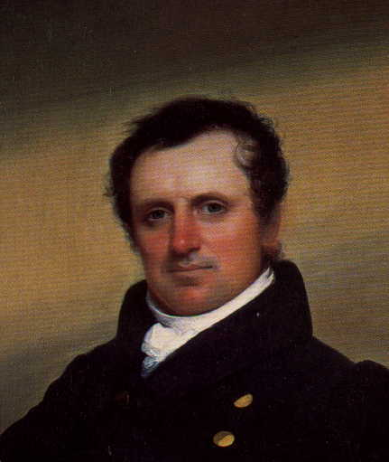
James Fenimore Cooper

Slide 2
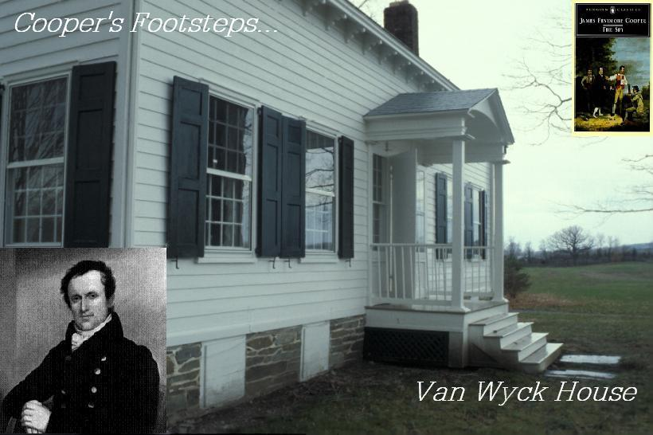

Slide 3
Thesis Statement
James Fenimore Cooper was one of America’s first great novelists because he helped to create a sense of American history through his writings. Cooper was influenced greatly by nature and wrote about it frequently in his novels. Cooper was also influenced by and wrote about places in the Hudson River Valley, such as the Van Wyck House.

Slide 4
Life story
born in a rich family
attended Yale but expelled
five years at sea
inherited fortune then a comfortable life
wrote lots of novels because he oneday was disgusted by one novel

Slide 5
Major works
"Leather stocking Tales" (a series of five novels about the frontier life): The Pioneers, The Prairie, The Last of the Mohicans, The Pathfinder, The Deerslayer
Central character: Natty Bumppo (several names for same character: Hawk-eye, the Pathfinder, the Deerslayer, Leatherstocking) (a typical frontier man: honest, simple, innocent, generous) (represents brotherhood of man, nature and freedom)
Theme: modern civilization advancing on the wilderness and the contradiction between them

Slide 6
Features
Good at inventing plots (Cooper had never been to the frontier area personally.)
B. Style: powerful, yet clumsy and dreadful
C. Wooden Characters
D. Use of dialect, but not authentic (criticized by Mark Twain)

Slide 7
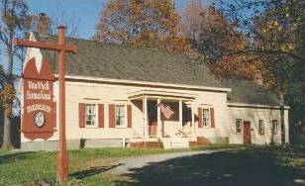
Van Wyck House
Fishkill, NY
1732 Dutch Colonial
Requisitioned by the Continental Army as officers’ headquarters.
Military trials were held here
Orders for the army were issued from the house.
Visited by many notables including: Washington, Lafayette, Van Steuben, Alexander Hamilton, and John Jay.
Used by the Quartermaster Department for outfitting Continental troops with clothing.

Slide 8
Thanks for your attention!

