Slide 1
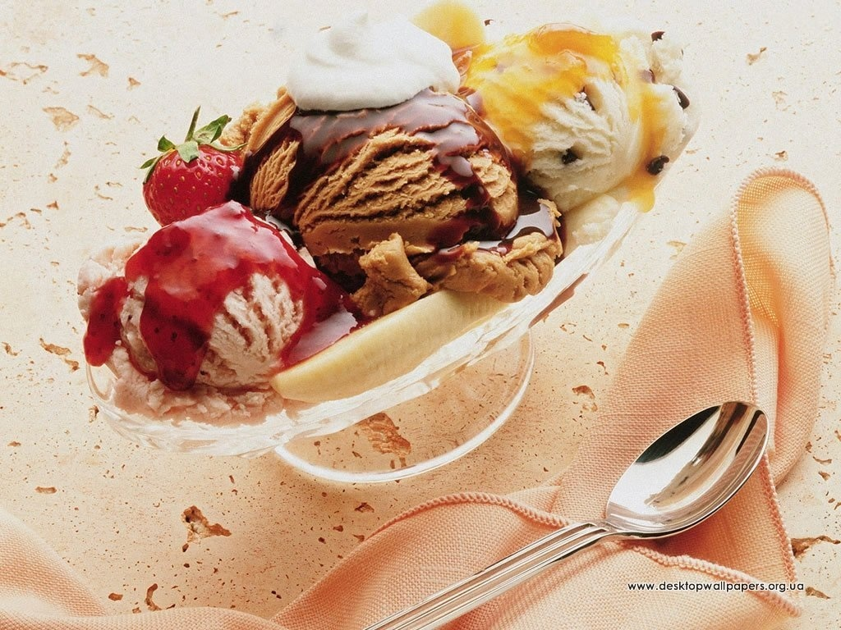
Ice cream

Slide 2
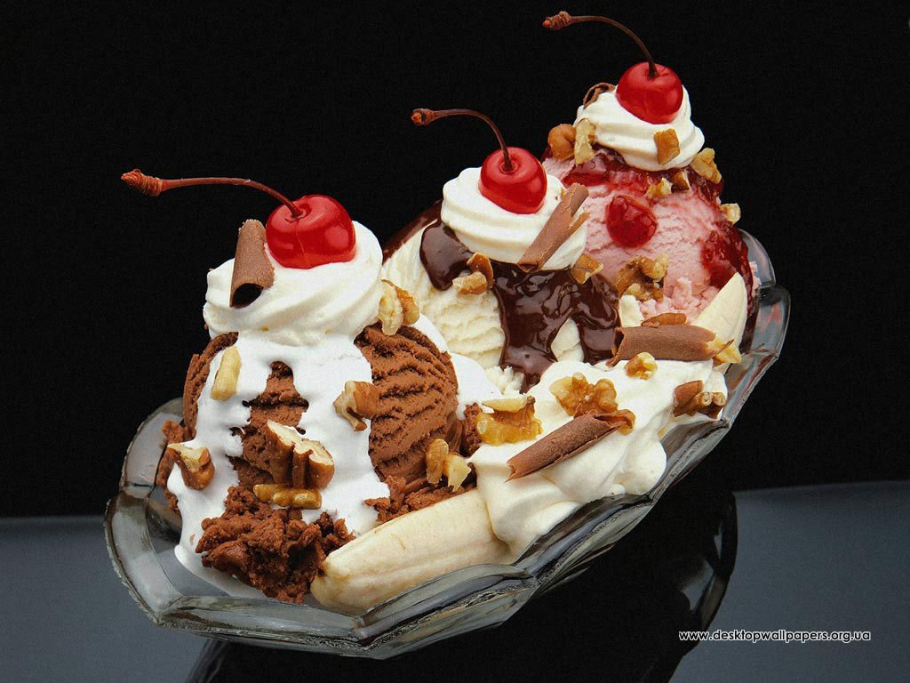
Ice cream is a frozen dessert usually made from dairy products, such as milk and cream, and often combined with fruits or other ingredients and flavours.

Slide 3
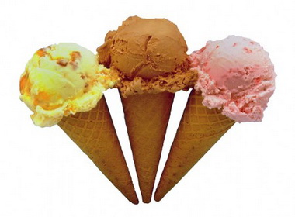
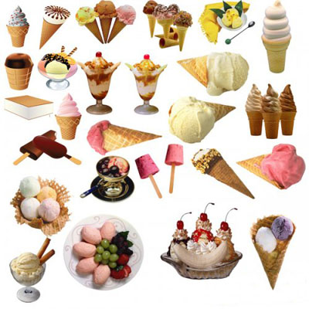
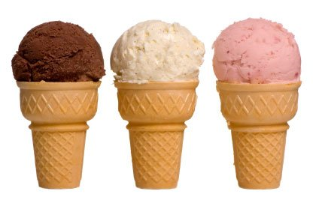

Slide 4
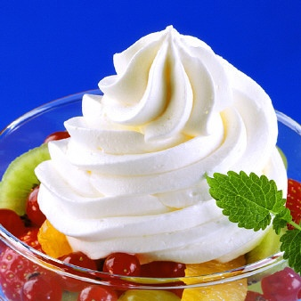
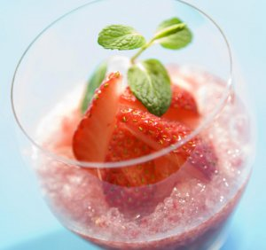
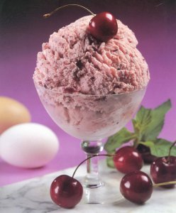
History
- Chinese did fruit ice the first, and later this mean from a heat was adopted by arabs, hindus, persi.
In IV age to n. e. Oleksandr Makedonskiy, which stood heat badly, used fruit juices with snow.
Loved ice-cream and Roman emperor Nero (1 age of n. e.).
In to Kievan Rus, where also nobody knew nothing about the Chinese ice cream, popularity was used by the recipe of cold dessert: the frozen milk mixed with fresh berries.

Slide 5
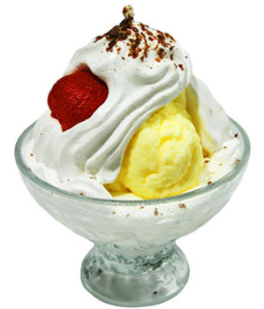
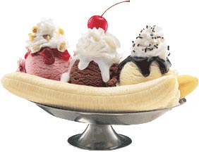
Then
In ХІІІ century the Italian traveller Marko Polo rought to Europe few recipes new product, it was ice cream.
In summer 1660 Italian Franchesko Prokopio opened in Paris the sale of ice-cream.
From 1750 in France began to make this product that became popular quickly.
In the USA the first mention about the open sale of ice-cream meets in May, 1777

Slide 6
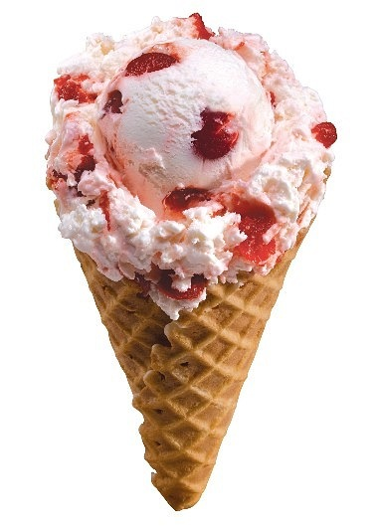
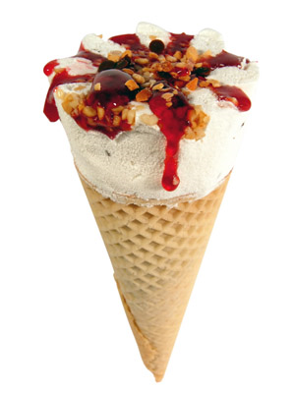
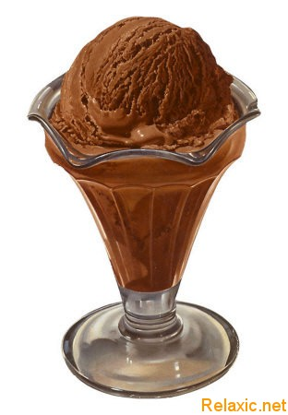
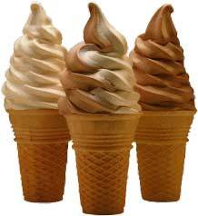
1851 in Baltimor Jacob Fyssel founded the first in the world factory from the production of ice cream

Slide 7
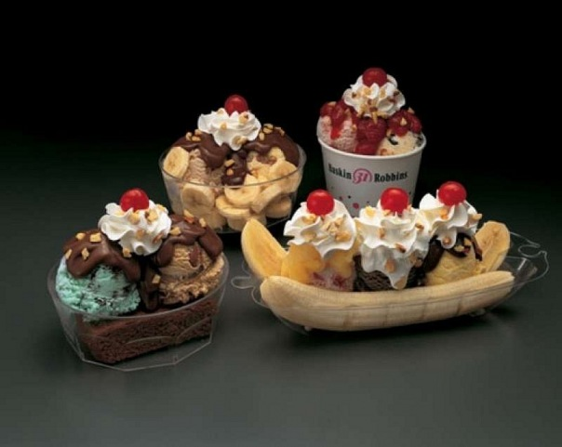
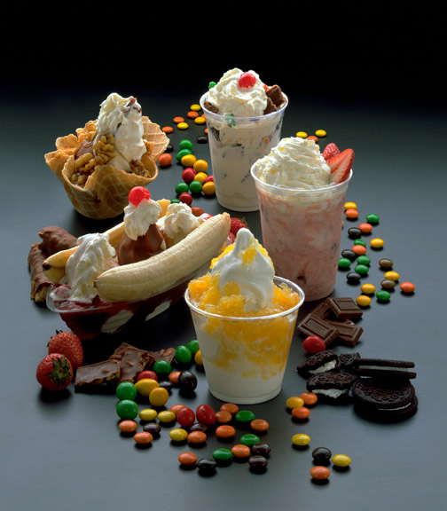
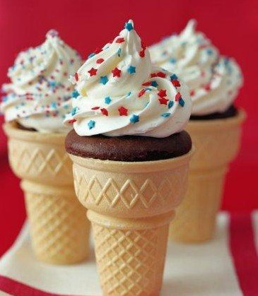
When perfect refrigeration machines appeared,
in the end ХІХ of century then production of ice cream
grew.

Slide 8
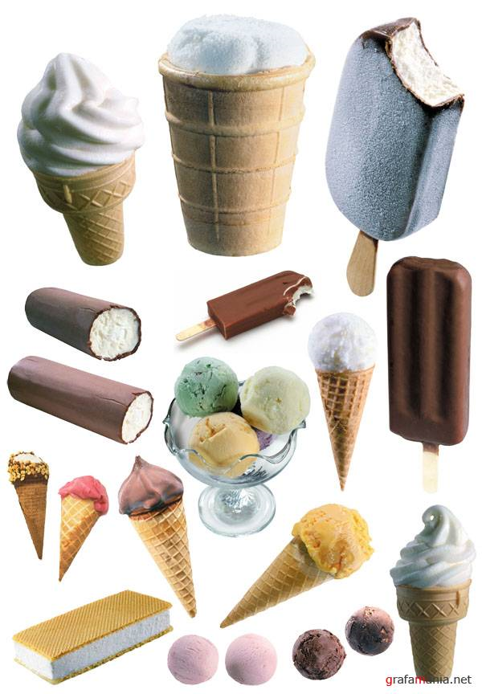
Value
An ice-cream as has a product milk over 100 useful substances. In him there are fats, carbohydrates, whole set of vitamins (And, В1, В2, В12, С, Д, Е, Р). The amount of vitamins of С increases at addition of fruit filler. The power value of ice-cream hesitates from 100 to 250 kkal/100 gs.

Slide 9
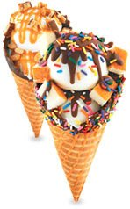
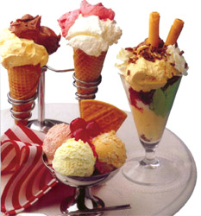
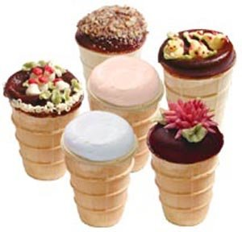

Slide 10
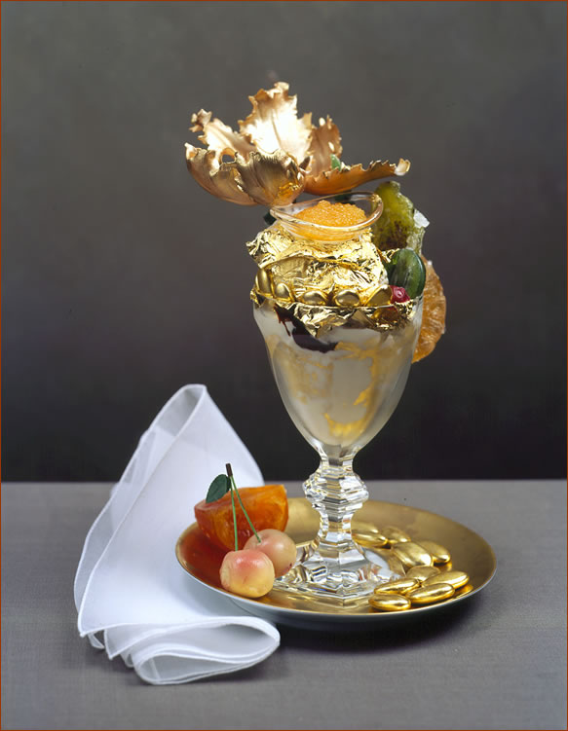
Ice cream by a price 1000 dollars
The most expensive dessert in the world is prepared in the New York restaurant of Serendipity. Creamy ice-cream from 25 sorts of cacao by the decorated creams, pieces of food of gold, and also little the chocolate of La Madeline au of Truffle, given in glass from gold and decorated by diamonds.. About a desire to taste a dessert it is necessary to warn in good time. By the way, a client can at a desire to take away with itself on memory.

Slide 11
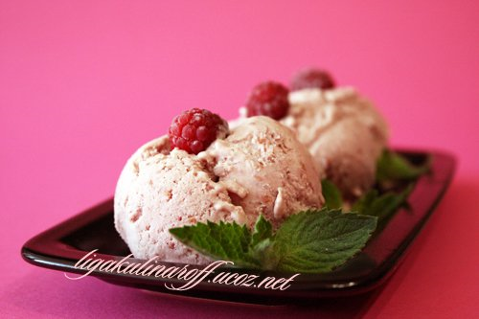
Today ice cream can be very different.
For any taste.

Slide 12
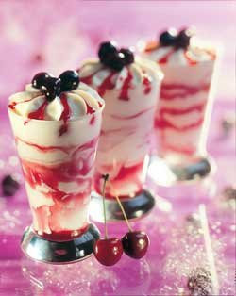
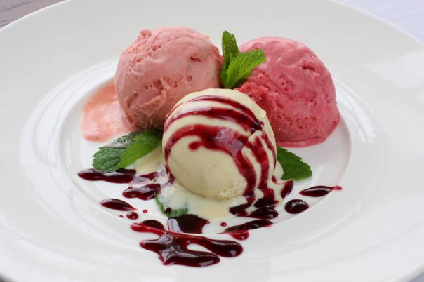

Slide 13
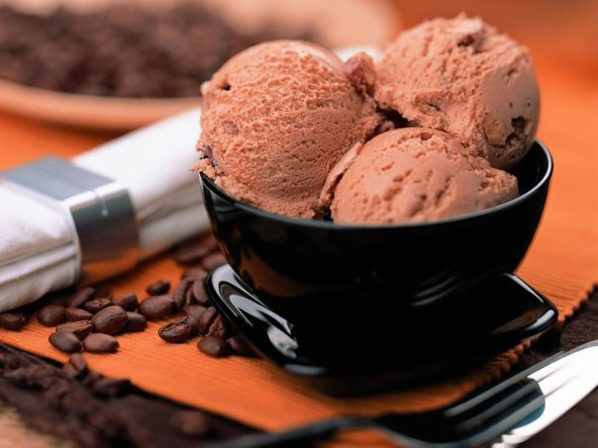

Slide 14
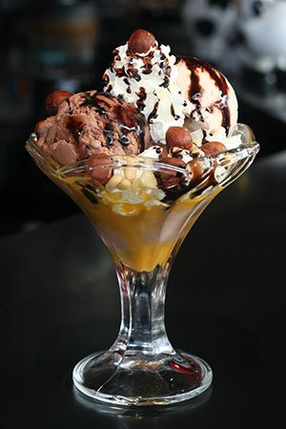

Slide 15
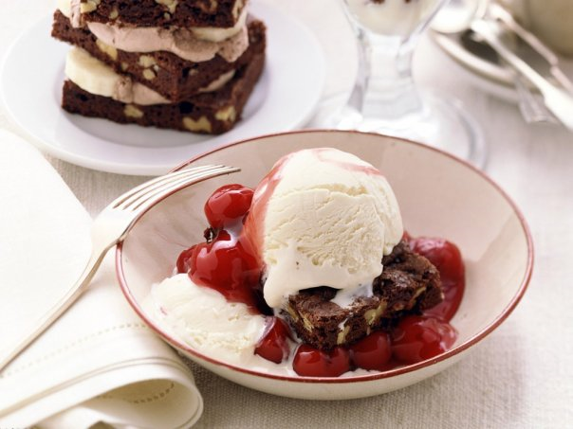

Slide 16
Thank you for attention

