Slide 1
Leeds
Leeds is a city in West Yorkshire, England, the principal settlement in the City of Leeds metropolitan district. It’s the 3rd largest city in the UK by population, after London and Birmingham. It is the cultural, financial and commercial heart of the West Yorkshire Urban Area. Public transport, rail and road communications networks in the region are focused on Leeds.

Slide 2
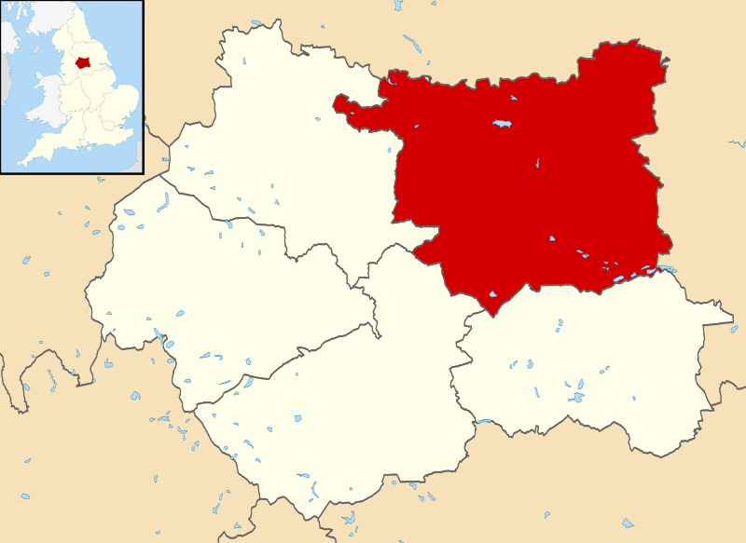
Map of West Yorkshire, UK with Leeds highlighted.

Slide 3
Geography
Leeds is 266 km north-northwest of London. It is connected to the North Sea by the Aire River and to the Irish Sea by the Leeds and Liverpool Canal. The city centre lies at about 63 m above sea level while the district ranges from 340 m in the far west to about 10 m where the rivers Aire and Wharfe cross the eastern boundary. The centre of Leeds is part of a continuously built-up area extending to Pudsey, Bramley, Horsforth, Alwoodley, Seacroft, Middleton and Morley. Over 65% of the Leeds district is green belt land and the city centre is less than twenty miles (32 km) from the Yorkshire Dales National Park, which has some of the most spectacular scenery and countryside in the UK. Inner and southern areas of Leeds lie on a layer of coal measure sandstones. To the north parts are built on older sandstone and gritstones and to the east it extends into the magnesian limestone belt. The land use in the central areas of Leeds is overwhelmingly urban.

Slide 4
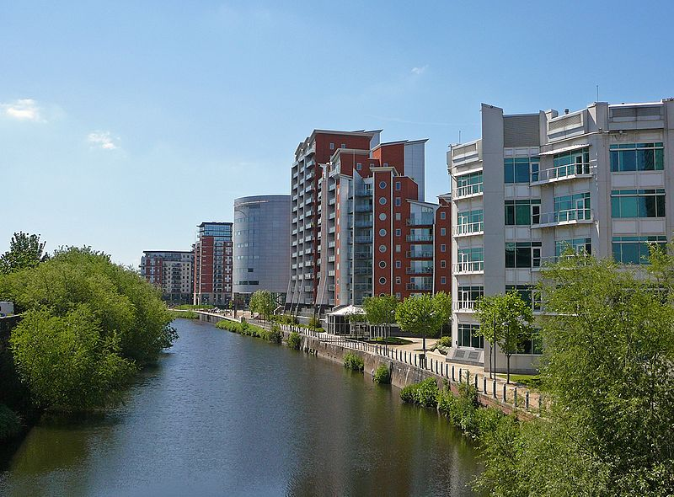
River Aire in Leeds

Slide 5
Climate
Leeds has a climate that is oceanic, greatly influenced by the Atlantic and the Pennines. Summers are usually mild, with moderate rainfall, while winters are chilly, cloudy with occasional snow and frost. Spring and autumn are mild but snow and frost are not unheard of in either season. July is the warmest month, with a mean temperature of 16 °C (61 °F), while the coldest month is January, with a mean temperature of 3 °C (37 °F). Temperatures above 30 °C (86 °F) and below −10 °C (14 °F) are not very common but can happen occasionally. As is typical for many sprawling cities in areas of varying topography, temperatures can change depending on location. Situated on the eastern side of the Pennines, Leeds is among the driest cities in the United Kingdom, with an annual rainfall of 660 mm (25.98 in). Though extreme weather in Leeds is relatively rare, thunderstorms, blizzards, gale force winds and even tornadoes have struck the city.

Slide 6
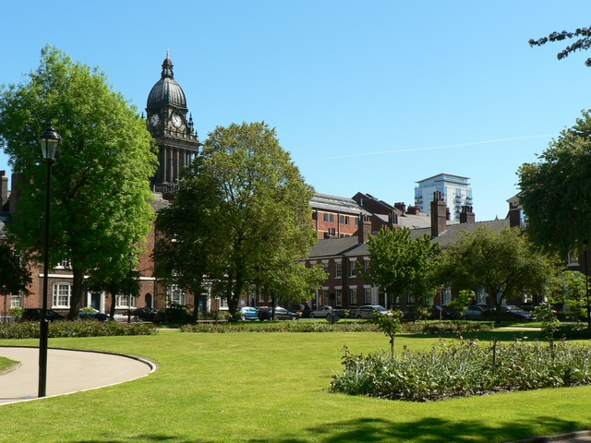
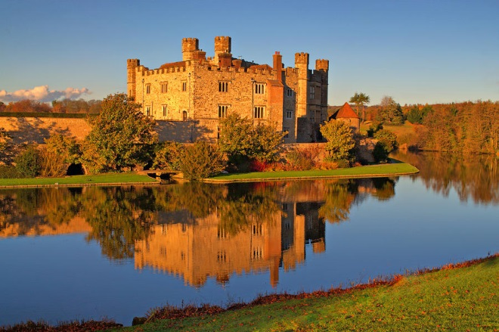
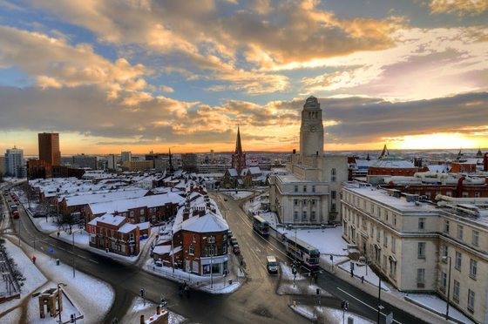
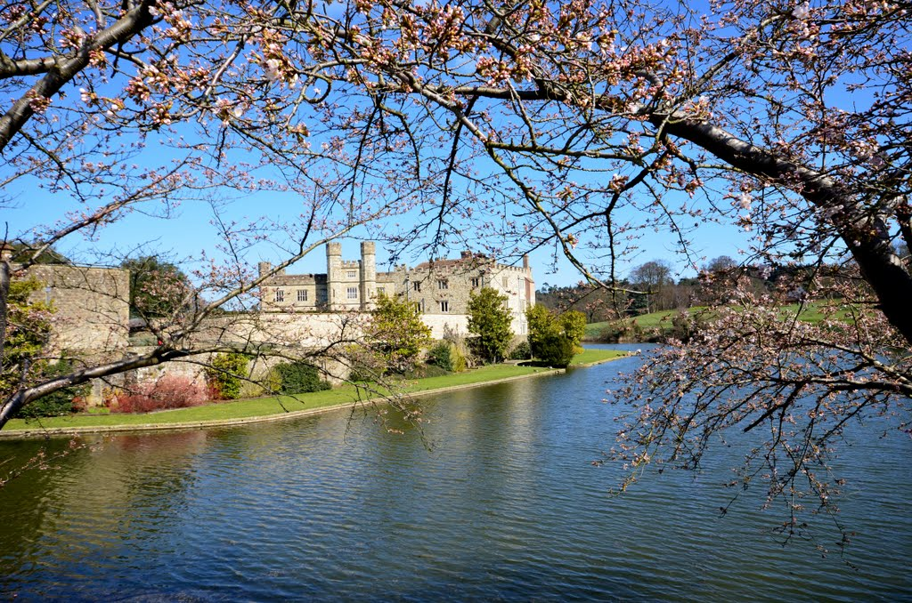
Climate
Autumn
Summer
Winter
Spring

Slide 7
Economy
The city region has a diverse economy consisting of around 100,000 businesses, generating around £52 billion a year and is becoming recognised as a national centre for financial and business services. Leeds is at the economic heart, with some 124,000 people engaged in financial services. The city is the UK's second largest financial and legal centre. There is a large conference industry in Harrogate where the UK's third largest integrated conference and exhibition centre, Harrogate International Centre, is located. Although like most of the UK manufacturing has declined, the city region retains role in the UK’s manufacturing base which has emerged from a period of restructuring and moved into producing higher value goods, managing off-shored elements of production and concentrating on research and development activity.

Slide 8
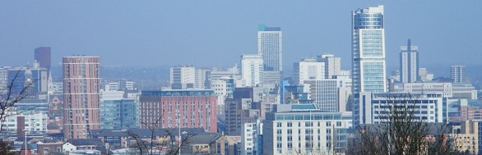
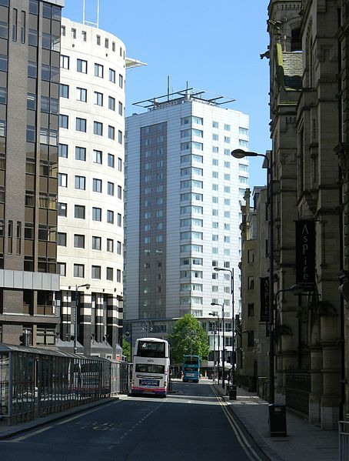
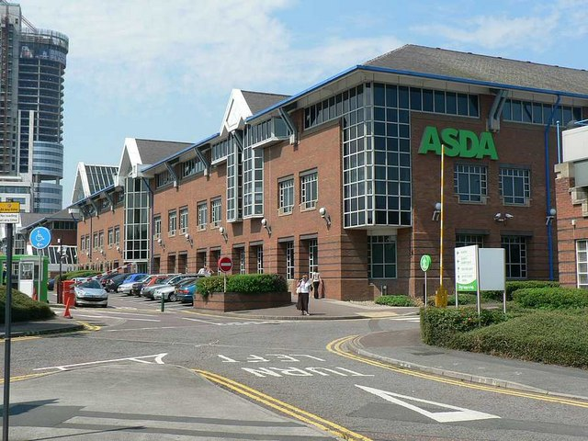
Economy
Central Business District
The Asda House, the head office of Asda
Infirmary Street in the heart of Leeds' Financial District

Slide 9
Education (schools)
In 2008 Education Leeds, a non-profit company owned by Leeds City Council, provided for 220 primary schools, 39 secondary schools and 6 special inclusive learning centres. Under the government Building Schools for the Future initiative, Leeds secured £260m, to transform 13 secondary schools into high achieving, e-confident, inclusive schools. Leeds was one of a number of local authorities to try the three-tier system with first, middle and secondary schools. It reverted to the two-tier system in 1989. The city's oldest and largest private school is The Grammar School at Leeds, which was legally re-created in 2005 following the merger of Leeds Grammar School, established 1552, and Leeds Girls' High School, established 1857. Other independent schools in Leeds include faith schools serving the Jewish and Muslim communities.

Slide 10
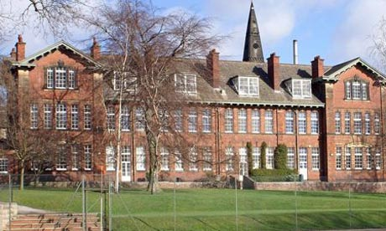
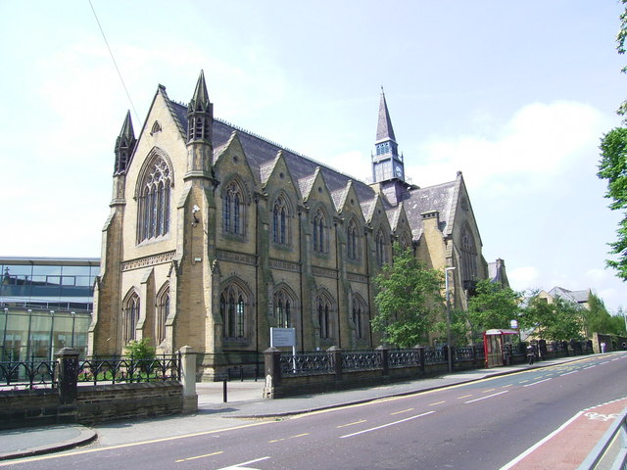
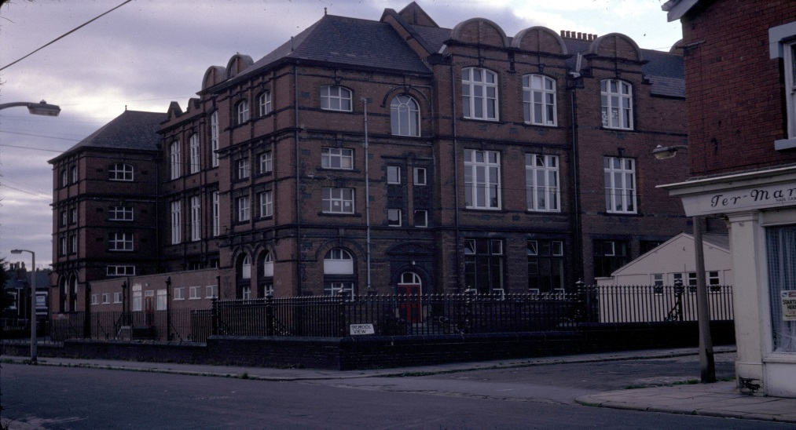
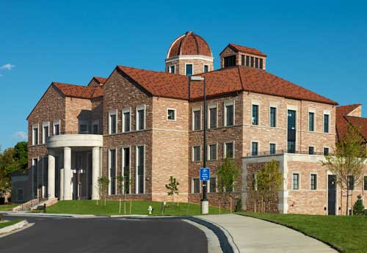
Education (schools)
Girl High School
Grammar School
Brudenell School
School of Business

Slide 11
Higher education
Further education in Leeds is provided by Leeds City College (formed by a merger in 2009 and having over 60,000 students), Leeds College of Building and Notre Dame Catholic Sixth Form College. The city has three universities: the University of Leeds – which received its charter in 1904 having developed from the Yorkshire College which was founded in 1874 and the Leeds School of Medicine of 1831; Leeds Metropolitan University (formerly Leeds Polytechnic) which became a university in 1992 but can trace its roots to the Mechanics' Institute of 1824; and Leeds Trinity University which began in 1966 as two teacher training colleges which merged in 1980 to form Trinity and All Saints College and became a university in 2012. The city was voted the Best UK University Destination by a survey in The Independent newspaper. The combined totals of learners give Leeds one of the largest student populations in the country with over 250,000 students

Slide 12
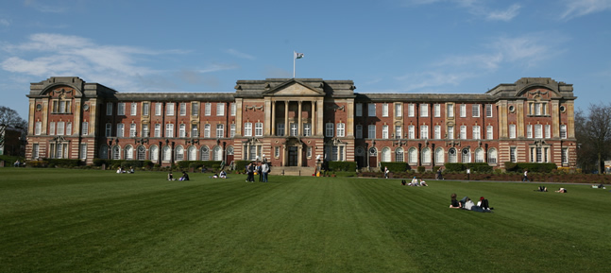
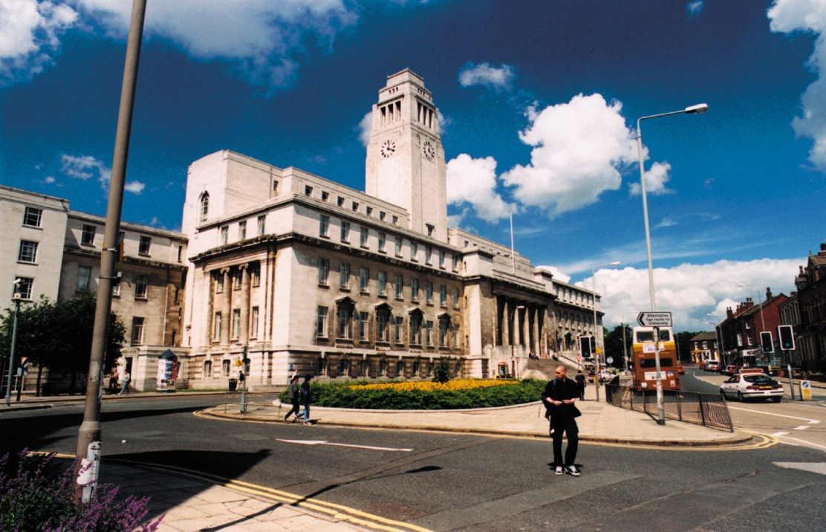
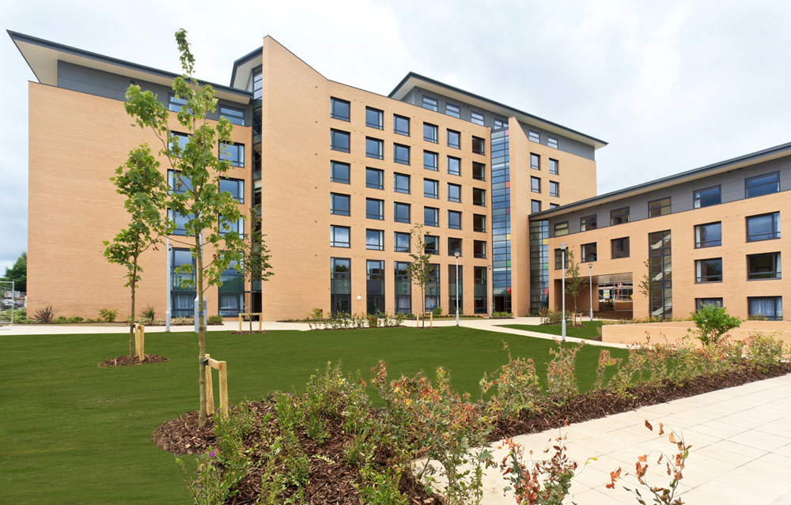
Higher education
Leeds Metropolitan University
University of Leeds
Leeds Trinity University

Slide 13
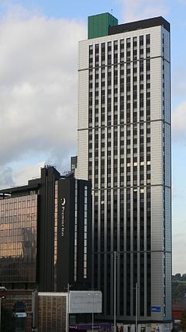
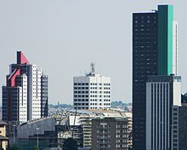
Architecture
Plaza Tower
The Plaza Tower is a skyscraper currently under construction. When complete in 2009 the Plaza overtook Opal 3 as Leeds' second tallest building. The tower contains 572 student flats and stands at 338 feet (103 m). It has 37 storeys (making it the building with the most storeys in Leeds, as the Bridgewater Place has commercial height ceilings. These are particularly high for the first eight storeys).

Slide 14
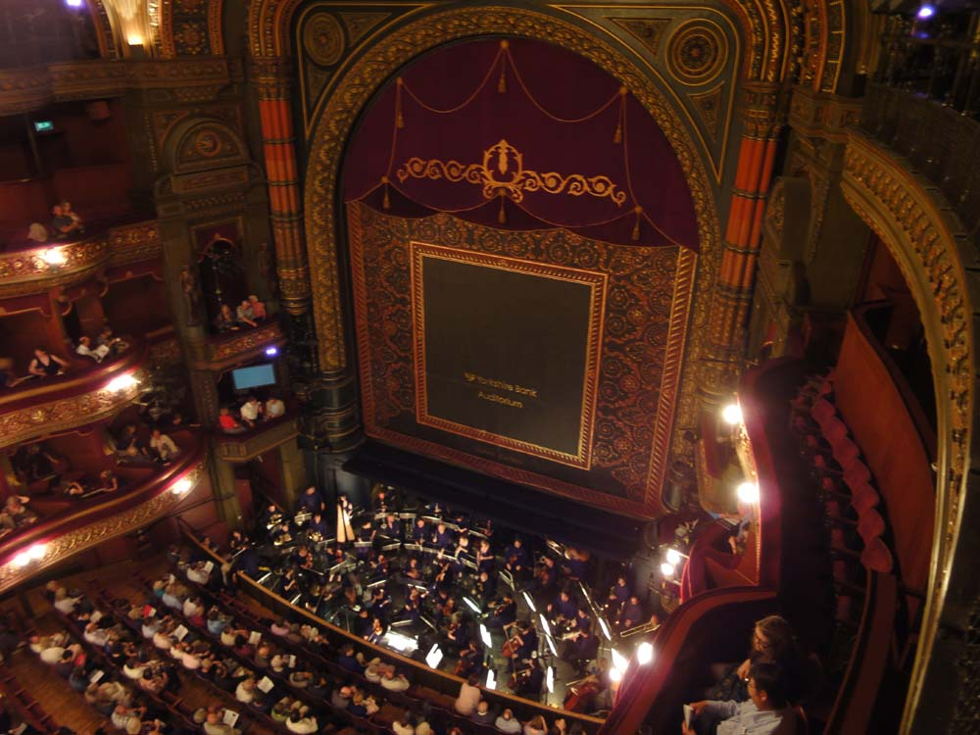
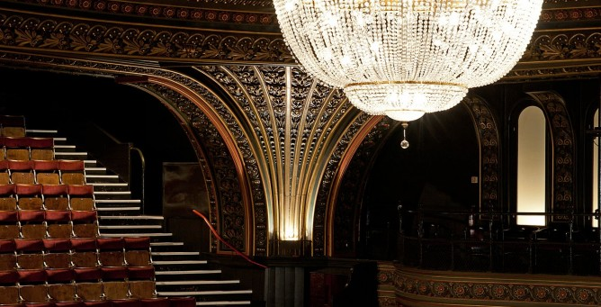
Architecture
Grand Theatre & Opera House
No guide to Leeds would be complete without the Leeds Grand Theatre and Opera House. The well-known theatre has hosted performance of long-running, touring shows, as well as our own homegrown creations. It’s the perfect example of Leeds culture at its best. The Leeds theatre offers consistently-stunning performances of Opera North and their repertoire of classic operas that will make any culture vulture swoon.

Slide 15
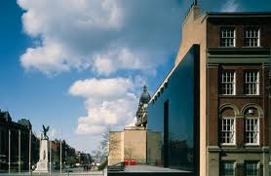
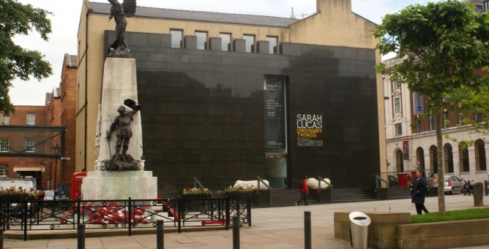
Architecture
Henry Moore Institute
Connected to Leeds Art Gallery, the Henry Moore Institute is one of the coolest and most unusual galleries in Leeds. It plays host to some incredible art, from old favourites and young newcomers, something that has earned it a place in our guide to Leeds. Providing some culture in Leeds, the exhibits at the Henry Moore Institute are rich and varied, with a focus on sculpture, some are even interactive, giving the viewer a unique involvement in the art.

Slide 16
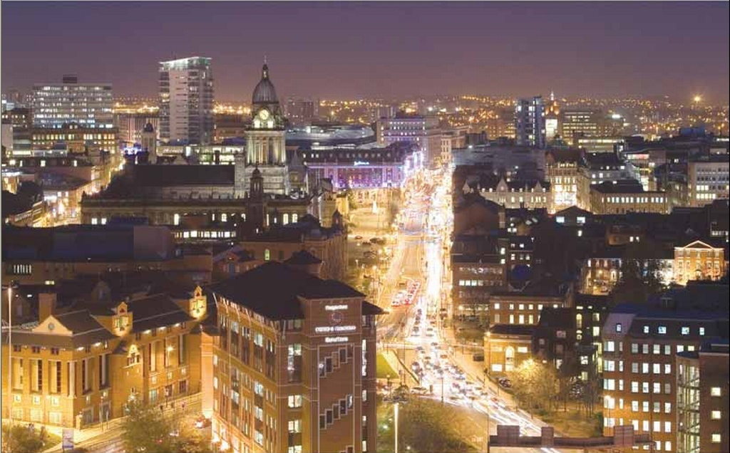
Thank you for attention!

