Slide 1
Japanese tea ceremony

Slide 2
The Japanese tea ceremony (called cha-no-yu, chado, or sado) is a special way of making green tea (matcha 抹茶).People who study the tea ceremony have to learn about different kinds of tea. They also have to learn about kimono (Japanese clothes), flowers, and many other things. It takes much practice to learn the tea ceremony.

Slide 3
History
Tea came to Japan from China in about 900 CE. Tea became very popular in Japan, and Japanese people started to grow tea in Japan. In the 12th century, matcha (green tea powder), became popular. This tea comes from the same plant as black tea. By the 16th century, all people in Japan, rich people and poor people, liked drinking tea. A man called Sen no Rikyu started teaching the ceremony. Many years have passed, but people still make tea the same way that Sen no Rikyu taught.

Slide 4
Materials needed
Tea bowl
Tea scoop
Whisk
Tea caddy
Napkin
Ladle
Water jar
Waste-water container
Iron pot
Tea

Slide 5
Tea ceremony

Slide 6
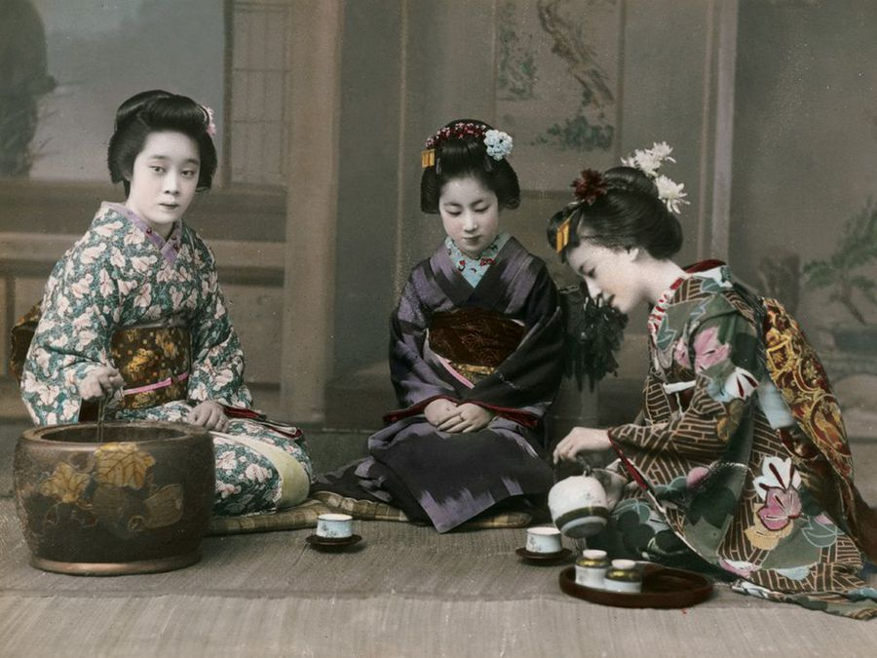

Slide 7
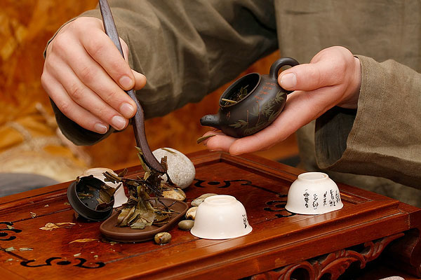

Slide 8
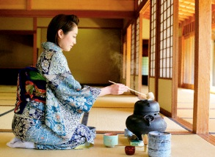
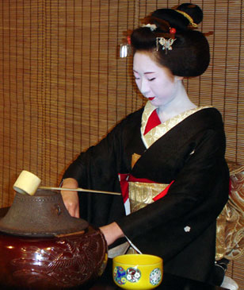

Slide 9
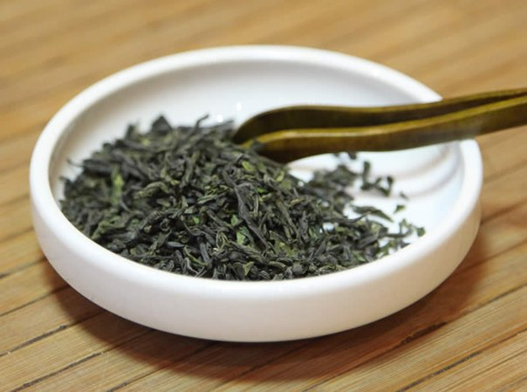
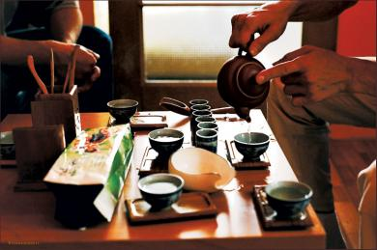

Slide 10
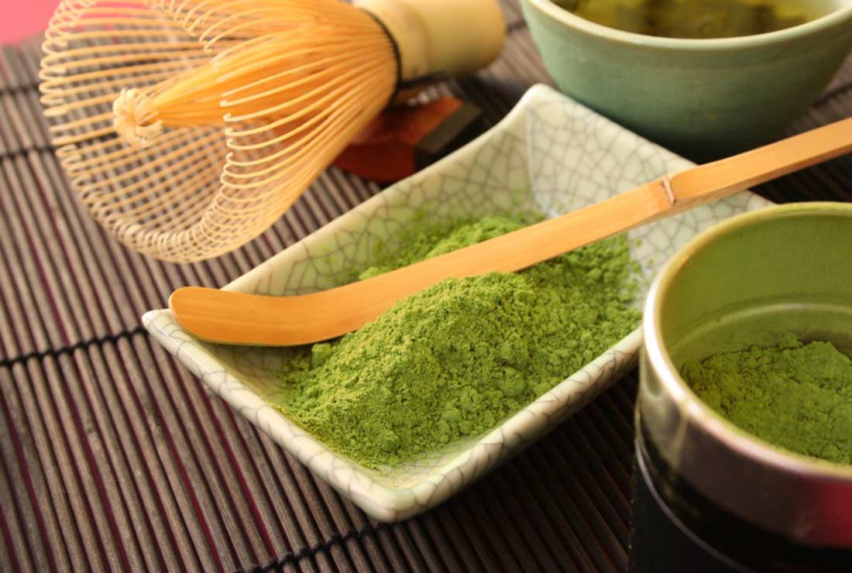

Slide 11
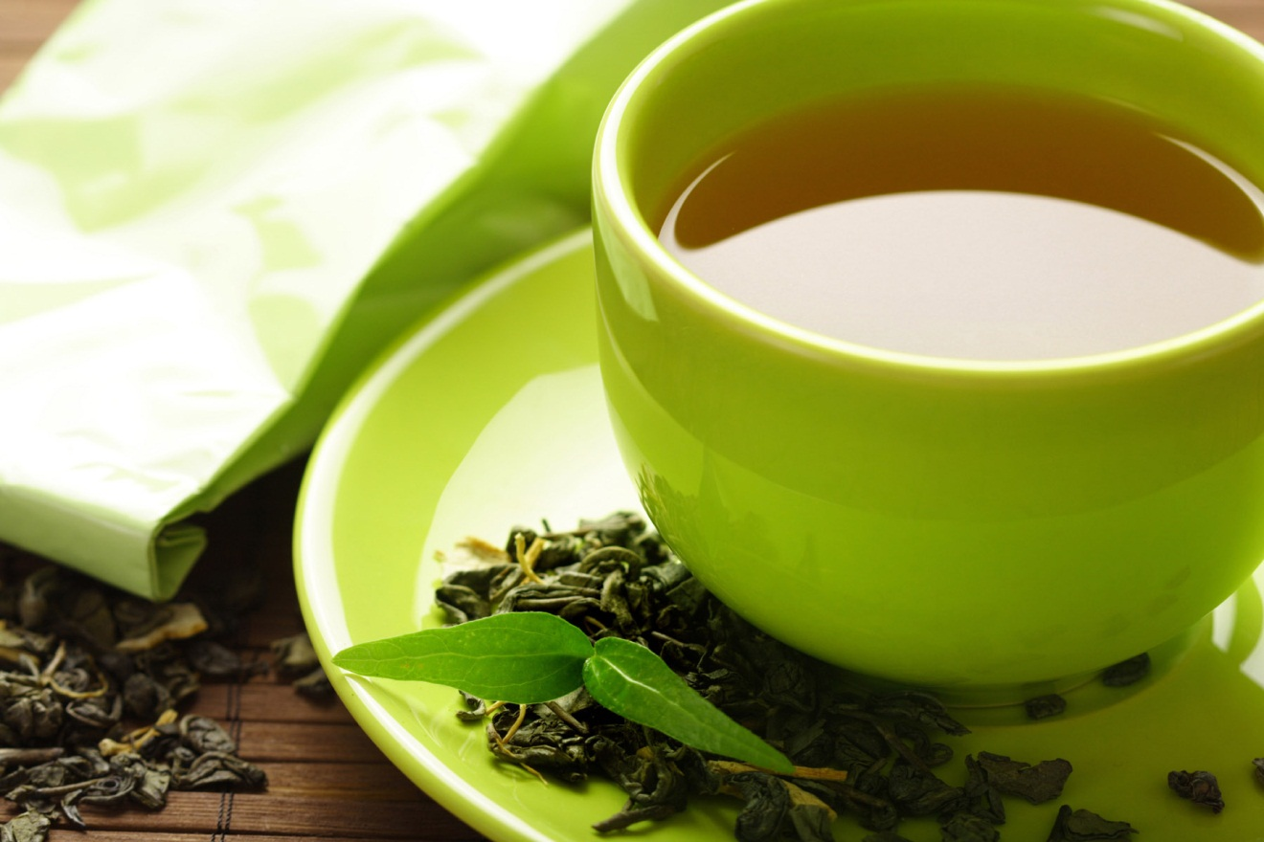
Thanks for your attention !

