Slide 1
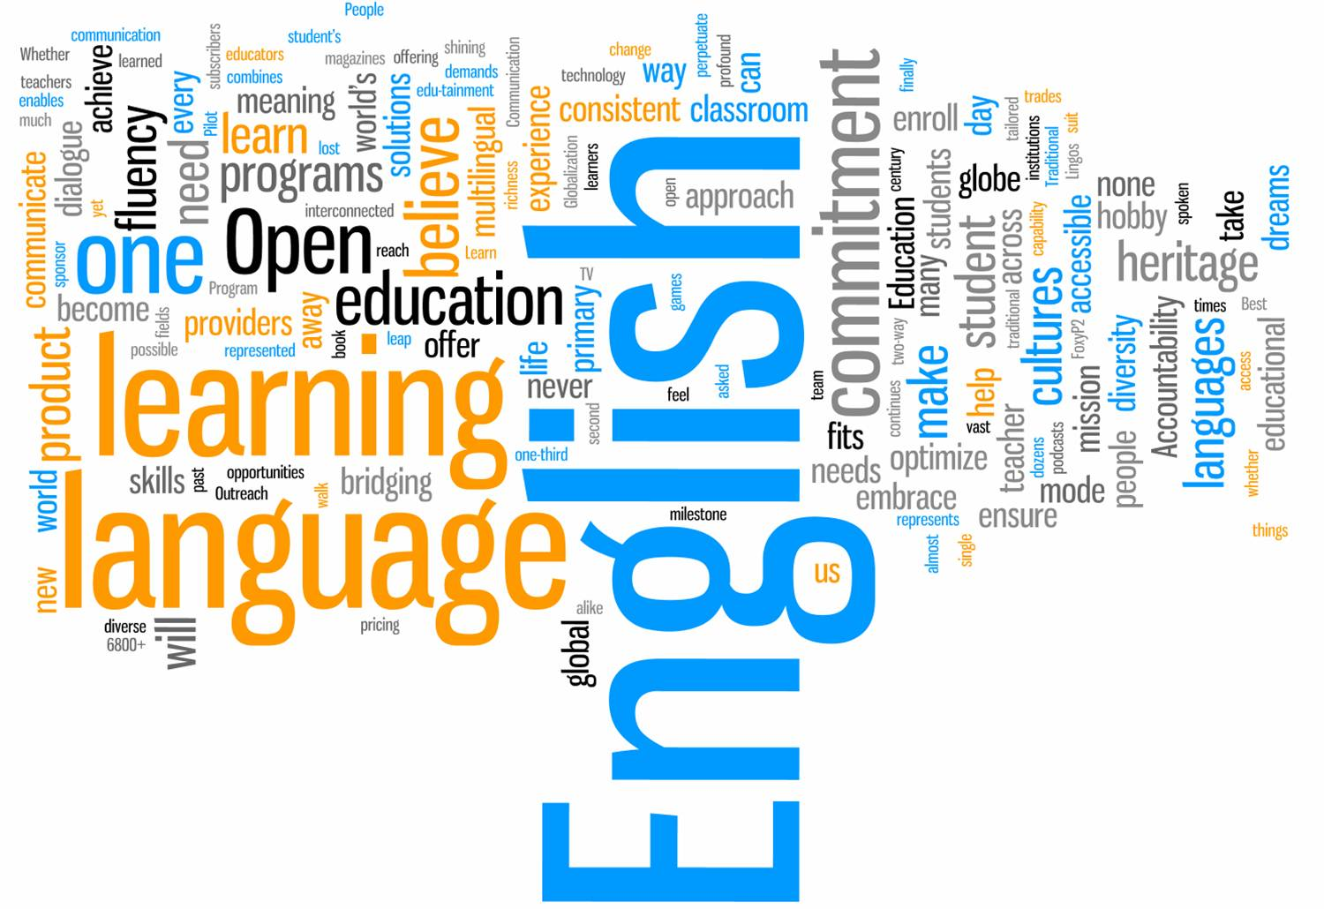
Interesting Facts About English
Oleksandr Petrenko
10th Form

Slide 2
The most common letter in English is "e".
Only two English words in current use end in "-gry". They are "angry" and "hungry".
More English words begin with the letter "s" than with any other letter.
The word "uncopyrightable" is the longest English word in normal use that contains no letter more than once.

Slide 3
The following sentence contains all 26 letters of the alphabet: "The quick brown fox jumps over the lazy dog." This sentence is often used to test typewriters or keyboards.
The only word in English that ends with the letters "-mt" is "dreamt" (which is a variant spelling of "dreamed")
The word "alphabet" comes from the first two letters of the Greek alphabet: alpha, bēta.

Slide 4
The shortest complete sentence in English is the following. "I am.“
The word "Checkmate" in chess comes from the Persian phrase "Shah Mat" meaning "the king is helpless".
The longest English word without a true vowel (a, e, i, o or u) is "rhythm".
The only planet not named after a god is our own, Earth. The others are, in order from the Sun, Mercury, Venus, Mars, Jupiter, Saturn, Uranus, Neptune.

Slide 5
There are only 4 English words in common use ending in "-dous": hazardous, horrendous, stupendous, and tremendous.
We can find 10 words in the 7-letter word "therein" without rearranging any of its letters: the, there, he, in, rein, her, here, ere, therein, herein.
“Typewriter” can be written using only the first line of a QWERTY keyboard.

