Slide 1
Sport

Slide 2
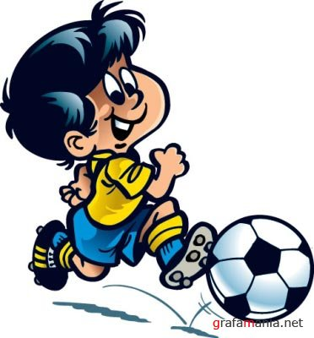
Sport (or sports) is all forms of usually competitive physical activity which, through casual or organised participation, aim to use, maintain or improve physical ability and skills while providing entertainment to participants, and in some cases, spectators. Hundreds of sports exist, from those requiring only two participants, through to those with hundreds of simultaneous participants, either in teams or competing as individuals.

Slide 3
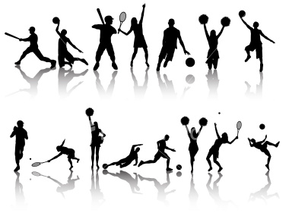
Sports play an important part in our life as our state of health depends on it. It’s popular among both children and grown-ups. The sport helps to bring up physically strong, courageous, strong-willed and energetic people.

Slide 4
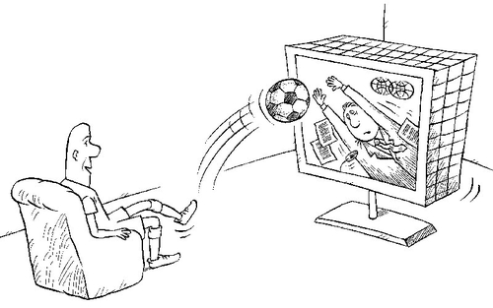
People who are interested in sports can be roughly divided into two following groups: those who like doing sports and those who prefer watching sport events or competitions.

Slide 5
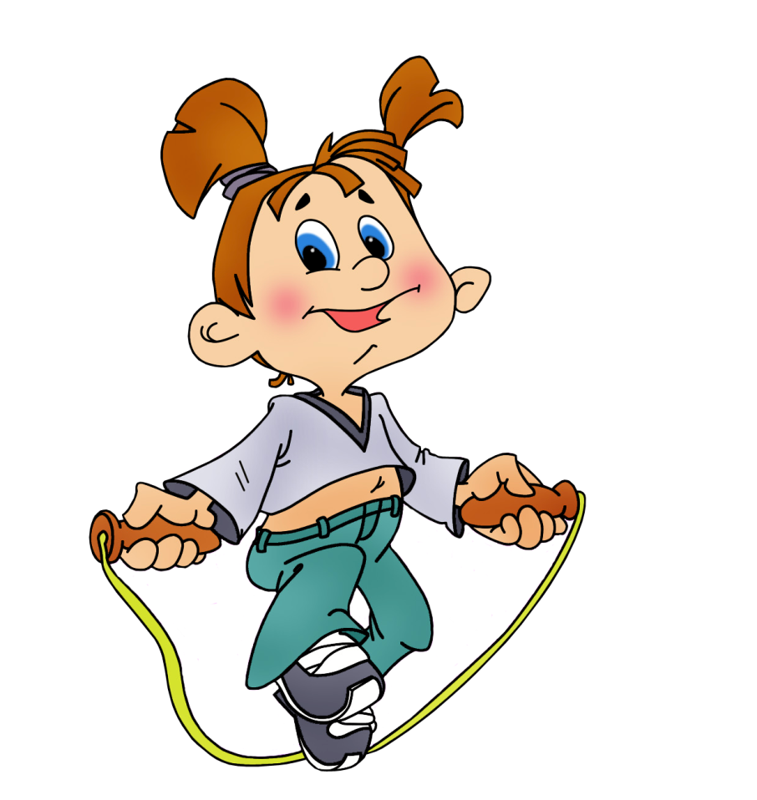
The first group includes people who prefer to take part in competitions, do morning exercises regularly and train themselves in different clubs and sections.

Slide 6
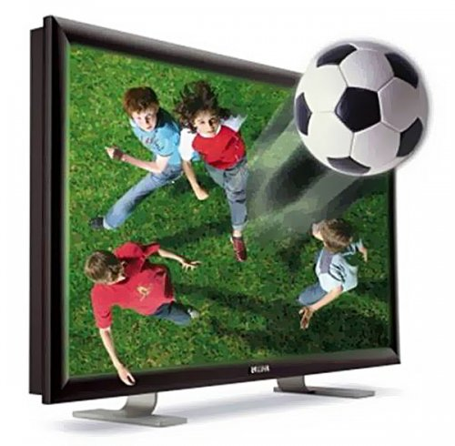
The second group is more numerous and consists of people who like just watching competitions and sports games, listening to sports news and interesting stories about sportsmen. They do not go in for sports.

Slide 7


