Slide 1
Club of English

Slide 2
I would like to make a club of the English language. There could walk all the students and teachers of our school, and their relatives.

Slide 3
I think that first of all it is necessary to divide all the levels of education (someone knows better, and someone worse). Who knows English well, they could just come and communicate in the English language, improve their speech, their pronunciation, and they can also help those pupils who is worse-know Russian.

Slide 5
Of course, each member of the club may make changes such as: getting the music, video, photos, and etc. The aim of the club is to study and improvement of knowledge of the English language.

Slide 7
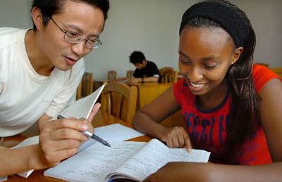
We will also bring foreigners to us in the group, it's one thing to talk among themselves, but it is another thing to a foreigner. He may also give a lot of advice for studying a foreign language.

Slide 8
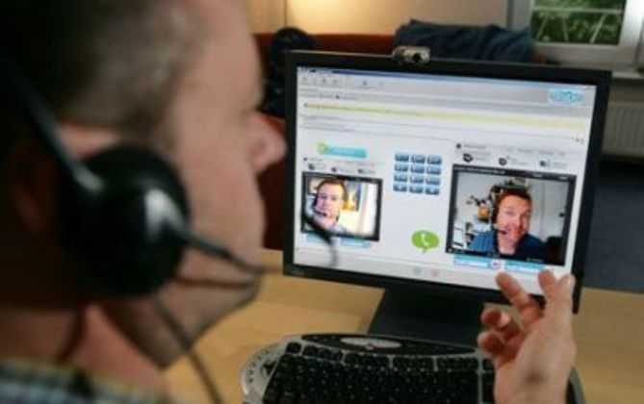
And who wants to, can communicate with a foreigner on Skype and share their experiences with other participants of the club.

Slide 9
Our club will work from Monday to Friday from 17:00 to 20:00. For engaging students can hang out in the school of posters, add to the site of the school of information about our club.

Slide 10
In the school. | In school, we can offer cards with photos, music, videos, books in English. All of this will help us to improve our knowledge of the English language.
Outside of school. | Outside of school every one of us can listen to music, watch videos, movies, read books in English. It is due to this all of the things replenished our vocabulary and improving English.

Slide 12
Presentation was prepared by Danil’chenko Vlada

