Slide 1
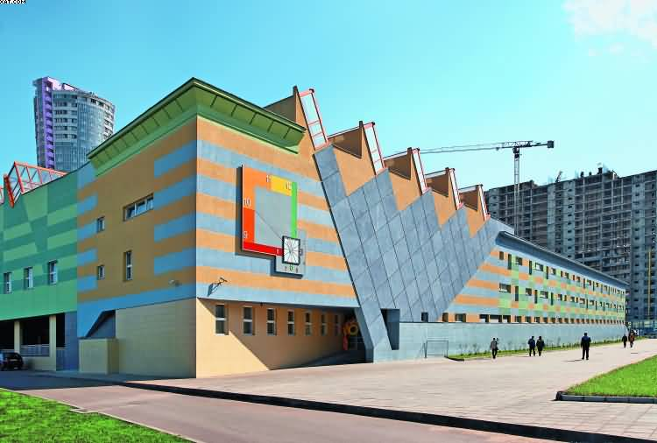
The school in my dreams is not very big, but very comfortable.

Slide 2
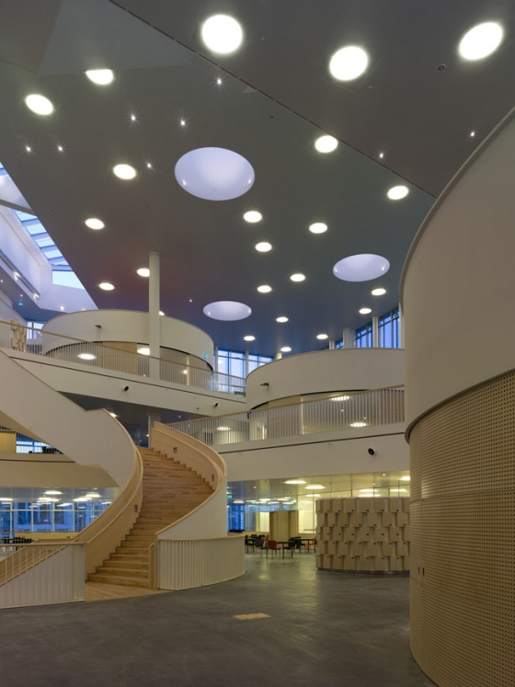
It has many beautiful classrooms,
with TV. tape-recorders,
computers,many interesting
pictures and other modem
conveniences

Slide 3
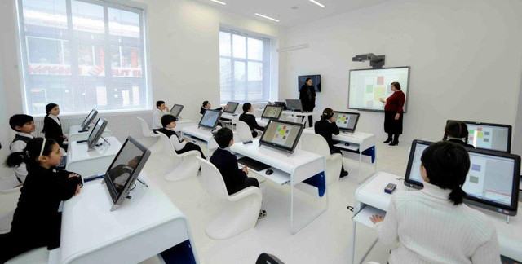
With the help of computers we can carry out exercises and receive marks. That is very interesting

Slide 4
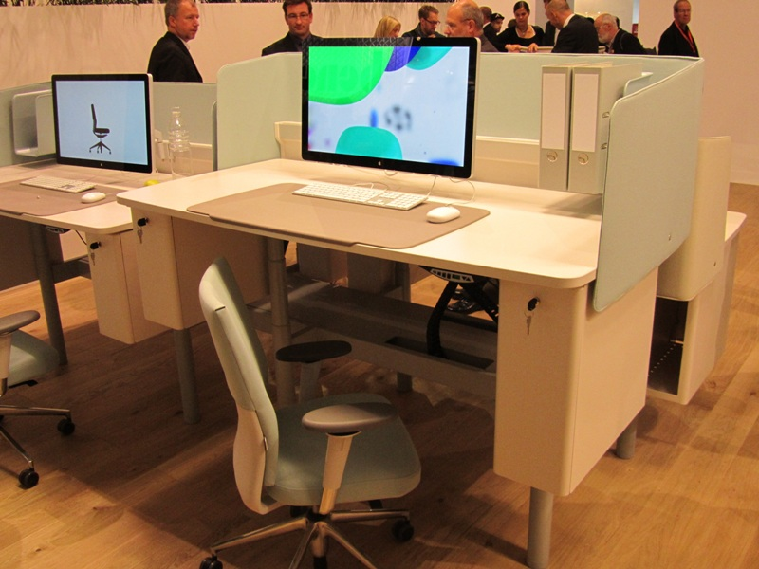
Now 1 want to tell 'you about the furniture in our classrooms. All the tables are new with computer in it, comfortable. with shelves and vases for pens

Slide 5
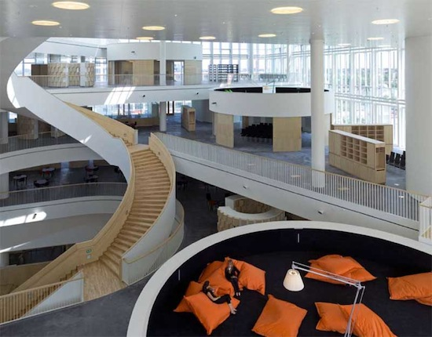
One of the parts of our cloak-room is a shower. The corridors in our school are light-filled.

Slide 6
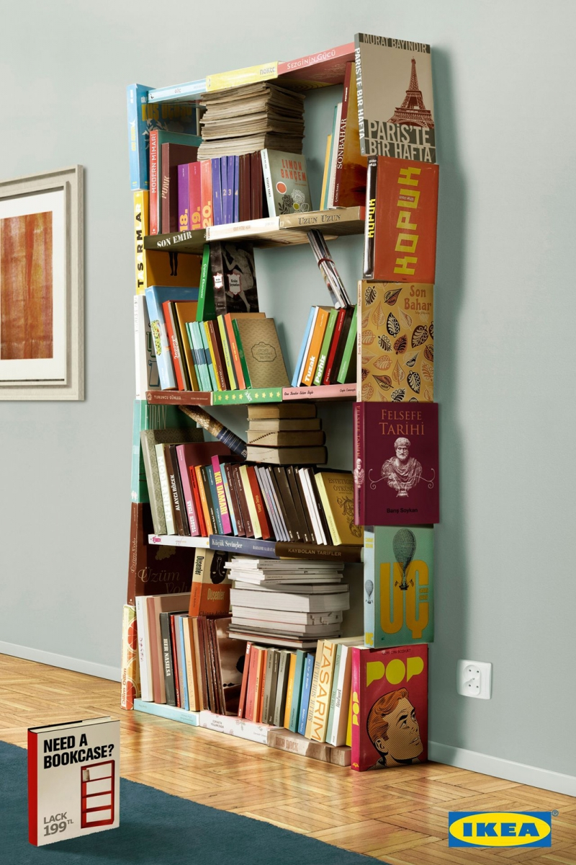
In the classroom I want to sec big bookcases with many interesting books and magazines

