Slide 1
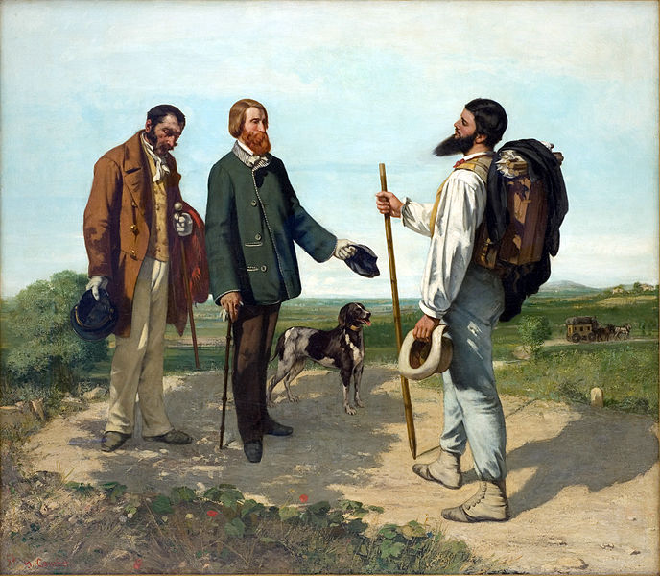
Realism
(arts)
Bonjour, Monsieur Courbet, 1854. A Realist painting by Gustave Courbet.

Slide 2
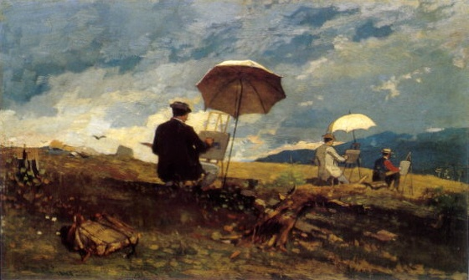
Realism in the arts may be generally defined as the attempt to represent subject matter truthfully, without artificiality and avoiding artistic conventions, implausible, exotic and supernatural elements.
The term originated in the 19th century, and was used to describe the work of Gustave Courbet and a group of painters who rejected idealization, focusing instead on everyday life

Slide 3
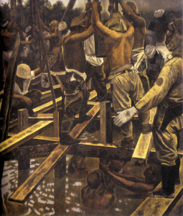
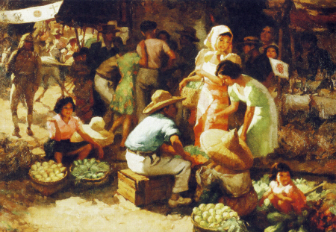
Realism or naturalism as the depiction of ordinary, everyday subjects
Realism and Naturalism were major points in which Americans began to industrialize themselves.
Marketplace during the Occupation (1942), Fernando Cueto Amorsolo, Philippines, Oil on canvas, Collection of National Heritage Board, Singapore
Engineering Corps Constructing a Bridge in Malaya (c. 1944), Shimizu Toshi, Japan, Oil on canvas, Collection of National Museum of Modern Art, Japan
Realism began to move towards images of contemporary life and society 'as they were'.

Slide 4
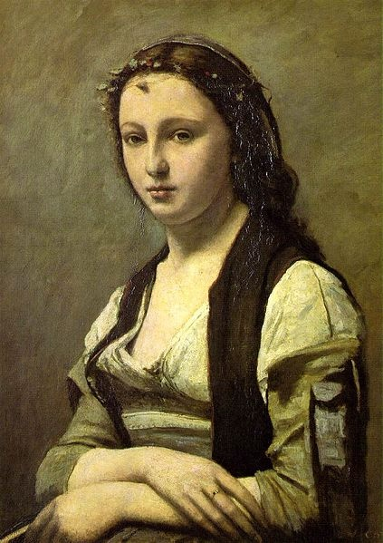
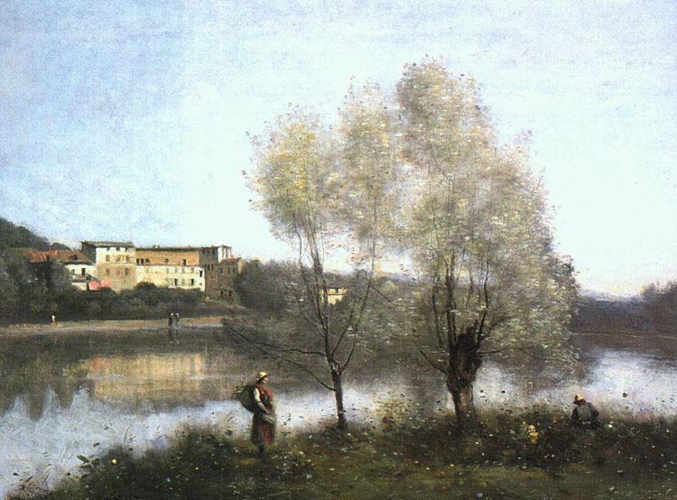
Jean-Baptiste-Camille Corot
Jean-Baptiste-Camille Corot was a French landscape painter and Portrait painter as well as a printmaker in etching. Corot was the leading painter of the Barbizon school of France in the mid-nineteenth century. He is a pivotal figure in landscape painting and his vast output simultaneously references the Neo-Classical tradition and anticipates the plein-air innovations of Impressionism.
Ville d'Avray, ca. 1867, oil on canvas. Washington, D.C.: National Gallery of Art.
Woman with a Pearl, 1868-70, Paris: Musée du Louvre.

Slide 5
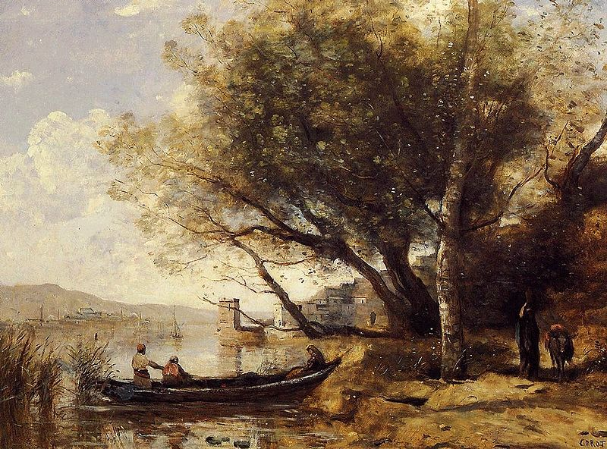
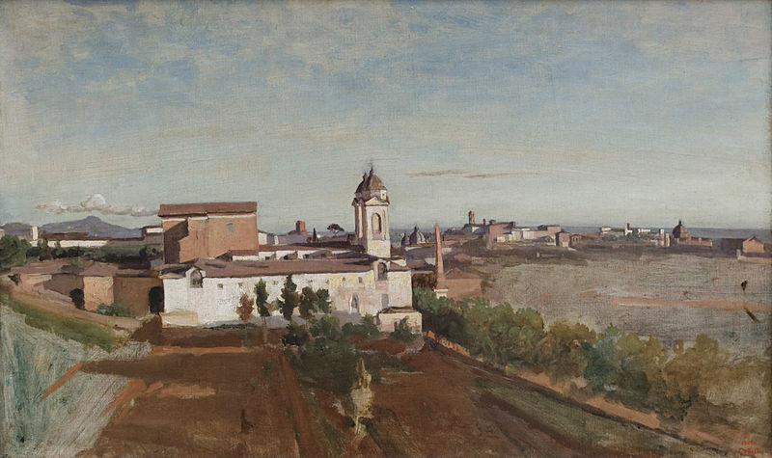
La Trinité-des-Monts, seen from the Villa Medici, 1825-1828 oil on canvas. Paris: Musée du Louvre.
Bornova, İzmir, 1873

Slide 6
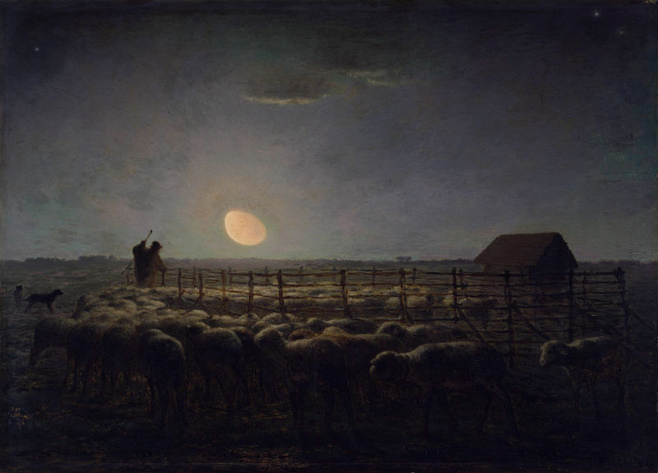
Jean-François Millet
Jean-François Millet was a French painter and one of the founders of the Barbizon school in rural France. Millet is noted for his scenes of peasant farmers; he can be categorized as part of the movements of Realism and Naturalism.
In this painting by Millet, the waning moon throws a mysterious light across the plain between the villages of Barbizon and Chailly. The Walters Art Museum.

Slide 7
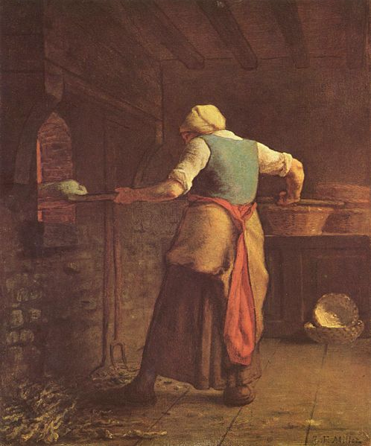
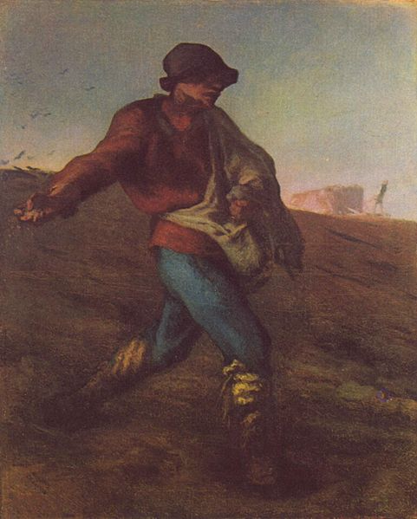
Woman Baking Bread, 1854. Kröller-Müller Museum, Otterlo.
The Sower, 1850. Museum of Fine Arts, Boston.

Slide 8
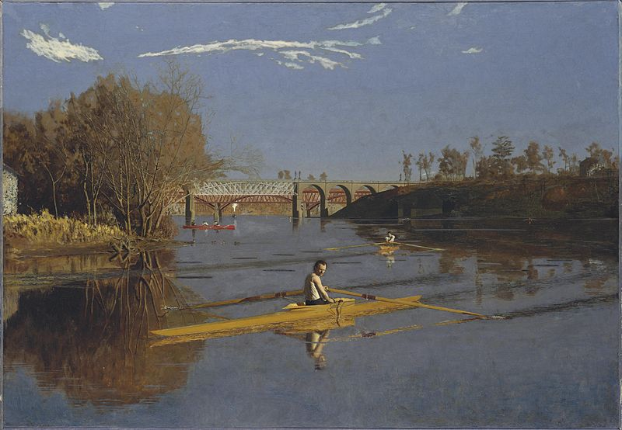
Thomas Cowperthwait Eakins
Thomas Cowperthwait Eakins was an American realist painter, photographer,sculptor, and fine arts educator. He is widely acknowledged to be one of the most important artists in American art history.
Max Schmitt in a single scull (1871), Metropolitan Museum of Art, New York.

Slide 9
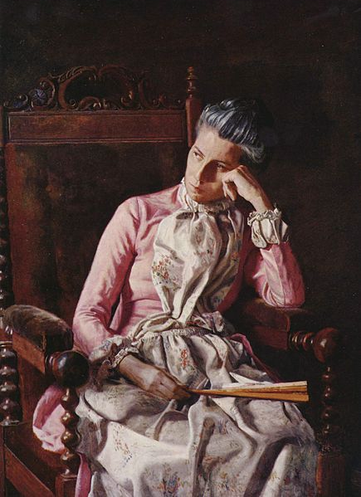
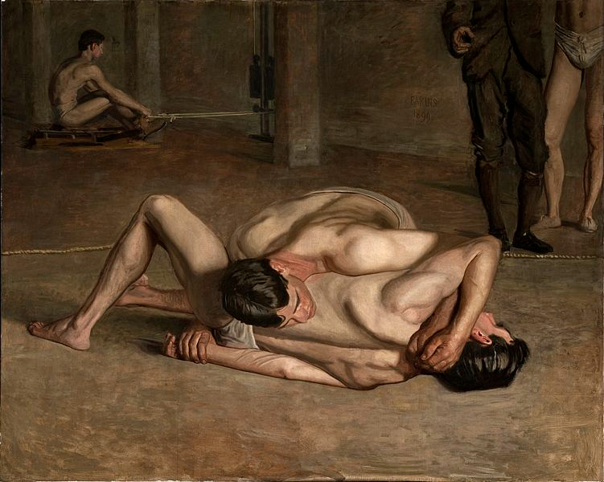
Miss Amelia Van Buren, ca. 1891, The Phillips Collection, Washington DC
Wrestlers, 1899, Los Angeles County Museum of Art, Los Angeles, California.

Slide 10
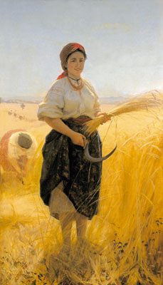
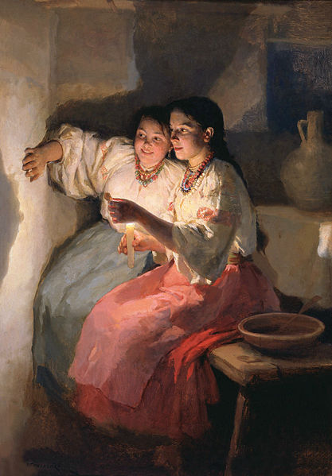
Mykola Kornylovych Pymonenko
was a Ukrainian painter. One of the most eminent Ukrainian genre painters Pymonenko was widely acclaimed in the Russian Empire; A member of the Imperial Academy of Arts since 1904 and of a progressive Peredvizhniki artistic movement and the turn of the century.
Harvester, Oil on canvas. 1889, National Art Museum of Ukraine, Kiev
Mykola Pymonenko. Fortune-Telling on Christmastide. 1888. The State Russian Museum, Saint Petersburg

Slide 11
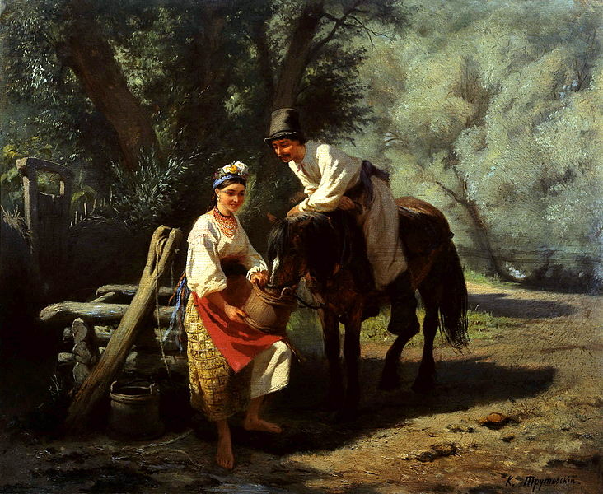
Konstiantyn Trutovsky
Konstiantyn Trutovsky was a Russian-Ukrainian realist painter and graphic artist.
His artistic heritage includes numerous genre screens on Ukrainian themes. He was interested in ethnography and depicted colorful Ukrainian folk customs, not shying away from "a dash of good humour". Like Taras Shevchenko, Ukraine's foremost bard, Trutovsky described the miserable and hopeless life of the peasant.
By the water well by Trutovsky

Slide 12
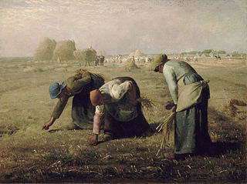
The Gleaners (Jean-Francois Millet)
This painting is a great example of realism. It shows three peasant women gleaning a field for some scraps of wheat. They are bent over in hard work in the hope of finding a tiny bit of food. This painting was not well received by the French upper class when it was first exhibited in 1857 as it showed the harsh reality of poverty.

Slide 13
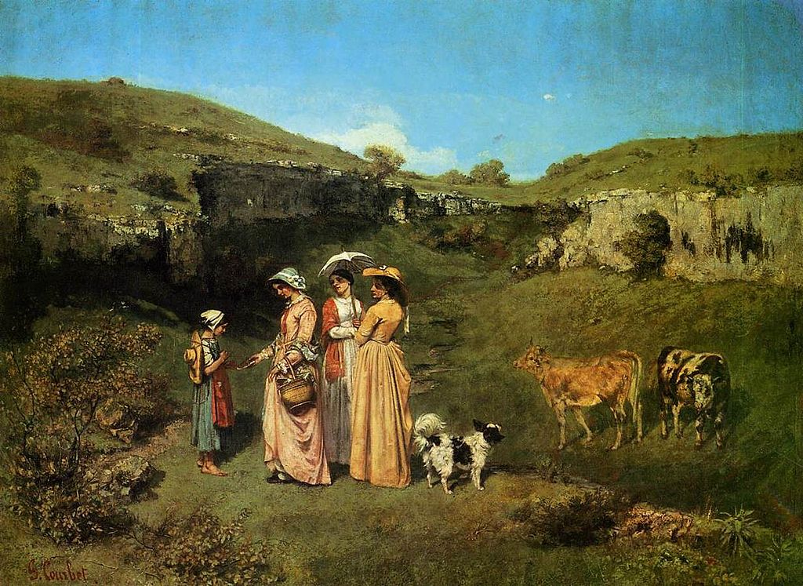
Young Women from the Village (Gustave Courbet)
The reality of this painting is in stark contrast to Romanticism. The three women are dressed in their country clothes and the landscape is rough and a little ugly. Even the cows are scraggly looking. The rich lady is handing some money to the poor girl while the others look on. Courbet was criticized for the "reality" of this painting, but that was what he found beautiful and was trying to capture.

Slide 14
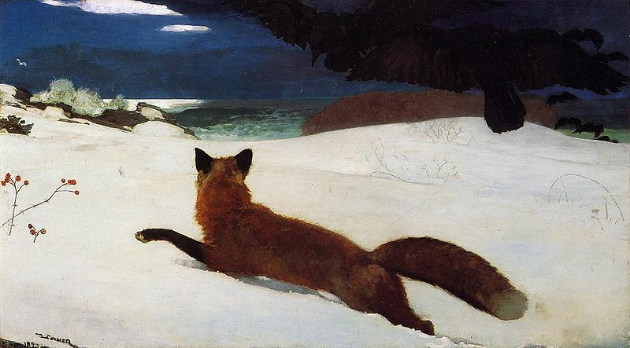
The Fox Hunt (Winslow Homer)
In this painting Winslow Homer shows a hungry fox hunting in the snow for food. At the same time there are ravens which are so driven to hunger they are hunting the fox. There is nothing heroic or romantic about this painting, just the reality of what happens in the winter to hungry animals.

Slide 15
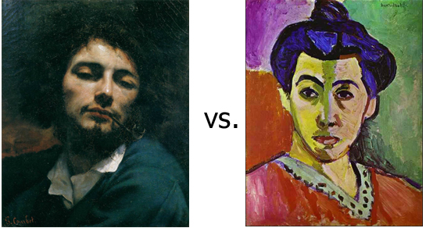
Realism vs Fauvism: How will you paint?
There is a big difference between Realism and Fauvism.

Slide 16
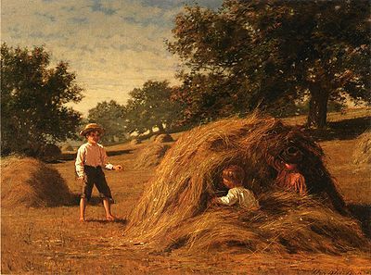
Realist painting is an art form that requires copying every single detail from the hair on the farmer to the wrinkles on the tree. It’s making sure that the sky stays blue and the sea stays green. Thus, someone capable of following the rules – imitating every single detail and colour onto the canvas will be successful.

Slide 17
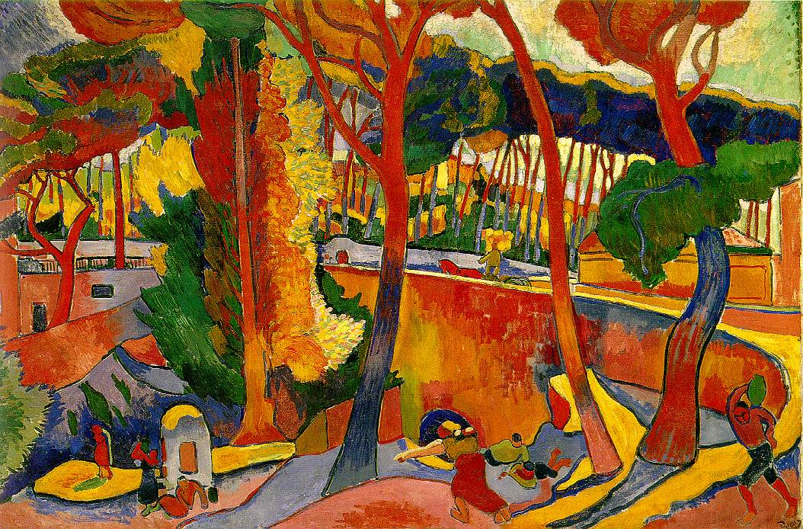
Fauvist painting on the other hand requires much less physical skill but will take much more creativity. Artists of this style emphasize strong colour over the representation of realistic subjects. This is when the sky can be red and the sea can be aquamarine. A much deeper level of skill is needed– the ability to creatively interpret the subject using colours to communicate an emotional response to a scene.

Slide 18
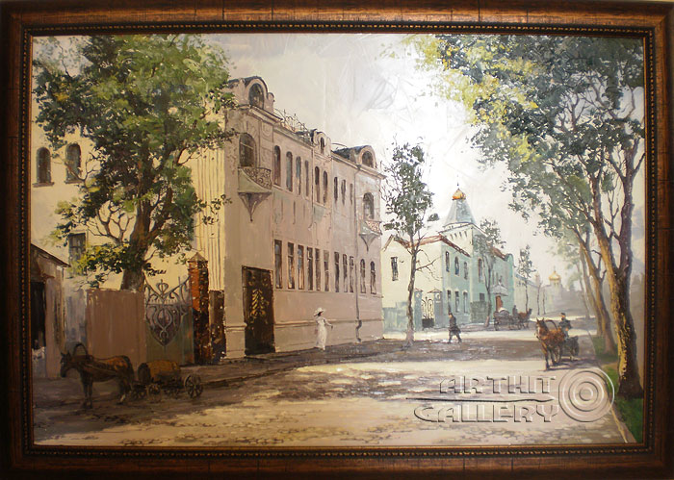
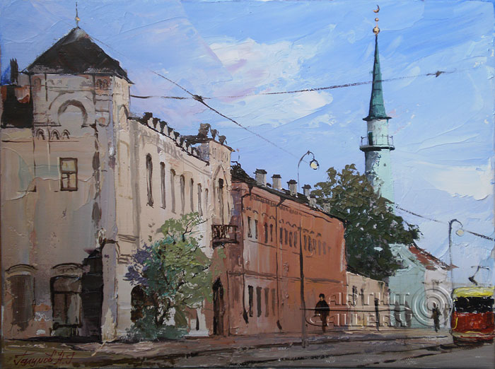
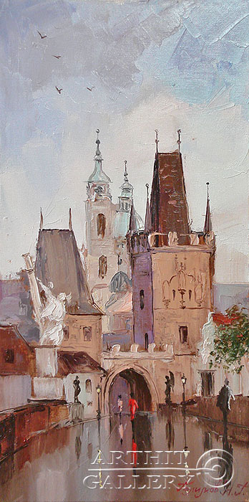
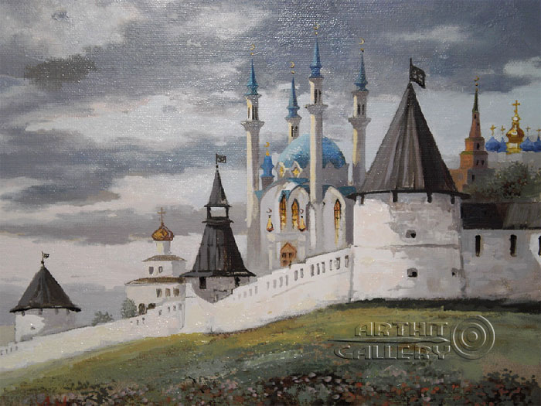
Ufa. Alexandrovskaya Street
Kazan. Tukaevskaya Street
Prague
Kazan Kremlin. View of the Kul-Sharif Mosque

Slide 19
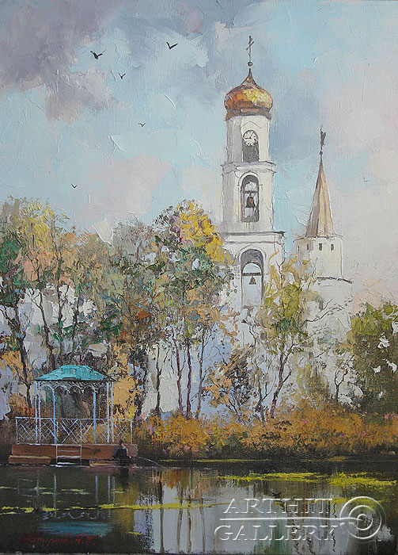
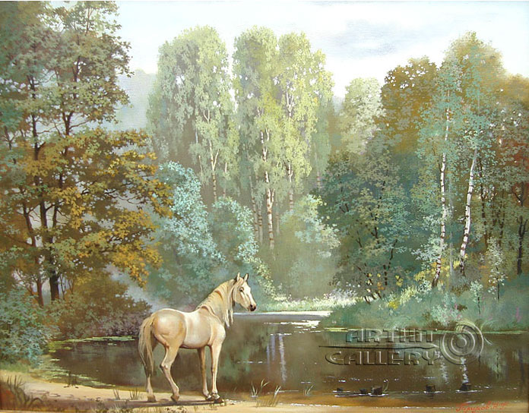
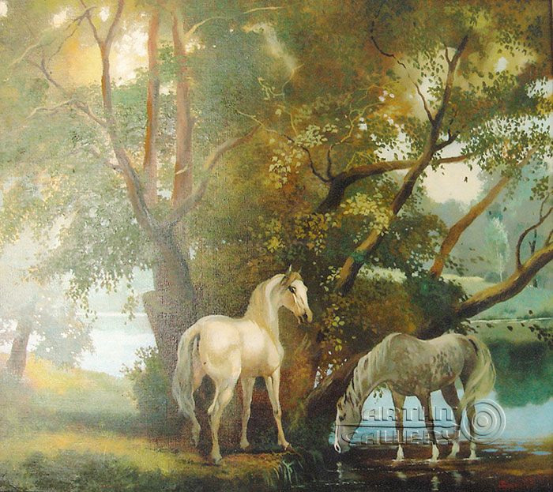
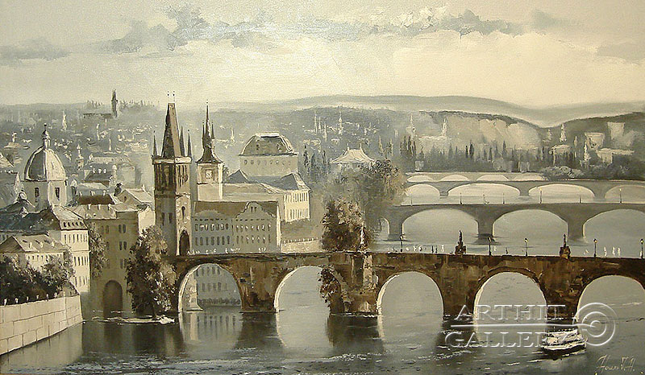
Raifsky Monastery
Forest lake
Charles Bridge (Prague)
Under the shady willows

Slide 20
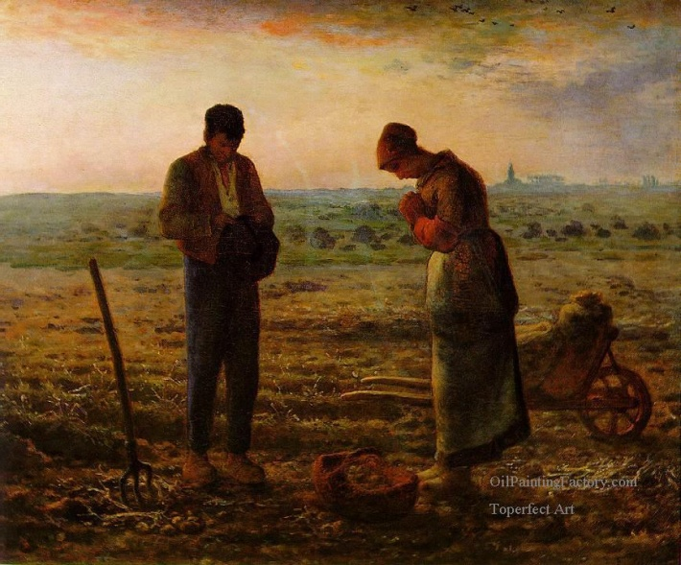
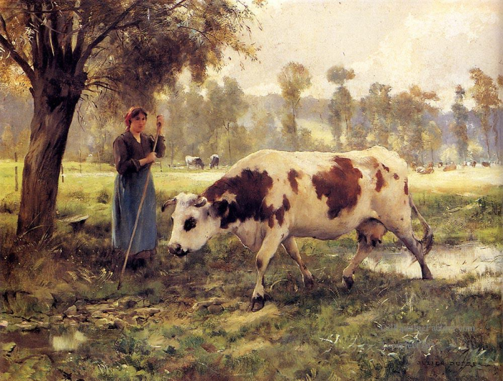
Interesting Facts about Realism
• The Realism movement started in France after the 1848 revolution.
• Unlike some other artistic movements, there was little sculpture or architecture as part of this movement.
• Near the end of the Realism movement, a school of art called the Pre-Raphaelite Brotherhood immerged. This was a group of English poets, artists, and critics. They felt the only true art was the High Renaissance.
• The invention of photography in 1840 likely helped to spur on the realism movement.

Slide 21
http://www.orgsites.com/de/english11story/_pgg8.php3
http://en.wikipedia.org/wiki/Realism_(arts)
http://www.ducksters.com/history/art/realism.php
http://opencontours.com/2010/05/19/realism-in-asia/
http://en.wikipedia.org/wiki/Jean-Baptiste-Camille_Corot
http://col0urblind.wordpress.com/2011/05/08/realism-vs-fauvism-how-will-you-paint/
http://en.wikipedia.org/wiki/Mykola_Pymonenko
http://shelf3d.com/i/realism%20(art)
http://en.wikipedia.org/wiki/Jean-François_Millet
http://en.wikipedia.org/wiki/Thomas_Eakins
http://www.artcyclopedia.com/history/realism.html
http://www.arthit.ru/realism/0153/realism.html
http://en.wikipedia.org/wiki/Konstiantyn_Trutovsky

