Slide 1
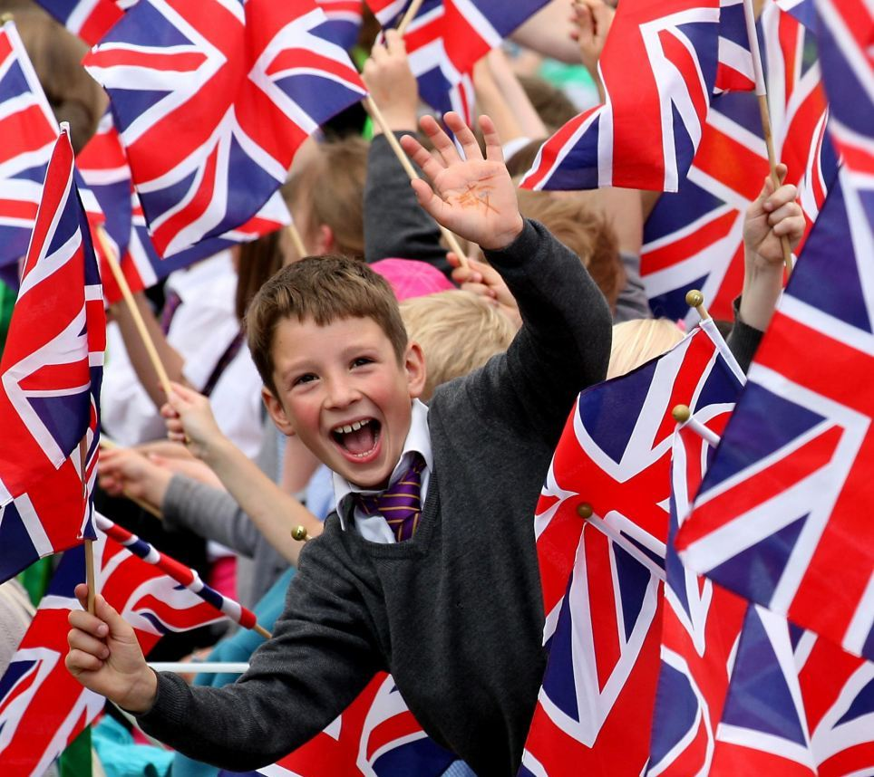
School Life in Britain

Slide 2

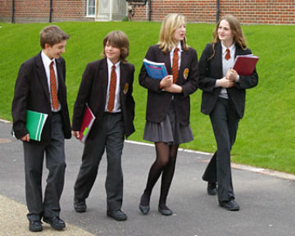
The School Uniform

Slide 3

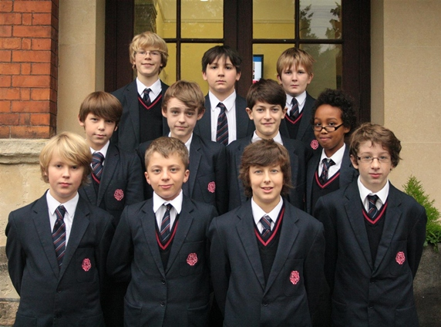

School Ages

Slide 4


School Holidays
Term 1 - September to October (followed by a one week holiday)
Term 2 - October to December (followed by a two week holiday)
Term 3 - January to February (followed by a one week holiday)
Term 4 - February to March (followed by a two week holiday)
Term 5 - April to May (followed by a one week holiday)
Term 6 - June to July (followed by a six week summer holiday)

Slide 5
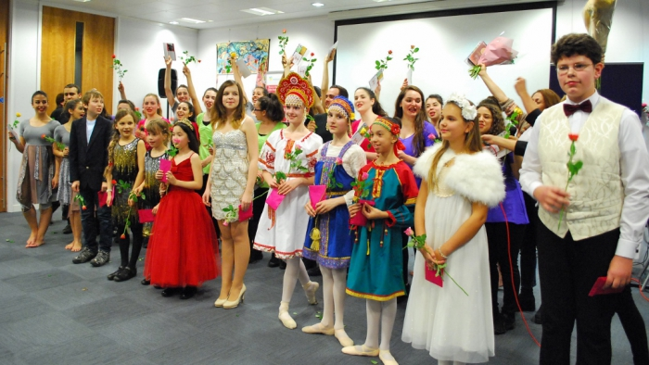
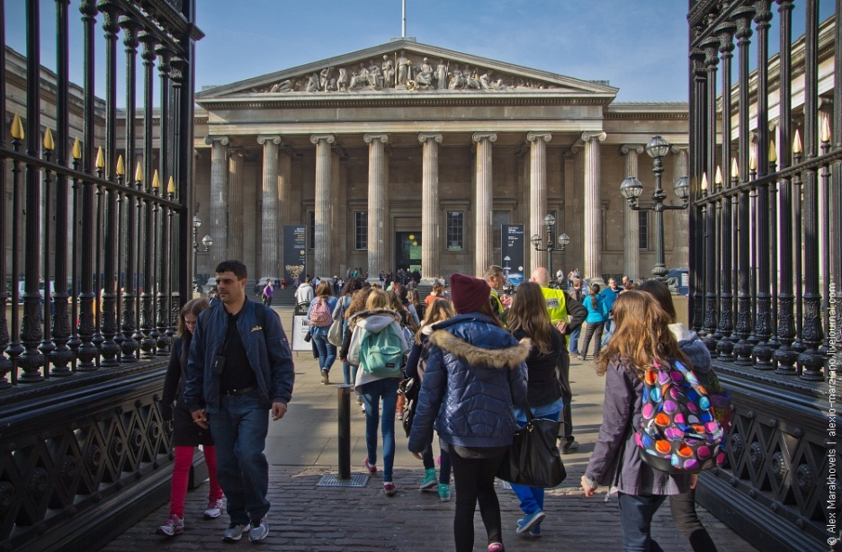
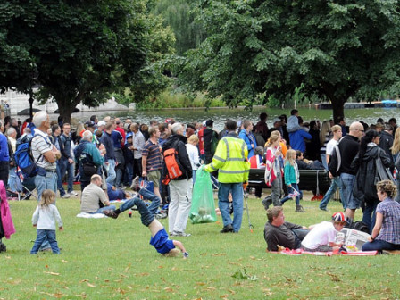
School Events
School Trips
Sport days

