Slide 1
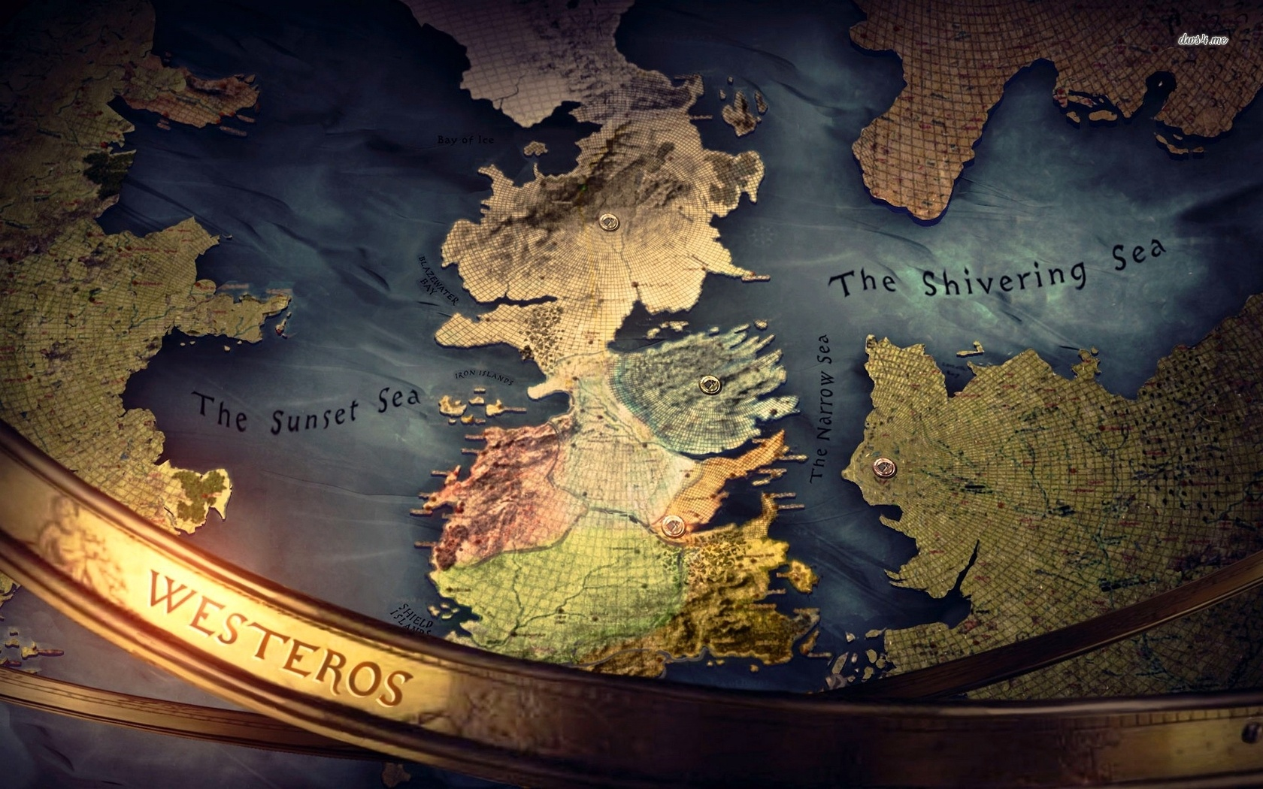
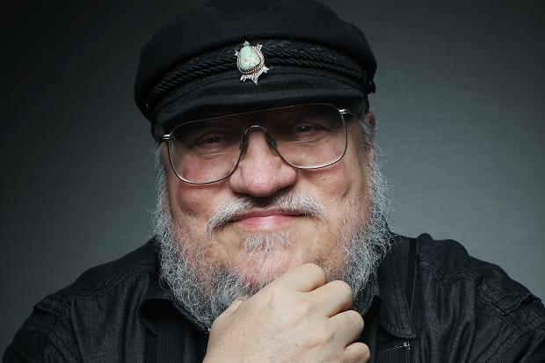
George Martin

Slide 2
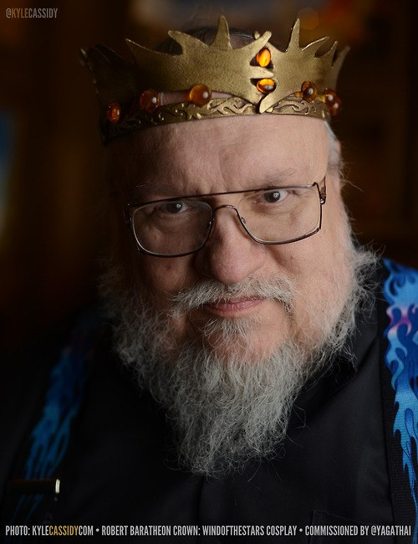
GE
OR
GE
MARTIN
George Raymond Richard Martin (born September 20, 1948), often referred to as GRRM, is an American novelist and short story writer in the fantasy, horror and science fiction genres, as well as a screenwriter and television producer. He is best known for A Song of Ice and Fire, his international bestselling series of epic fantasy novels. Martin was selected by Time magazine as one of the "2011 Time 100," a list of the "most influential people in the world."

Slide 3
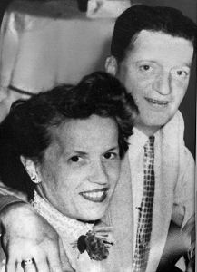
GE
OR
GE
MARTIN
George Raymond Martin was born on September 20, 1948,in Bayonne, New Jersey. The son of longshoreman Raymond Collins Martin and his wife Margaret Brady Martin. He has two younger sisters, Darleen and Janet. The family first lived in a house on Broadway, belonging to Martin's great-grandmother.
In 1953 they moved to a federal housing project near the Bayonne docks. During his childhood, his whole world consisted predominantly of "First Street to Fifth Street", between his grade school and his home.

Slide 4
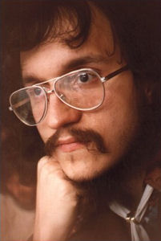
GE
OR
GE
MARTIN
The young Martin began writing and selling monster stories for pennies to other neighborhood children, dramatic readings included.
Martin attended Mary Jane Donohoe School and then later Marist High School.
In 1970 Martin earned a B. S. in Journalism from Northwestern University, Evanston, Illinois, graduating summa cum laude, meaning "with highest honor". He went on to complete a M.S. in Journalism in 1971, also from Northwestern.

Slide 5
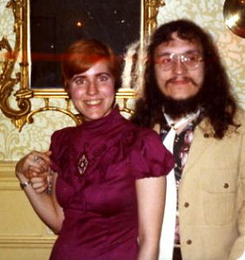
GE
OR
GE
MARTIN
The sudden death of friend and fellow author Tom Reamy in the fall of 1977 made him reevaluate his own life, and he eventually decided to try to become a full-time writer.
Martin began selling science fiction short stories professionally in 1970, at age 21. His first sale was "The Hero", sold to Galaxy magazine and published in its February 1971 issue; other sales soon followed. His first story to be nominated for the Hugo Award.
In 1975 he married Gale Burnick. They divorced in 1979, with no children.

Slide 6
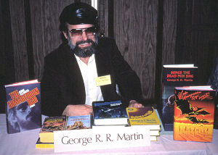
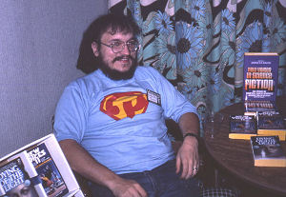
GE
OR
GE
MARTIN
Moving on to Hollywood, Martin signed on as a story editor for Twilight Zone at CBS Television in 1986. In 1987 Martin became an Executive Story Consultant for Beauty and the Beast at CBS. In 1988 he became a Producer for Beauty and the Beast, then in 1989 moved up to Co-Supervising Producer. He was Executive Producer for Doorways, a pilot which he wrote for Columbia Pictures Television, which was filmed during 1992-93.
Martin's novella, Nightflyers, was adapted into a 1987 feature film of the same title; he was not happy about having to cut plot elements for the screenplay's scenario in order to accommodate the film's small budget.

Slide 7
A Song of Ice and Fire
A Song of Ice and Fire is a series of epic fantasy novels written by American novelist and screenwriter George R. R. Martin. Martin began the first volume of the series, A Game of Thrones, in 1991. He published it in 1996. In November 2005, A Feast for Crows, the fourth novel in this series, became The New York Times No. 1 Bestseller and also achieved No. 1 ranking on The Wall Street Journal bestseller list. Martin gradually extended his originally intended trilogy to seven volumes, the fifth of which, A Dance with Dragons, took him five years to write before its publication in 2011. Two more novels are planned and still being written in the Ice and Fire series: The Winds of Winter and A Dream of Spring.

Slide 8
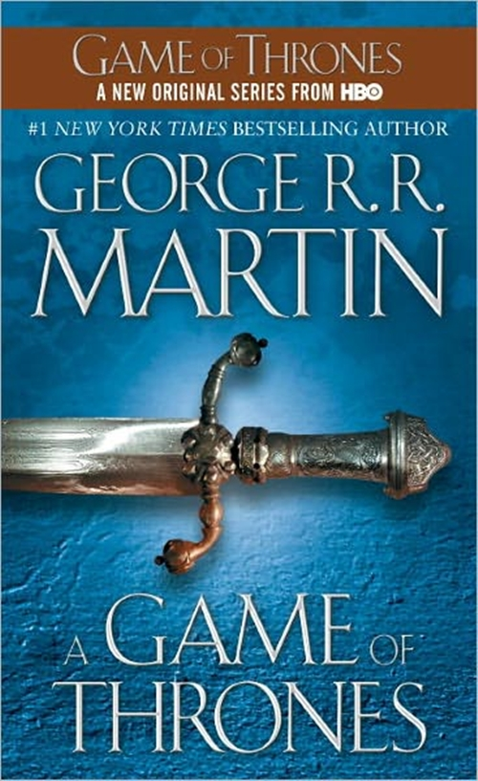
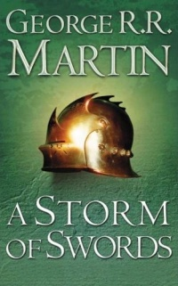
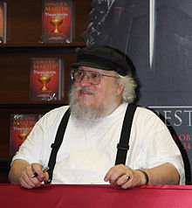
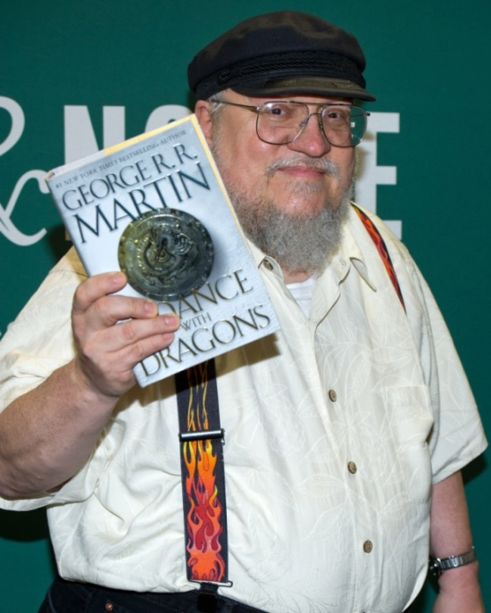
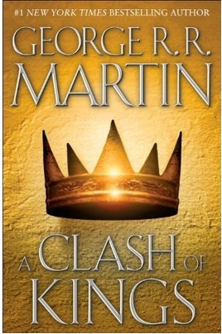
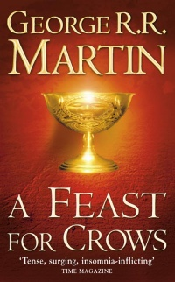

Slide 9
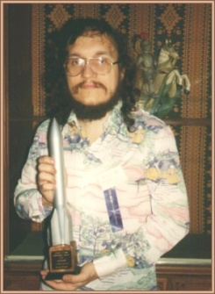
AWARDS AND HONORS
A Game of Thrones
Ignotius Award, Best Foreign Novel of 2002
A Storm of Swords
#1 on SF Site Readers’ Choice Best SF and Fantasy Books of 2000
A Clash of Kings
1999 Nebula Award nomination
Tops Locus Poll for Best Fantasy Novel of 1999
A Feast for Crows
2006 Hugo Award nomination for Best Novel
2006 Locus Award nomination for Best Fantasy Novel A Dance with Dragons
2012 World Fantasy Award nomination for Best Novel
2012 Hugo Award nomination for Best Novel
2012 Locus Award winner for Best Fantasy Novel
The Armageddon Rag
Balrog Award, 1983 Fantasy Novel

