Slide 1
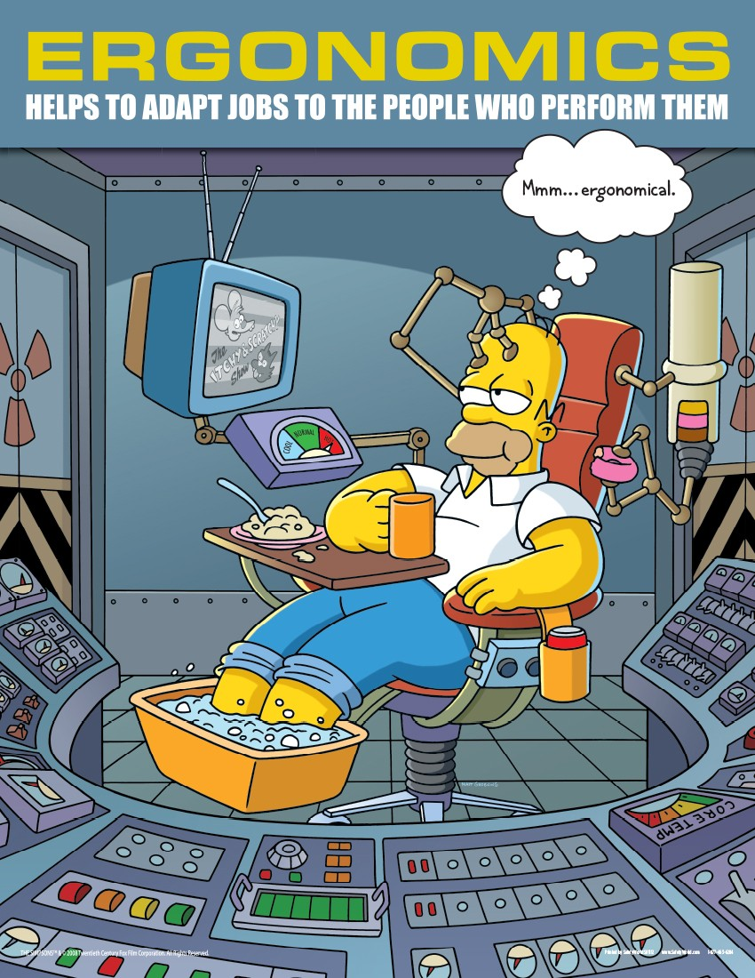

Slide 2
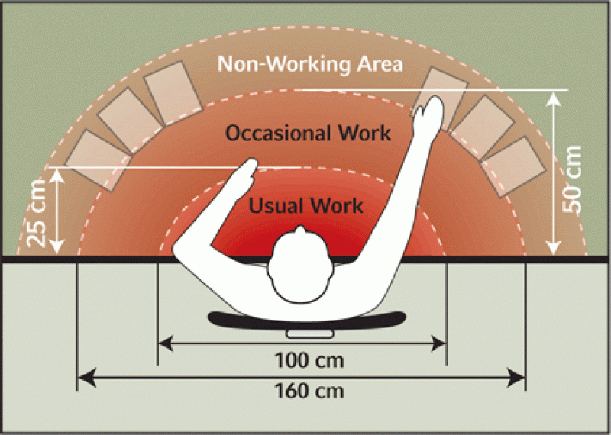
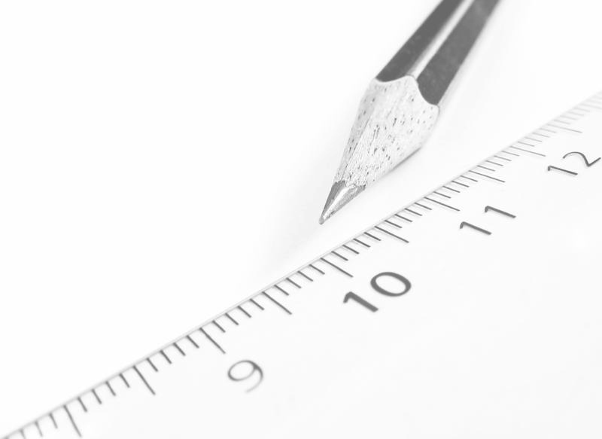
CONCEPT OF ERGONOMICS
Ergonomics - the science that studies the problems arising in the "human-technology system" in order to optimize the work of the operator, creating for him a comfortable and safe environment, thereby improving productivity, health and performance.

Slide 3


Slide 4

ЦЕЛИ ЭРГОНОМИКИ
The first objective of ergonomics - improving the effectiveness of the "human-technology environment."
The second objective of ergonomics - safety.
The third objective of ergonomics - ensuring conditions for the development of the individual in the labor process.

Slide 5
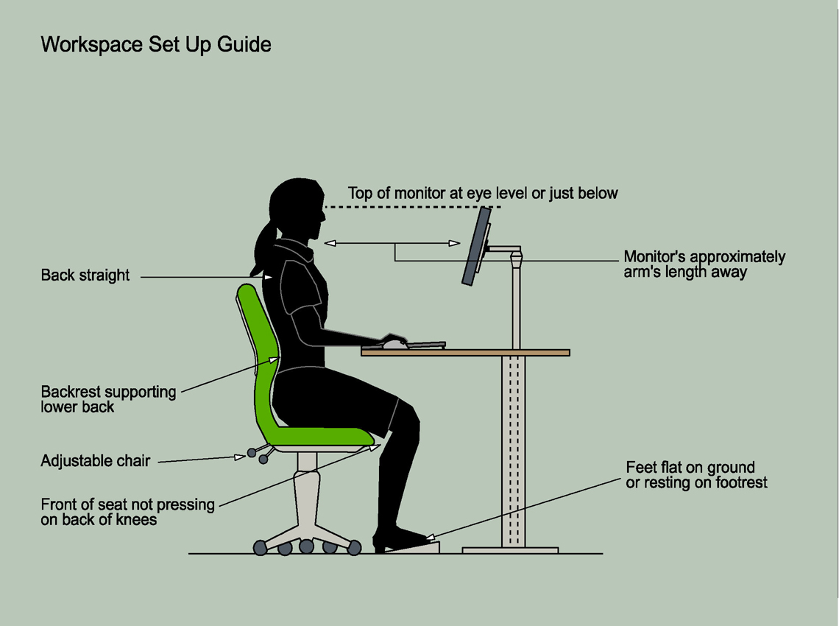

Slide 6
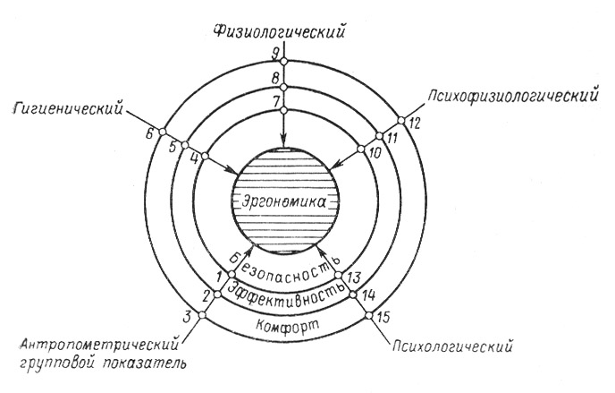
The composition and structure of ergonomics

Slide 7
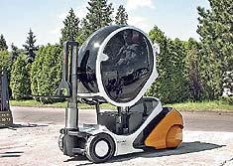

Interaction between humans and tools
Human functions in the production process:
• energy
• technological
• control and regulating
• management

Slide 8
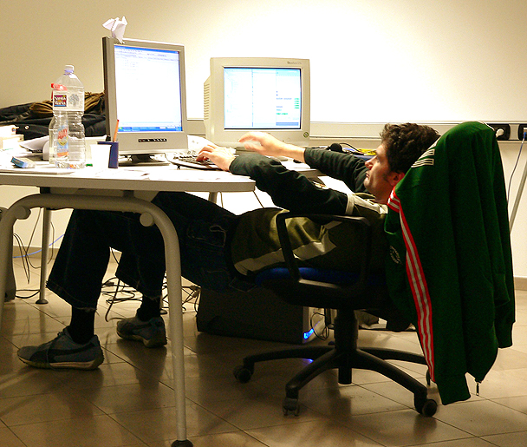

Slide 9
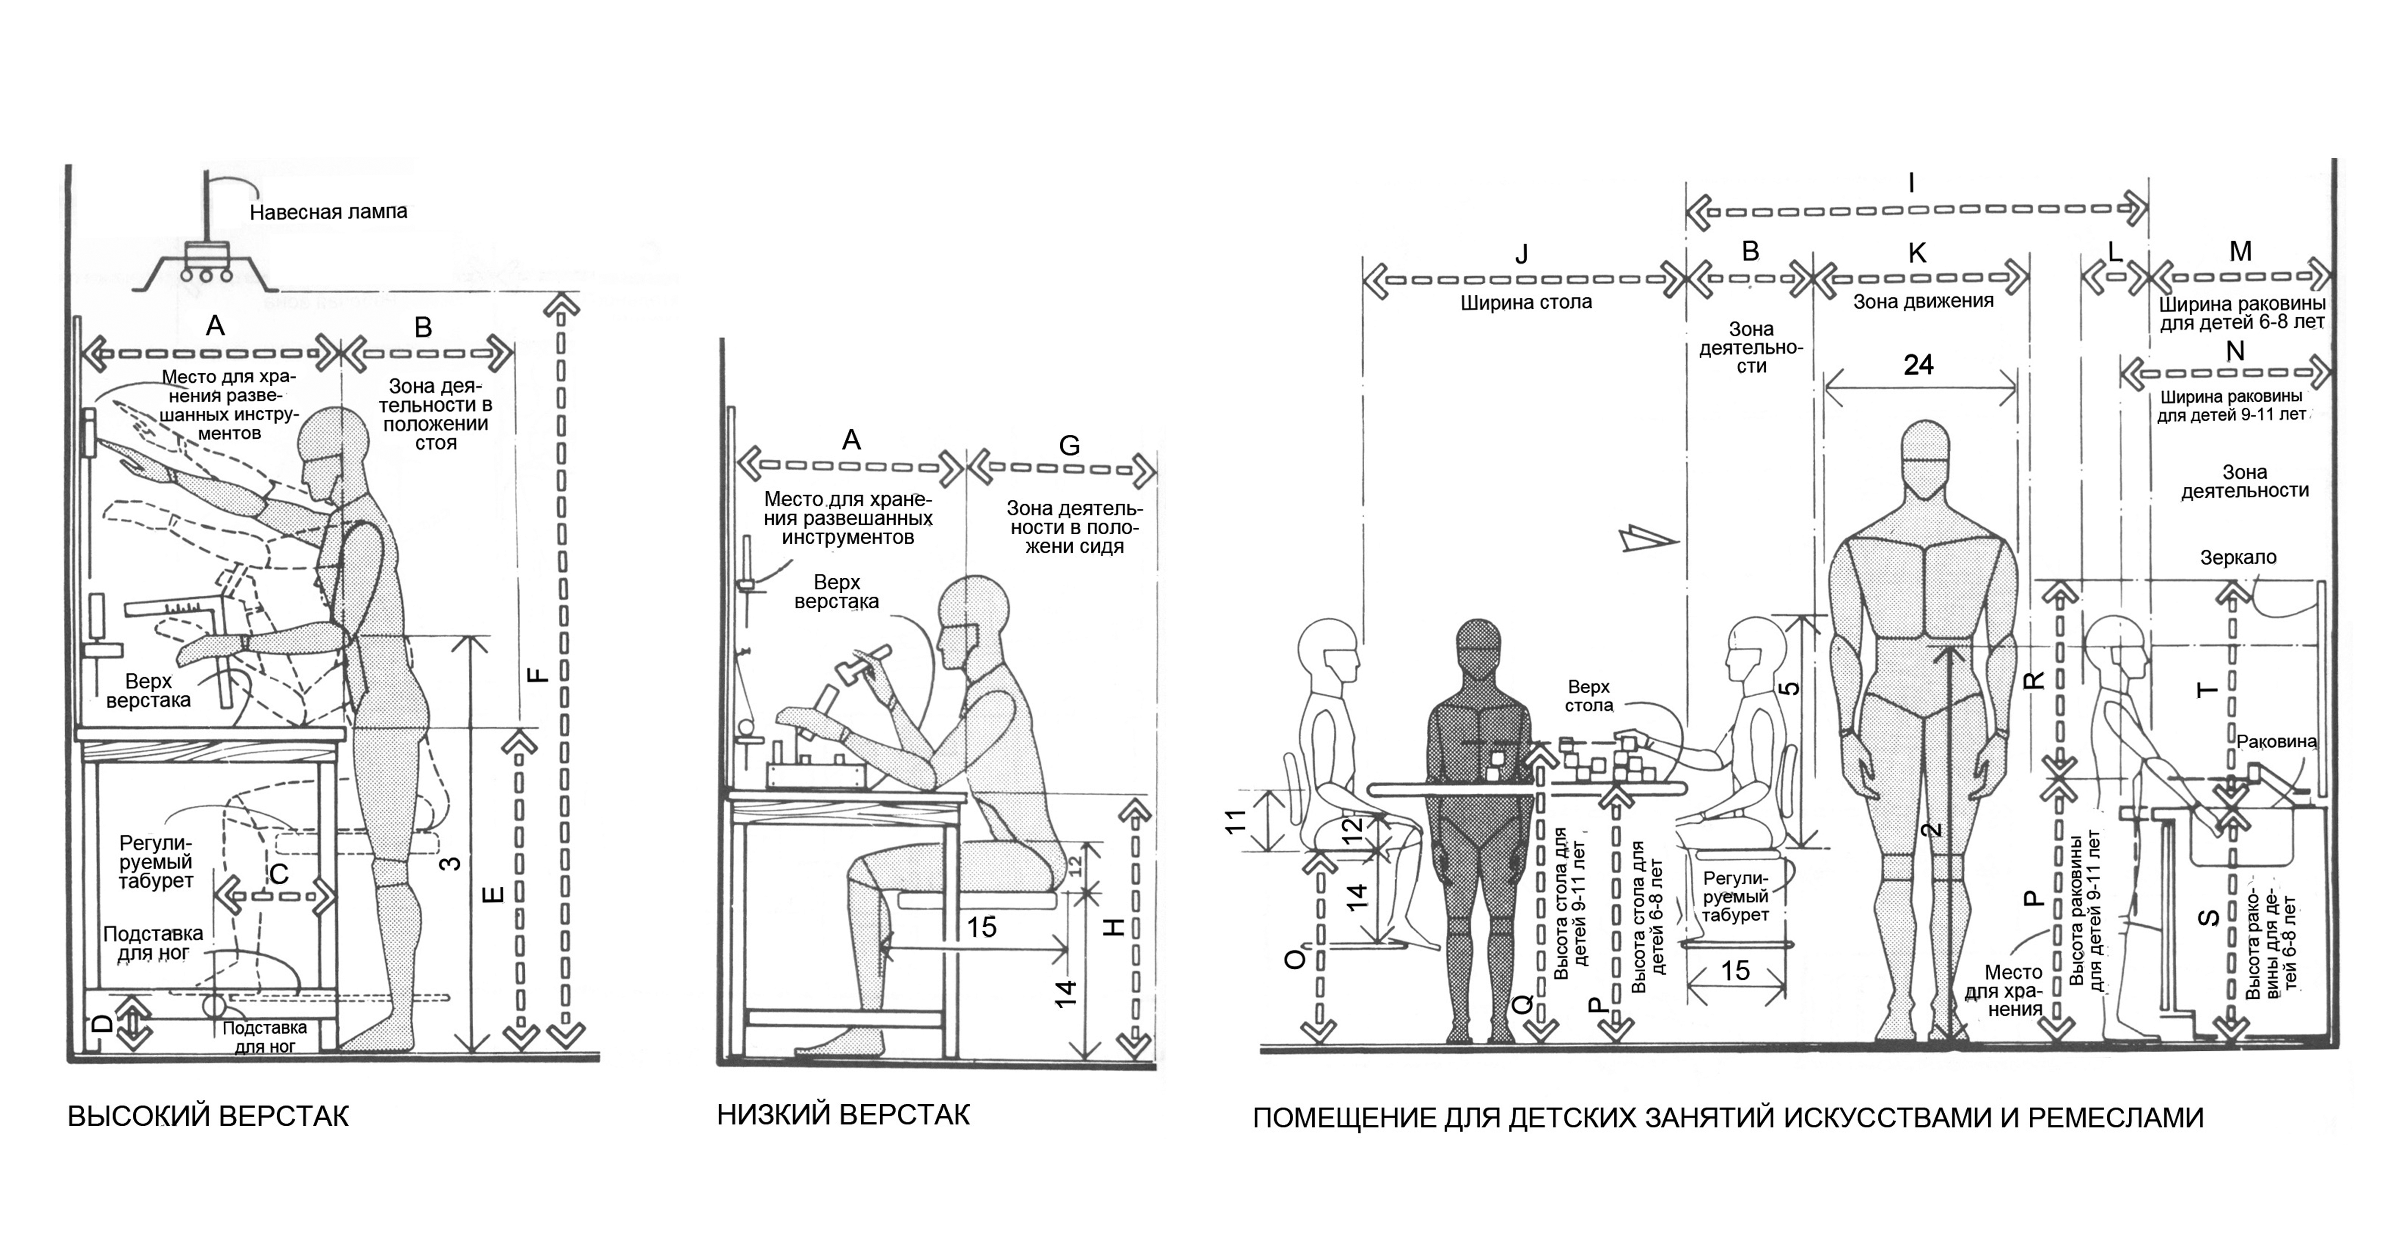
The design meets the industrial equipment of workplace organization anthropometric and physiological data contributes to the rational human interaction between man and the instruments of labor and increases the efficiency and effectiveness of the work.

Slide 10


Slide 11
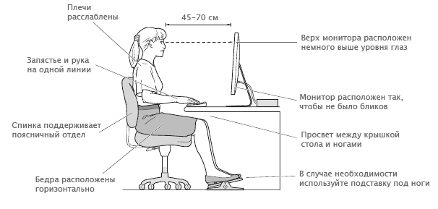
The basis of the workplace are the consoles and panels, on which are placed the controls (buttons and keys, toggle switches, knobs, flywheels, rotary switches, foot pedals), and display facilities.

