Slide 1
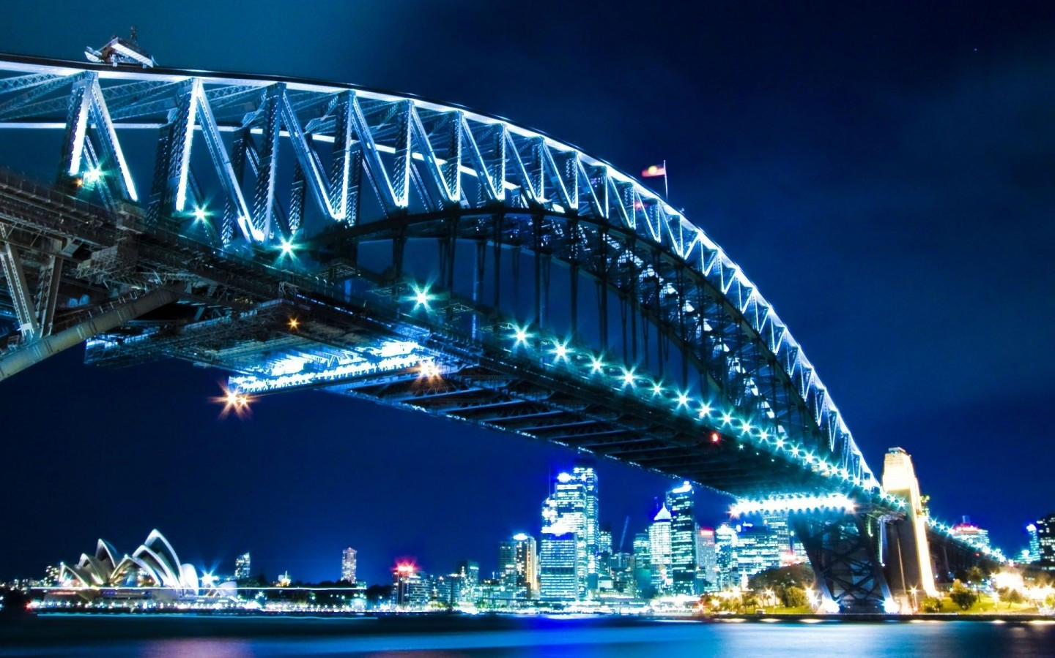
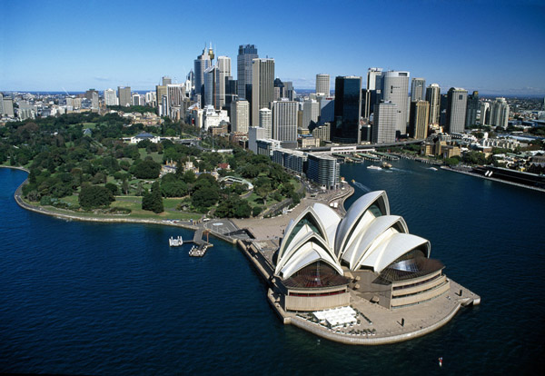
Australia

Slide 2
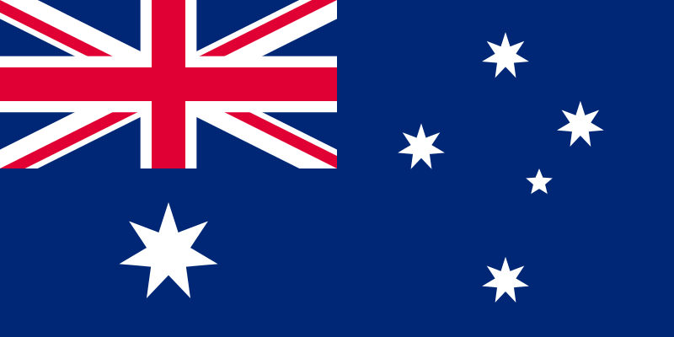
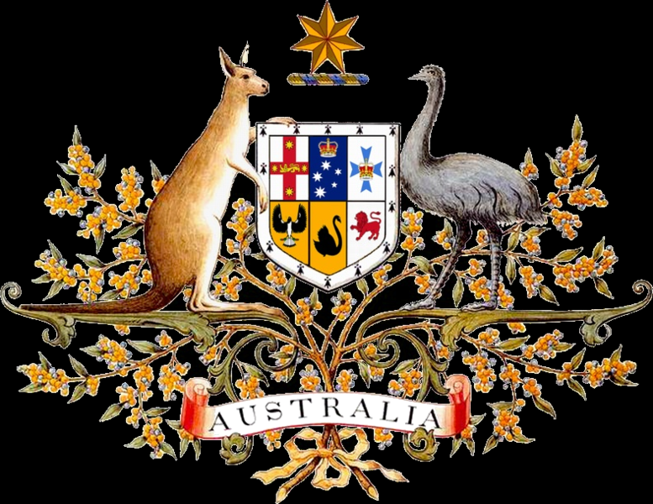
Commonwealth of Australia
Coat of Arms
Flag

Slide 3
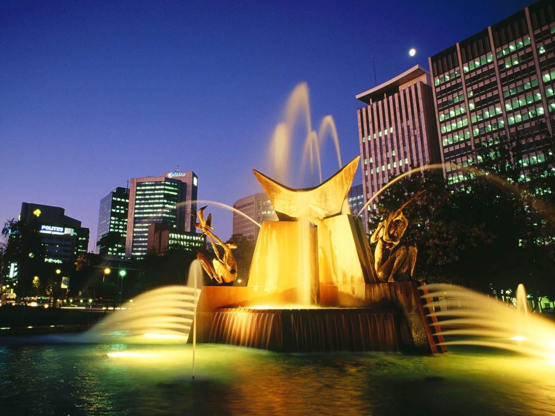
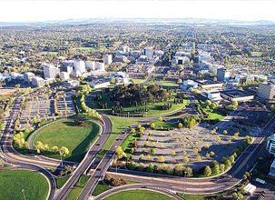
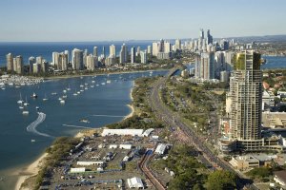
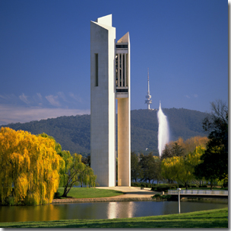
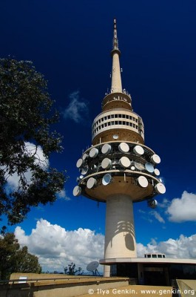

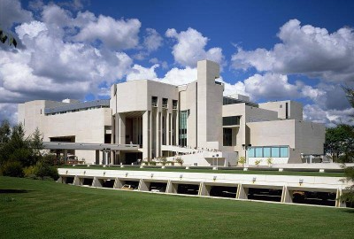
Canberra is the capital city of Australia

Slide 4
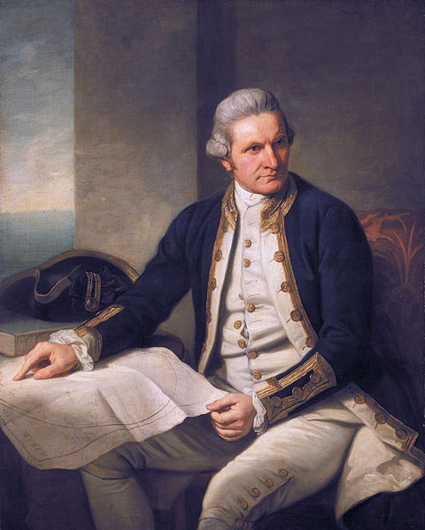
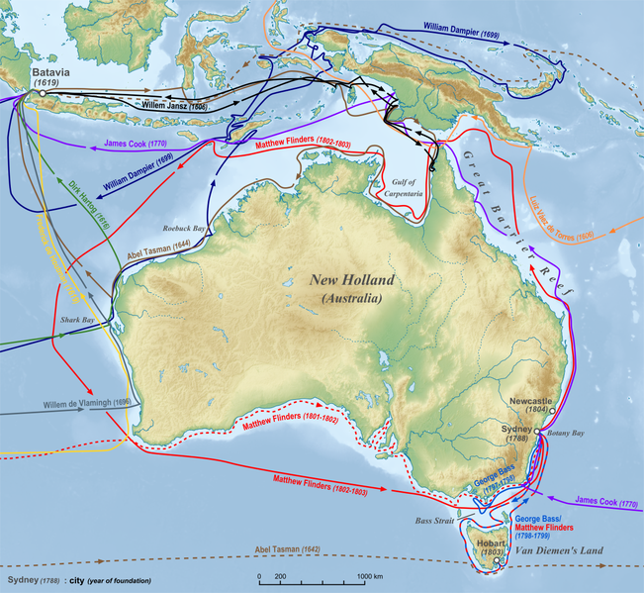
History
Portrait of Captain James Cook, the first European to map the eastern coastline of Australia in 1770.
Exploration of what was then New Holland by Europeans until 1812

Slide 5
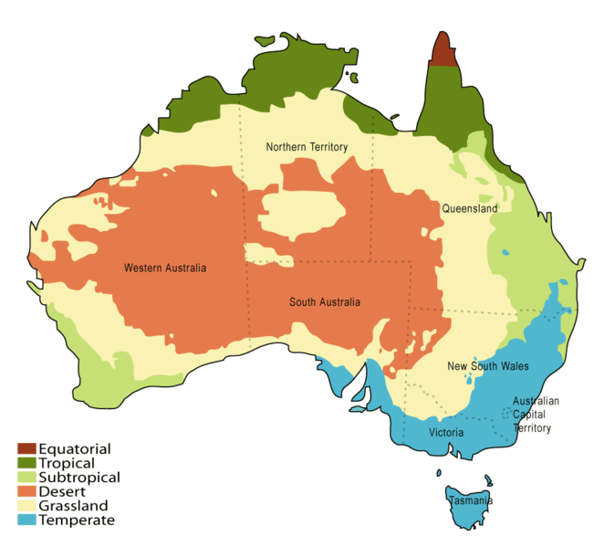
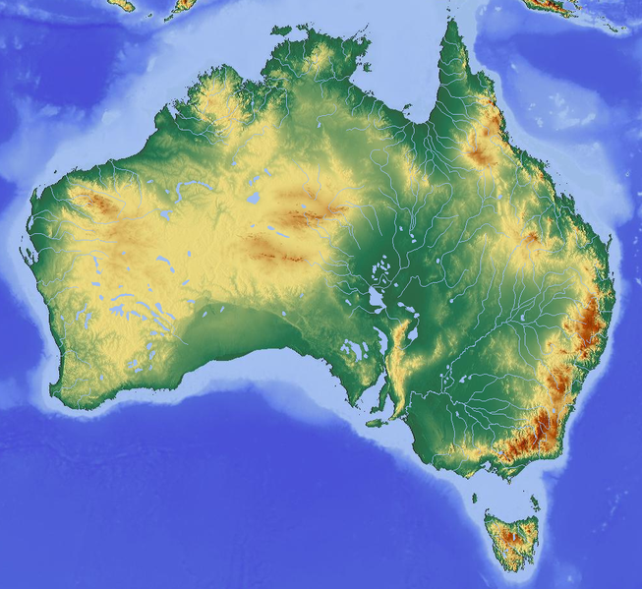
Location and Geography
Topographic map of Australia
Climatic zones in Australia

Slide 6
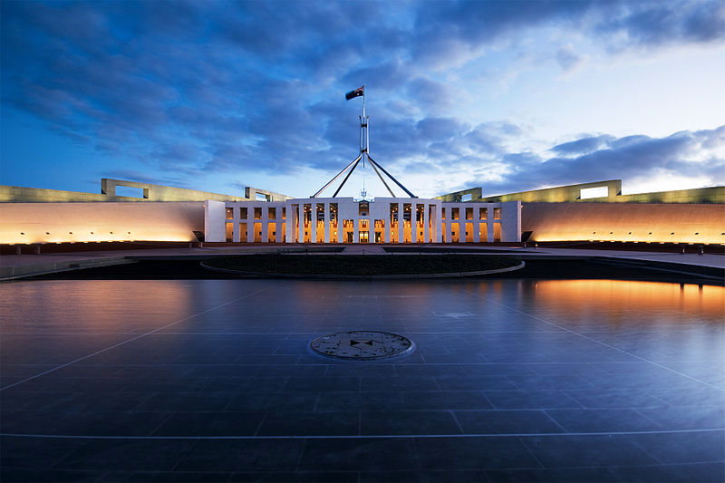
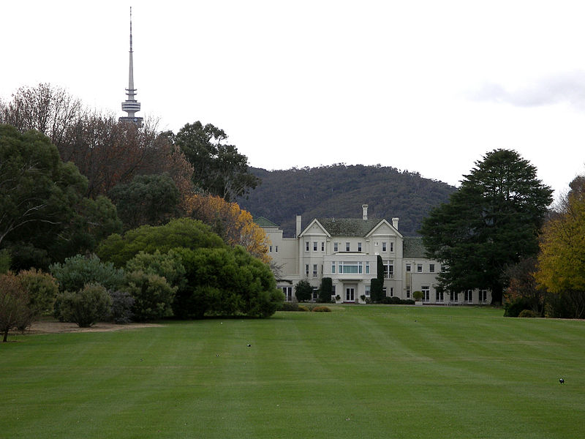
Government
Government House, Canberra, also known as "Yarralumla", is the official residence of the Governor-General.
Parliament House, Canberra was opened in 1988

Slide 7
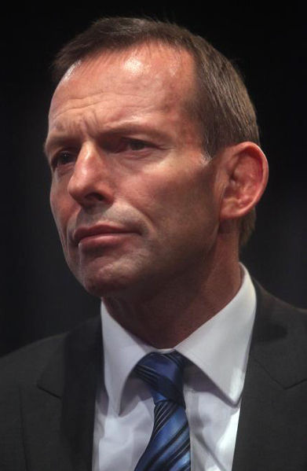
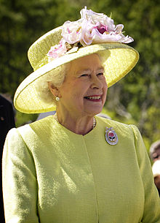
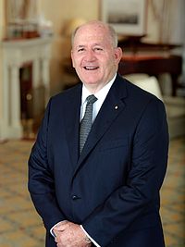
Queen Elizabeth II
Governor-General of Australia
Tony Abbott, Prime Minister of Australia

Slide 8
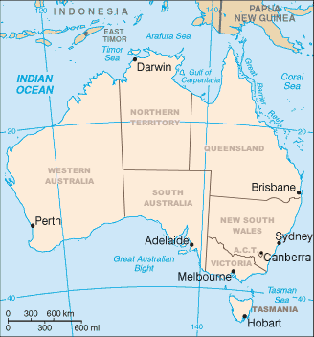

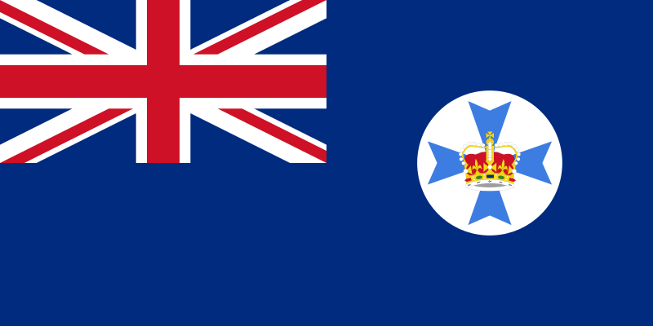
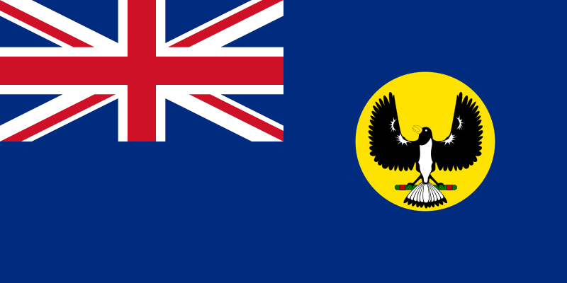
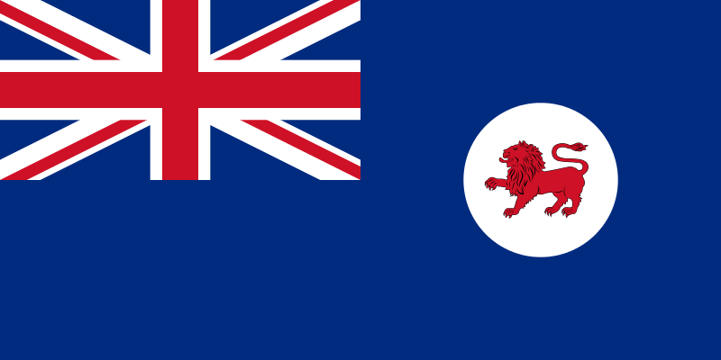
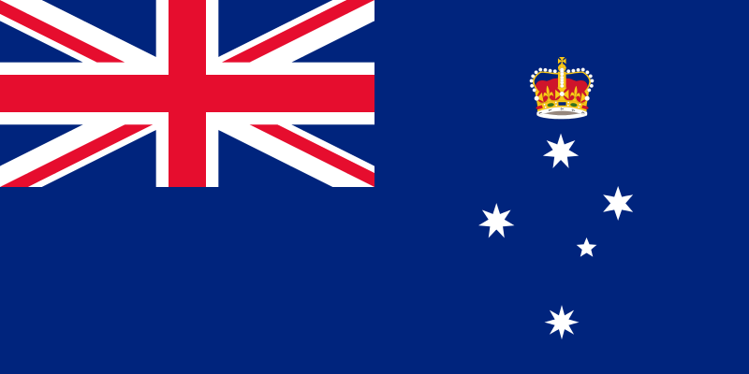
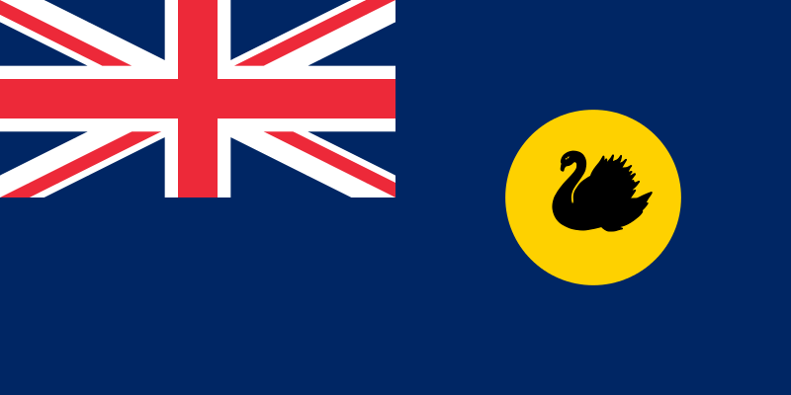

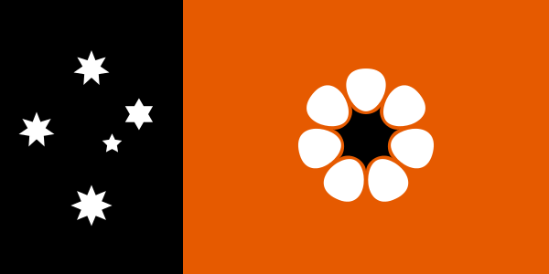
States and territories
Australia has six states:
- New South Wales (NSW),
Queensland (QLD),
South Australia (SA),
Tasmania (TAS),
Victoria (VIC) ,
Western Australia (WA)
and two major mainland territories:
the Australian Capital Territory (ACT),
the Northern Territory (NT).

Slide 9
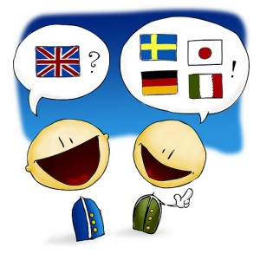


Language

Slide 10
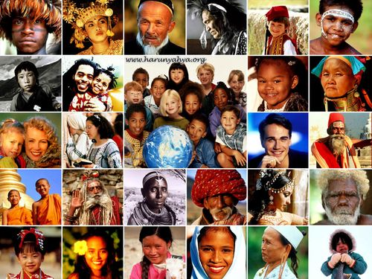

People and Society
Population
- 23,671,000

Slide 11
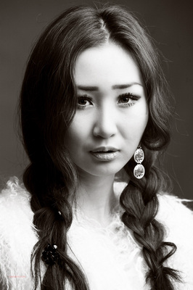
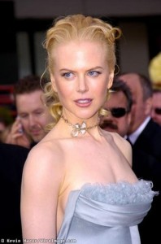
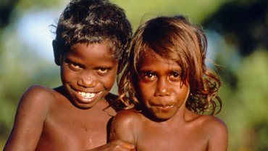
Ethnic groups:
white - 92%, Asian - 7%, aboriginal and other - 1%

Slide 12
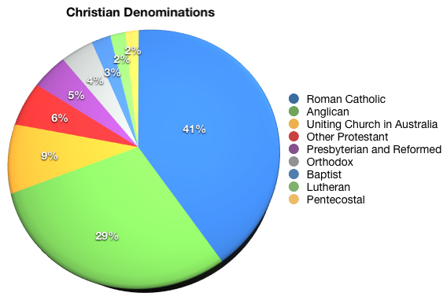
Religion In Australia: Statistics

Slide 13
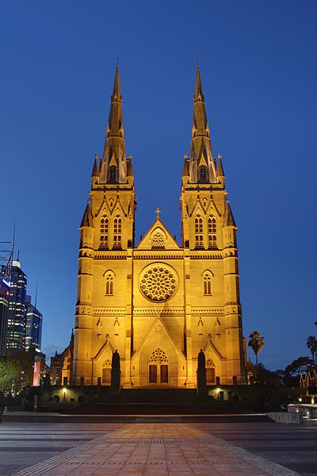
St Mary's Catholic Cathedral, Sydney, built to a design by William Wardell. About a quarter of Australians are Roman Catholic.

Slide 14
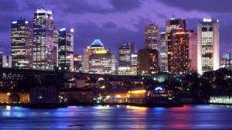
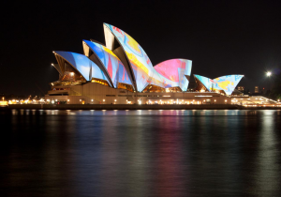
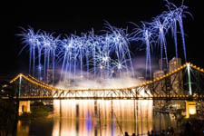
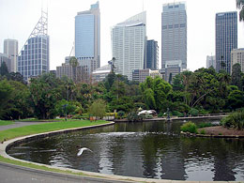
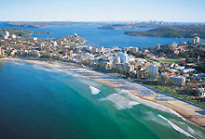
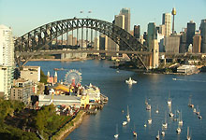
Sydney is the state capital of New South Wales and the most populous city in Australia.

Slide 15


Slide 16
The presentation was prepared by:
Derkach Katheryna

