Slide 1
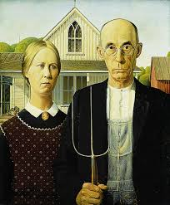
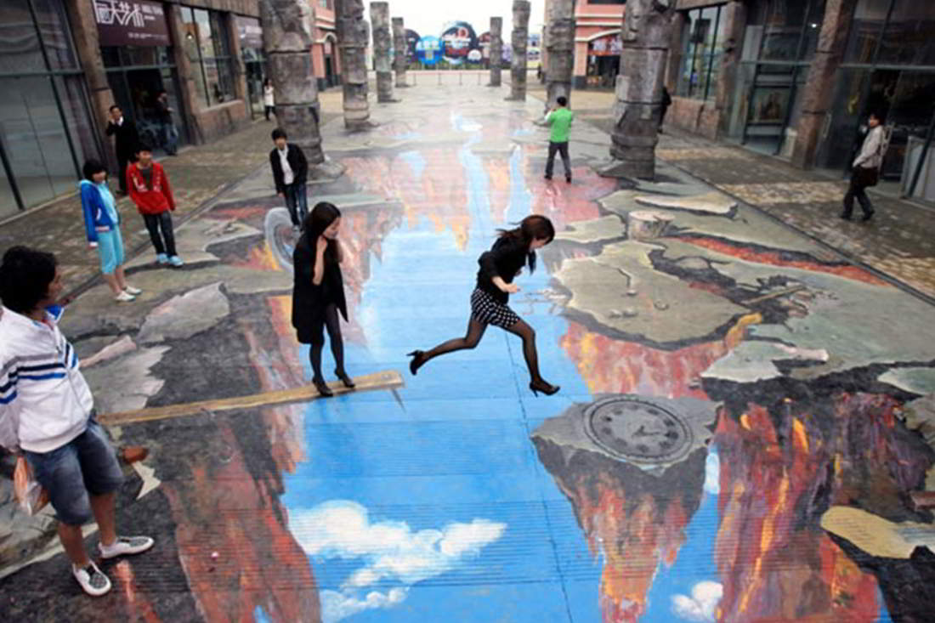
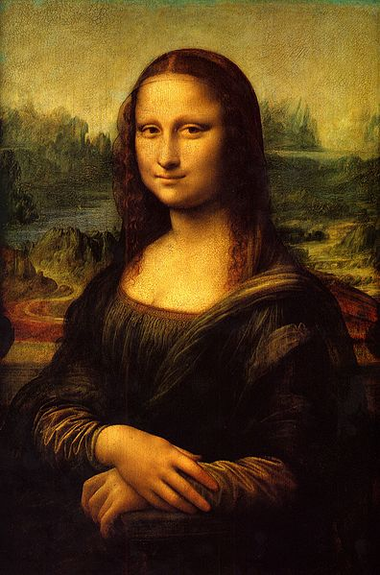
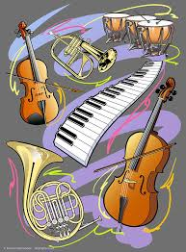
FORMS OF ART means the type of artwork such as drawing, painting, sculpture (carving, modelling, assemblage and construction) architecture, printmaking, electronic media such as computer and digital graphics, ceramics, Visual Design, Graphic Design, collage, photography and Post Modern appropriation and recontextualisation.

Slide 2
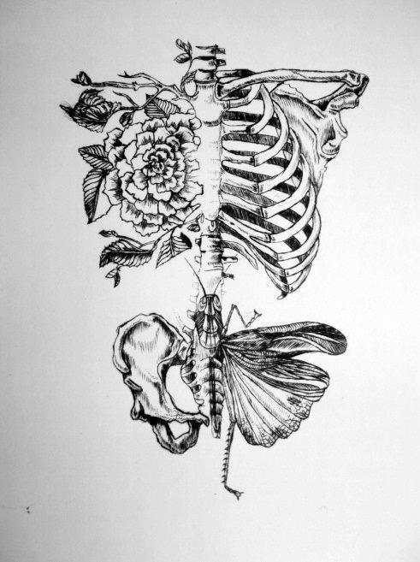
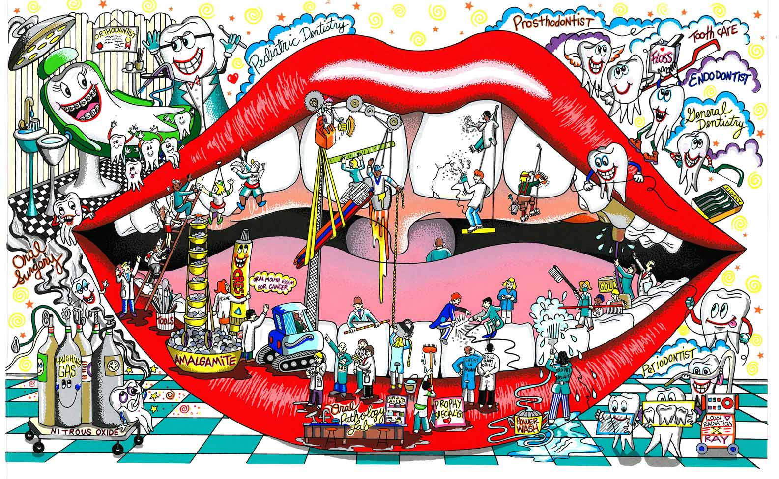
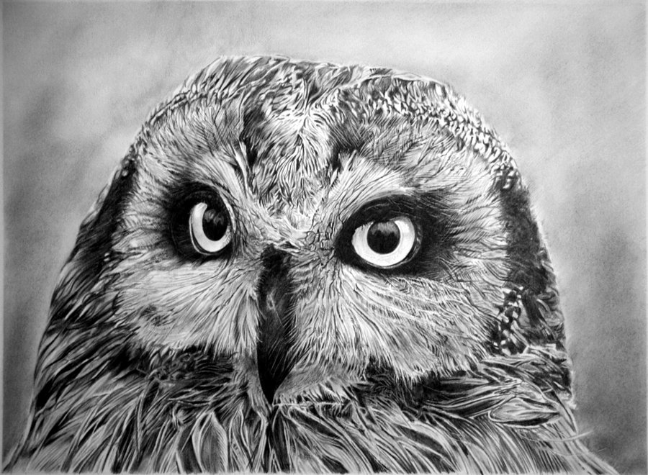
Drawing is a form of visual art that makes use of any number of drawing instruments to mark a two-dimensional medium. Instruments used include graphite pencils, pen and ink, inked brushes, wax color pencils, crayons, charcoal, chalk, pastels, various kinds of erasers, markers, styluses, and various metals (such as silverpoint). An artist who practices or works in drawing may be called a draftsman or draughtsman

Slide 3
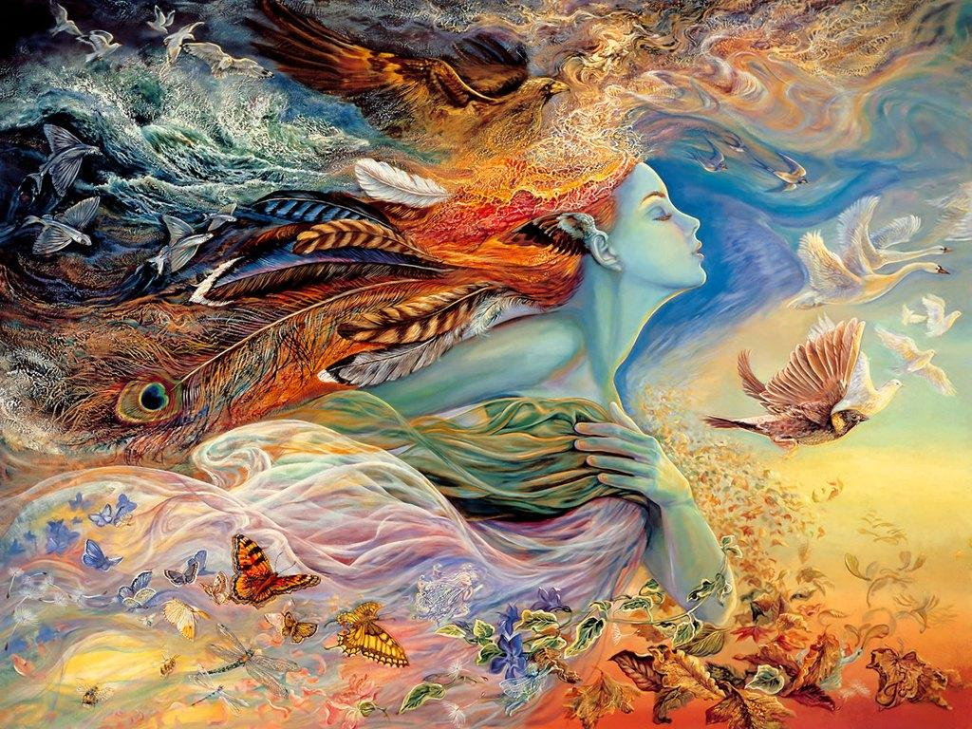

Slide 4
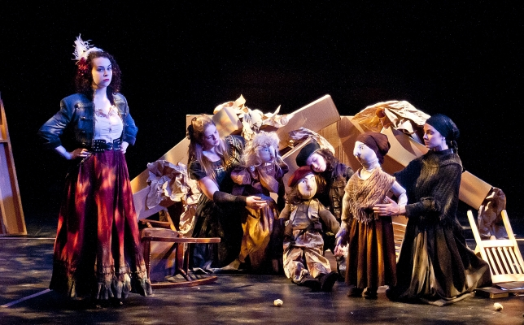
Theatre or theateris a collaborative form of fine art that uses live performers to present the experience of a real or imagined event before a live audience in a specific place. The performers may communicate this experience to the audience through combinations of gesture, speech, song, music, and dance. Elements of design and stagecraft are used to enhance the physicality, presence and immediacy of the experience. The specific place of the performance is also named by the word "theatre" as derived from the Ancient Greek (theatron, "a place for viewing")

Slide 5
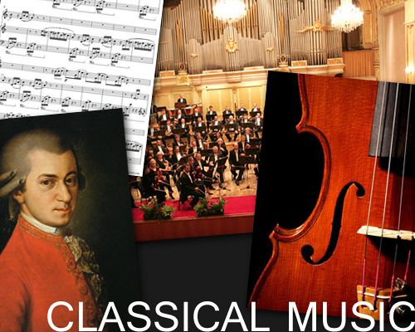
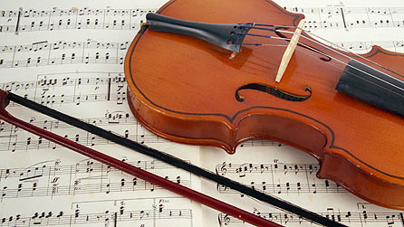
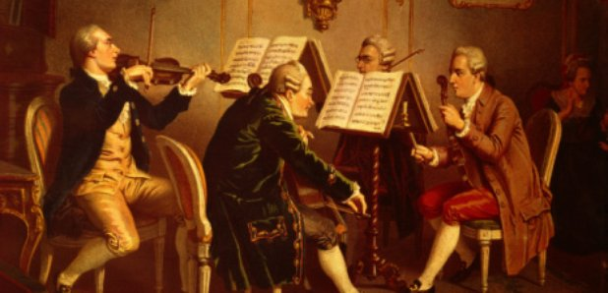
Classical music is art music produced or rooted in the traditions of Western music (both liturgical and secular). It encompasses a broad period from roughly the 11th century to the present day. The central norms of this tradition became codified between 1550 and 1900, which is known as the common practice period.

Slide 6
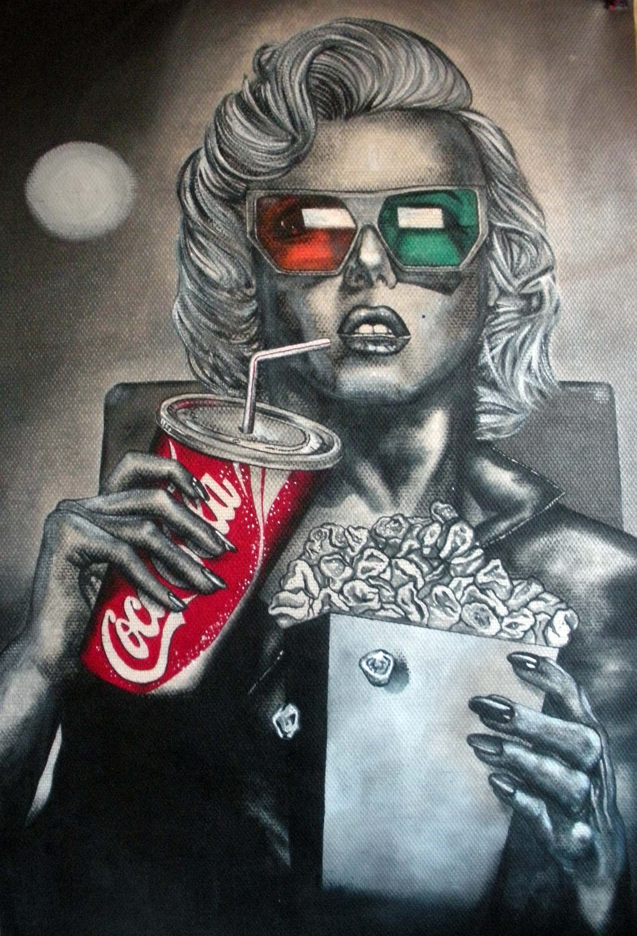
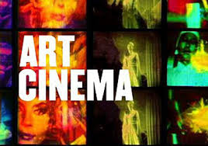
Art film (also known as art movie, specialty film, art house film, or in the collective sense as art cinema) is typically a serious, independent film aimed at a niche market rather than a mass market audience. An art film is "intended to be a serious artistic work, often experimental and not designed for mass appeal";[they are "made primarily for aesthetic reasons rather than commercial profit", and they contain "unconventional or highly symbolic content.

Slide 7
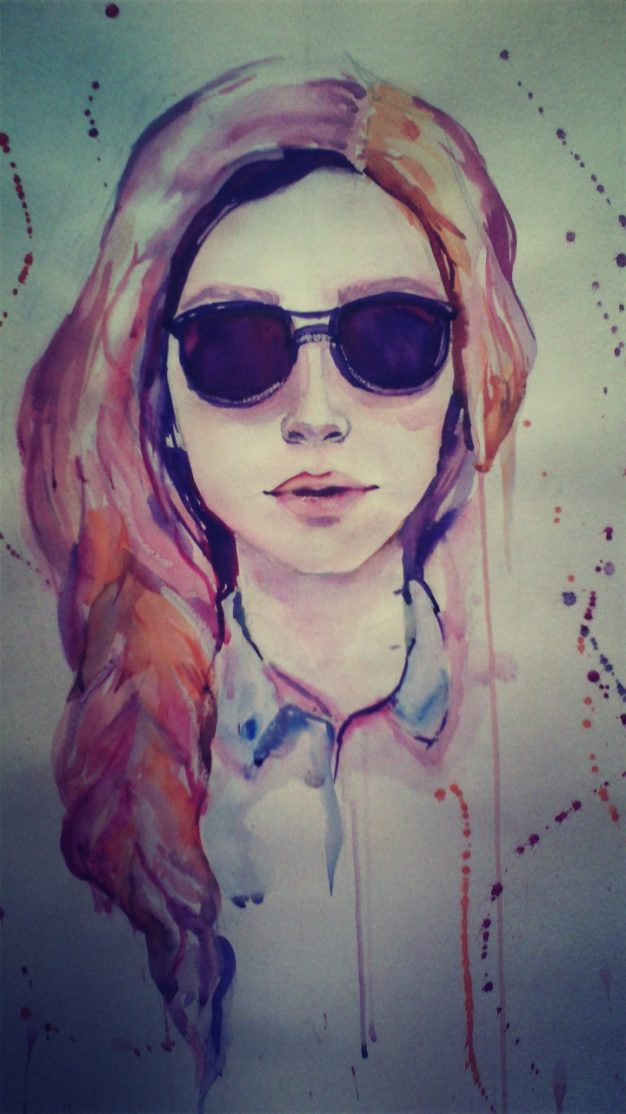
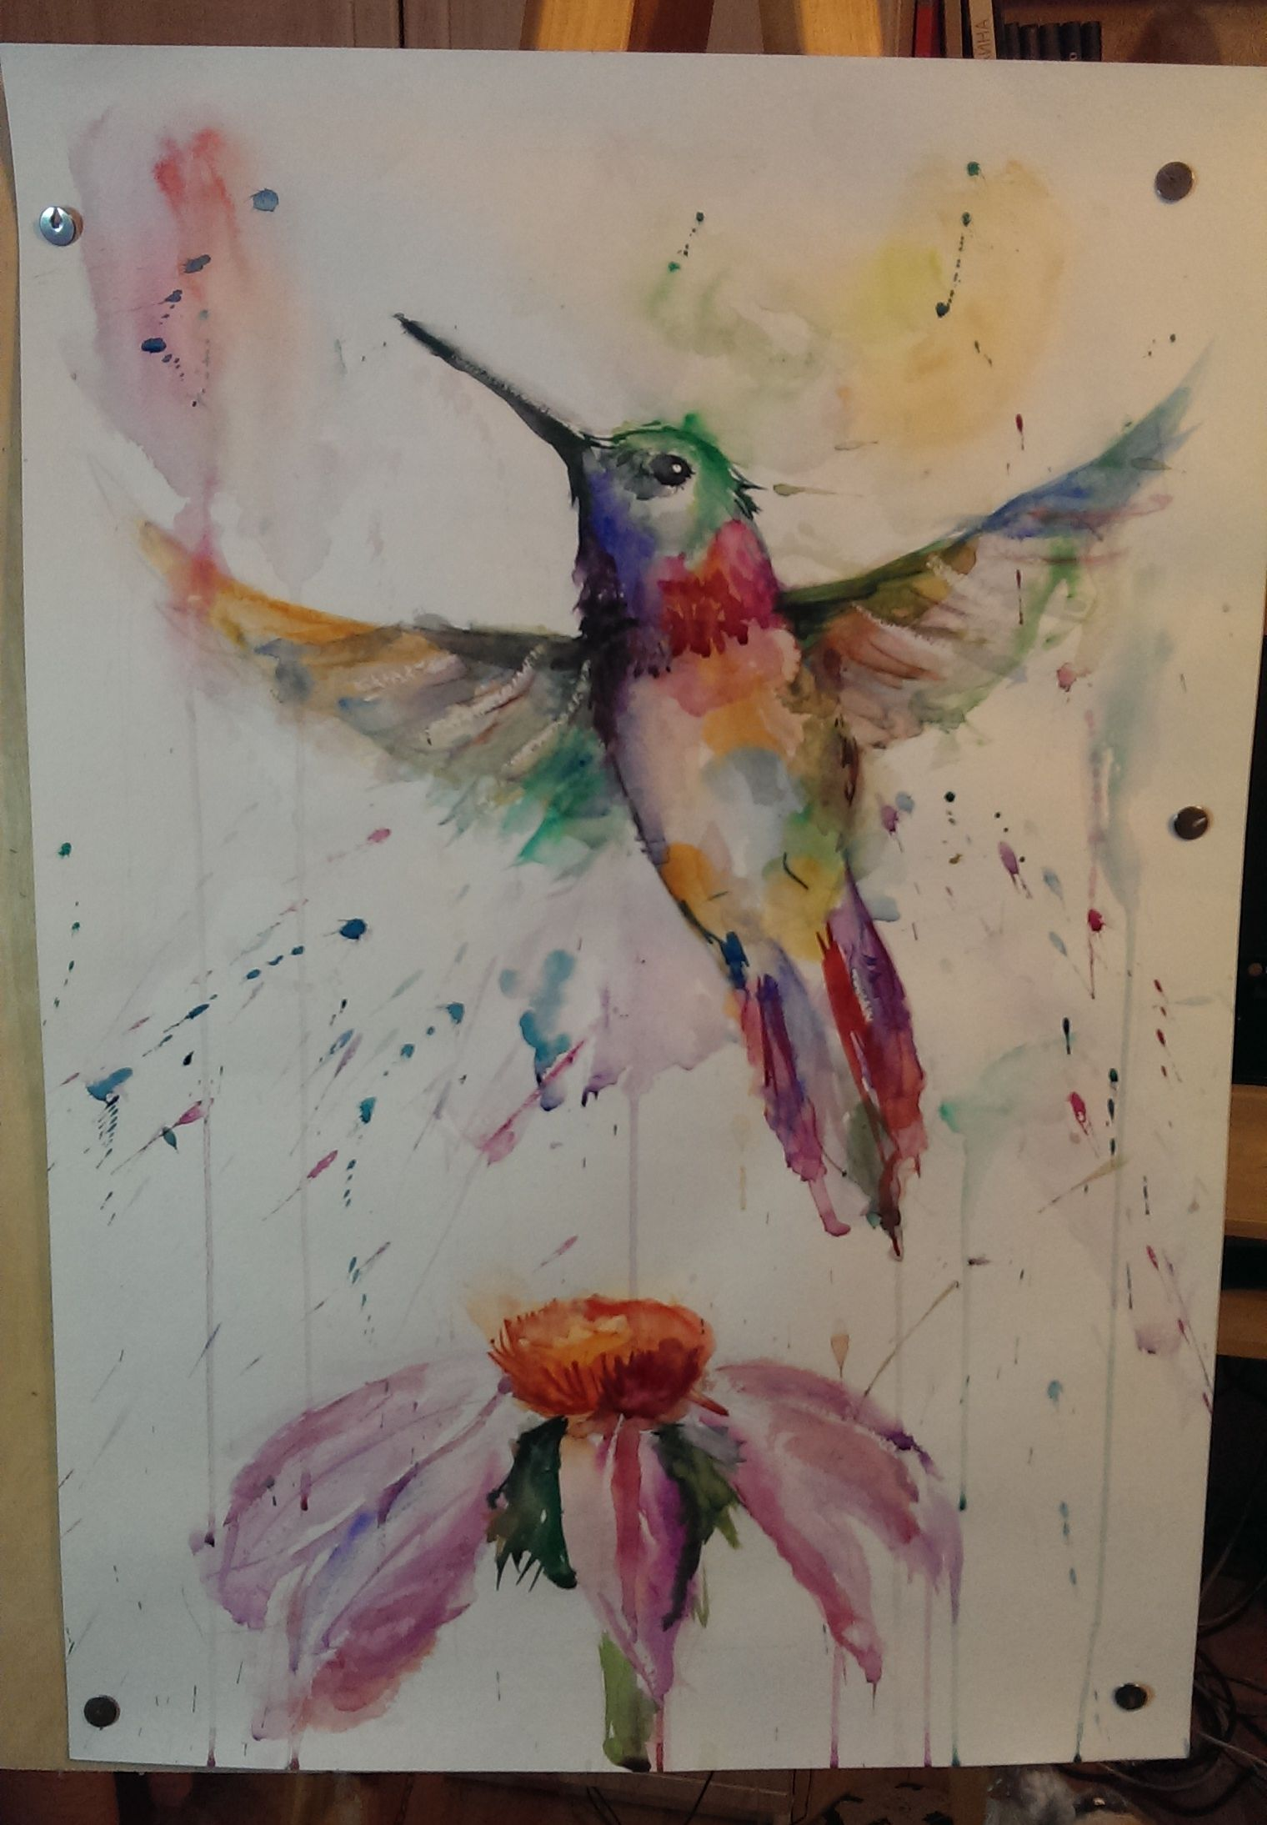
I like painting and painting is inspiring me . Arts is developing our cognition
My works

