Slide 1
The most famous love stories
Made by:
Liz Prishchepa

Slide 2
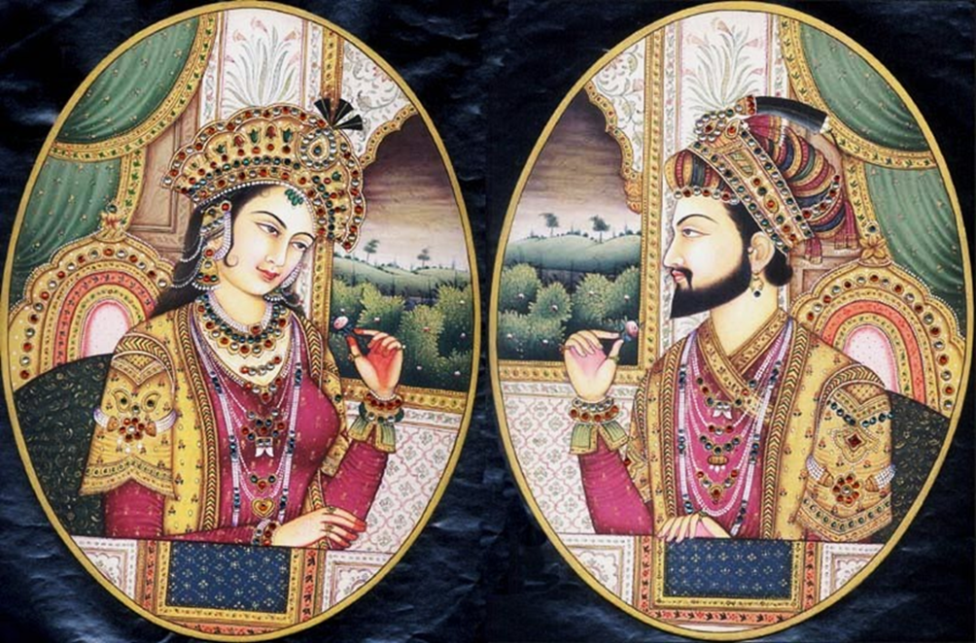
Shan Jahan and Mumtaz Mahal
This story takes place in 17th century in India. Prince Shan Jahan met beautiful Arjumand Bano Begum and a glance in love with her. The girl was not only the most important love Prince, but Mumtaz Mahal, that is Chosen Palace. As in all fairy tales, they were married and they had many children.

Slide 3
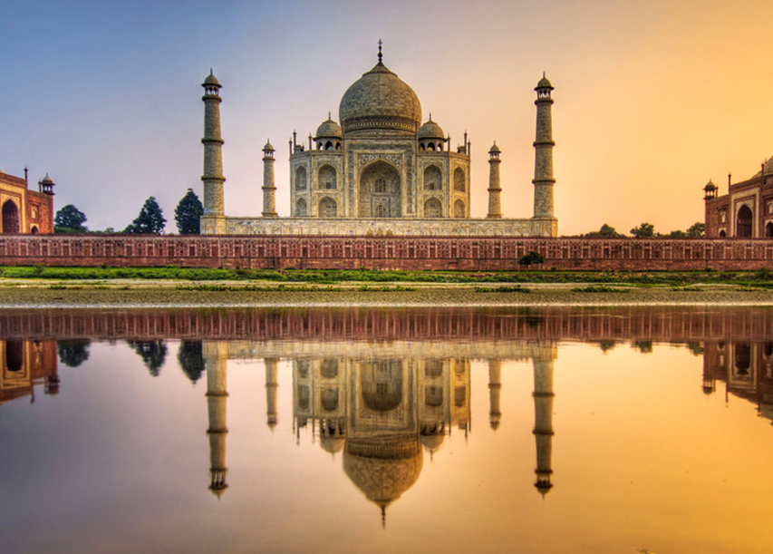
Unfortunately, during childbirth 14 child Mumtaz died. Before her death, Shan Jahan promised her not to have more children and to build a palace for the glory of their love. So there was the Taj Mahal, the universal symbol of eternal love, where their bodies are buried.

Slide 4
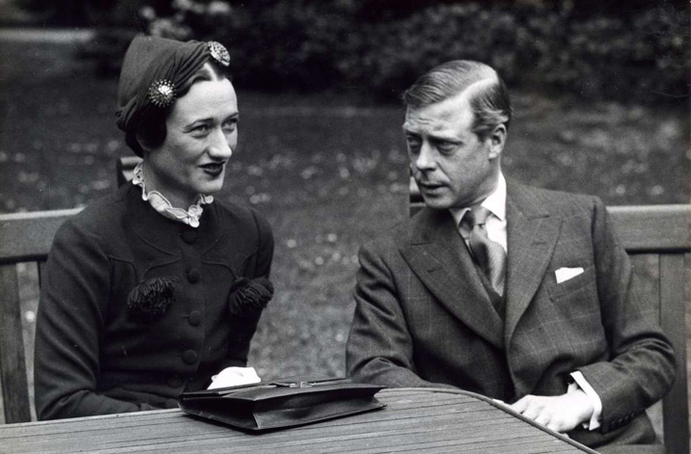
The Duke of Windsor and Wallis Simpson

Slide 5
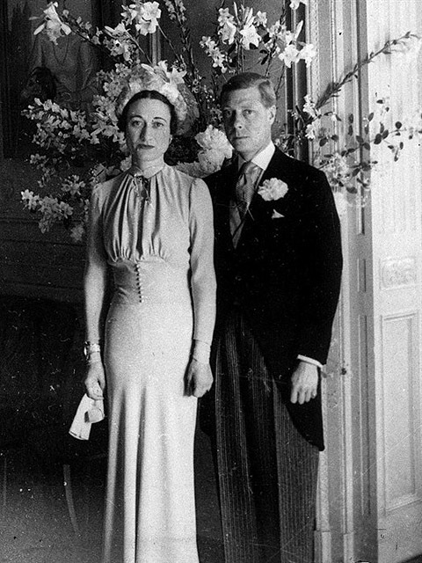
After the death of King George V in 1936 the King of the British Empire was his eldest son, Edward VIII. At that time, he met Thelma Furness , the English aristocrat . One day she invited him to a party where he met with the American couple, The Simpsons. Four became very good friends. When Lady Furness went on a trip , she asked his American girlfriend Wallis " look after " the King . Thus began their love story . At the court of scandal : the king with American , besides married ! Members of Parliament urged the monarch to leave Wallis .

Slide 6
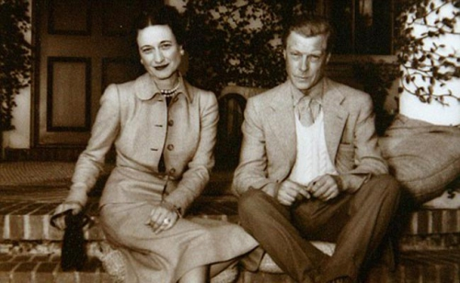
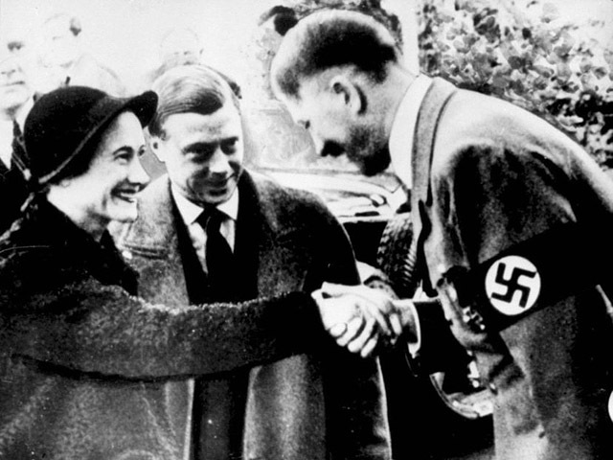
But the heart has a will of its own … and in the official statement Edward VIII declared that abdicates to be with the beloved woman.Leaving the throne , losing his title , he became the Duke of Windsor and leave home, and the next year marry Wallis . Despite this alliance , Wallis Simpson never had the rights to the title " Royal Highness ." King was proclaimed George VI, the father of the British Queen Elizabeth II.

Slide 7
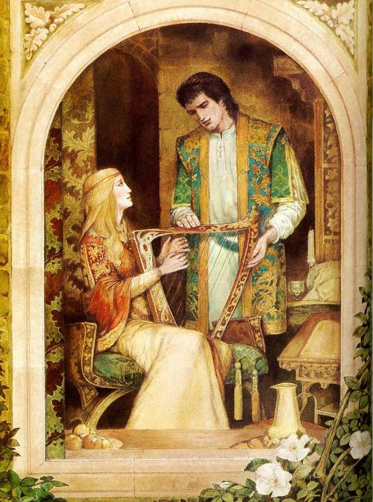
Tristan and Isolde
The tragic love story of Tristan and Isolde has been retold and rewritten numerous times. Isolde was the daughter of the King of Ireland, and only betrothed to King Mark of Cornwall . King Mark sent his nephew Tristan to Ireland to he escorted his bride Isolde to Cornwall. During the trip, Tristan and Isolde fall in love . Isolde marries Mark, however, the love affair continues after her marriage.

Slide 8
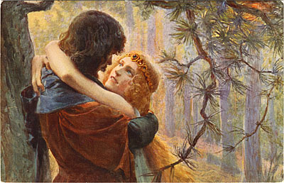
When Mark finally learned about the change, he forgave Isolde, but Tristan forever banished from Kornuolla. Tristan in Brittany. There he met Isolde of Brittany. He was attracted to her because she looked like his true love. He married her , but the marriage was unsuccessful because of its genuine true love for another woman. After he became ill , he sent for his beloved in the hope that she will be able to come and cure him .

Slide 9
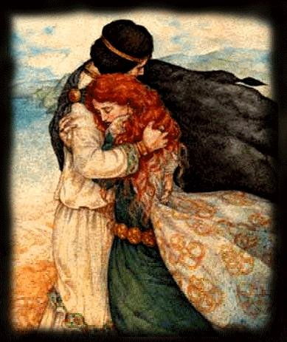
With the captain of a ship was sent to an arrangement that if she would agree to come, the ship sails on the return will be white, if not, then black . Tristan's wife, seeing the white sails, told him that black sails . He died of grief before his love could get to he, shortly thereafter Isolde died of a broken heart .

