Slide 1
Children’s Rights
Ryazanceva Ira

Slide 2
Children’s Rights
Children have the right:
to a family
to education
to protection
to express their opinions
to rest
to health care

Slide 3
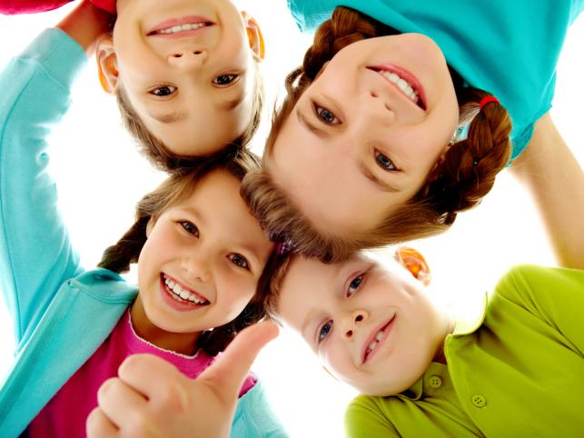
Children's rights can be put into three categories: -provision; -protection; -participation.

Slide 4
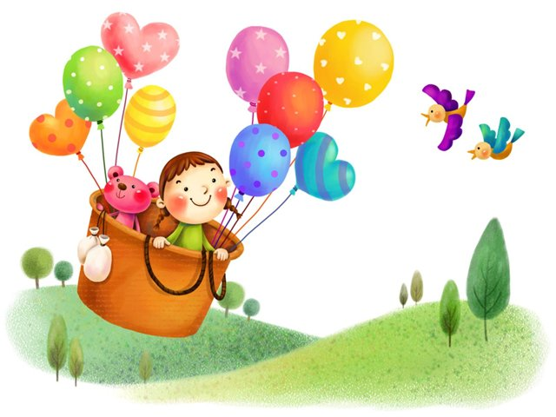
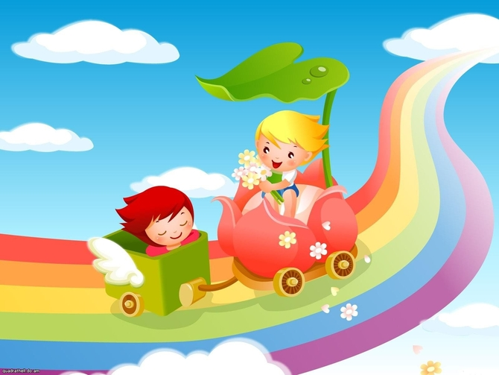
Provision: Children have the right to an adequate standard of living, health care, education and services, and to play and recreation. These include a balanced diet, a warm bed to sleeping, and access to schooling.

Slide 5
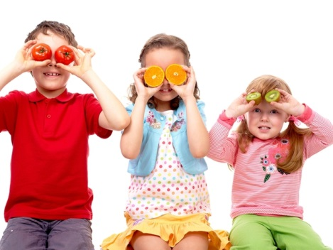
Protection: Children have the right to protection from abuse, neglect, exploitation and discrimination. This include the right to safe places for children to play; constructive child rearing behaviour, and acknowledgment of the evolving capacities of children.

Slide 6
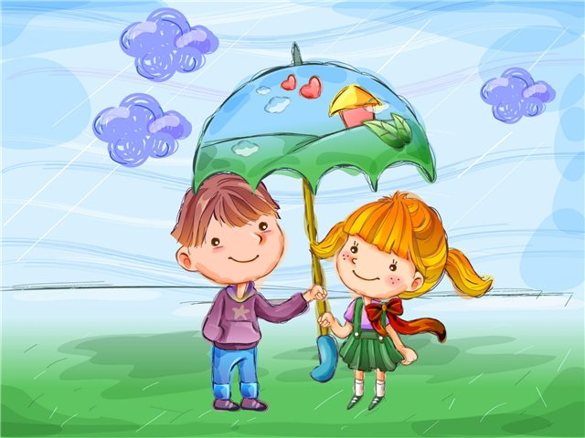
Participation: Children have the right to participate in communities and have programs and services for themselves. This includes children's involvement in libraries and community programs youth voice activities, and involving children as decision-makers.

Slide 7
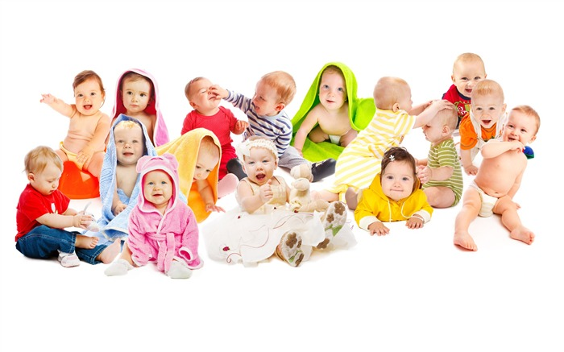
Children - it is absolutely a special caste of people!

