Slide 1
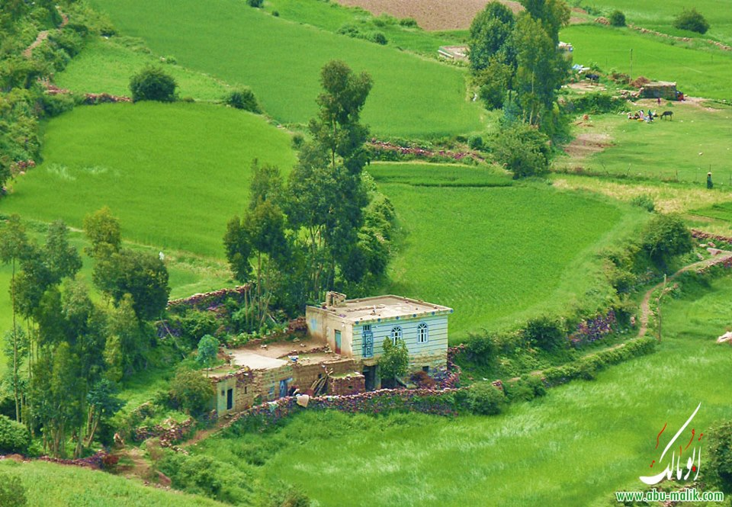
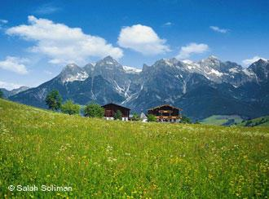
Care about the environment

Slide 2

The international, regional or local organisation of save the animals
The World Society for the Protection of Animals exists to tackle animal cruelty across the globe. They work directly with animals and with the people and organizations that can ensure animals are treated with respect and compassion. WSPA is dedicated to improving the lives of animals. They are inspired by our supporters’ commitment to animal welfare – you make our work possible. Together we are creating a world where animal welfare matters.

Slide 3
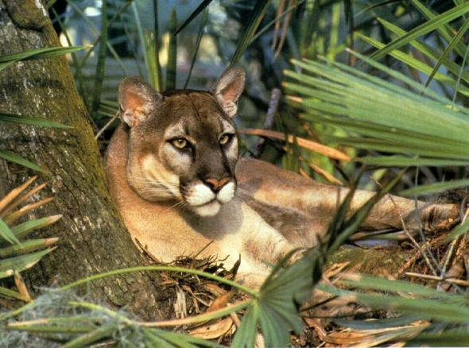
Endangered animals or birds. The ways to save them
The Florida panther
Previously, the Florida panther (Puma concolor coryi) lived across the south-east coast of the United States. Now, this species is found only in Florida. Municipal landfills, farms, contaminated water leaves no chances to survive this animal. In order to somehow save this view, scientists are forced to cross the Florida panther panther Texas. Make a conclusion, otherwise we will soon lose forever the rare species of animals.

Slide 4
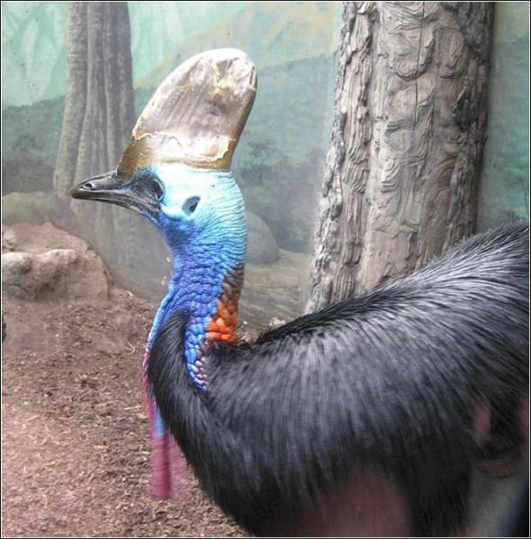
Cassowary
Cassowary (Casuarius casuarius) - ancient flightless bird of Australia, eating fruit, it spreads the seeds of a tropical tree species. The reason for the disappearance of this bird are feral pigs, which attack and ruin the nest cassowaries, regardless of their size (weight cassowary is 60 kg). By the wild pigs from the face of the earth had disappeared Australian dodo.

Slide 5
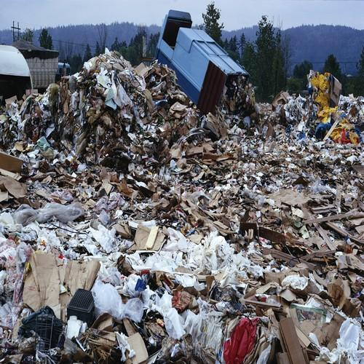

The environmental situation in the world.
Urban environmental problems of the world, mainly the largest of they are related to the excessive concentration on relatively small areas of population, transport and industry, with formation of man-made landscapes, far removed from the state ecological balance.

Slide 6
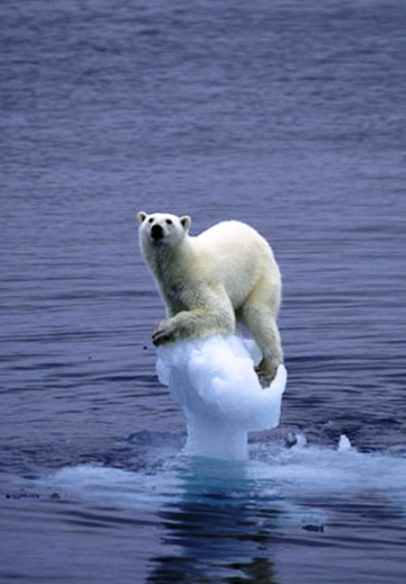
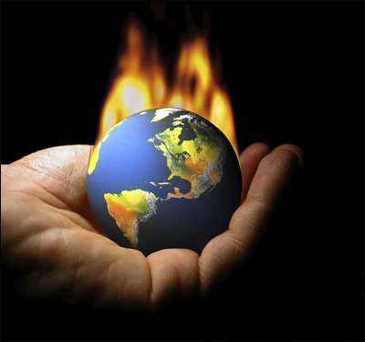
The results of global warning
The fact that the planet was warmer - a fact that is hard to argue. In the middle latitudes of Russia will soon have forgotten that the boots, and the Sahara desert is increasing every year by hundreds of thousands of hectares. Global warming over many centuries. Today, scientists around the world are trying to find the main cause of global warming. Causes of global warming for a long time are the cause of the dispute climate scientists, but most of the discussions is the anthropogenic greenhouse effect.

Slide 7
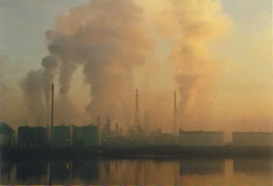
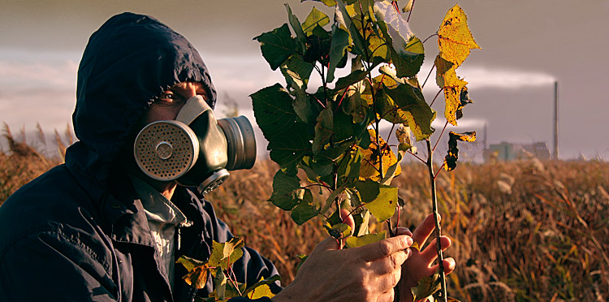
Pollutants in our town
In recent decades, the environmental situation worsened Ukraine. One of the main factors that influenced the ecological environment, is to develop the mining and processing industries with outdated technologies associated with the excessive urbanization of many areas. To prevent this we must be attentive to the environment

Slide 8
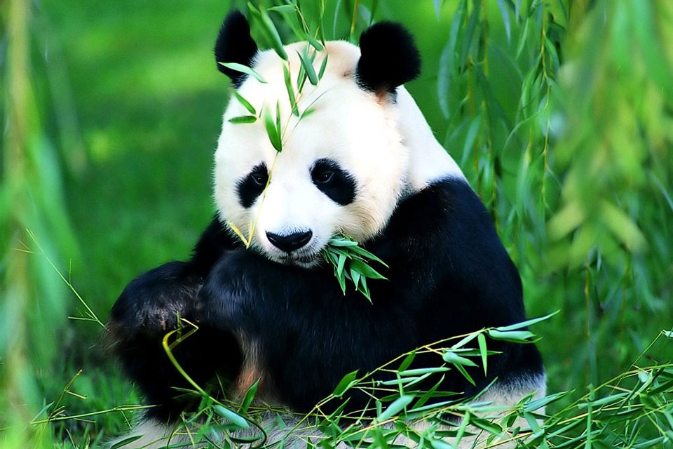
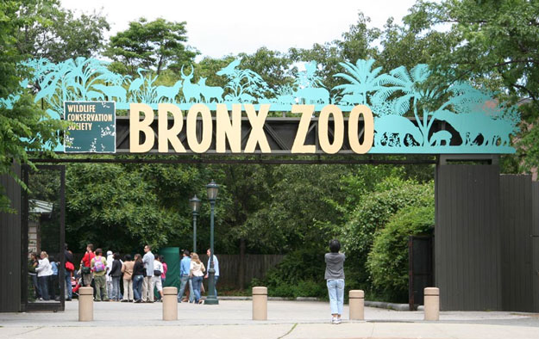
My attitude to life of animals in the zoos
I think that to keep the animals in a zoo in most cases, inhumane. Cruel treatment of animals is prohibited by law, but many owners it does not stop. But thanks to some zoos animals apparently still exist. I thank them for that.

